Slide 1
Linked Web Data for Research
Graham Klyne
My background:
  Industry software developer for many years (decades), applications including:
    real-time process control, motion capture, computer aided design, networking for financial services
  Worked on IETF and W3C standards for email and web data; co-editor of RDF Concepts document
  Joined David Shotton's IBRG group in Zoology about 10 years ago to work on research data management (images and more) using Semantic Web/Linked Data ideas; now part-time with OeRC

Slide 2
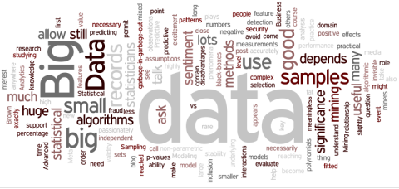
Populating data repositories
Data is increasingly seen as a first class product of research, underpinning trust in results
  “Research Objects”
  Reviewability
  Reproducibility
  Funder mandates
I perceive many data repositories are under-used
  so where will the data come from?
Notes:
Data is increasingly see as a first class research output, and funders and others are requiring that data produced by funded research is made public.
Also, community expectations are increasingly (if not yet overwhelmingly) that data should be published to support replication and reproducibility of results.
But who is to create this data, and ensure that it is fit for re-examination by other researchers?

Slide 3
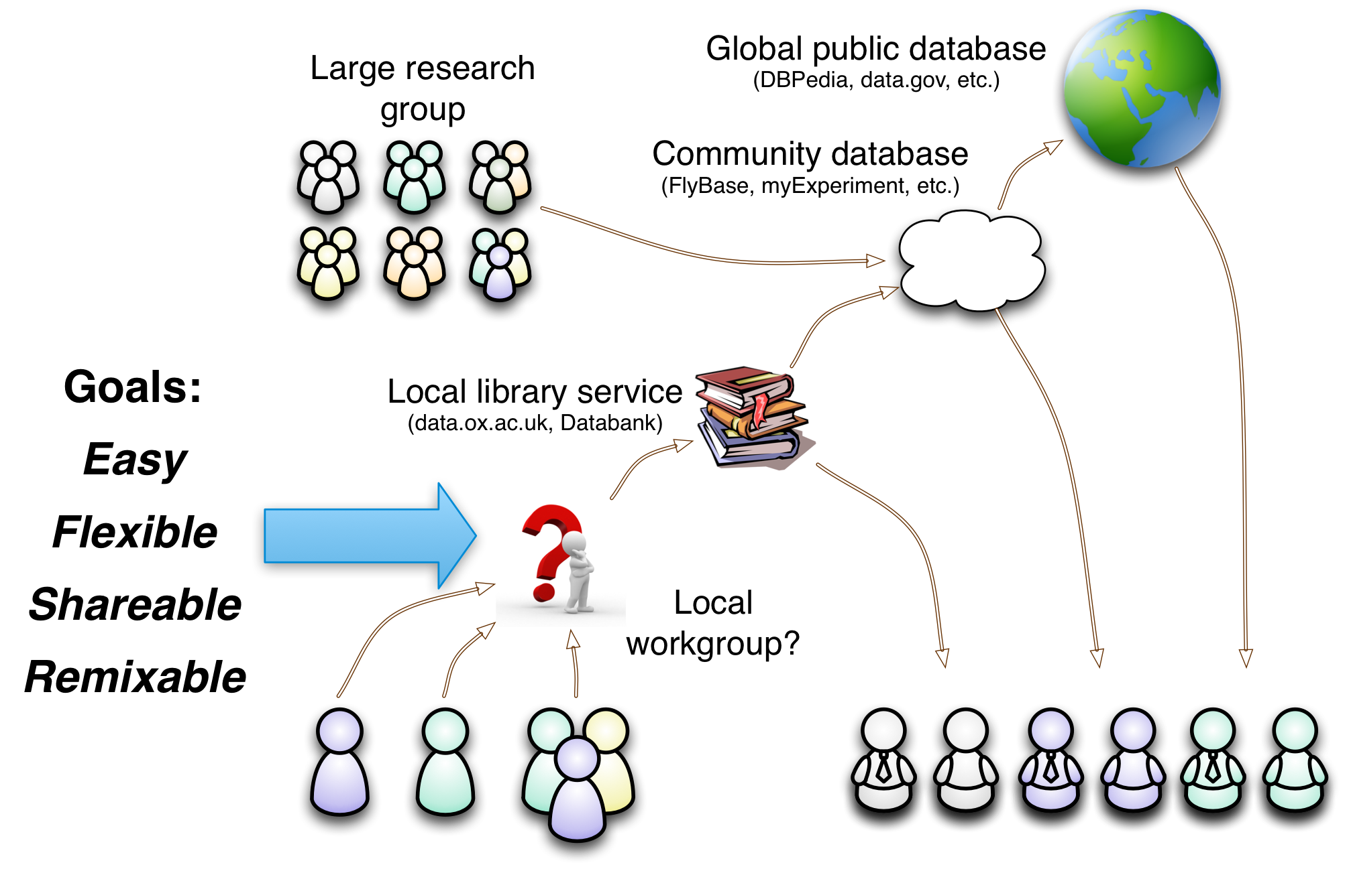
Research data: the “first mile”
A missing link?
Notes:
Collaborative use of data by small research groups
Background: several years working on projects related to research data management, some of which has been spent working with small research groups without technological skills or capacity to undertake software development or complex system configuration. Data may be diverse and labour intensive to collect and analyze. E.g., my first project in this area was working with a small team to collect and organize microarray, PCR, statistical, literature and other data around in-situ hybridization images of gene expression in fruit fly testes.
There are many generic systems for data publication and more specialized tools for sharing in larger projects or specialized domains. A lot of attention is focused on “big data”.
But for small research groups, it seems there is a missing link in the toolchain that conveys data from the lab bench and desktop computers to community and public repositories. Often, for them, the best solution is a spreadsheet, but these are weak for sharing and combining diverse data.
I am working on a “human scale” system that aims to provide data collection and organization features with the following goals:
Easy: can be used for data management “out of the box”, without prior configuration
Flexible: the shape of collected data can be evolved and adapted as patterns are observed. No force-fitting data to pre-defined schema
Shareable: data are easily shared with collaborators through the use of simple, standard, text-based file formats and web protocols
Remixable: local data can be combined with public data, though inward and outward linking, and common linked-data vocabularies can be applied (even after the event) to create meaningful compositions.

Slide 4
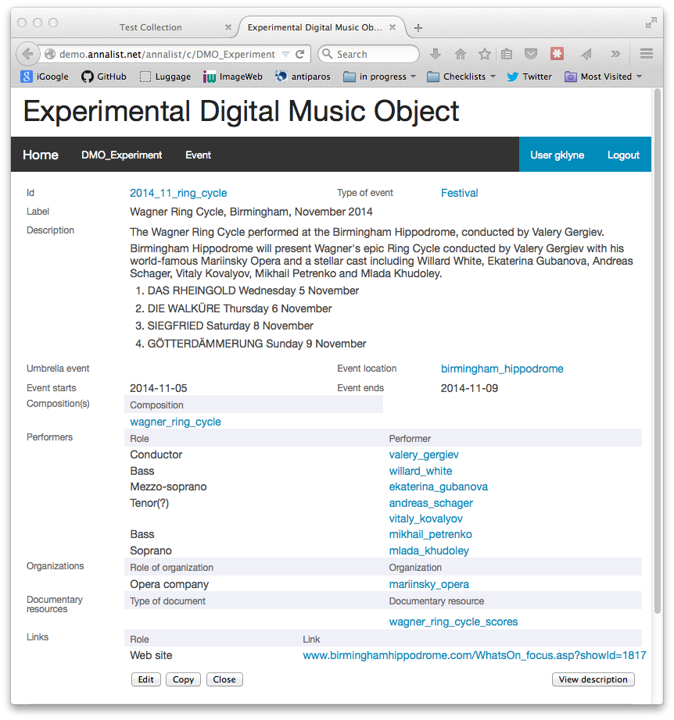
Annalist: Linked Data Notebook
Work-in-progress
Demo:
http://annalist.net
Code: https://github.com/gklyne/annalist
Target small groups and projects without dedicated software development capacity
Currently being used in an exploratory capacity with two projects
See also: ORDS – http://ords.ox.ac.uk
Notes:
I think such a tool would have the following key features, out of the box, without prior configuration:
Easy data entry and acquisition
Flexible development of structure around the data
Controlled sharing with collaborators using common web tools
Remixing with third party resources – links in and out, and some form of co-reference management

Slide 5
Research Software Development
A different model?
“Self patronage”
  a semi-entrepreneurial model within academia
Funded by engagement with research projects
  currently 2 projects, each about 20% fte
  working directly with researchers
  less costly for projects than a full-time engineer
Tool development that survives any single project
  working across rather than within silos
  longer-term sustainability
  open development promotes sharing and re-use

Slide 7
Annalist: Linked Data Notebook
Work-in-progress
Demo:
http://annalist.net
Code: https://github.com/gklyne/annalist
Target small groups and projects without dedicated software development capacity
Currently being used in an exploratory capacity with two projects
See also: ORDS – http://ords.ox.ac.uk
Notes:
I think such a tool would have the following key features, out of the box, without prior configuration:
Easy data entry and acquisition
Flexible development of structure around the data
Controlled sharing with collaborators using common web tools
Remixing with third party resources – links in and out, and some form of co-reference management

