Slide 1
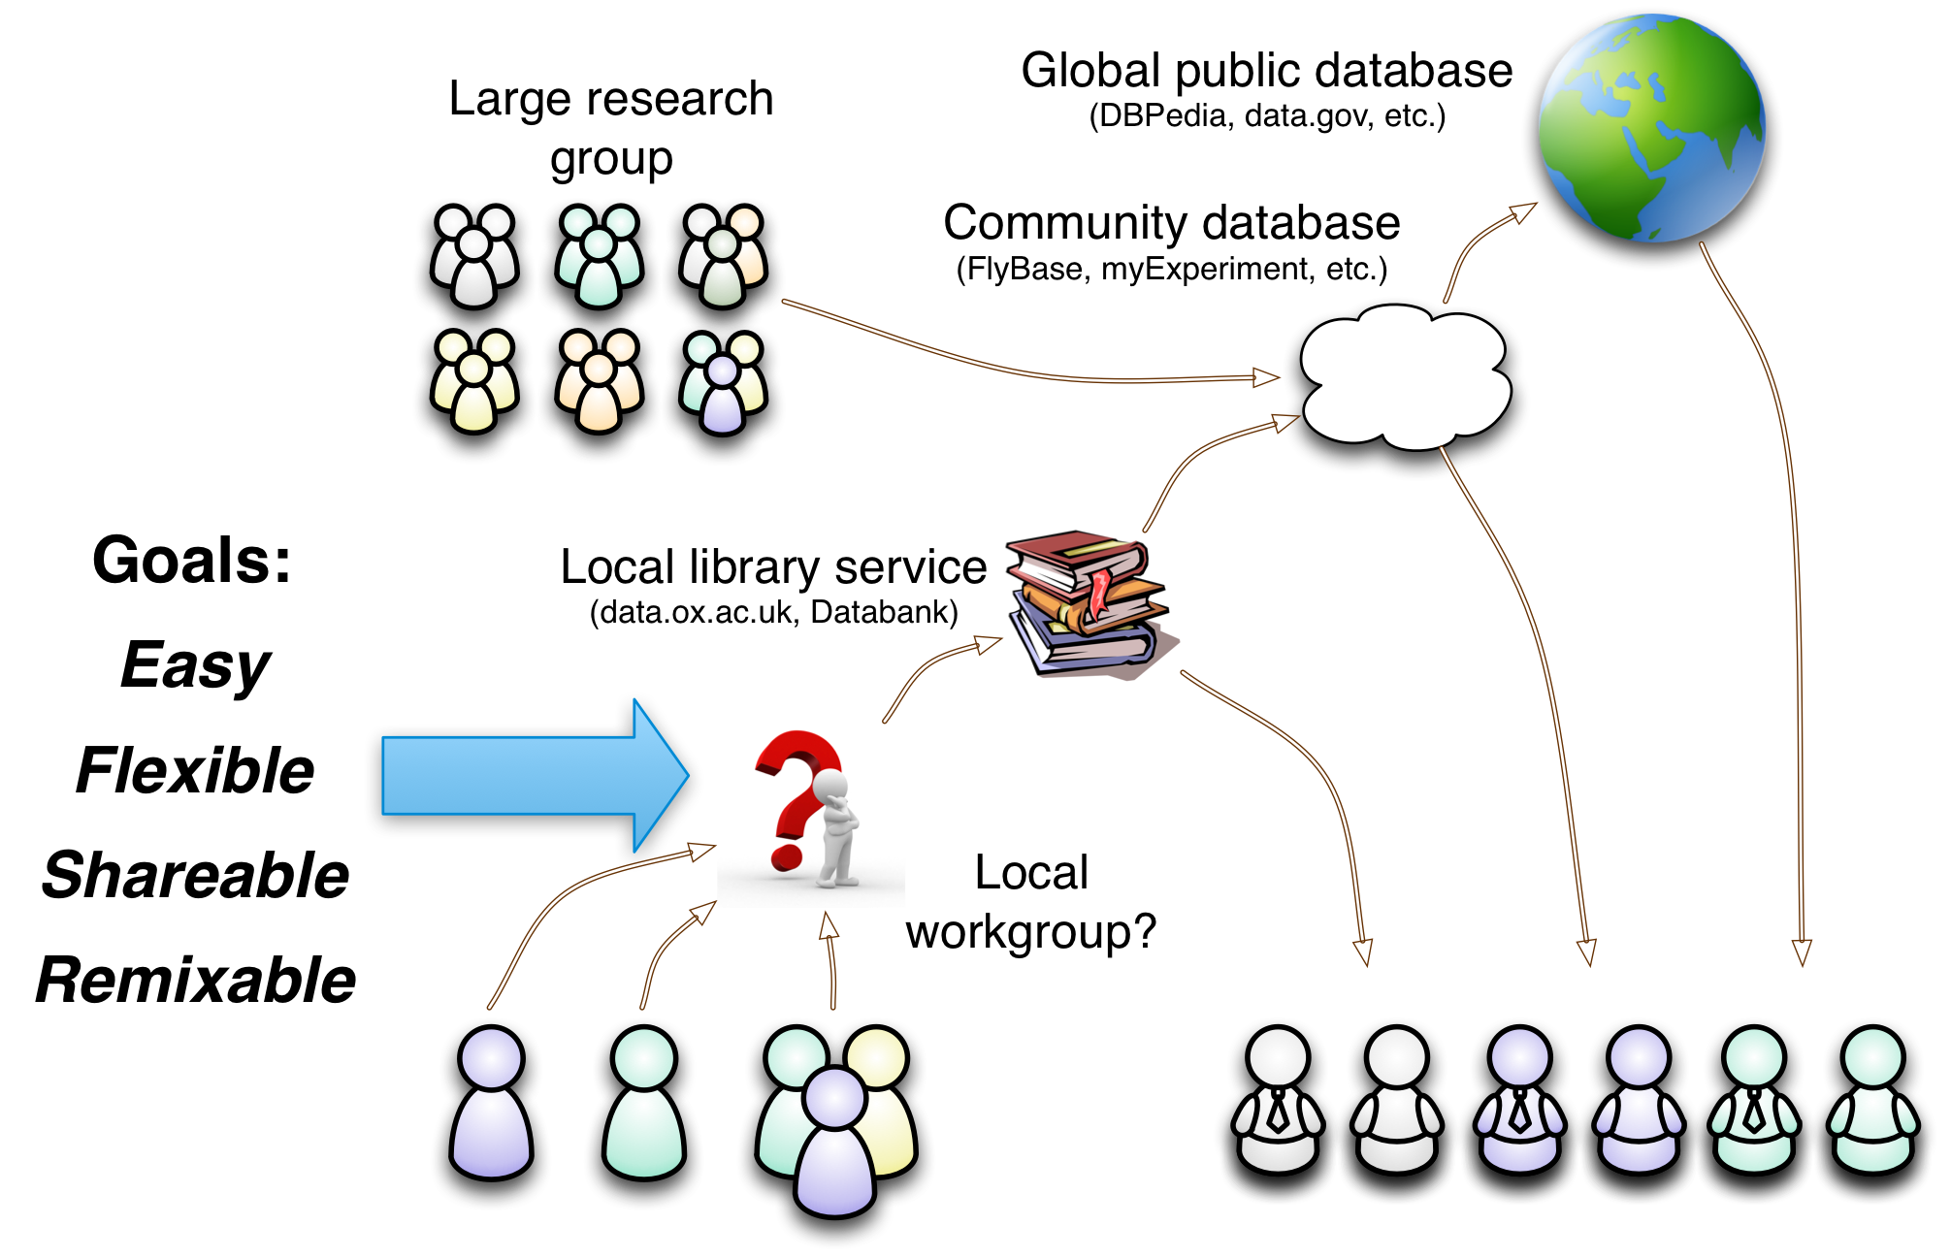
Research data: the “first mile”
A missing link?
Notes:
Collaborative use of data by small research groups
Background: several years working on projects related to research data management, some of which has been spent working with small research groups without technological skills or capacity to undertake software development or complex system configuration. Data may be diverse and labour intensive to collect and analyze. E.g., my first project in this area was working with a small team to collect and organize microarray, PCR, statistical, literature and other data around in-situ hybridization images of gene expression in fruit fly testes.
There are many generic systems for data publication and more specialized tools for sharing in larger projects or specialized domains. A lot of attention is focused on “big data”.
But for small research groups, it seems there is a missing link in the toolchain that conveys data from the lab bench and desktop computers to community and public repositories. Often, for them, the best solution is a spreadsheet, but these are weak for sharing and combining diverse data.
I am working on a “human scale” system that aims to provide data collection and organization features with the following goals:
Easy: can be used for data management “out of the box”, without prior configuration
Flexible: the shape of collected data can be evolved and adapted as patterns are observed. No force-fitting data to pre-defined schema
Shareable: data are easily shared with collaborators through the use of simple, standard, text-based file formats and web protocols
Remixable: local data can be combined with public data, though inward and outward linking, and common linked-data vocabularies can be applied (even after the event) to create meaningful compositions.

