Slide 1
Trends and Transients
18 September 2019
Linked Data in Digital Humanities
Graham Klyne
University of Oxford
Notes:
The field of Digital Humanities explores the ways in which digital technologies can be used to support and enhance humanities research. This session will be about my experiences of using linked data on the Web, in the form of RDF and associated Semantic Web technologies, in some Digital Humanities applications.
---
I shall initially discuss some ways that application of Semantic Web technologies in humanities may differ from use of the same in scientific or other common applications. I shall then describe a couple of applications I’ve been working on recently, hopefully showing how affordances of linked data can support some of the particular requirements of humanities data.
///

Slide 2
Linked Data in Digital Humanities
Graham Klyne
XML Summer School 2019
Trends and Transients
Notes:
The field of Digital Humanities explores the ways in which digital technologies can be used to support and enhance humanities research. This session will be about experiences of using linked data (RDF) and associated Semantic Web technologies in Digital Humanities applications.
---
I shall discuss some ways that application of Semantic Web technologies in humanities may differ from use of the same in scientific or other common applications. I shall then describe a couple of applications I’ve been working on recently, hopefully showing how affordances of linked data can support some of the particular requirements of humanities data.
///

Slide 3
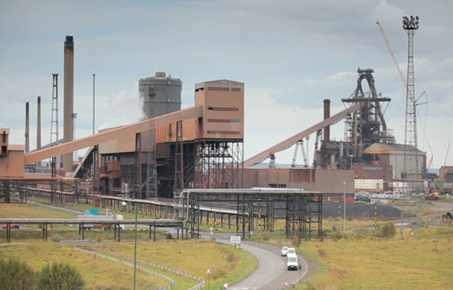
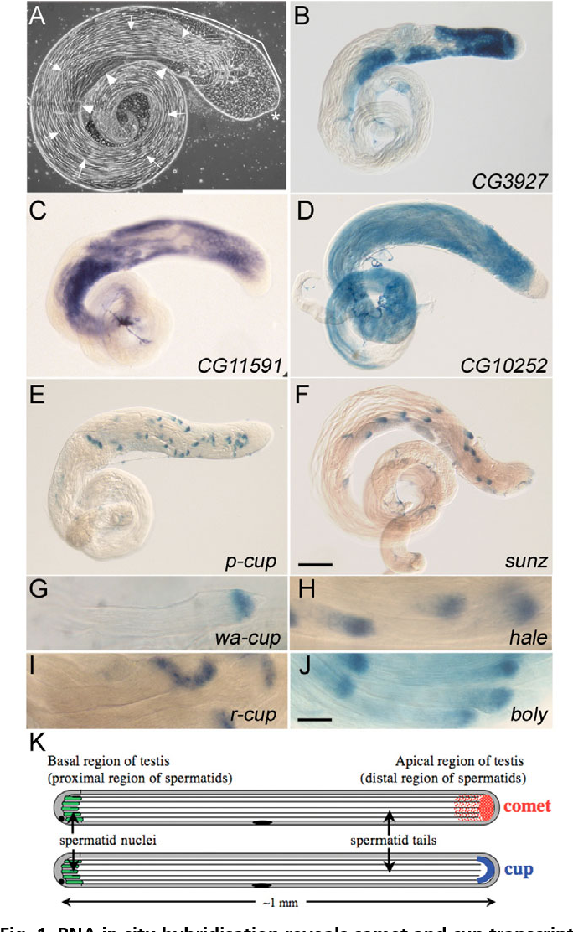
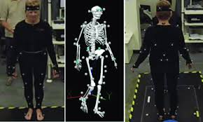
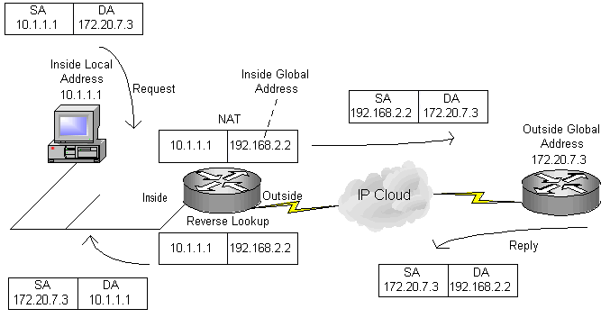

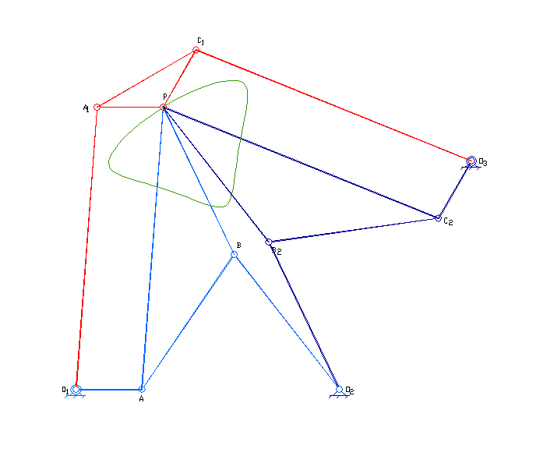
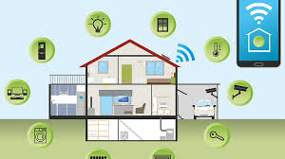
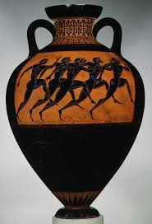





About me
µ
graham.klyne@oerc.ox.ac.uk
Notes:
I'll start with a brief summary of my background, to give an idea of my biases and prejudices…
---
I work as a research software engineer at Oxford University, in the multidisciplinary e-Research centre. Before I came to Oxford I was a commercial software developer, working on applications ranging from industrial process control, 3D motion capture for medical use, computer-aided mechanism design, computer networking, financial trading systems and home automation. While working for a now defunct start-up, I was involved in defining IETF standards for email enhancements and content negotiation, which led (by a roundabout route) to participation in the W3C working group that was defining RDF, where RDF is one of the technical standards that underpins linked data on the web.
---
When I came to Oxford, I joined David Shotton’s Image Bioinformatics Research Group, to work on using Semantic Web technologies in a metadata-rich biological image database. At the time, I believe David’s was the only group in Oxford doing any kind of Semantic Web related research, and I was keen to gain experience actually using the technologies I’d helped to specify. When I joined David’s group, I expected it would be for just a short period of working in the university. But, somehow, 15 years later I’m still here. I promise it’s not for the money!
---
During my time at Oxford, I’ve worked on a range of applications from bioinformatics to classical art to scientific workflow description to digital music to historical data. A common underlying theme has been management of research data, which I believe raises some challenges that are different from other applications, by not always being susceptible to full definition until data collection is well under way. In my opinion, it is this open-ended nature of research data that makes linked data particularly applicable.
---
I also work, in a personal capacity, on a linked data notebook tool [Annalist](http://annalist.net/), which I’ve used extensively for prototyping linked data model designs.
///

Slide 4
Humanities
“Humanities are academic disciplines that study aspects of human society and culture.”
— Wikipedia (https://en.wikipedia.org/wiki/Humanities)
Notes:
So what are Humanities, and what makes humanities data different?
---
Broadly conceived, the humanities include ancient and modern languages, literature, philosophy, history, human geography, law, politics, religion, and art. My own interactions have been primarily with aspects of history and art (which are topics in which I claim no expertise!), so my comments here may be less applicable to other humanities fields.
---
Compared with scientific research, which focuses substantially on observable and reproducible measures of the world around us, I perceive humanities research to be much more concerned with outputs that involve significant levels of human interpretation or reception.
---
This in turn depends crucially (among other things) on establishing a context within which interpretation or reception can take place. Different people may view the same information from different perspectives, different background contexts, and come to quite different conclusions.
---
Often (particularly when trying to understand historical events) the available information is sparse, and the best that can be achieved is to create a compelling narrative that accords with the available facts. There is plenty of scope for Disagreement! I think the point is not necessarily to arrive at a single unarguable conclusion, but to engender a deeper understanding of the material under study.
---
(I was recently involved in a discussion about reproducible research in the humanities, where I asked what reproducibility in humanities actually means. One respondent suggested that it might be the ability to consistently engender an attitude or conclusion in the mind of a person receiving the research.)
///

Slide 5
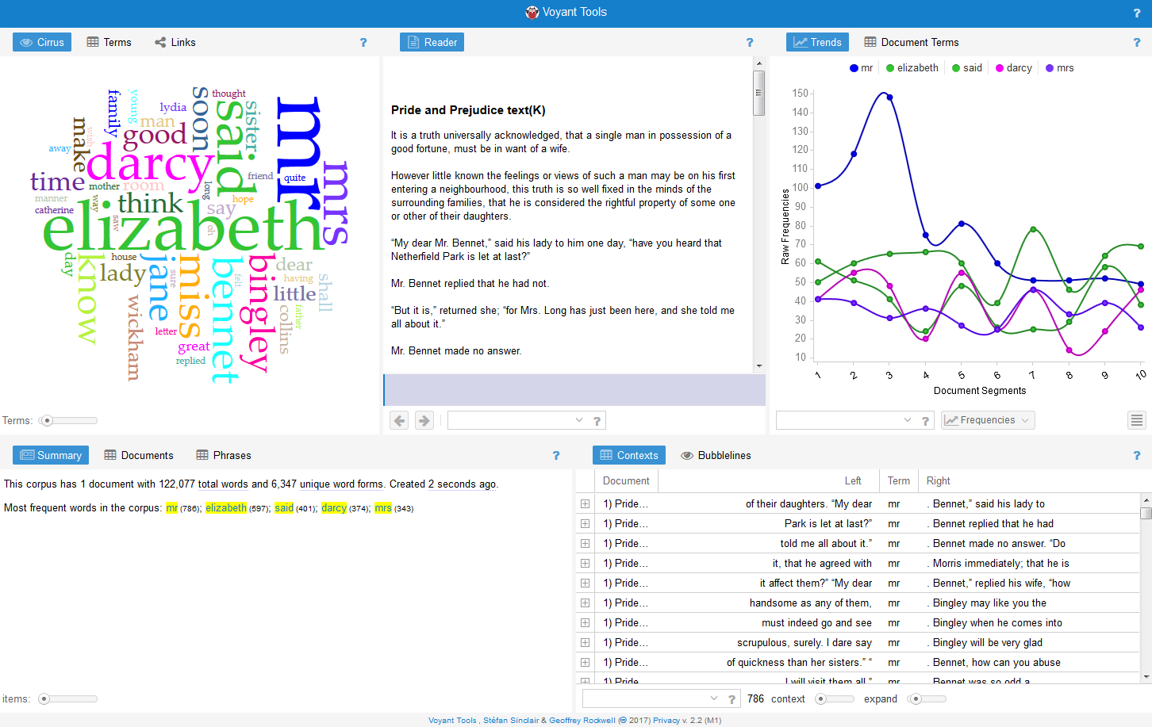
Digital Humanities
Text of Jane Austen's Pride and Prejudice in textual analysis program Voyant Tools
- https://commons.wikimedia.org/wiki/File:Pride_and_Prejudice_in_Voyant_Tools.png
Notes:
So what is Digital Humanities?
---
The field of Digital Humanities, which grew out of “Humanities Computing”, explores the ways in which digital technologies can be used to support and enhance humanities research.
---
There is some debate about whether “Digital Humanities” deserves to be recognized as a field in its own right - some say it’s all just “Humanities”. I don’t take a position on this, but I readily use the term as a shorthand to help contextualize my work.
---
Digital Humanities supports researchers with a range of digital tools: digitized archives, text analysis, digital mapping, network analysis, data mining, data visualization, image analysis, audio analysis, 3D modelling, cataloging, and general research data management are all used in humanities projects..
---
The image here is an example lifted from Wikipedia, that shows panels doing things computers do easily: presenting text, visualization, graphing, counting, indexing, etc., and presenting results for human interpretation.
---
One of the early fruits of Digital Humanities research was the Text Encoding Initiative (TEI), which is an XML-based format for representing and tagging digital texts. More recently, a similar initiative, the Music Encoding Initiative (MEI) has emerged: this is an XML-based format for digitally representing musical structure. I shall refer back to this later in this talk.
///

Slide 6
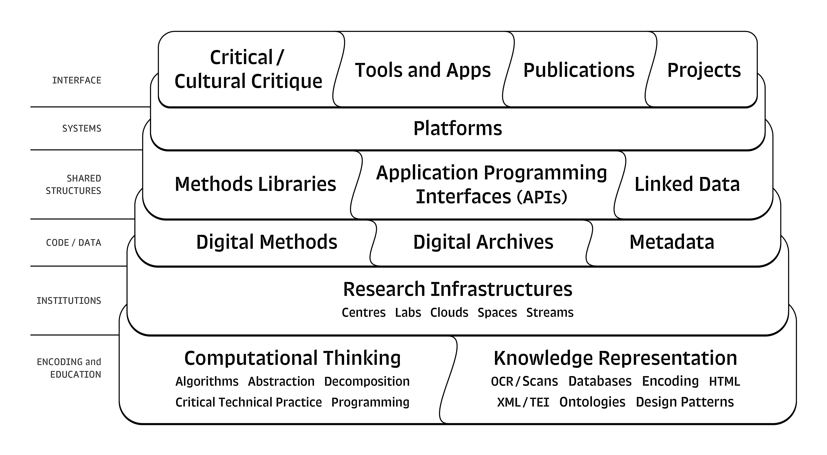
Digital Humanities Stack?
Digital Humanities Stack
- https://commons.wikimedia.org/wiki/File:Digital_Humanities_Stack_(from_Berry_and_Fagerjord_2017-_18).jpg
from Berry and Fagerjord, Digital Humanities: Knowledge and Critique in a Digital Age
Notes:
By way of a slight diversion, this “Digital Humanities Stack” is something I came across while preparing these slides.
It is referenced by the Wikipedia page on Digital Humanities.
---
I'm not entirely sure what to make of it, but I notice that it substantially consists of conventional digital techniques with interpretive and communication activities layered on the top.
---
Also, the construction of the stack itself suggests a humanistic rather than a purely technical perspective (e.g. the way it builds up from “computational thinking” and “knowledge representation” at its base). I think this different perspective might conceivably be an interesting aspect of Digital Humanities compared with other uses of digital technologies..
///
Referenced by:
- [Wikipedia](https://en.wikipedia.org/wiki/Digital_humanities)

Slide 7
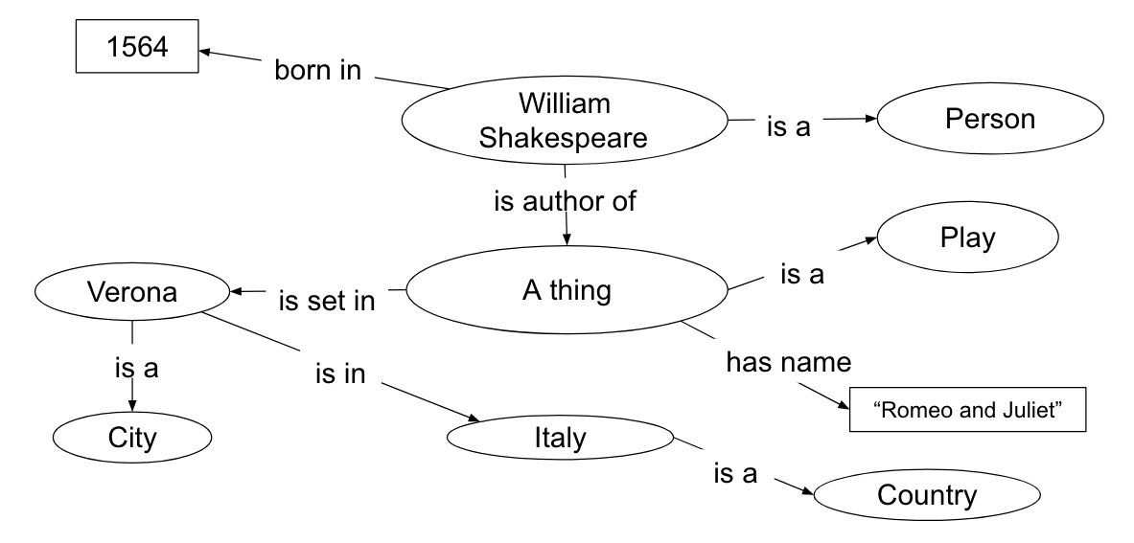
Introducing Linked Data (RDF)
Simple example
Slide credit: Terhi Nurmikko-Fuller
Notes:
Turning now to RDF linked data... (ask who is not familiar)
---
I'm not going to attempt a detailed technical description of RDF linked data: this is intended to be just-enough background for you to be able to follow what I'll talk about later.
---
Linked data focuses on entities, and relations between them. So in this (simplified) example, the elements labelled “William Shakespeare” and “A thing” correspond to the playwright William Shakespeare, and his play Romeo and Juliet”, respectively. The relation between them described here is that William Shakespeare is the author of Romeo and Juliet.
---
Each connecting line in the graph corresponds to a relation between two concepts, or between a concept and a literal value. When describing linked data, people often talk about “triples”: taken together, the two related concepts and the type of relation between them constitute such a “triple”.
///

Slide 8
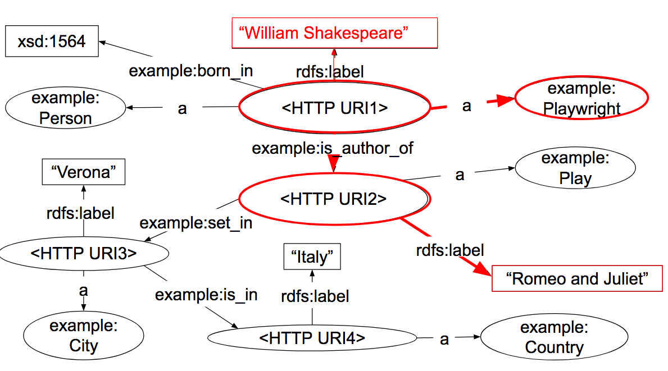
Introducing Linked Data (RDF)
A bit closer to the truth
Slide credit: Terhi Nurmikko-Fuller
Notes:
In actual RDF linked data, the concepts and relation types are represented as URIs, which (preferably) are HTTP URIs that can be retrieved on the web.
---
This means that:
---
1. we have unique identifiers for every concept and relation type that is referenced, and
---
2. further information about any concept or relation type can (in principle) be retrieved from the Web using it’s URI. Only the literals have predefined meaning, and that meaning is generally very limited; e.g., strings, numbers, dates, etc.
---
This use of URIs to identify things is what makes RDF be truly “of the Web”, and not just another graph database that can be accessed over the Web.
---
And that’s pretty much it. There are plenty of technical details, which some of you will have learned about in the linked data strand of this summer school. But this connecting of concepts with relations, where concepts and relation types are identified by URIs, is the essential nature of RDF linked data.
///

Slide 9
Introducing Linked Data (RDF)
The painful reality?
“People think RDF is a pain because it is complicated. The truth is even worse. RDF is painfully simplistic, but it allows you to work with real-world data and problems that are horribly complicated.”
“While you can avoid RDF, it is harder to avoid complicated data and complicated computer problems. RDF brings together data across application boundaries and imposes no discipline on mandatory or expected structures.”
(Dan Brickley and Libby Miller)
- https://book.validatingrdf.com/bookHtml005.html
Notes:
I particularly like this quote from Dan Brickley and Libby Miller.
---
^^^
---
The rest of this talk could be viewed in this light: describing how we can use a “painfully simplistic” structure to represent complicated real-world problems, particularly as they arise in humanities research.
///

Slide 10
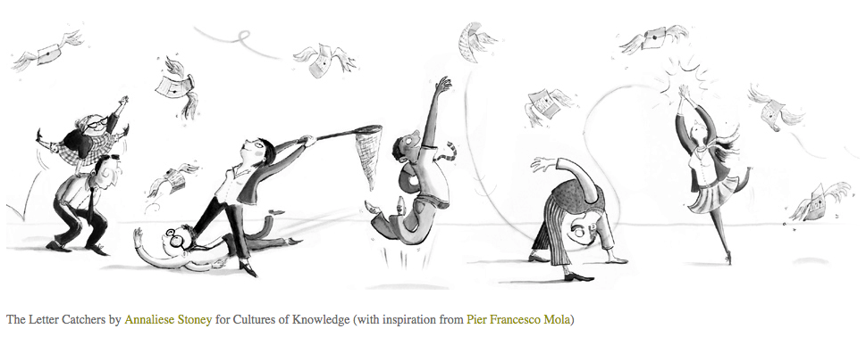
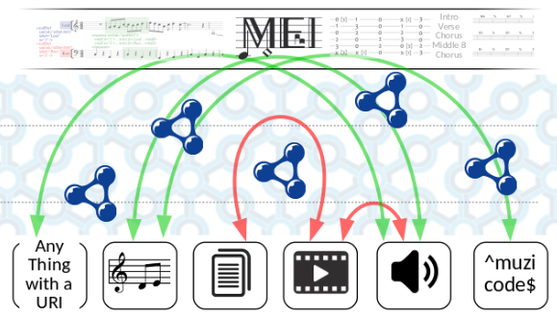
About this talk
1. EM Places: Early Modern historical places
2. MELD: Music Encoding and linked data
Notes:
Having described some introductory concepts, the rest of this talk will look more closely at two of the digital humanities linked data applications I’ve worked on recently, hopefully showing how the affordances of linked data are suited (or not) to dealing with the data representation and processing issues that arise.
---
1. EM Places: recording Early Modern historical place information ([Cultures of Knowledge (CofK) project](https://www.history.ox.ac.uk/cultures-knowledge)). Cultures of Knowledge has created the Early Modern Letters Online (EMLO) database. The EM Places project is building an online reference resource of place information from EMLO. I shall discuss the development of a data model that captures historical contextual information, and also provides for incorporation of up-to-date information from other sources.
---
2. MELD: Music Encoding and Linked Data ([Fusing Audio and Semantic Technology (FAST) project](http://www.semanticaudio.ac.uk/)). The FAST project is exploring the intersection of semantic and music-related technologies. I shall talk about the MELD framework, conceived by my colleagues David Weigl and Kevin Page, which uses linked data in applications that establish and act upon connections between musical structure, music-related media and other data.
///

Slide 11
EM Places
Early Modern historical place data

Slide 12
EM Places
Early Modern historical place data

Slide 13
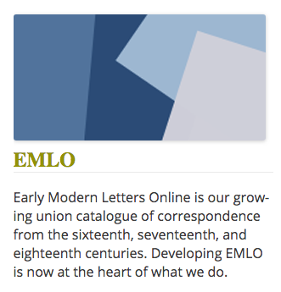
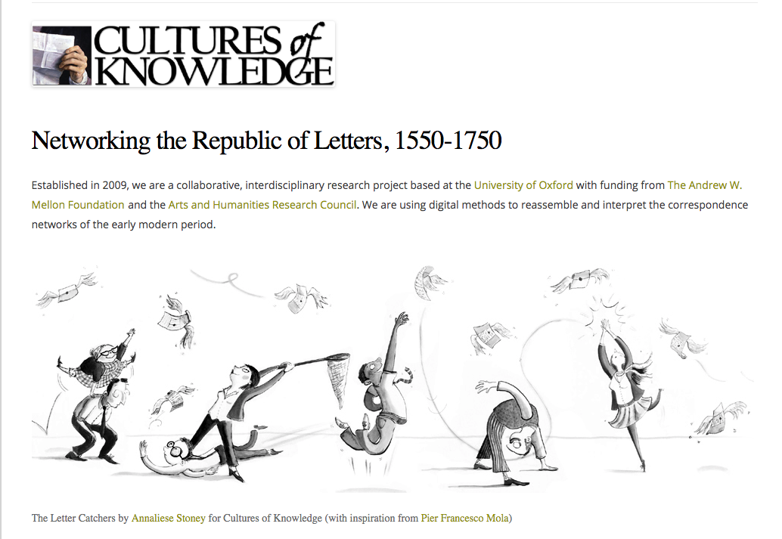
EM Places
Notes:
The Cultures of Knowledge project has created the Early Modern Letters Online (EMLO) catalogue, which contains information about selected correspondence by notable people in the Early Modern period. This period saw a flourishing of science and understanding that underpins modern society. The data collected includes information about the correspondents (people), correspondence dates, and places of origin and receipt of the letters.
---
Currently, the place information is somewhat isolated from other similar resources. A fair number, but not all, of the places mentioned have GeoNames identifiers included in their descriptions, but that is as far as cross-referencing goes in EMLO.
---
Not all places mentioned in the letters are recorded in GeoNames, for a variety of reasons: GeoNames records current places, but places associated with the letters may no longer exist. Also, GeoNames tends to record larger entities such as cities and countries, but some letters refer to more local or obscure places.
---
Yet this place information may be important to allow for interpretation of of other related content; e.g. to determine the actual day in history that a letter was written may require knowledge of the calendar in use in the place where it was written, which may in turn depend on administrative relationships that were in place at the time.
///

Slide 14
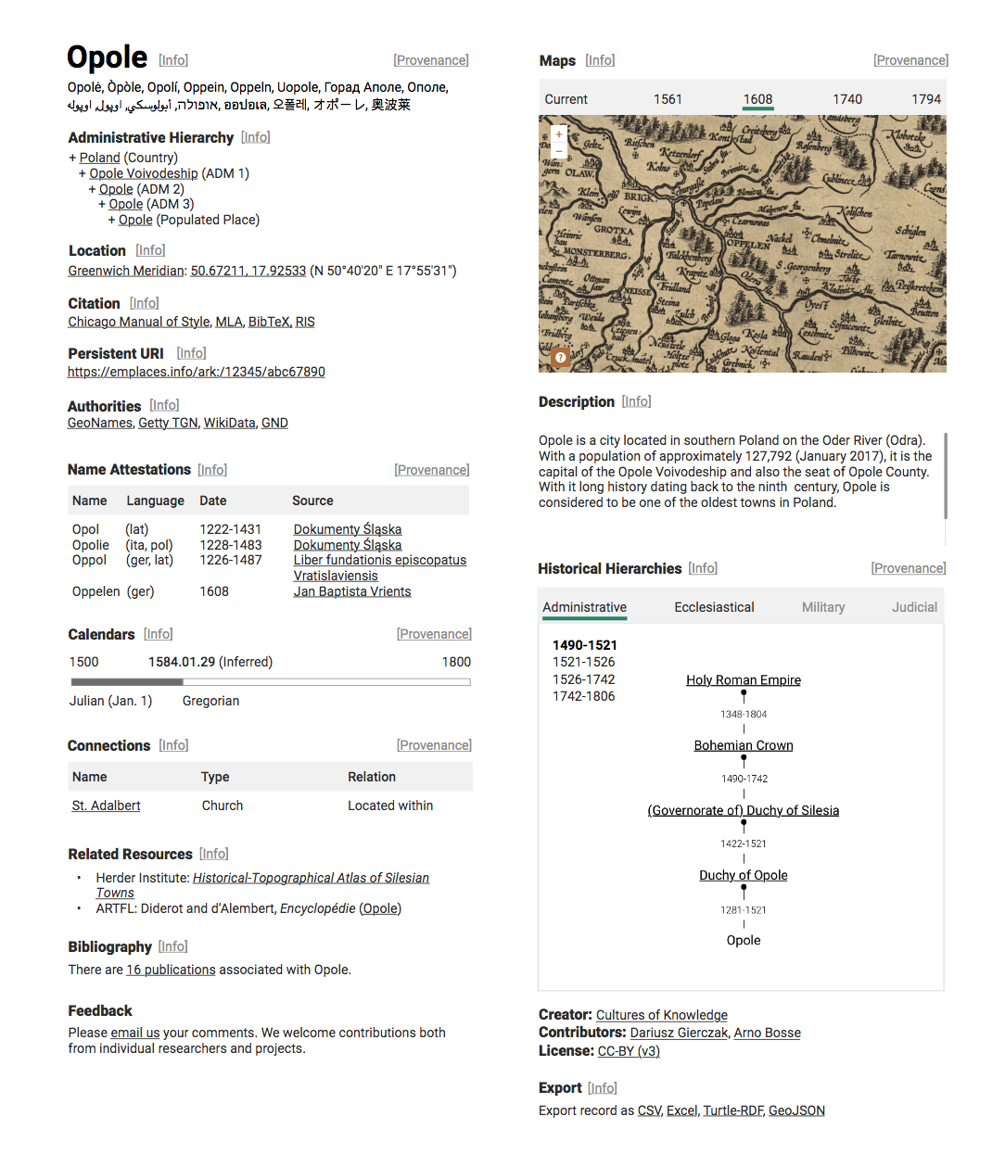
EM
Places require- ments
Notes:
The aim of the EM Places project is initially to create a free-standing web site and service that can be used to collect information about historical places associated with Early Modern correspondence. This may subsequently be expanded to include other places referenced by other projects with similar needs.
---
Our aim has been to create a resource from which we can generate something like the display mock-up shown here, with temporally-qualified information about names used, calendars used, etc.
---
But we don’t want this to become yet another isolated resource, so it is also important to be able to incorporate and reference existing authority data, where it exists, into EM Places. Our data model has been developed to maintain a separation between data that are obtained from different sources.
///

Slide 15
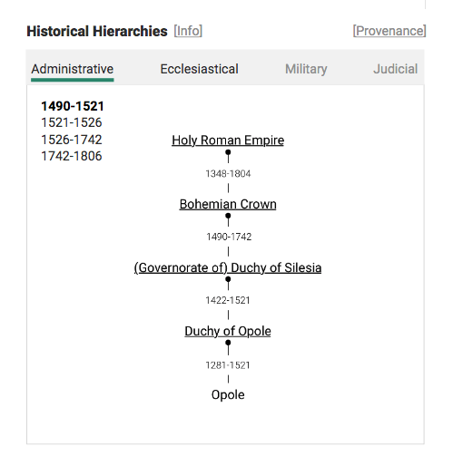
EM
Places require- ments
Notes:
The historians involved in this project felt that existing gazetteers did not fully meet their needs for a number of reasons:
---
1. a need to record information about places that no longer exist.
---
2. a need to capture time-specific information about a place; e.g. different names and different calendars used in different periods.
---
3. a desire to be able to capture multiple time-varying hierarchical relationships between places; e.g. administrative, ecclesiastical, military, etc.
///

Slide 16
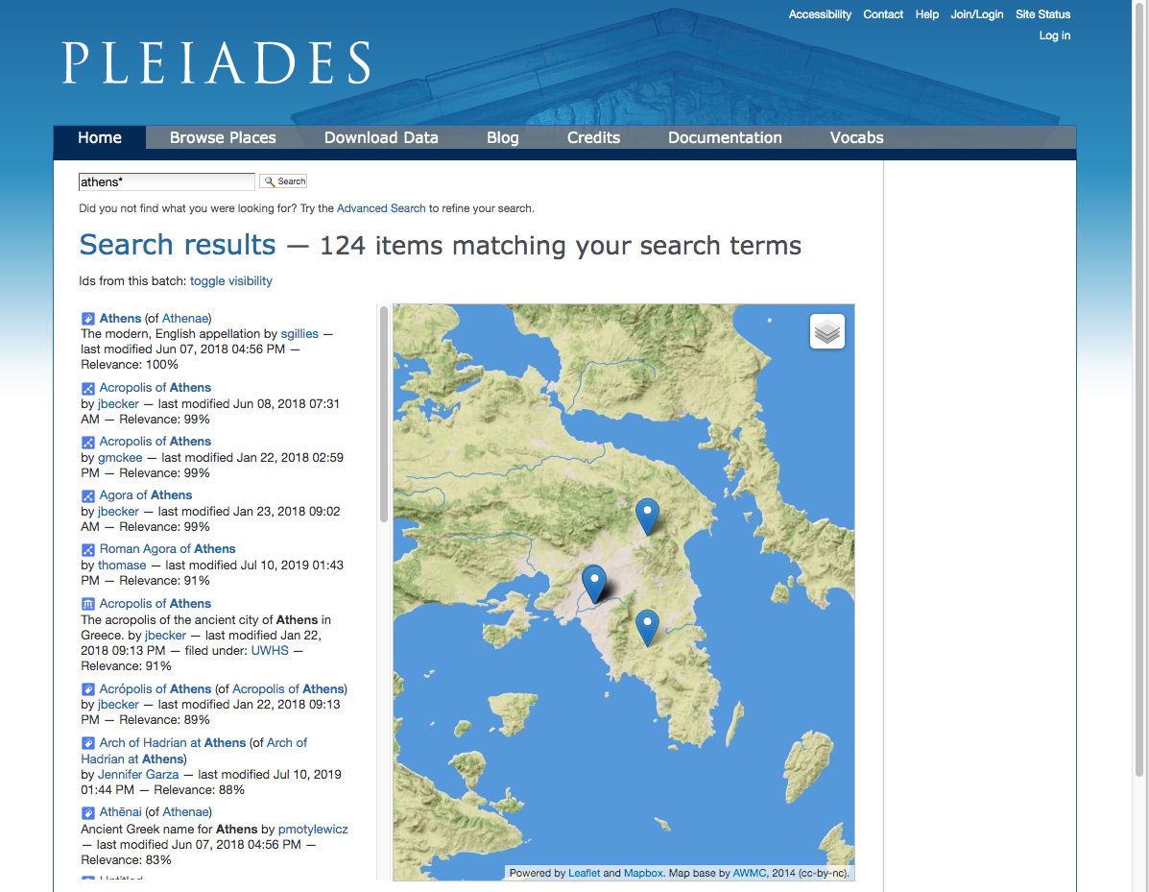
Related work: Pleiades
Notes:
There has already been a fair amount of work on recording information about historical places, from which we have tried to avoid gratuitous deviation.
---
One important related work is the Pleiades project, which has created an online service to access information about historical places.
---
A starting point for our place modelling work was the [Pleiades data model(https://pleiades.stoa.org/help/pleiades-data-model), which explicitly separates the notions of place, place name, place location and temporal applicability. This approach has been adapted and extended to handle other kinds of temporally qualified information, especially hierarchical relationships between places.
---
When we started on EM Places, Pleiades did not record time-varying hierarchies. Since our early modelling work, the Pleiades project has started to introduce the notion of a “connection resource”, which closely parallels some of our modeling ideas for temporally qualified relationships, but was not available to us in time for us to use in our work.
---
(But it is encouraging that the similarity of approach does mean that more faithful data exchange should be possible in due course.)
///

Slide 17
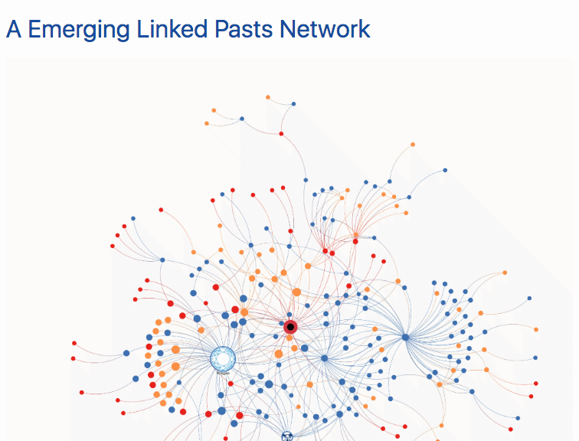
Related work:
Linked Pasts/Linked Places
http://linkedpasts.org/
Notes:
Another related work is the Linked Pasts Network, which is developing a “Linked Places” data model for interchange of historical place data. The Linked Places model itself draws ideas from the Pleiades project.
---
This is a quote from the Linked Pasts home page:
“Linked Pasts Network refers to a growing collection of historical datasets published as Linked Open Data and the community of researchers across the globe whose projects are producing and using them.”
-- http://linkedpasts.org/
---
(Linked Places)[https://github.com/LinkedPasts/linked-places], is a broadly based project that aims to provide a common framework for interchange of historical place data. As such, it covers some of the same requirements as our Cultures of Knowledge work, but aims for broader use while not necessarily being a complete solution for any single application.
---
We have been in communication with the Linked Places developers to ensure that our modelling remains broadly compatible and capable of supporting good fidelity conversion. As such, our work forms part of a wider effort to publish independently-developed historical datasets as linked data, allowing for information to be shared and cross-referenced between the datasets, thus building an aggregate that is more generally useful than the sum of its parts.
///

Slide 18
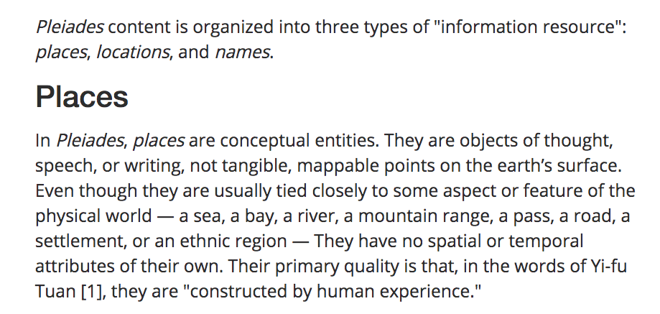
What is a place?
“constructed by human experience”
-- https://pleiades.stoa.org/help/data-structure
Notes:
There are many ways in which the idea of “Place” may be conceived. We are particularly interested in capturing an idea of place from a human perspective.
---
Thus, the idea of a place that we use is not location-specific nor period-specific. We follow the notion adopted by the [Pleiades project](https://pleiades.stoa.org/) that
---
‘[places] are conceptual entities ... They have no spatial or temporal attributes of their own. Their primary quality is that they are "constructed by human experience.”.
///

Slide 19
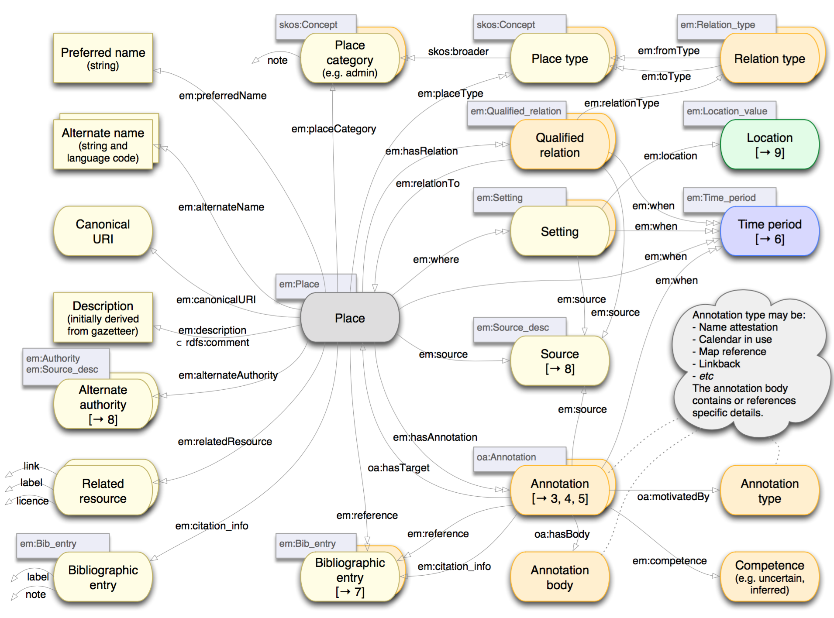
Overall place model
1
2
Notes:
So how does EM Places describe a place?
---
In the next few slides, I shall describe some specific elements of the EM Places data model, and relate them back to the requirements discussed previously.
---
In viewing this work, do bear in mind that when modeling data there is usually not a single right way to do it. (Even if there are plenty of wrong ways!) So some of the choices presented here are somewhat arbitrary, and shouldn't be taken as a specific prescription. What I hope to expose is how the previously identified requirements can impact the modeling choices made.
---
---
This slide shows the overall place model, which is mostly fairly conventional, but there are some points I’ll highlight:
---
1. Much of the left hand side is information extracted from an existing authoritative source (e.g., GeoNames), and as such is designed to be refreshable when an original source is updated. More details about this come later.
---
2. Alternate authority data (i.e. identifiers derived from different authorities) allow cross-referencing to existing gazetteers. In our work, given a GeoNames identifier for a place, we use Wikidata to locate some of these alternative identifiers.
///
https://github.com/culturesofknowledge/emplaces/tree/master/models
https://github.com/culturesofknowledge/emplaces/blob/master/models/PDFs/20180802-EMPlaces-data-model-multisource.pdf

Slide 20
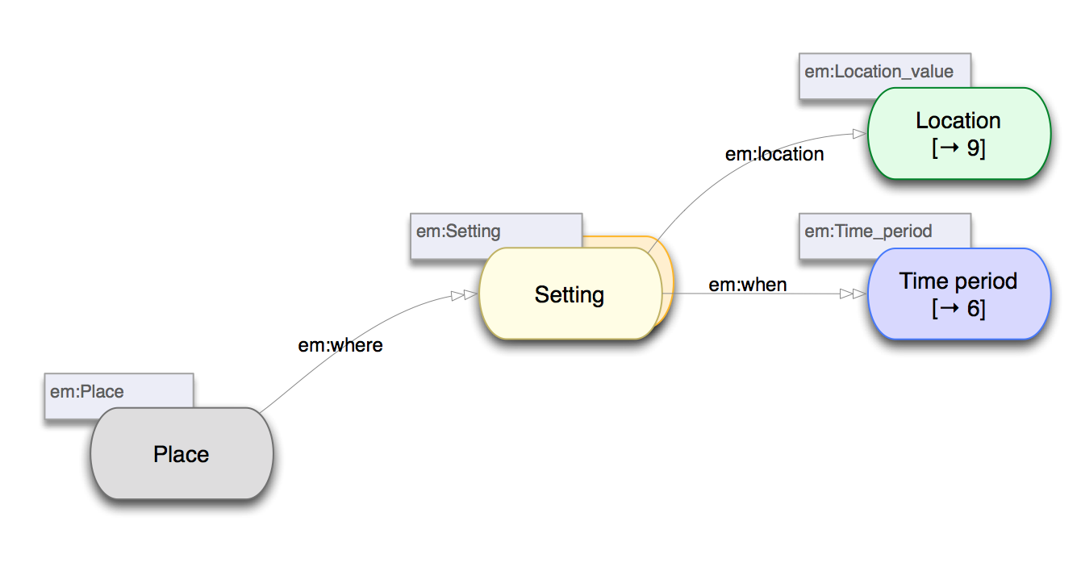
Setting: space and time
Notes:
3. In our work, the notion of a “Setting” is used to represent an extent in place and time (this terminology is adopted from earlier work of the Linked Pasts project).
---
A place location may change over time, so multiple settings may be associated with a place (where place is in the sense of being “constructed by human experience”).
///

Slide 21
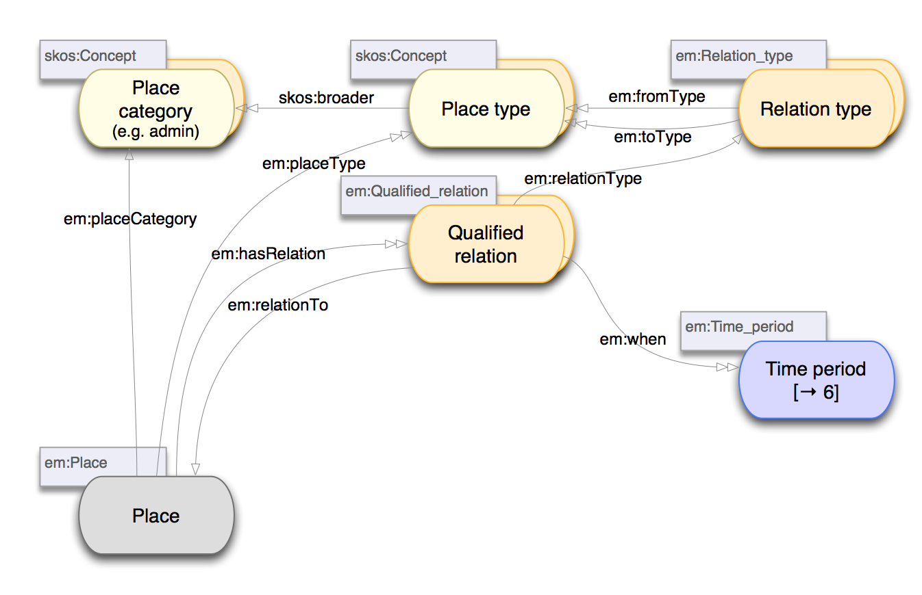
Qualified relations between places
Notes:
4. We represent a Qualified Relation as a node in the graph, rather than as just a direct relation. This is used to attach additional context for the relations between places, such as a time period, allowing us to capture multiple hierarchies of temporally qualified relations.
---
The pair of “Place type” and “Place category” values for relation types means that we can isolate different hierarchies (based on “Place category”). E.g, some relations apply to places as administrative entities, while others may apply to ecclesiastical entities (church parishes, etc.). A place may exist in multiple categories.
---
For example, the City of Opole in Poland is a populated place and an administrative region that is part of Opole Voivodeship, itself an administrative region that is part of the country of Poland. By comparison the parish of the Holy Cross in Opole is in the Deanery of Opole, in turn part of the Diocese of Opole: these ecclesiastical part-of relations would be distinct from administrative part-of relations, and are not necessarily in alignment.
---
The additional node representing a relation is an example of what I call “selective reification” of a relation, which is something I'll come back to later..
///

Slide 22
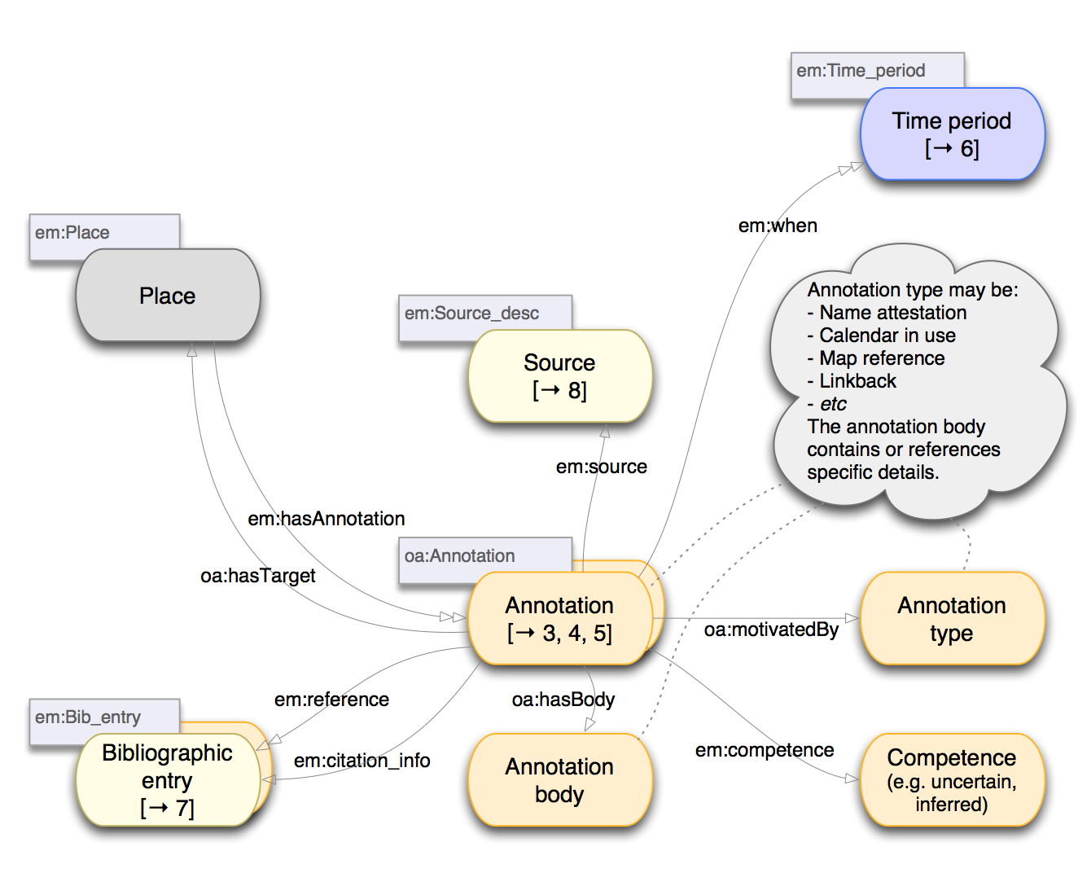
Use of Web Annotations
Notes:
5. Other information, such as place names used, calendars used, map references, etc., is captured using Web Annotations, used here as a kind of qualified and contextualized relation between a place and the additional information.
---
This use of Web Annotations means that we are using an existing standard vocabulary, albeit in a slightly extended form (e.g. with an associated time period). This provides an extension point (via the annotation type value) that can be used to incorporate additional information not defined by the initial data model, yet with a reasonable expectation that at least some of the information will be accessible to applications that know about web annotations.
---
The provision of a time period value attached to the Web Annotation node is used for recording a temporal constraint on the scope of the annotation.
///

Slide 23
Reflection on recording context
“People think RDF is a pain because it is complicated. The truth is even worse. RDF is painfully simplistic, but it allows you to work with real-world data and problems that are horribly complicated.”
(Dan Brickley and Libby Miller)
- https://book.validatingrdf.com/bookHtml005.html
See also:
https://github.com/gklyne/notes/blob/master/20180307-qualified-property-links.md
Notes:
Recall the quote from Dan Brickley and Libby Miller. Note how our place data model has been formulated to allow additional context information to be explicitly recorded.
---
In this respect, the introduction of Web Annotation and Qualified Relation nodes reflects a limitation of RDF compared with some other representations (such as property graphs). RDF does not allow additional information to be directly associated with a relation between nodes, so, to incorporate such information, we expand the application data model.
---
I have prepared [a small survey of modeling techniques](https://github.com/gklyne/notes/blob/master/20180307-qualified-property-links.md for what I call “qualified properties”, which can be found at the link shown here. Further, there is work in progress in the RDF community to address the representation of qualified relations, some of which is referenced in the survey document.
---
In this matter, we have adopted an approach that I refer to as selective reification. The approach is similar to that taken by the W3C provenance ontology (PROV-O), and also one that is being developed as a recommendation for representing role-in-activity information in CIDOC CRM. (Where CIDOC CRM is an ISO standard data model for representing museum data and more.)
---
There are also some theoretical considerations indicating that reified relations may allow simpler and more predictable performance for certain kinds of inference based on the relations (such as being specifiable using a particular restricted form of the web ontology language, OWL-QL, which is designed to be implemented using conventional, fast query mechanisms). For example, these considerations were an immediate motivator for introducing “Qualified associations” and related elements, in the W3C provenance ontology, these being another example of selective reification.
///

Slide 24
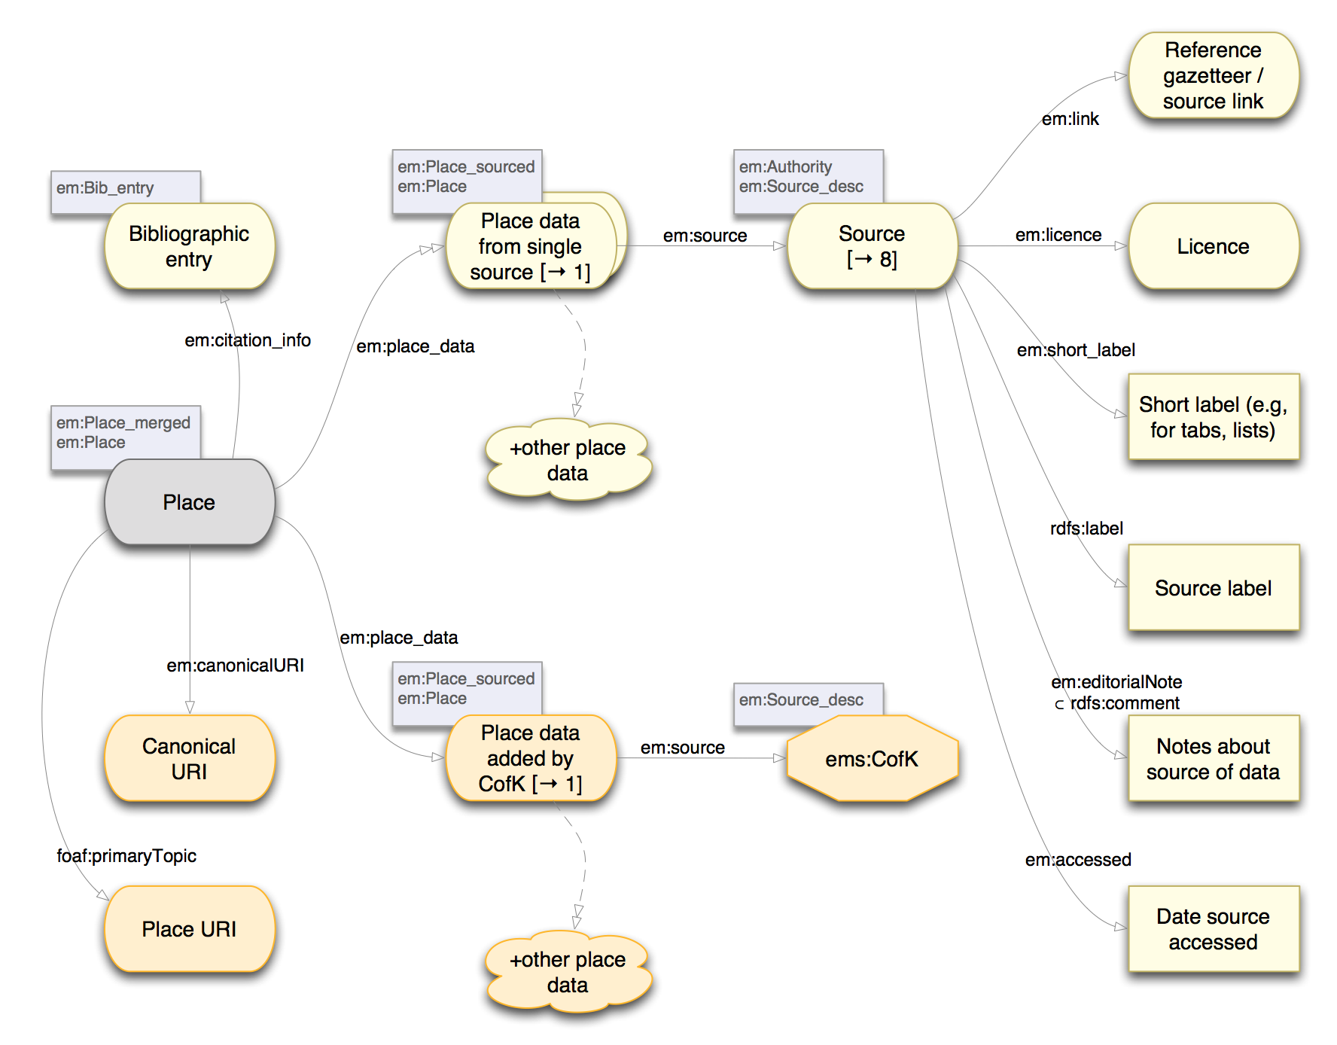
Multiple data sources
1
2
Notes:
Referencing multiple authority data sources has been mentioned previously. Using the original place model as presented, this is not achieved in a way that easily allows data from a single source to be refreshed.
---
The problem here is that when new data is pulled in from an authoritative source, the data previously obtained from that source should also be removed. But this is only possible if we have some way of identifying which data came from that source.
---
The solution we have adopted is to introduce an additional layer of place information, so we have:
---
1. A “Place_sourced” node representing information about a place from a single source, which uses the place data model described previously. Additional information about the source, when it was retrieved, and licensing information about the source data is associated with the “Source” node. Data that doesn’t come from an existing authority, but which is generated by EM Places editorial activity, is associated with a special “local-source” identifier (e.g., ems:CofK), but otherwise the modeling pattern is essentially the same as for any other authority source.
---
2. We also use a “Place_merged” node representing all of the available information about a place, which in turn references one or more single-sourced place descriptions.
---
Using this structure, all the information obtained from a particular source is associated with a “Place_sourced” node that references that source, and as such can be located and removed when data is refreshed.
---
The trade-off here is that applications needing to see the overall place data must take steps to traverse and aggregate data from each of the single sources.
///

Slide 25
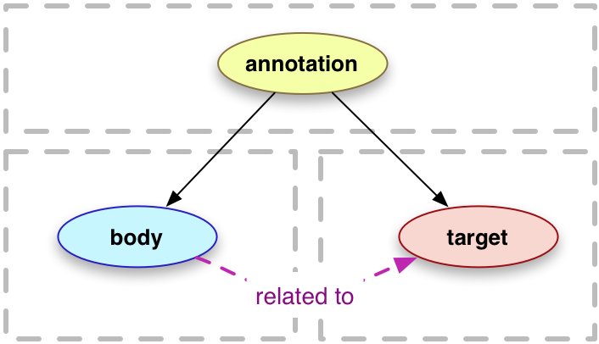

Web Annotation summary
Notes:
Next we'll look at additional details about a place that are included using Web Annotations.
---
The basic structure of a Web Annotation (at least, as used in EM Places) is an “annotation” node that references a “target” (what the annotation is about), and a “body”, which is what the annotation is claiming about the indicated target.
---
An additional “motivation” value associated with the annotation node is used to indicate the kind of relation between the target and body it is that the annotation is being used to represent.

Slide 26
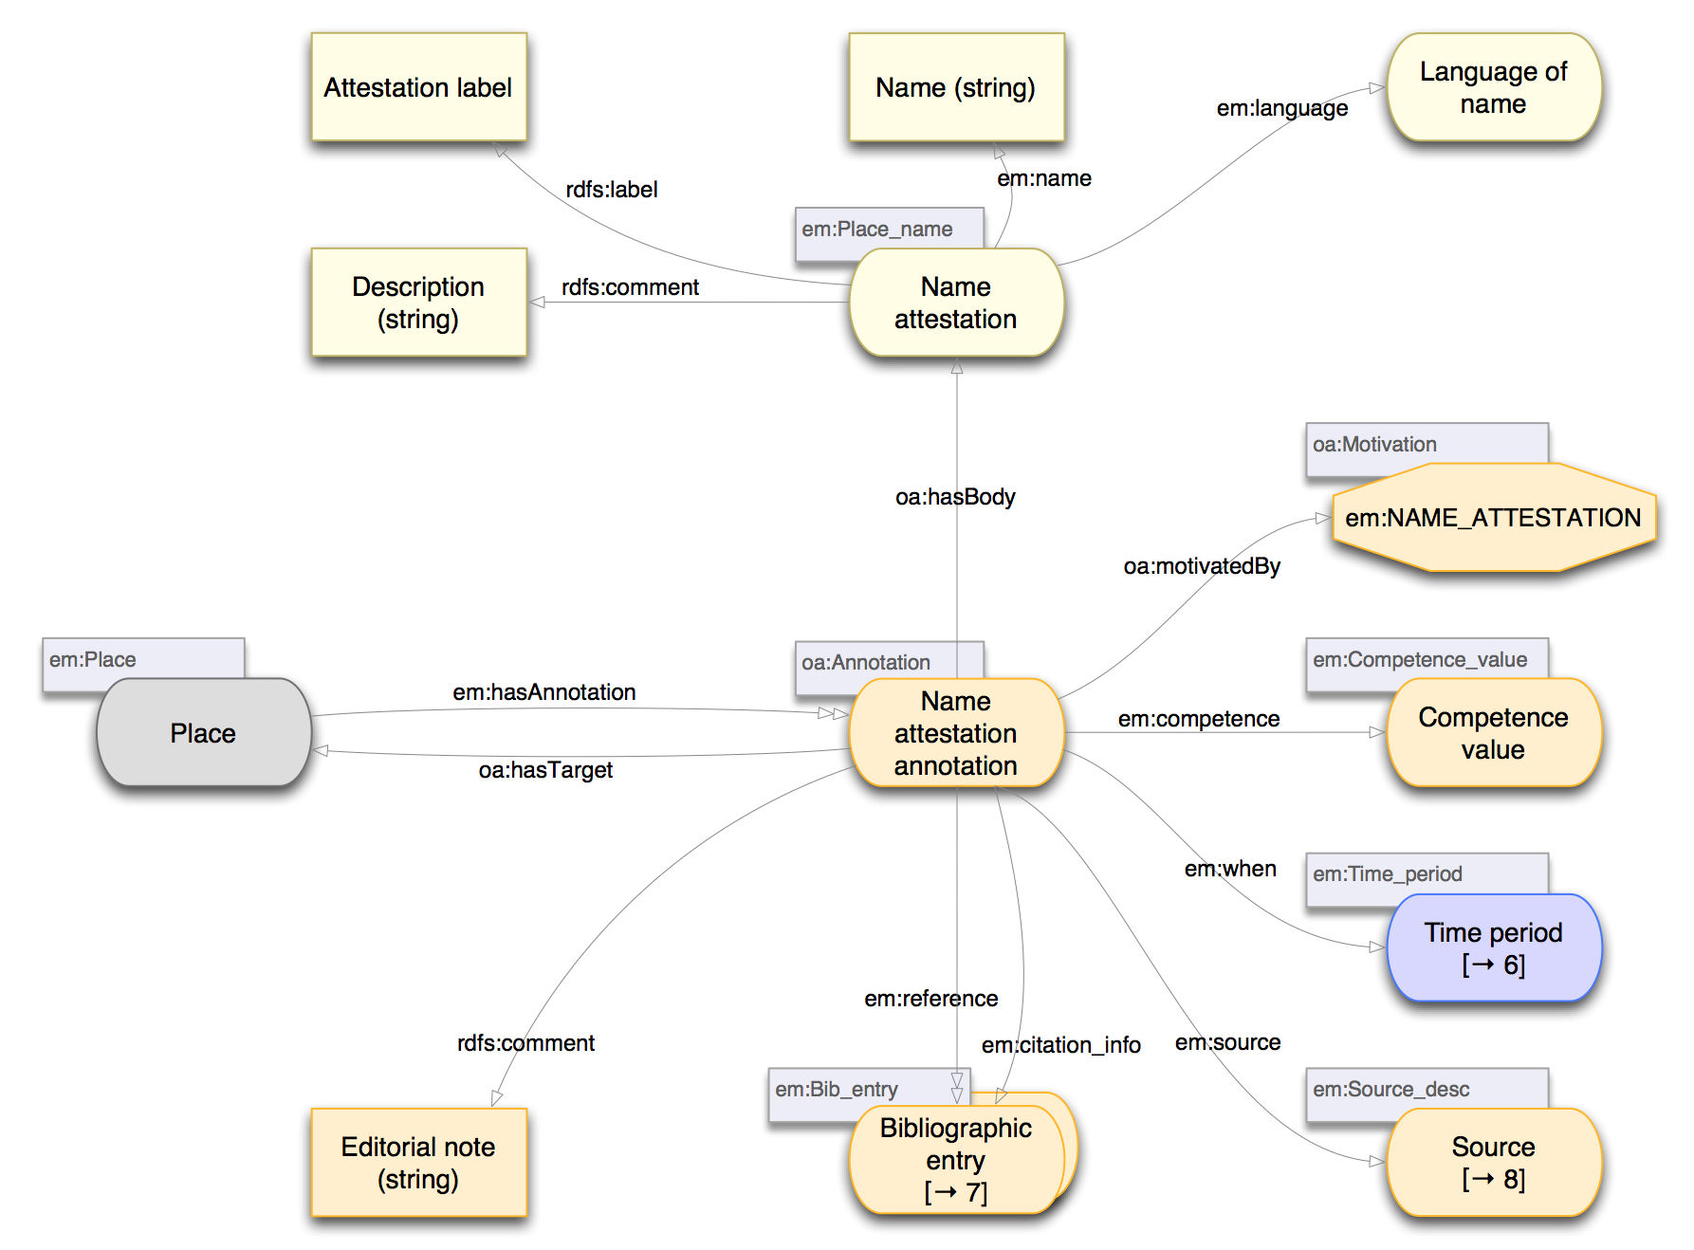
Additional details: name attestation
2
1
3
4
Notes:
A “Name attestation” is our first example of place detail using Web Annotations. This is an evidenced description of an alternative name that has been used for a place.
---
This diagram shows how the attested name and contextual metadata are associated with the place using a Web Annotation.
---
The name itself is described by a “Name attestation” node, which is referenced as the annotation body. The information specified here is mainly determined by requirements of the intended user interface for EM Places.
---
Elements used here that are additional to the the Web Annotation specification include:
---
1. temporal constraint on the applicability (i.e., when, historically, the name was used)
---
2. an indication of reliability or accuracy (referred to jointly as “competence”) of the information provided
---
3. an indication of the source of the name attestation information
---
4. bibliographic and citation information relating to the name attestation
---
All of these additions are intended to help scholars to assess the applicability of a given name attestation, by providing additional context to aid interpretation of the data.
///

Slide 27
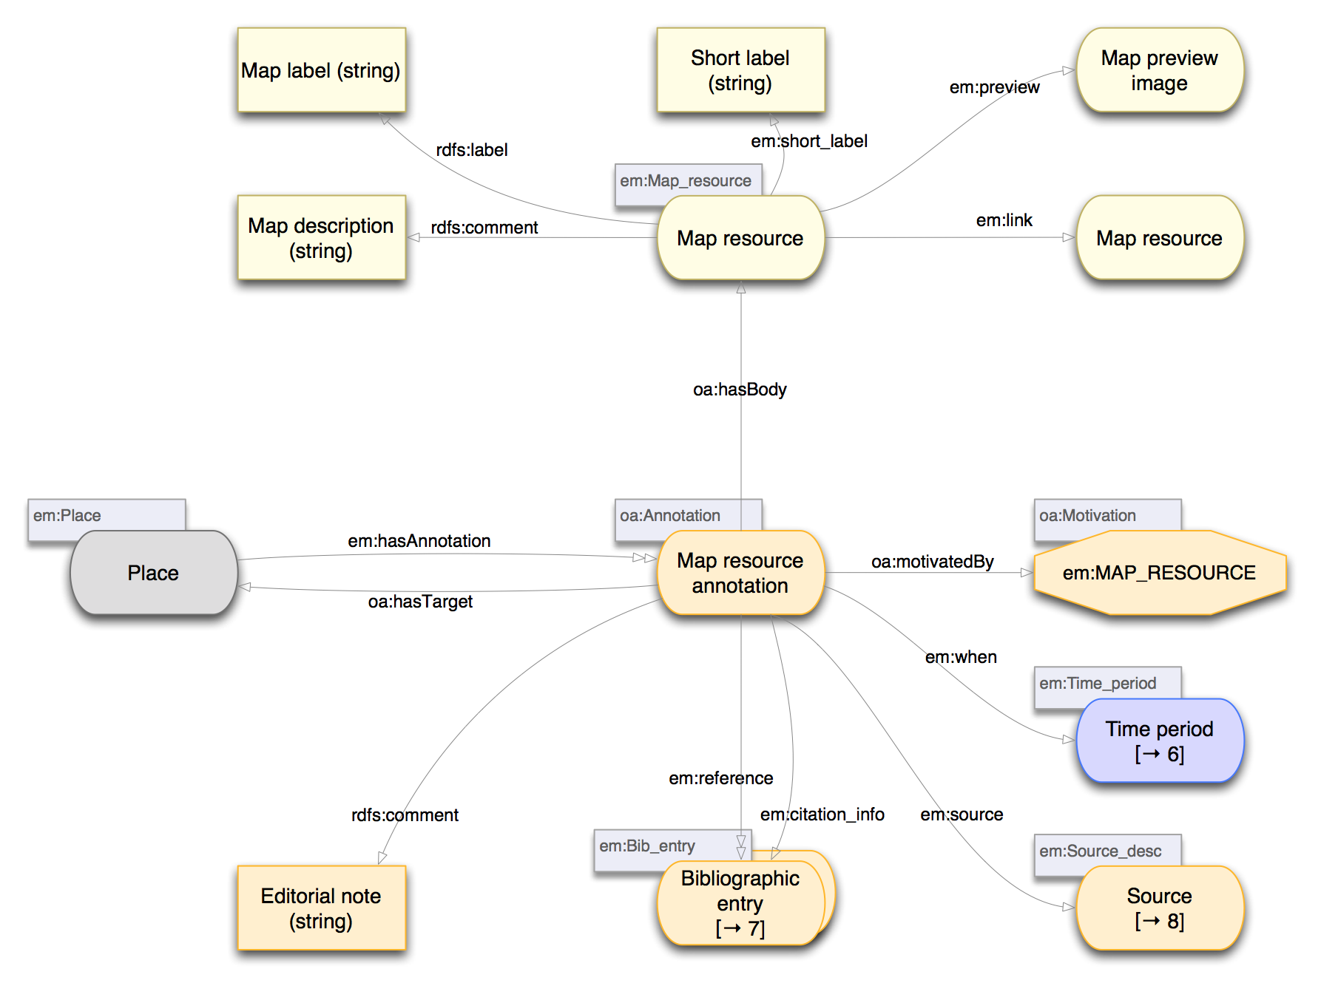
Map resource
Notes:
The map resource annotation allows historical maps corresponding to different time periods to be associated with a place.
---
This follows a similar pattern to the name attestation annotation, but with a different value for the motivation, and a different structure for the annotation body.
///

Slide 28
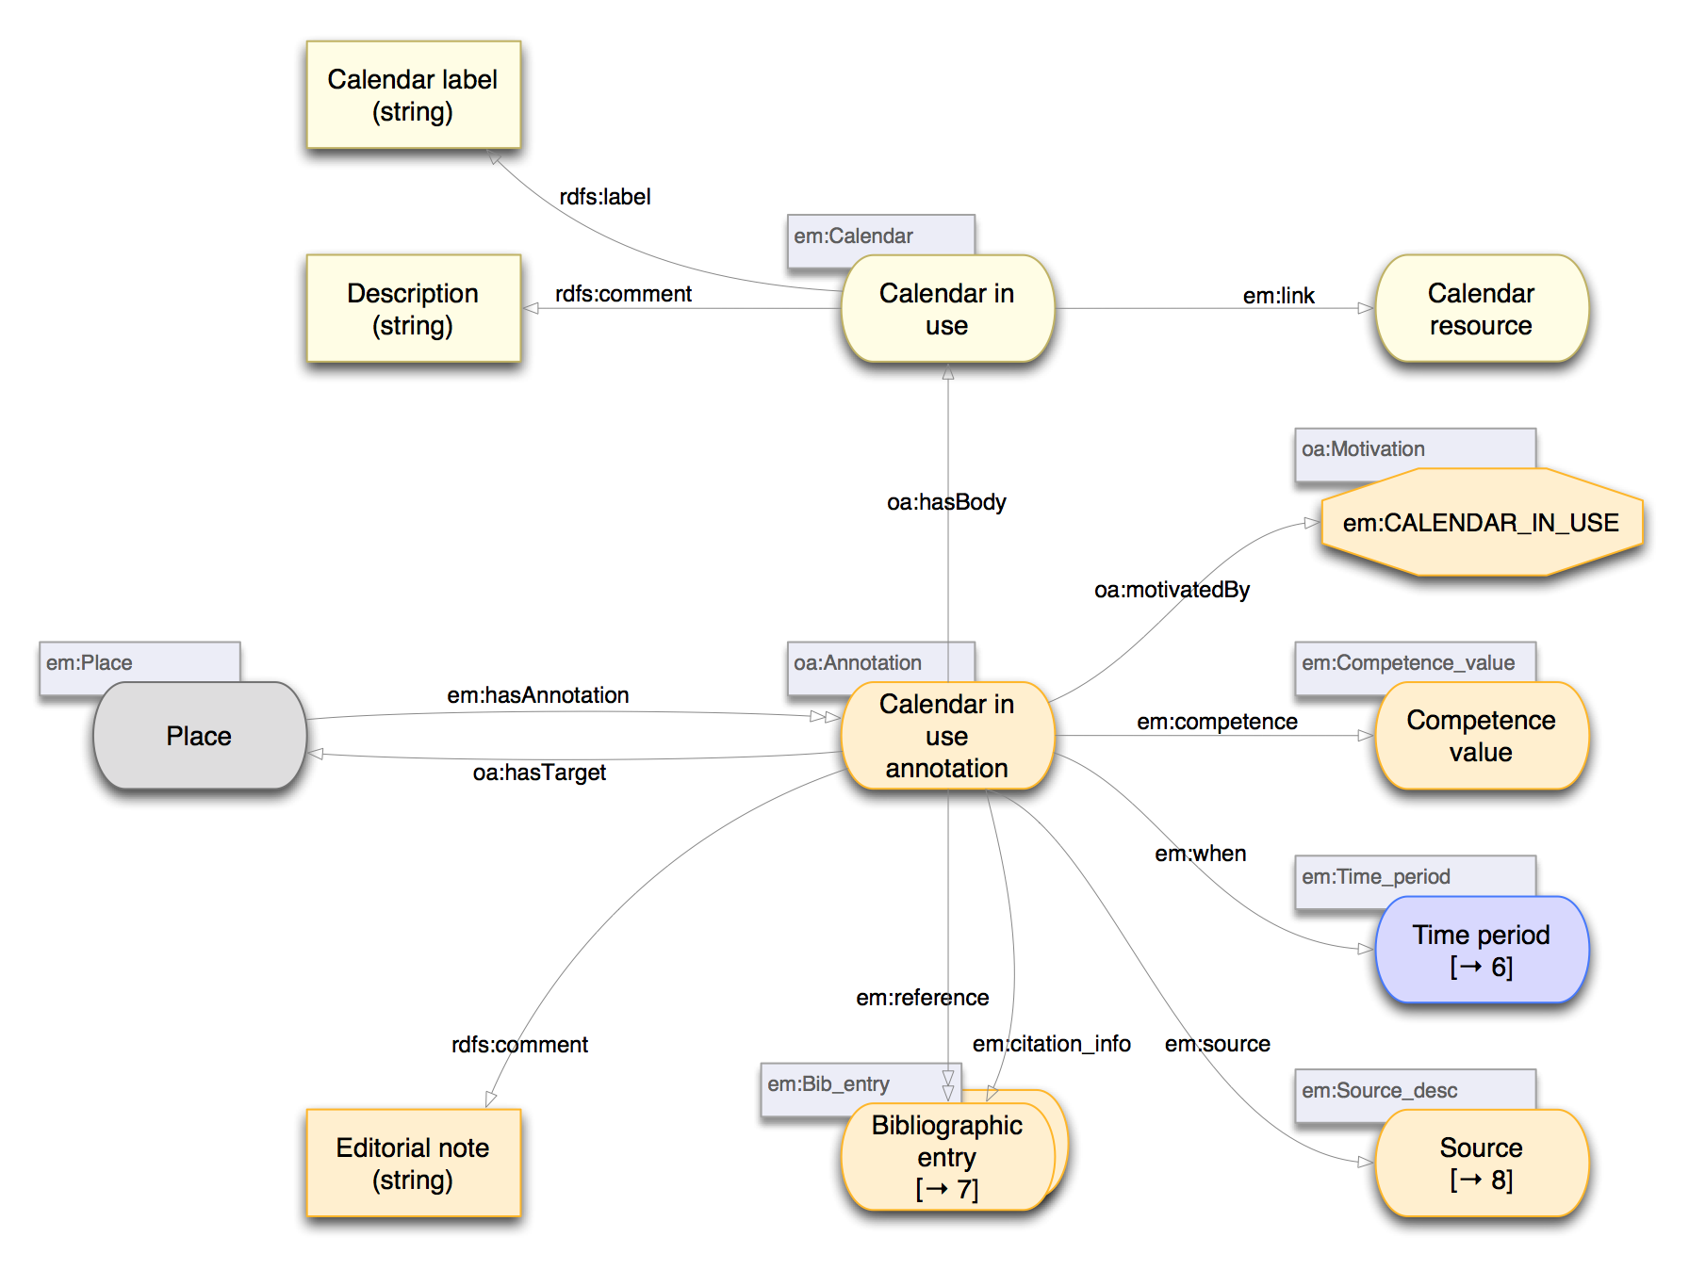
Calendar in use
Notes:
Similarly, a calendar-in-use annotation allows calendars used locally during different time periods to be associated with a place.
---
Again, the pattern is similar, but the details vary.
///

Slide 29
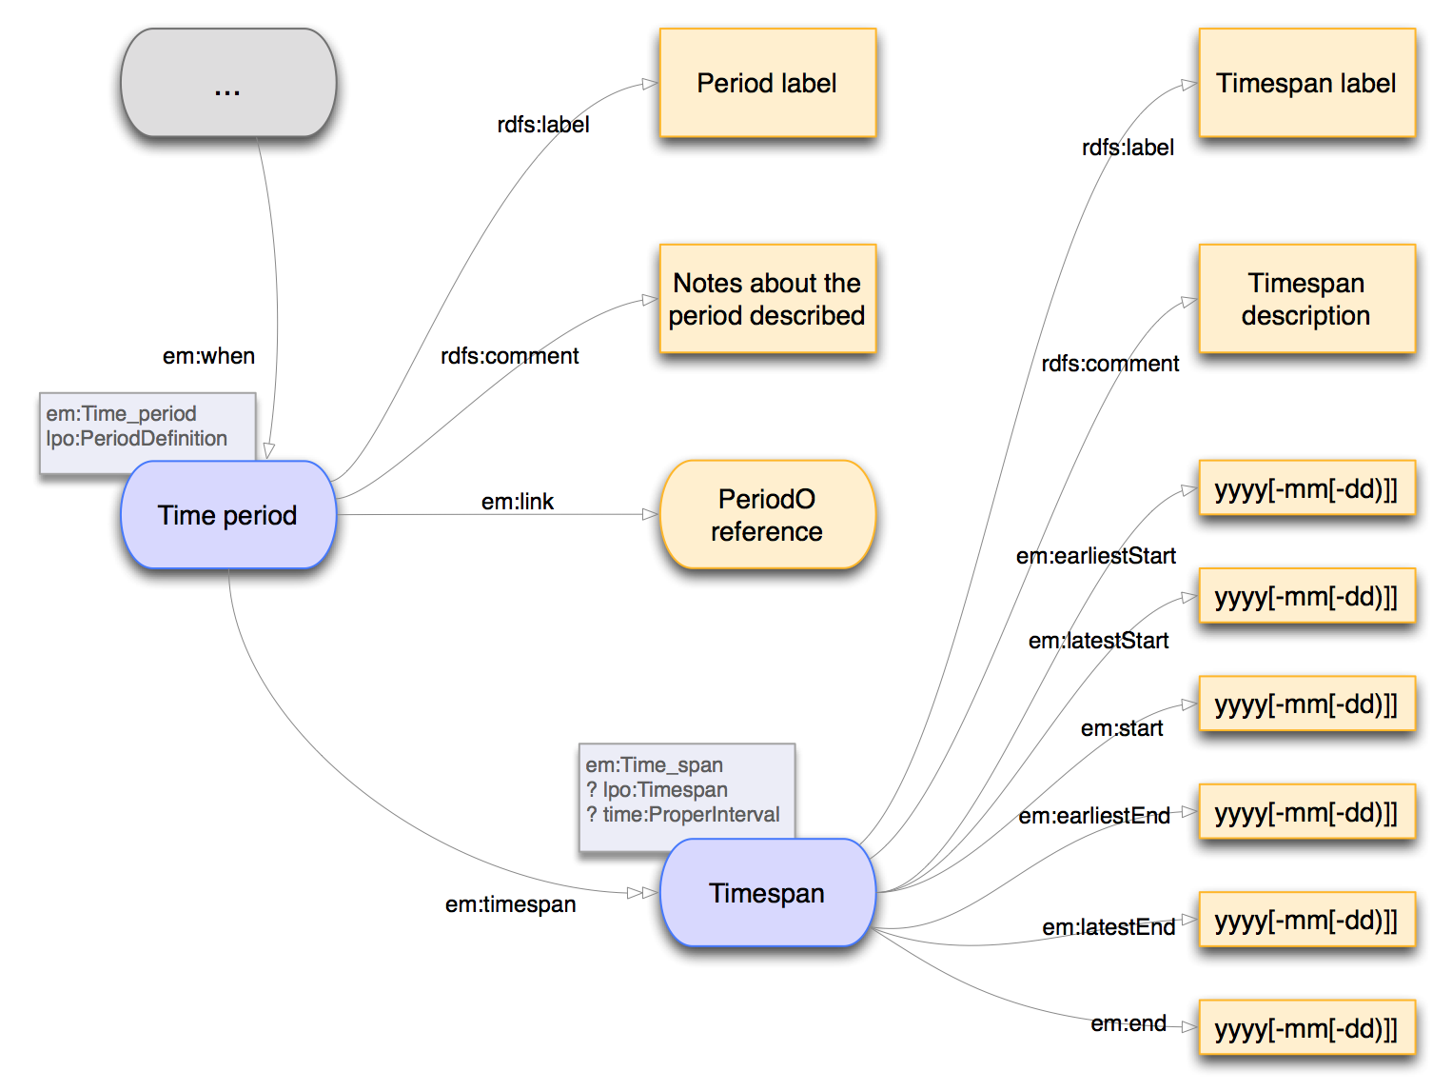
Time periods and time spans
Notes:
I've made several references to temporal constraints on information in the EM Places data model. These are all captured through using a “time period” description.
---
A time period may be associated with a place, a place setting, a qualified relation between two places, or an annotation providing additional qualified information about a place.
---
Some key points to note here are:
---
1. there is a distinction between a “time period” and a “time span”. A “time period” refers to some identified historical period without necessarily indicating when it actually occurred; e.g. “Early Modern period”. This follows the notion of time periods catalogued by the PeriodO project authority data, where each identified period is based on a cited document that refers to that period by (some) name.
---
2. a time period MAY have an associated “time span”, which provides an indication of when in history a period actually occurred, and whose exact extent may be only approximately known. We have settled on 6 terms to allow capture of uncertainties in the starting and ending dates of a time span.
---
This time span structure loosely follows work in the “Linked pasts” project, which was attempting to build upon the OWL Time ontology, but which we found was difficult to use for our purposes without introducing semantic inconsistencies. Semantically consistent mapping from the terms used here to OWL Time terms is possible, but the resulting data structure becomes somewhat more complex.
///

Slide 30
EM Places model summary points
Context and provenance
  Expanded data model
Ontology sharing/reuse: parallel efforts
  Tyranny of timescales
Ontology sharing/reuse: local needs
  Specific application needs vs concept sharing
Notes:
In summary, the following points can be made about our EM Places data model.
---
Context and provenance are captured by enlarging the application data model compared with what would be required to capture just the raw information.
---
The existence of parallel efforts in our domain of interest means that the ideal of vocabulary sharing conflicts with project timescales, particularly for some humanities projects where the technical data model design may be a part-time effort conducted over an extended period.
---
Local project needs are not necessarily reflected by common vocabularies for information sharing, so rather than trying to force-fit into an existing vocabulary we have tended to create new terms, but remaining cognisant of how these can be mapped to the common vocabularies. In some cases (e.g. for time spans), local terms have been used to keep the overall data model simpler.
///

Slide 31
Data model references
Place model description files:
  https://github.com
  /culturesofknowledge/emplaces/tree/master/models
Place model diagrams:
  https://github.com
  /culturesofknowledge/emplaces/blob/master/models
  /PDFs/20180802-EMPlaces-data-model-multisource.pdf
Place model sample RDF data:
  https://github.com
  /culturesofknowledge/emplaces/blob/master/models
  /20180802-opole-example-multisourced.ttl
Notes:
(This slide is included for the course notes to provide references to more details about our design.)
---
https://github.com/culturesofknowledge/emplaces/tree/master/models
---
https://github.com/culturesofknowledge/emplaces/blob/master/models/PDFs/20180802-EMPlaces-data-model-multisource.pdf
---
https://github.com/culturesofknowledge/emplaces/blob/master/models/20180802-opole-example-multisourced.ttl
///

Slide 32
MELD
Music Encoding and Linked Data
Notes:
I now turn to the second project I shall describe: Music Encoding and Linked Data (MELD).
///

Slide 33
MELD
Music Encoding and Linked Data

Slide 34
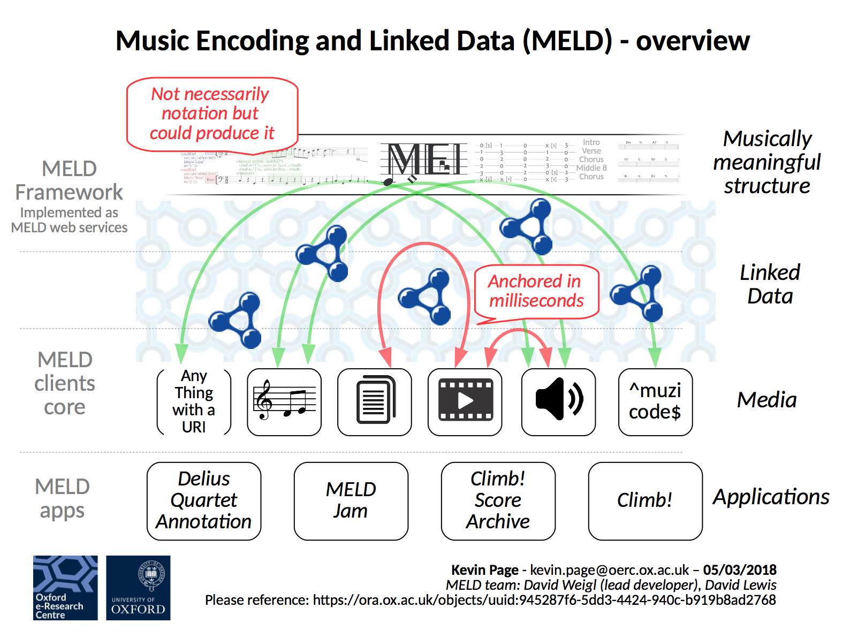
Notes:
Historically, a body of work dealing with computer analysis of music has focused on an audio stream of a performance as a primary record of the music, for which a common way of identifying particular musical elements is by time offset within the performance. This raises a number of problems:
---
1. Different performances will generally have different timing, so a reference is performance-dependent.
---
2. References are separated from any notion of musical structure.
---
3. Research to determine musical structure from audio performances is still early-stage, and is far from complete and reliable across all potential applications.
---
4. Similar problems arise when an image of (say) a musical score is used.
---
In many cases, there exists a more structured digital description of the music (e.g. Midi) that can be used as a performance-independent description of the musical content. One such format, that is finding application in music-related research, is the Music Encoding Initiative (MEI), which is somewhat like TEI but for musical rather than textual source material.
---
MEI is additionally supported by the Verovio renderer, which can present suitable MEI data as a musical score that is suitable for a sight-reading musician to follow.
///
-- https://github.com/oerc-music/meld
-- https://github.com/oerc-music/meld/blob/master/meld-overview.png

Slide 35
Notes:
MELD uses linked data to connect musically meaningful structure with with other related resources (e.g., musical score images, documents, performance audio, videos - indeed, any data that can be located on the web using a URI.)
---
MELD is not a single application, but a framework that has been used for a diverse range of applications, a few of which are covered in the following slides.:
---
(To follow: 1. Climb!, 2. Climb archive, 3. SOFA remixer)
---
It is not my purpose here to describe the various applications in detail, but to highlight that MELD can support a range of very diverse applications, including musical composition, musical performance and musical review activities, based on a small number of common underlying elements.
///

Slide 36
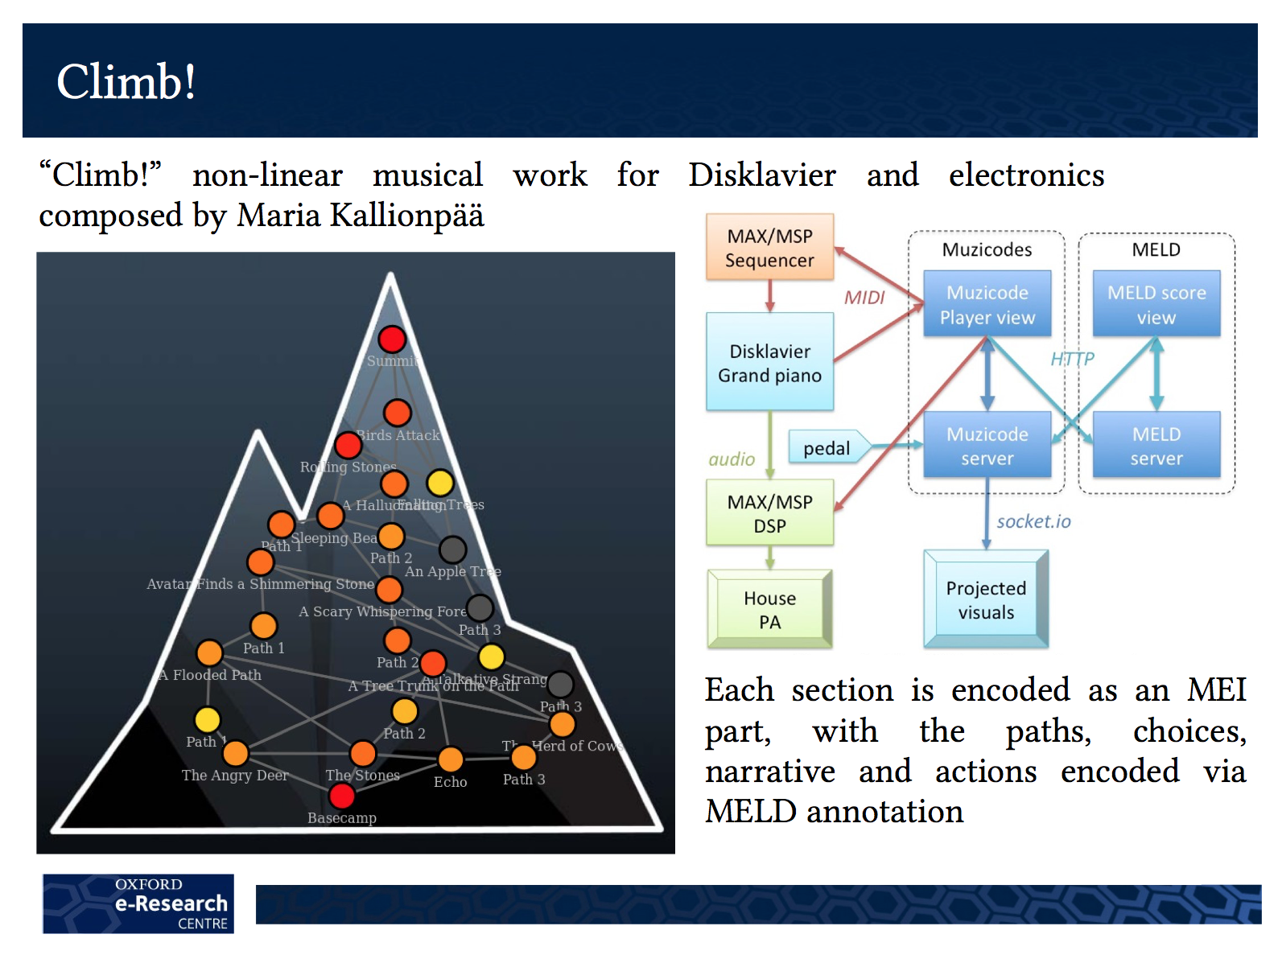
(Kevin Page)
Notes:
The first of our MELD example applications is “Climb!”.
---
“Climb!” is a non-linear musical work for Disklavier and electronics, composed by Maria Kallionpää.
---
The overall piece represents a passage up a mountain, with various obstacles to be traversed. Each performance may follow a different route, so, typically, no two performances follow the same static score.
---
Each passage in the music is encoded as an MEI file, with choices for the next passage to play determined by events triggered by the musician's actual performance. The score presented to the performer is updated in real time, reflecting the actual path up the mountain.
///

Slide 37
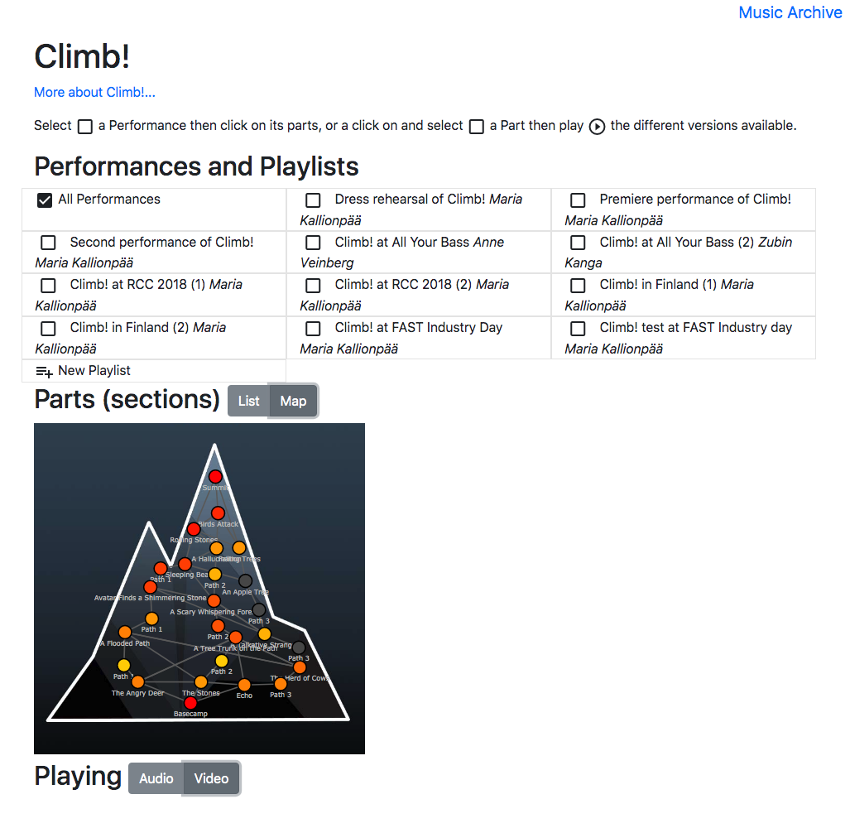
Climb! archive
http://music-mrl.nott.ac.uk/1/archive/explore/Climb
Notes:
Our second example of MELD, an application related to Climb!, is the “Climb!” archive.
---
With no two Climb! performances being the same, retrospective study by musicologists or reviewers becomes more challenging.
---
Using MELD to connect archive user interface events to audio playback and score display allows navigation and comparison of different performances that follow different paths, but still contain some passages in common.
///

Slide 38
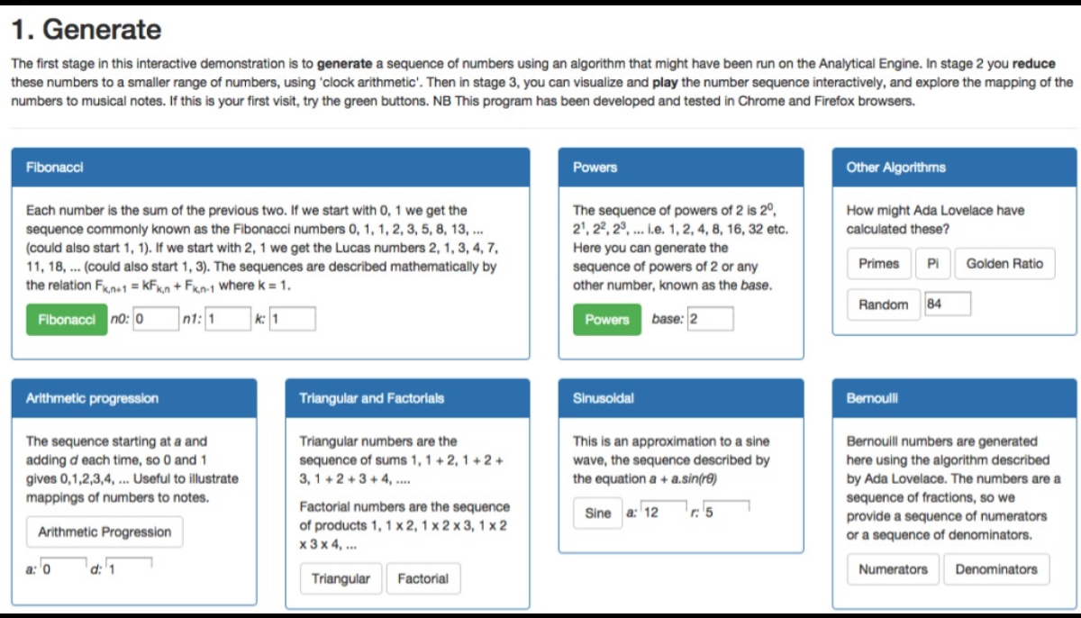
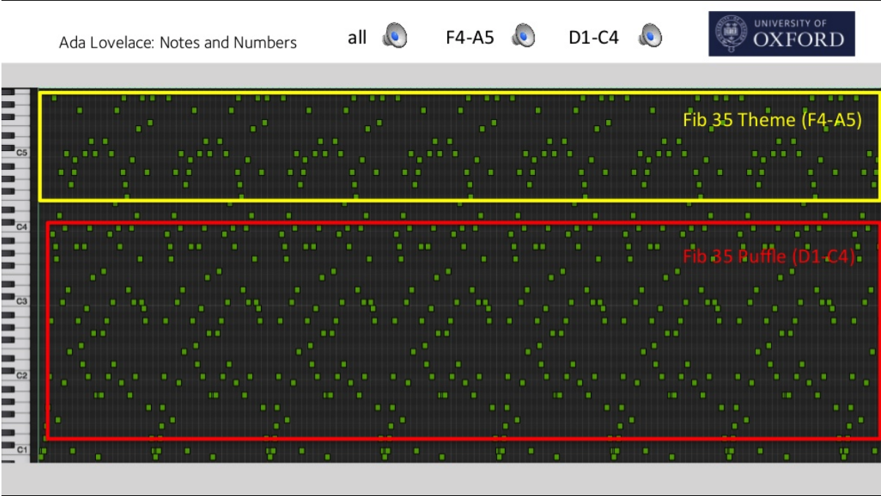
SOFA Remixer
Numbers into Notes
https://www.slideshare.net/dder/ada-lovelace-numbers-and-notes
Notes:
Anf finally, a very different use of MELD is in a guided music composition application, the SOFA remixer:
---
The SOFA remixer builds upon “Numbers into Notes”, an application written by Prof. David De Roure, which was inspired by this speculation nearly 200 years ago by Ada Lovelace:
---
“Supposing, for instance, that the fundamental relations of pitched sounds in the science of harmony and of musical composition were susceptible of such expression and adaptations, the engine might compose elaborate and scientific pieces of music of any degree of complexity or extent.”
---
The “engine” here is a reference to Babbage’s Analytical Engine.
---
The [Numbers into Notes](https://www.eng.ox.ac.uk/people/david-de-roure/ @@down?) application uses a combination of numerical manipulation and user selected parameters to generate fragments of music algorithmically.
///

Slide 39
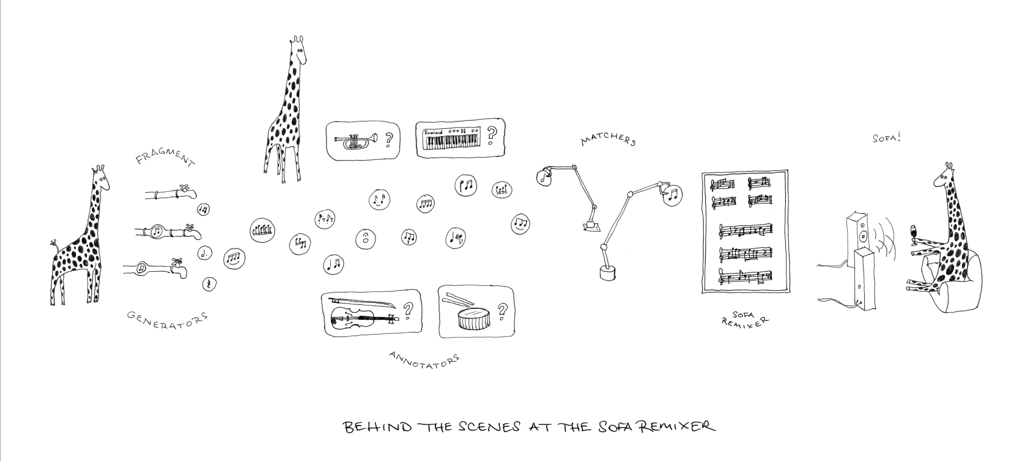
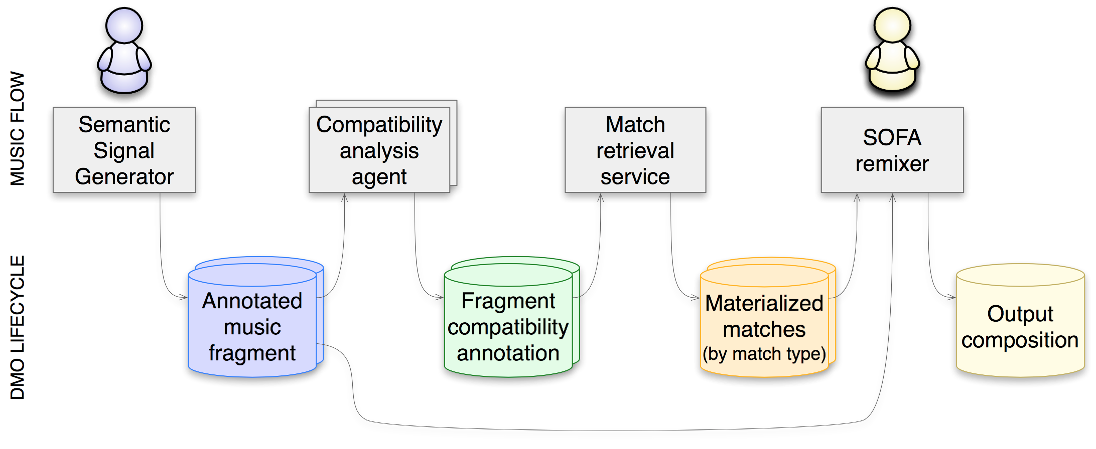
SOFA Remixer
(SOFA Ontological Fragment Assembler)
Notes:
The SOFA Ontological Fragment Assembler (SOFA), reads a collection of generated fragments (such as those generated by Numbers into Notes) and provides an interactive interface for assembling these into a multi-part musical composition that meets certain constraints, such as musical key compatibility. Satisfaction of these constraints is determined using MELD annotations created by agents that analyse the music fragments.
---
Each fragment includes a playable audio sequence, and also an MEI description that can be used to render score elements for that fragment.
---
The elements of MELD allow the analysis agents to be independent and separate from the remixer application. Thus, new forms of fragment matching analysis can be added by writing a new agent, without having to change the rest of the system.
---
The MELD linked data model is used to provide the structure that the remixer needs to locate and incorporate the various available analyses.
///

Slide 40
SOFA Remixer: sample interface

Slide 41
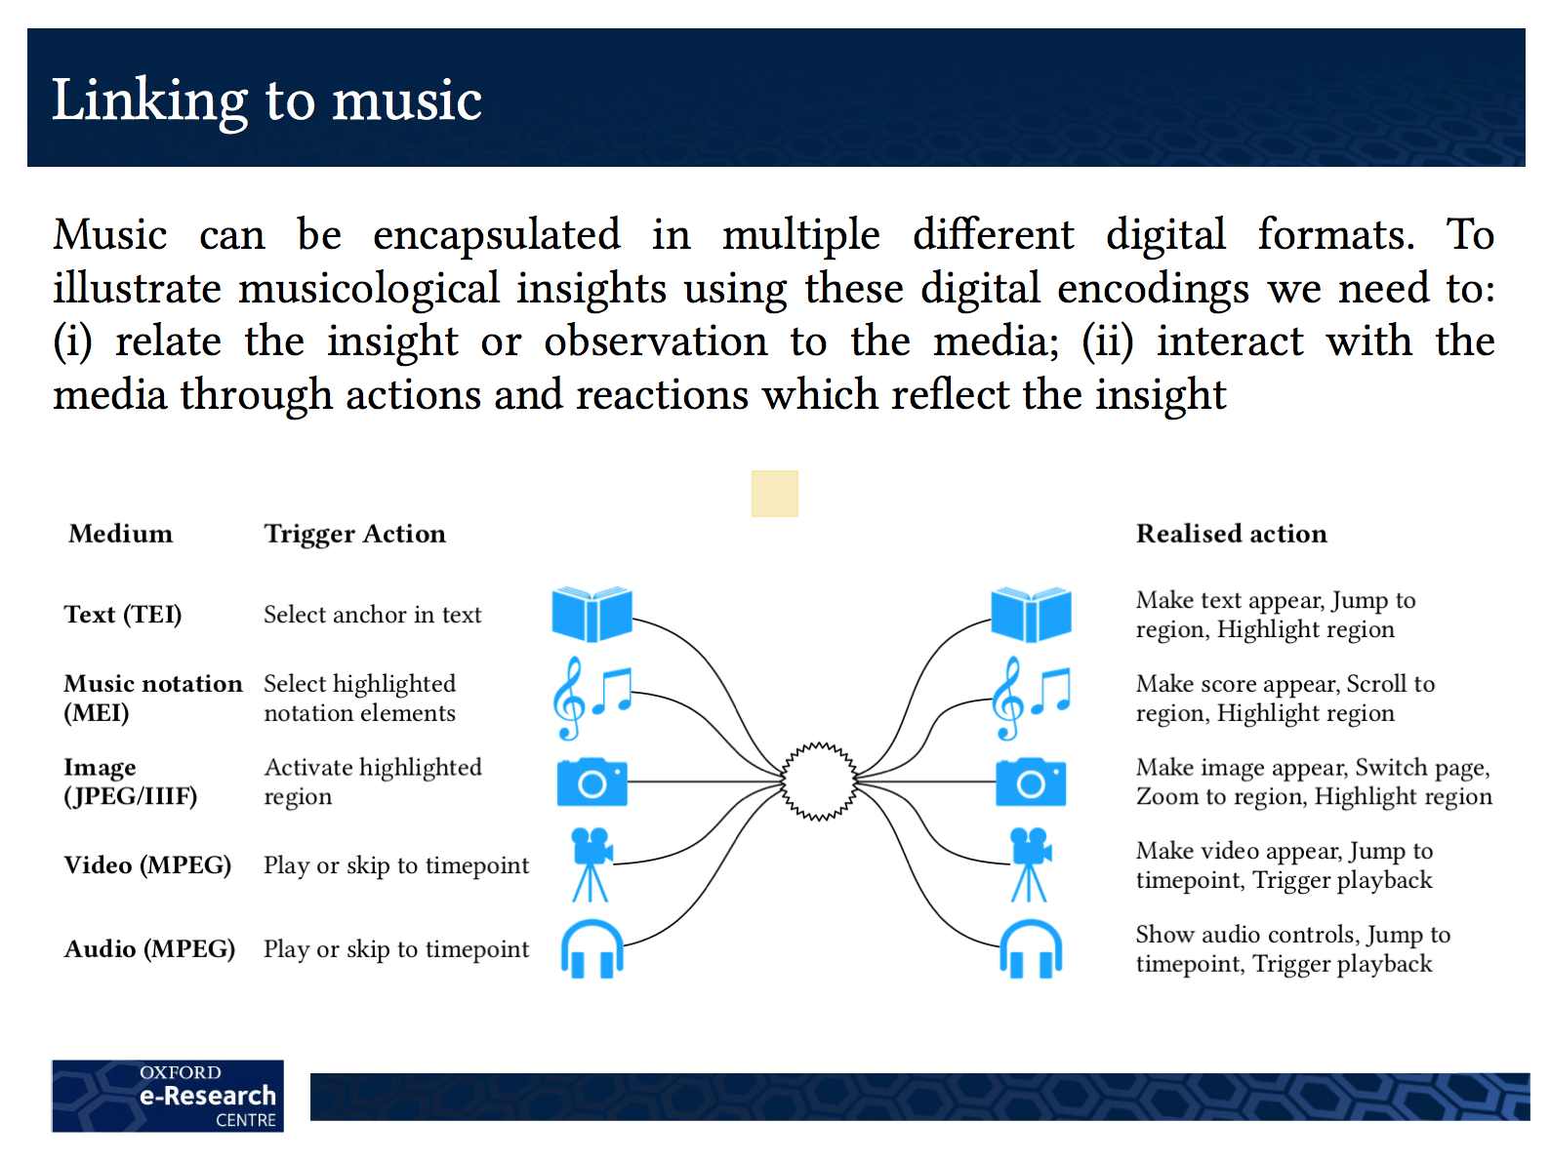
(Kevin Page)
Notes:
The common theme across these MELD applications is the use of linked data to capture musical insights through connecting musical elements and media, and to use these connections to enable a diverse set of interactions with the musical content.
---
In the case of Climb!, it is actions by the musician and detection of patterns in the music as it is played, that trigger updates to the musician's displayed score and also to audience displays about the progress of the performance.
---
In the case of the Climb! archive, it is user interactions with the archive web interface that trigger playback of audio from a past concert, alongside a presentation of the score and other displays as they appeared during the live performance.
---
In the case of the SOFA remixer, it is user interactions with the remixer interface that trigger updated display, playback of composed audio, and eventually the creation of a new musical work.
///

Slide 42
Notes:
The role of MELD in these applications is to provide a framework that connects corresponding elements across diverse media.
---
It does this using linked data to make the connections, along with data that represents musically meaningful structure in a computationally accessible fashion that raw audio or score images can not. Typically, this is provided by MEI, but it could be any data format that represents musically meaningful elements, and allows instances of these elements to be individually identified by a URI.
---
In the case of MEI, addressing of musical elements is handled by using @xml:id attributes in the XML data, which can be referenced by the MELD linked data using URIs with fragment identifiers. (For the purposes of linked data, a URI can include a fragment identifier, even though when accessing the resource over the web, the fragment identifier is not usually sent to the origin server.)
---
The “Verovio” engraving software can be used to render a musical score image from MEI data. In so doing, element identifiers in the MEI are persisted to the resulting SVG image elements, allowing user interactions with the image to be connected back to the musical elements in the MEI.
///

Slide 43


MELD:
Building on existing standards
RDF linked data
Web Annotations
Linked Data Platform (LDP)
  SoLiD
Music Encoding Initiative (XML)
Notes:
MELD itself defines very little that is new. Rather, it brings together a number of established web standards and uses them in innovative ways. As such, it can benefit from re-use of existing software platforms and libraries.
---
One element of MELD not mentioned previously is the Linked Data Platform, or LDP. LDP is a simple HTTP-based protocol that allows both reading and writing of arbitrary resources, allowing parts of the web to be used like a simple file system.
---
We have recently started using a Solid data pod server as our implementation of LDP. This is a product of Tim Berners-Lee's Solid project at MIT to “re-decentralize the web”. As well as supporting the LDP interactions, it also provides a framework for user authentication and access control to data. The idea of decentralized operation enabled by separation of data storage and web application logic is quite important to some of our ideas for web applications based on MELD.
---
An important idea here is that linked data is being used, not as a stand-alone technology, but as an integral member of the technology family that makes up the World Wide Web. The strength of linked data here is its ability to connect arbitrary resources on the web (including things like people and musical works that are not themselves web documents), and as an open-ended framework which can accommodate new and unanticipated information about the related entities.
---
This approach uses linked data as something that is truly of the web, rather than just another graph database that is accessed over the web.
///

Slide 44
Questions / discussion
(Reminders)
  Linked data connecting other formats (esp. XML)
  MELD
    LDP + Web Annotations + musical structure...
  SoLiD (re-decentralizing the web)
    Separation of data custody from web applications
  EM Places
    Time-constrained attributes and relations
    Extending basic data model to capture context and provenance
Notes:
This concludes my main presentation.
---
I've hopefully left plenty of time for questions and discussion, which may be directly about the applications discussed, or more broadly about linked data applications, particularly when dealing with data that are uncertain, or call for some degree of interpretation.
---
The topics shown here are intended as reminders, or prompts for possible avenues of discussion... but don't feel constrained in the questions you might ask!
///

