Slide 1
Parametric 3D CAD with OpenSCAD
or... Drawing 3D objects with code
Graham Klyne, @gklyne

Slide 2
Install and start OpenSCAD
Web site:
  http://www.openscad.org/
Code and downloads
  https://github.com/openscad/openscad
Manual:
  http://en/wikibooks.org/wiki/OpenSCAD_User_Manual

Slide 3
Key features
Parametric
  Users of objects define dimensions and features
  A single design can be realized for different uses
  Designs can be adjusted to use available materials
Coding not drawing
  Algorithmic specification of complex shapes
    e.g. teeth on a gear
  Errors can be corrected by changing the code
  Build new designs on shared materials
  Not necessarily for everyone

Slide 4
Viewport survival guide
Quick display update: F5
Full recompute and display update: F6
View > Show axes: COMMAND/2
Pan view:
  Right-drag
Zoom view:
  Scroll-wheel, or “+”, “-”
Change text size:
  COMMAND/“+”, COMMAND/“-”

Slide 5
Primitive solid shapes
Cube / cuboid
Cylinder/cone
Sphere
Also, general polyhedron and extruded -D shapes are possible, but I won't go into that.

Slide 6
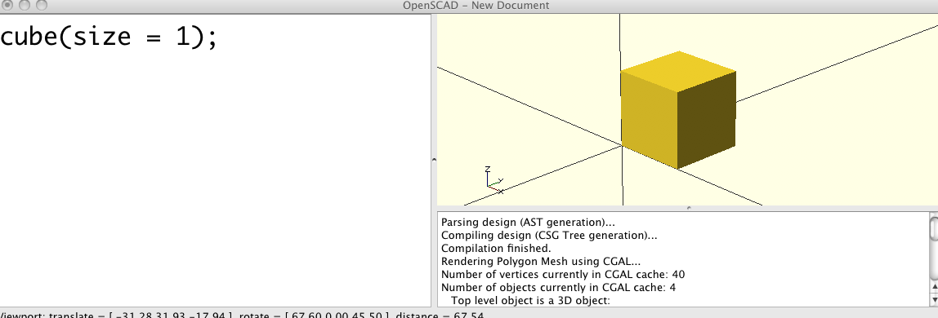
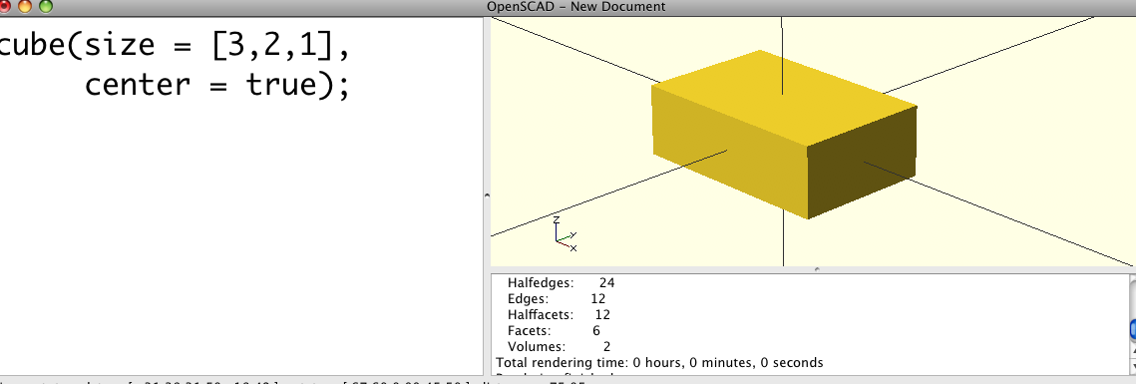
Cube / cuboid

Slide 7
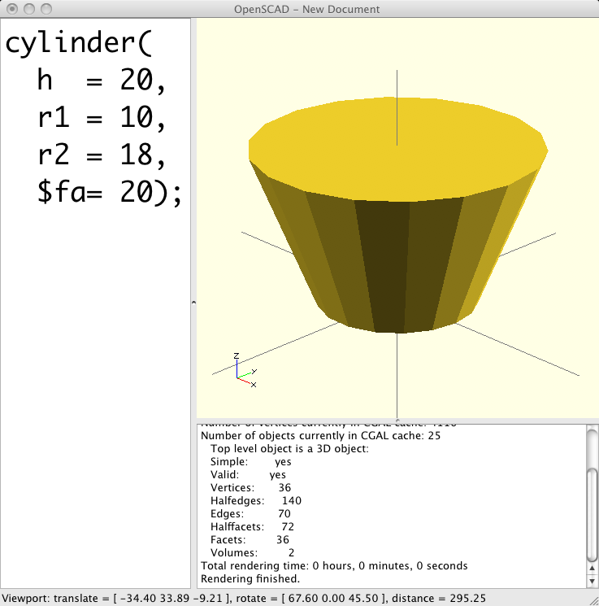
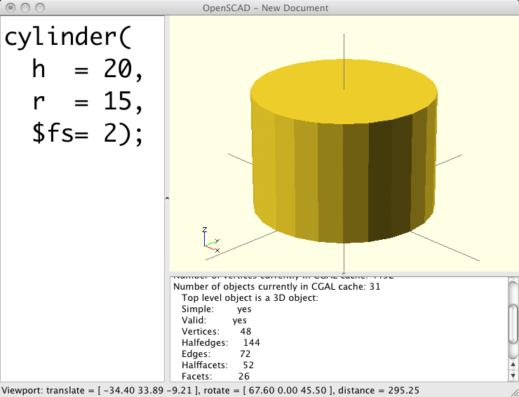
Cylinder and cone

Slide 8
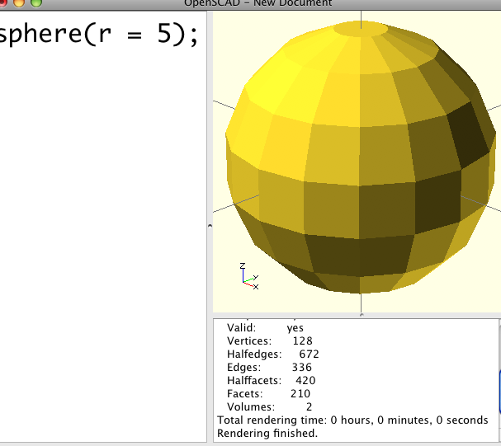
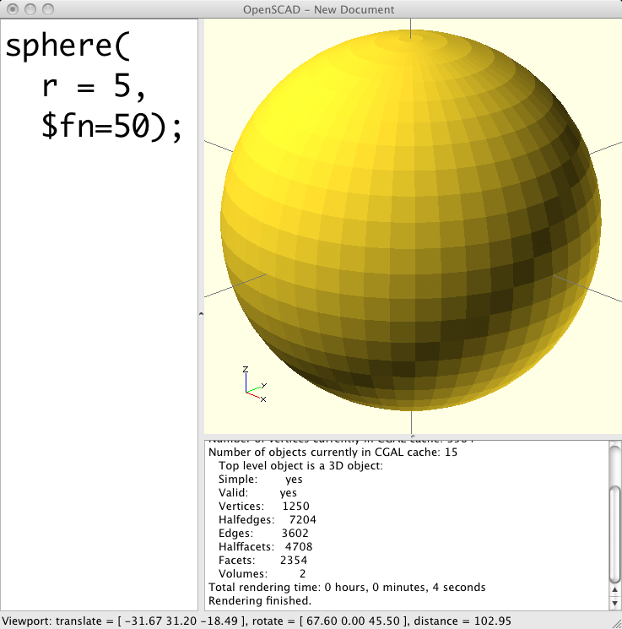
Sphere

Slide 9
Transformations
Translate (move)
Rotate

Slide 10
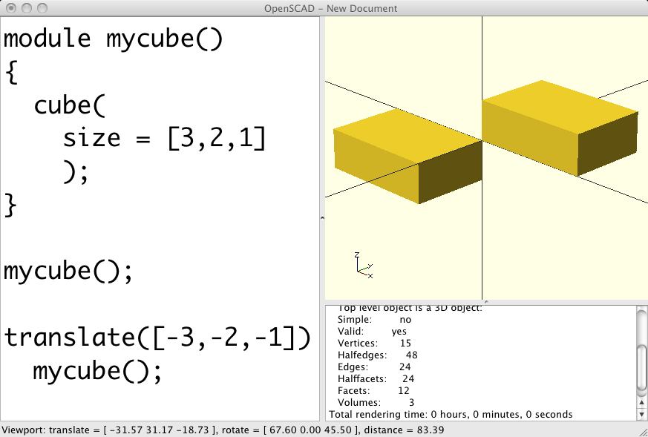
Translate

Slide 11
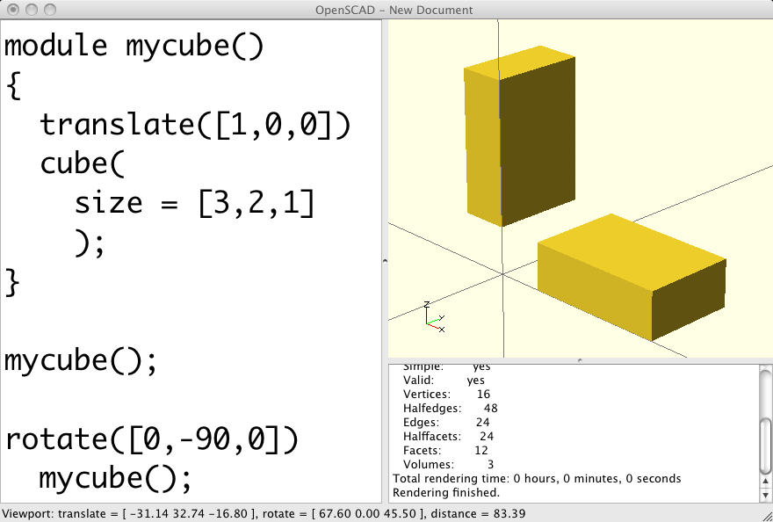
Rotate

Slide 12
Constructive Solid Geometry (CSG)
Like 3D Venn Diagrams
Boolean combinations of 3D objects
Union
Intersection
Difference

Slide 13
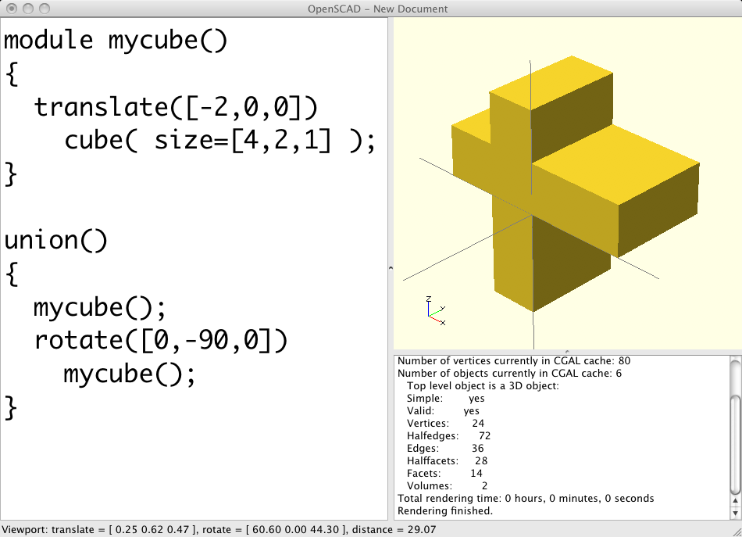
Union

Slide 14
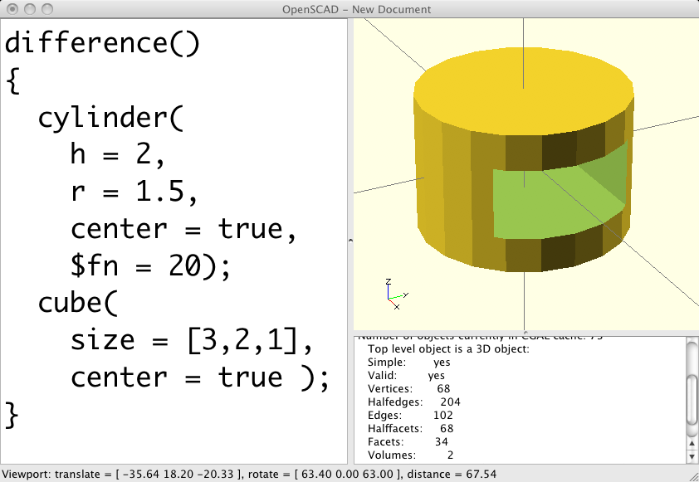
Difference

Slide 15
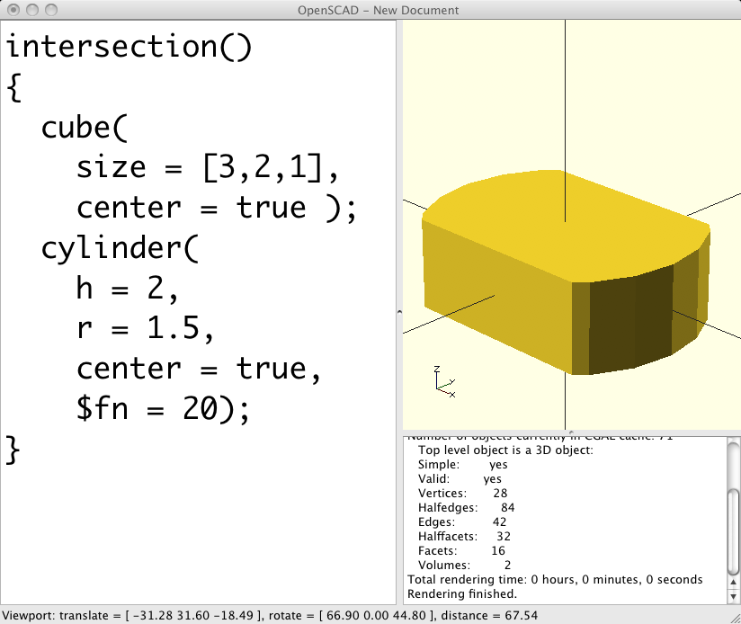
Intersection

Slide 16
The gotcha: non-manifold shapes
Avoid Boolean combinations with co-incident surfaces
These result in zero-thickness boundaries between objects, which computers cannot reliably represent
UNION/DIFFERENCE objects should overlap
See also: http://reprap.org/wiki/AoI

Slide 17
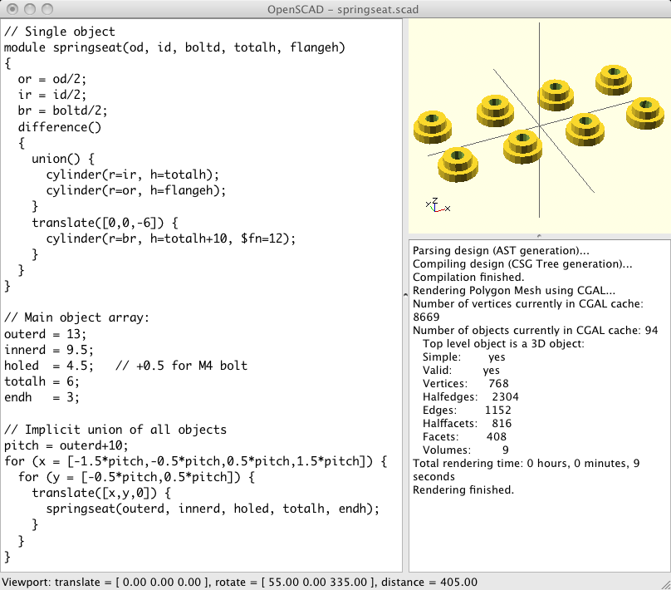
A very simple design
http://pif3d.googlecode.com/hg/Objects/SpringSeat/springseat.scad

Slide 18
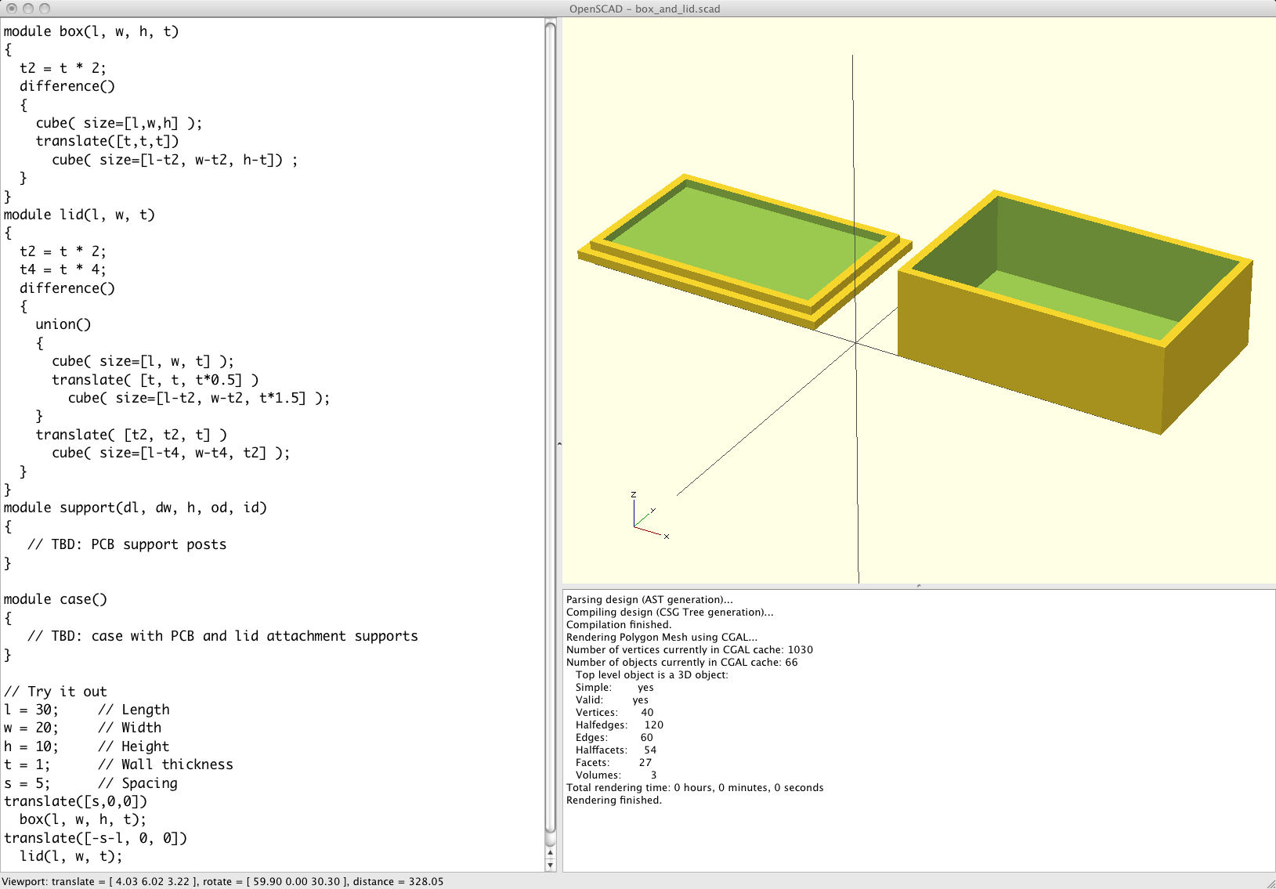
Making it real...

Slide 19
Sources
Slides:
http://pif3d.googlecode.com/hg/Presentations/20111025-OpenSCAD.odp
http://pif3d.googlecode.com/hg/Presentations/20111025-OpenSCAD.pdf
Spring seat design:
http://pif3d.googlecode.com/hg/Objects/SpringSeat/springseat.scad
Electronics case design:
http://pif3d.googlecode.com/hg/Objects/ElectronicsCase/box_and_lid.scad

