Slide 1
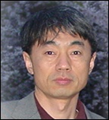
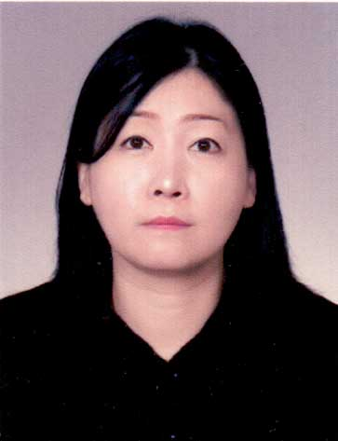
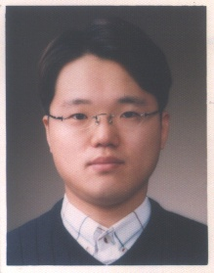
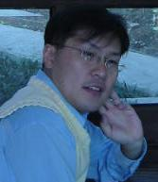
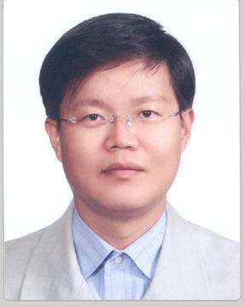
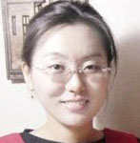
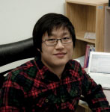
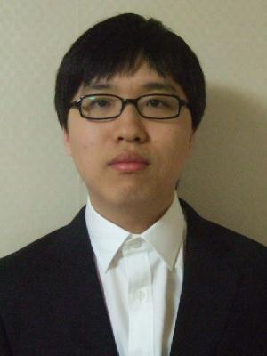
SA Lab
Software Architecture Lab
소프트웨어 구조 연구실
Prof. Sungwon Kang
Jung-Ho Kim
Chang-Sup Keum
Shin-Young Ahn
Jingyu Kim
Dr. Hye-Kyeong Ko
Jihyun Lee
Sungjoo Kang
Hwi Ahn

Slide 2

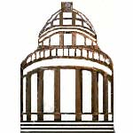
What is software architecture?
Building Architecture
- Support the whole building to stand
- Abstract entity that exists without building construction
material such as metal, mud or bricks
- Difficult and dangerous to change architecture

Slide 3
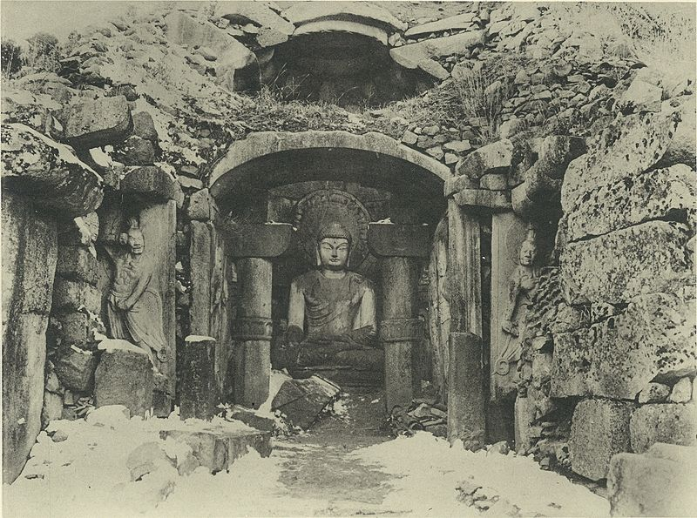
Example of a Good Architecture
Arches
appeared as early as the 2nd Millennium BC in Mesopotamian brick architecture .
Sukgoolam (석굴암): Built in AD 751.

Slide 4
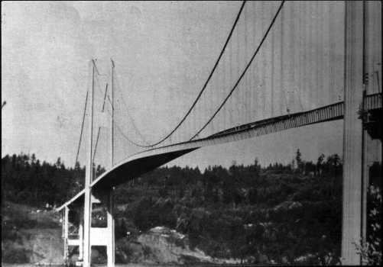
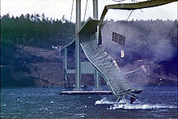
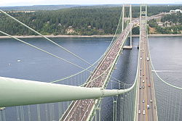
Example of a Bad Architecture
Tacoma Narrows Bridge
Opened: July 1, 1940
Collapsed: Nov. 7, 1940
The old Tacoma Narrows Bridge twisted and vibrated violently under 64 km/h winds on the day of the collapse.
http://en.wikipedia.org/wiki/Wikipedia:Featured_picture_candidates/Tacoma_Narrows_Bridge_Collapse
Notes:
A cautionary tale for engineering, architecture, and physics students.
The bridge's collapse had a lasting effect on science and engineering. In many physics textbooks the event is presented as an example of elementary forced resonance with the wind providing an external periodic frequency that matched the natural structural frequency, even though its real cause of failure was aeroelastic flutter.[1] Its failure also boosted research in the field of bridge aerodynamics-aeroelastics, the study of which has influenced the designs of all the world's great long-span bridges built since 1940.

Slide 5

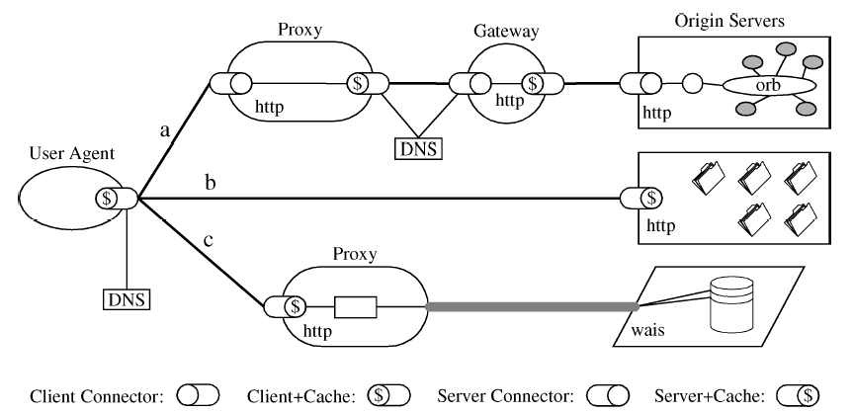
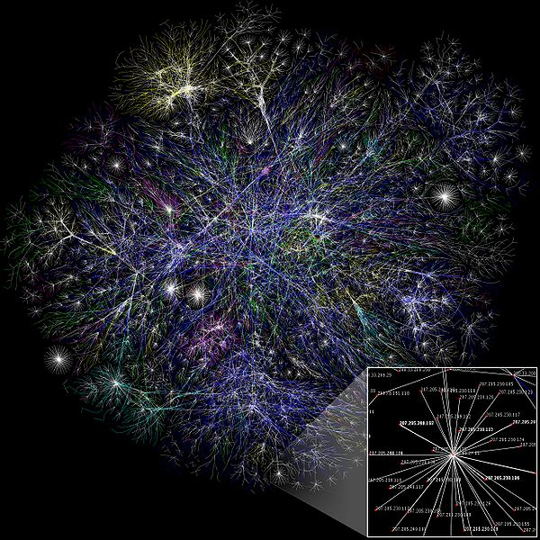
What is software architecture?
Software Architecture
- Shows the overall relation between components of a software system
Determines performance and quality of the system
Helps us understand the whole system “before” it comes into existence
Architecture needs multiple viewpoints
WWW Architecture
Internet Architecture

Slide 6
- Model Driven Development
- Dynamic Architecture
Design and Analysis Tools
Testing Tools
. . .
Automation & Intelligence
Architecture Research
Areas
…
Architecture-based
Evolution
Architecture-based Adaptation
Architecture for Product Line
Architectural Analysis
Software Productivity
…
Software Architecture
…
Software Quality
Component-Based Development
Architecture-based Testing
Evolvability
Reliability
Extendibility
Usability
…
Orthogonal Variability
Description Language
PL Architecture Design
Commonality Analysis
…
Architecture
Design
Architecture Description
Language
…
Foundation

Slide 7
Research Directions of SA Lab
“As developing a family of multiple products has become an essential
competence in software development, our research is also
targeting the same foundational issues in the software product line context.”
Protocol
Conformance Testing
Protocol
Interoperability
Testing
Software/Service
Interoperability
Testing
Interoperable
Specification
Interoperability
Engineering
: Research
evolution
: Planned
research area
Software Development
Software and Systems Product Line
Architecture-Based
Engineering
Value-Oriented
Engineering
Software
Architecture
Enterprise
Architecture
Value-Oriented
Maturity
Model
Value-Oriented
Enterprise Architecture
Engineering

Slide 8
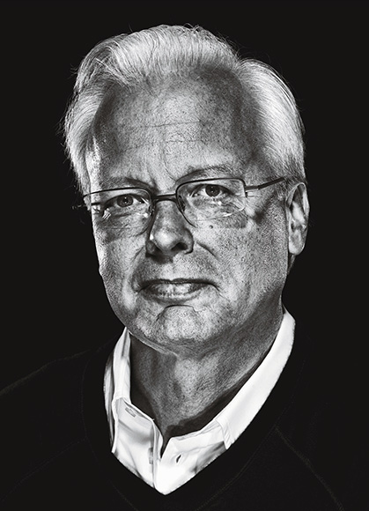
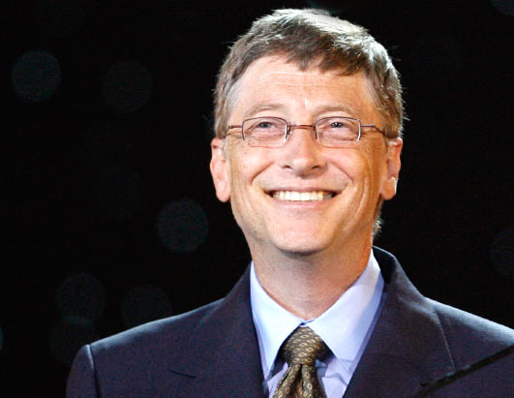
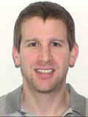
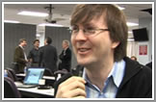
World Famous Software Architects
Bill Gates
Microsoft Former
Chief Software Architect
Ray Ozzie
Microsoft New
Chief Software Architect
Kevin Lynch
Adobe senior vice president and Chief Software Architect
Craig Weissman Salesforce.com
Chief Software Architect
SA Lab trains students to be software architects !

Slide 9

Projects and Publication
On-going and Up-coming Projects
“Multiple View Driven Common Domain Architecture Design for Integrated Services Platform”
“Model Driven Development of Samsung Home Appliance Software”
“Redesigning Mobile Harbor Control System”
Selected Publications
“Transformation Rules for Synthesis of UML Activity Diagram from Scenario-based Specification,” The 34th Int’l Computer Software and Applications Conf. (COMPAC’10), Seoul, Korea, July 19–23, 2010.
“KAIST-CMU MSE Program – the Past and the Future,” The 23rd IEEE-CS Conference on Software Engineering Education and Training (CSEET'2010), Pittsburgh, United States, March 9-12, 2010.
“A Comparison of Software Product Line Scoping Approaches,” IJSEKE, (To be published)
“vPMM: A Value Based Process Maturity Model,” Studies in Computational Intelligence, Vol 208/2009, Springer-Verlag Berlin Heidelberg 2009.
“Software Architecture Evaluation Methods Based on Cost benefit Analysis and Quantitative Decision Making,” Empirical Software Engineering, Vol. 14, No. 2, April 2009.
“A Framework for Tool-based Software Architecture Reconstruction,” International Journal of Software Engineering and Knowledge Engineering, Vol. 19 Issue: 2, March 2009.

Slide 10
SA Lab Activities
Lab seminar
Seminar subject: “Software Architecture at work”
Research
Information System Architecture Design Method, PL Architecture Evaluation, Testing for SOA, Architecture Recovery, Code Navigation Technique, Architecture Design for Multiple Views, SaaS Application Customization, Value-based Enterprise Architecture Engineering, etc.
Project
Model Driven Development for Commercial Dishwasher Software
Architecture Design Recovery
PL Architecture Evaluation
Lab Reunion
1st Reunion: Nov 2009
Graduates present industry experience and needs
Students present research results

Slide 11
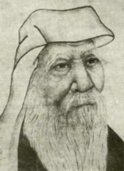

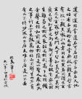
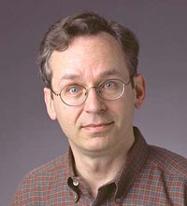
The Tao(道) of the Software Architect
The following is a liberal reading by Philippe Kruchten,
the former chief architect of IBM Rational, of Lao-Tsu (老子)’s Tao Te Ching for the use of software architects, based on various French and English translations. Lao-Tsu’s original sayings are on the right column in Korean.
Philippe Kruchten
Notes:
SA lab 에서는 멤버들을 software architecture 가 되기 위하여 필요한
이론과 practice 를 연구
Practice 는 발표, 세미나

Slide 12
The Tao of the Software Architect
...
When the architect leads, the team
is hardly aware that he exists.
Next best is one that is loved.
Next, one who is feared.
The worst one who is despised.
The architect doesn't talk, he acts.
When this is done,
the team says, "Amazing:
we did it, all by ourselves!"
17. 가장 훌륭한 왕은
백성들이 그가 있다는 것만을 알며,
그 다음은 좋아하는 왕이며,
그 다음은 두려워하는 왕이며,
가장 나쁜 것이 멸시 받는 왕이다.
훌륭한 왕은 말을 아껴
공(功)을 이루고,
일이 성취되어도
백성이 말하기를
저절로 그리 되었다고 한다.

Slide 13
The Tao of the Software Architect
...
If you want to be a great architect,
stop trying to control.
Let go of fixed plans and concepts and
the team will govern itself.
The more prohibitions you have,
the less disciplined the team will be.
The more coercion you exert,
the less secure the team will be.
The more external help you call,
the less self-reliant the team will be.
57. 훌륭한 왕은 나서지 않는다.
왜냐하면 규제가 많을수록
백성들은 가난해지고,
탄압이 많을 수록
세상은 혼란에 빠지고,
기교가 많을 수록
교묘한 방법이 생기고,
법령이 많을 수록
법을 어기는 자가 많아지기 때문이다.
그러므로 현(賢)자는 말하기를,
내가 나서지 않으면
백성은 서로 도우며,
내가 사심을 버리면
백성은 올바르게 되고,
내가 이익을 도모하지 않으면
백성은 부유해지고,
내가 욕심이 없으면
백성은 순수해진다고 하였다.

Slide 14
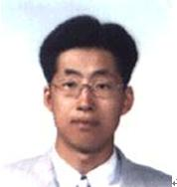
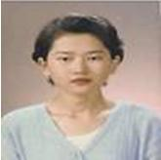
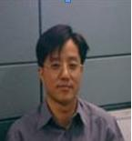
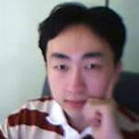
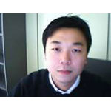
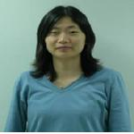
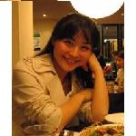
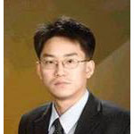
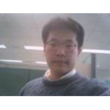
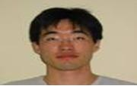
Alumni (1/2)
In-Hong Kim (2005: Samsung SDS)
Hee-Young Choi (2005: KT)
Jung-Jin Seo (2004: Korea Credit Bureau)
Dae-Sung Park(2005: NHN)
Youn-Seok Choi(2005: Hyundai Motors)
Mi-Yul Park(2006: LG Electronics)
Seon-Ah Lee(2004: Ph.D at UBC)
Jong-Gul Park(2006: VI Soft)
Chang-Sung Song(2006: Samsung Electronics)
Hyung-Il Park (2005 : Deloit Consulting)

Slide 15
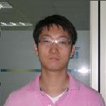
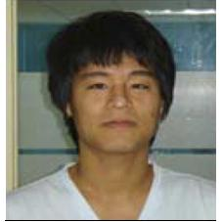
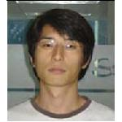
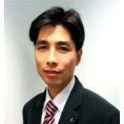
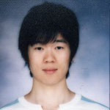
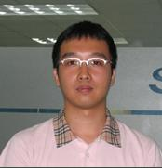
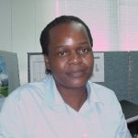
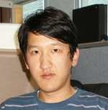
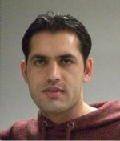
Alumni (2/2)
Taek-Goo Kim(2009: Samsung AIT)
Hyun-Woong Park (2008 : POSDATA)
Woo-Seok Choi (2008 : KT)
Jong-Su Bae (2007: LG CNS)
Eun-Chae Yoon (2007: Hyundai MOBIS)
Hyun-Ho Kim (2009 : LG Electronics)
Agnes O. Odongo (2008 : Kenya Electricity Generating company, Kenya)
Atabek Murtazaev
(2010: Samsung Electronics)
Akmal Yaghini
(2010: University of Kabul, Afghanistan)

