Slide 1

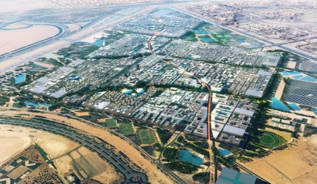






Masdar City, Abu Dhabi (2008-2015)
Clients: Masdar
Services:
Strategic Consulting
Valuation Advisory
Leasing
Project & Development Services
Investment Transactions
Project Description Occupying 6 million sq m of land, the project is a landmark development initiated by the Abu Dhabi Government. Envisaged to be the first carbon neutral city, the project will be cultivated as a global centre of excellence for research and education, as a commercial hub and most importantly, as a model for sustainable development for Abu Dhabi.
1

Slide 2
Chennai, India (2010-2016)
Clients: Rage
Services:
E-commerce applications
Website design and development
Online marketing
Site and server management
Search marketing
About Rage Rage is a digital marketing agency based in India. We help clients meet their business goals through a host of web-based services.
1

