Slide 1
CS329
Testing, Analysis, and Verification

Slide 2
Type Checking: Rules of Inference
Variable Declaration
Expression Statement (Assignment)
Infix Expressions
Integer Operators +, –, *
Boolean Operators &&, ||
Operator <
Operator ==
Prefix Expression Operator !
Return Statement
If Statement
While Statement
Method Invocation
Array Access

Slide 3
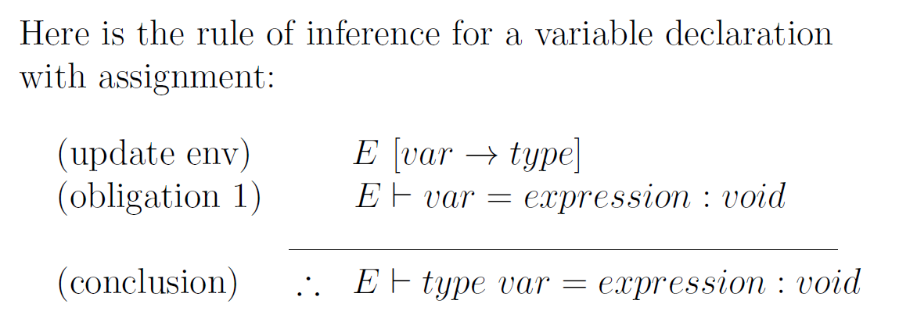
Rule: Variable Declaration

Slide 4
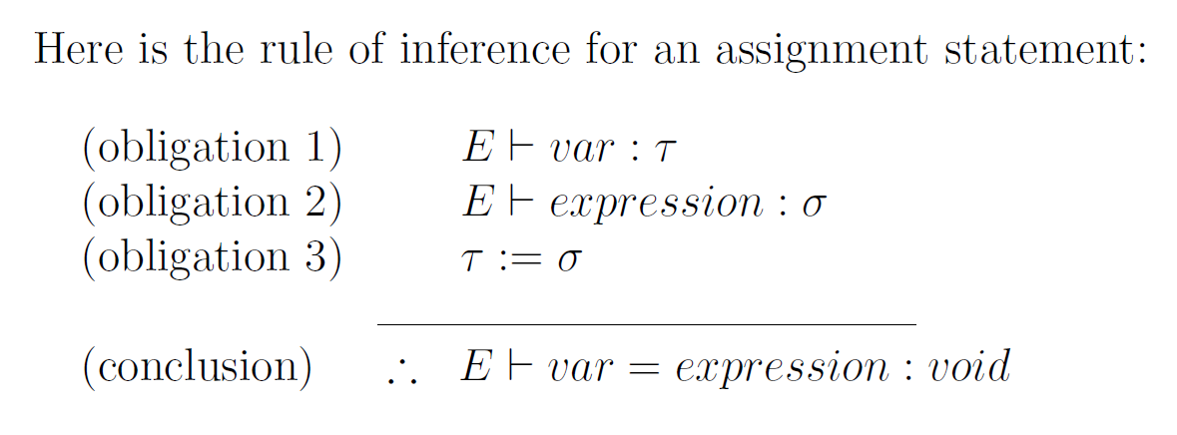
Rule: Expression Statement for Assignment

Slide 5
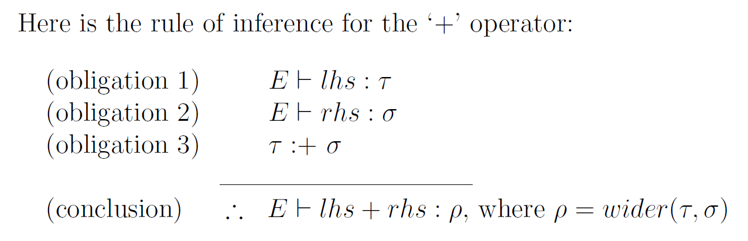
Rule: Infix Expression for + Operator

Slide 6
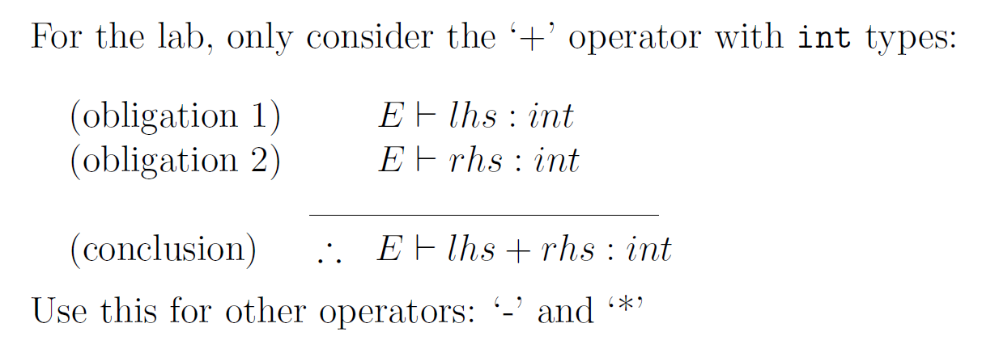
Lab: Infix Expression +, –, * Operators

Slide 7
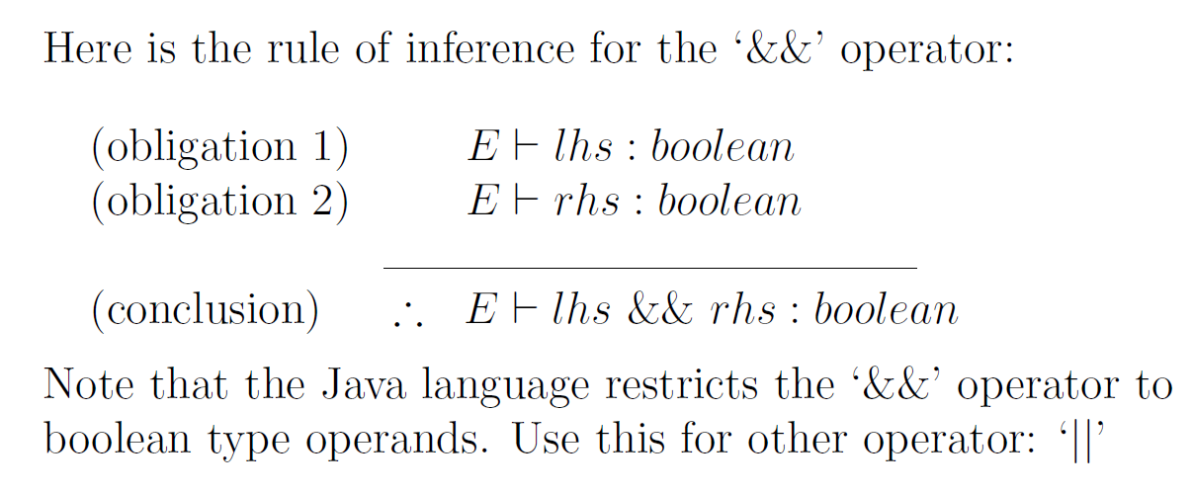
Rule: Infix Expression for &&, || Operators

Slide 8
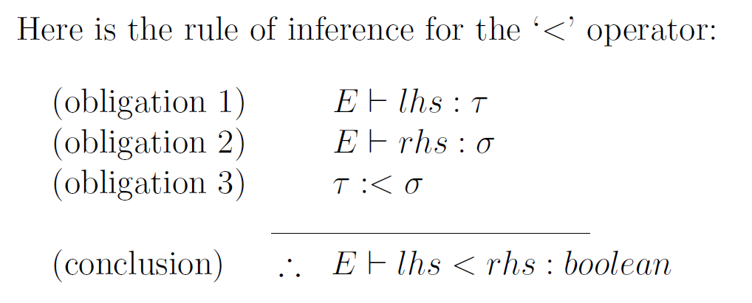
Rule: Infix Expression < Operator

Slide 9
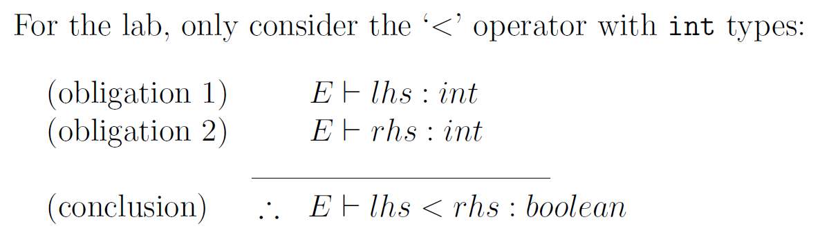
Lab: Infix Expression < Operator

Slide 10
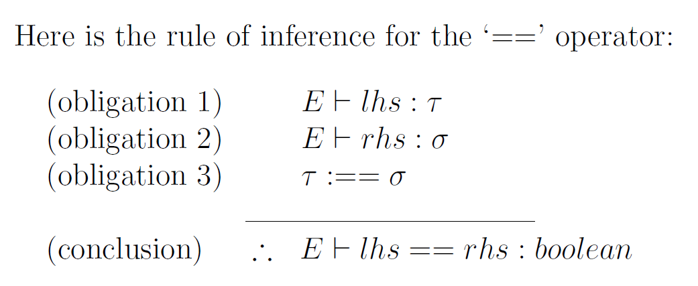
Rule: Infix Expression == operator

Slide 11
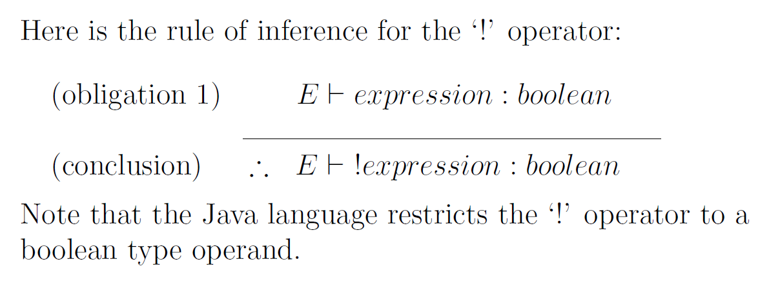
Rule: Prefix Expression ! Operator

Slide 12
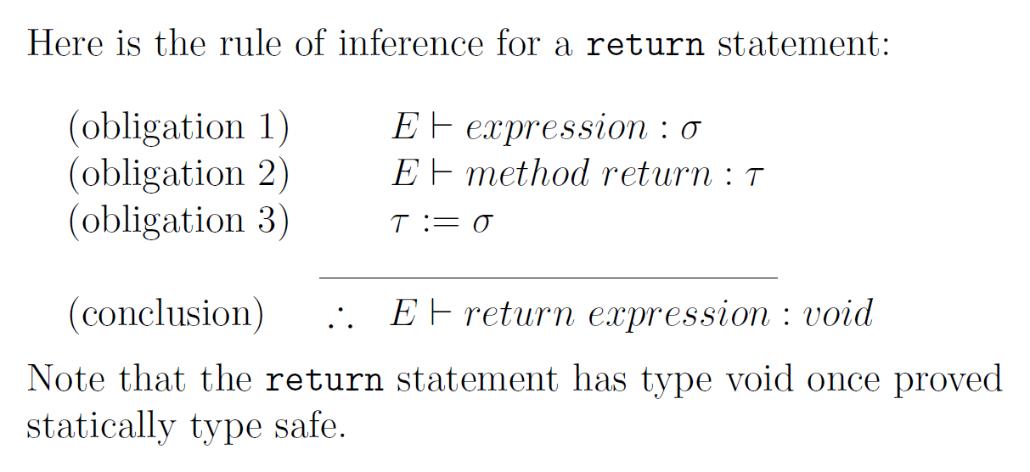
Rule: Return Statement

Slide 13
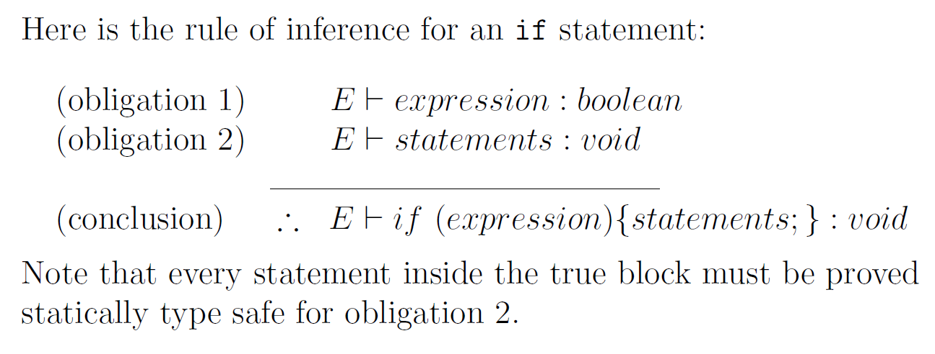
Rule: If Statement

Slide 14
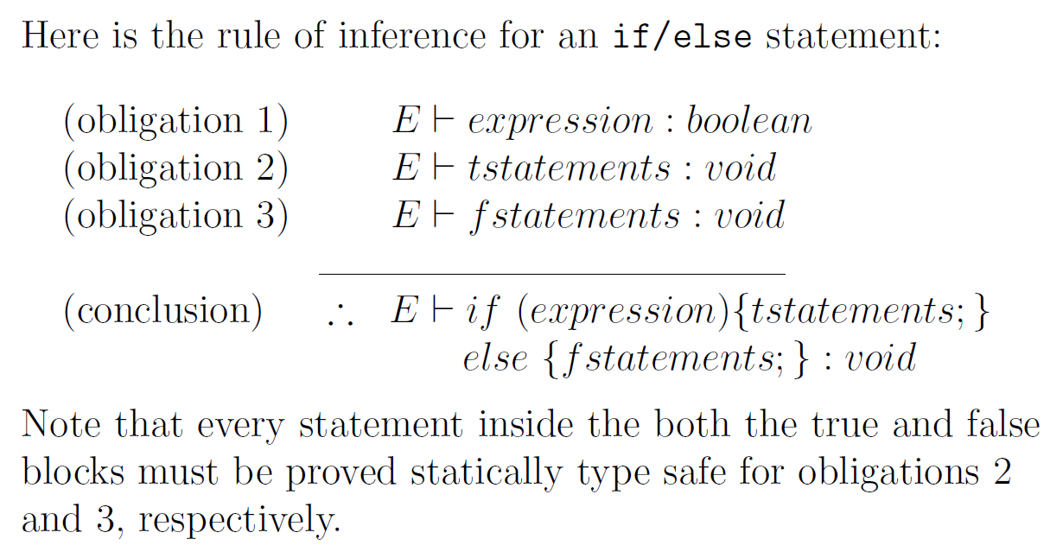
Rule: If/else Statement

Slide 15
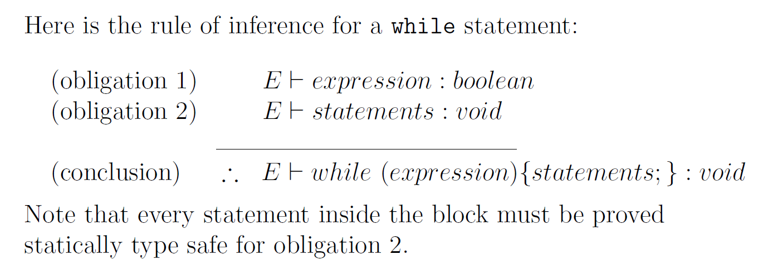
RULE: While Statement

Slide 16
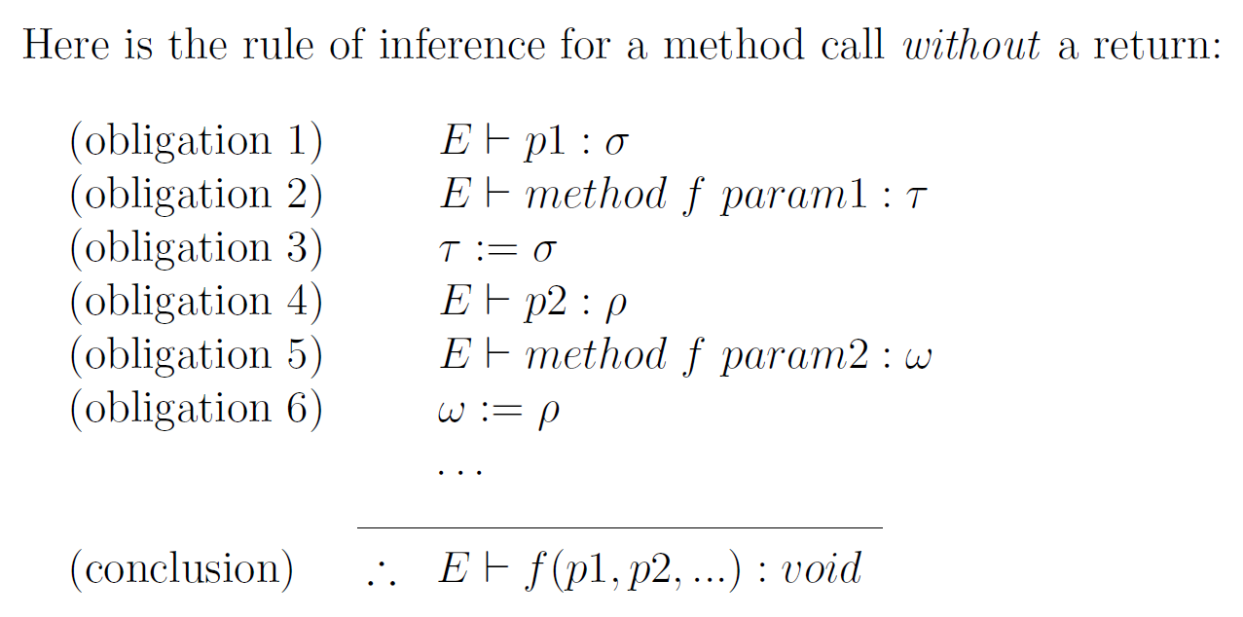
Rule: Method Invocation (no return)

Slide 17
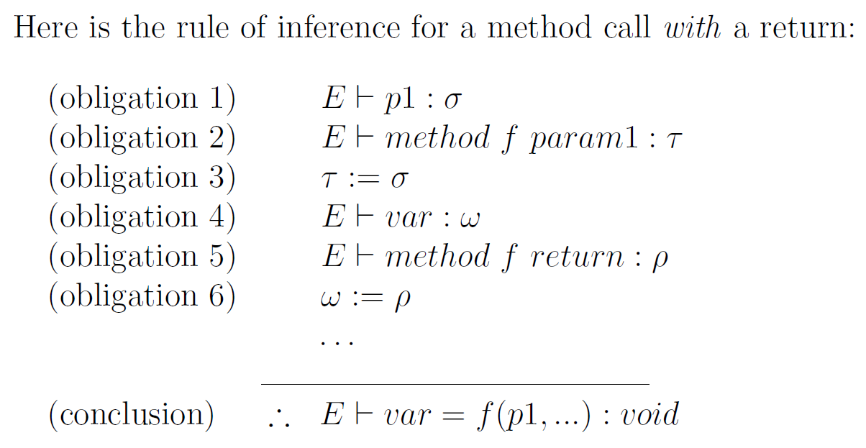
Rule: Method Invocation (with Return)

Slide 18
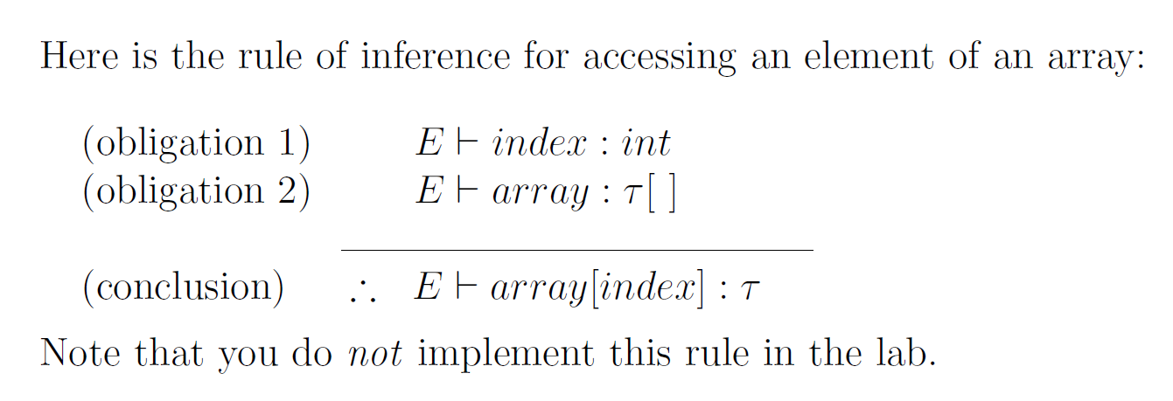
Rule: Array Access

