Slide 1

ApexPlanet Sales Performance
Final Presentation — Dashboard Walkthrough & Statistical Validation
Data Analytics Internship · Task 4

Slide 2
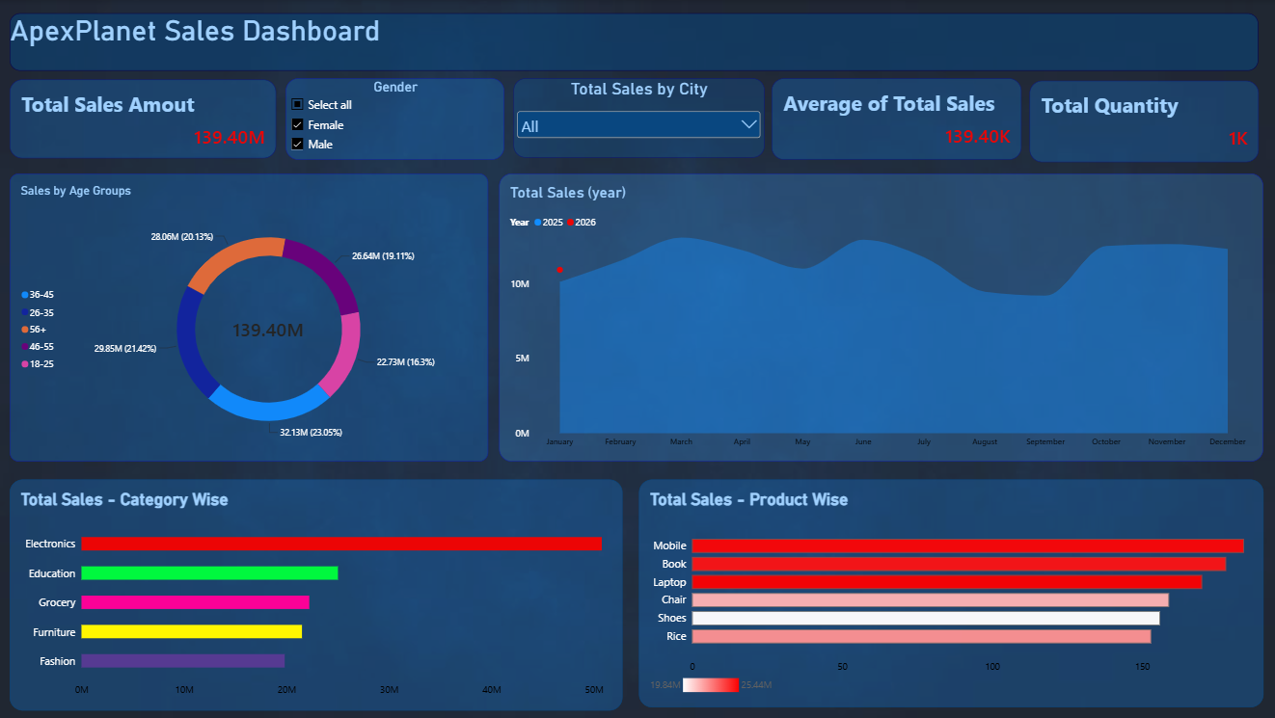

Slide 3
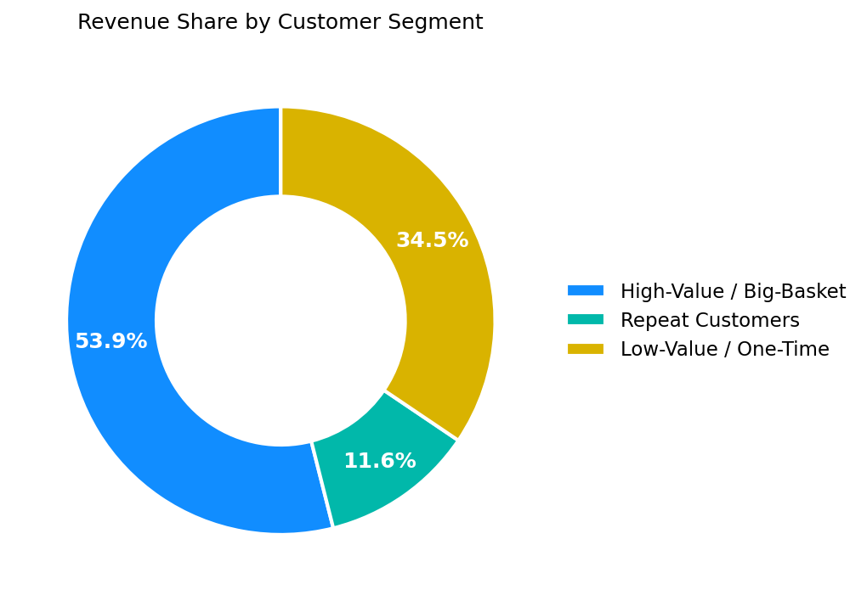
Beyond the Dashboard: Who the Customers Really Are
Segment | Customers | Revenue Share
High-Value / Big-Basket | 264 (27.9%) | 53.9%
Repeat Customers | 52 (5.5%) | 11.6%
Low-Value / One-Time | 631 (66.6%) | 34.5%
This customer-value split isn't visible anywhere in the Power BI dashboard
— it comes from clustering customers by spend, order frequency, and age. The headline: 28% of customers generate 54% of all revenue, despite ordering only once, on average.
ApexPlanet Sales Analysis | 3

Slide 4
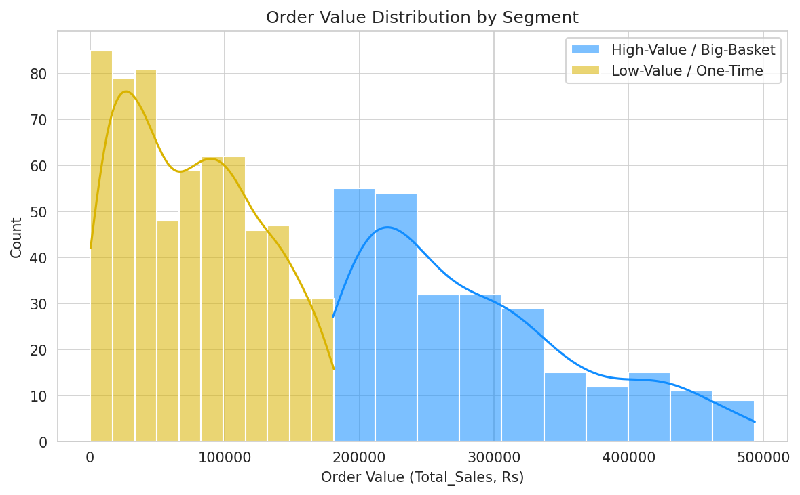
Is That Difference Real?
A striking split in a table isn't proof. Before recommending a retention strategy on it, we tested it.
H0 (null): No difference in mean order value between High-Value/Big-Basket and Low-Value/One-Time customers.
H1 (alternative): High-Value/Big-Basket customers have a significantly higher mean order value.
Test used: Welch's independent two-sample t-test (Levene's test confirmed unequal variances between the groups, p = 1.01×10⁻¹⁷)
ApexPlanet Sales Analysis | 4

Slide 5
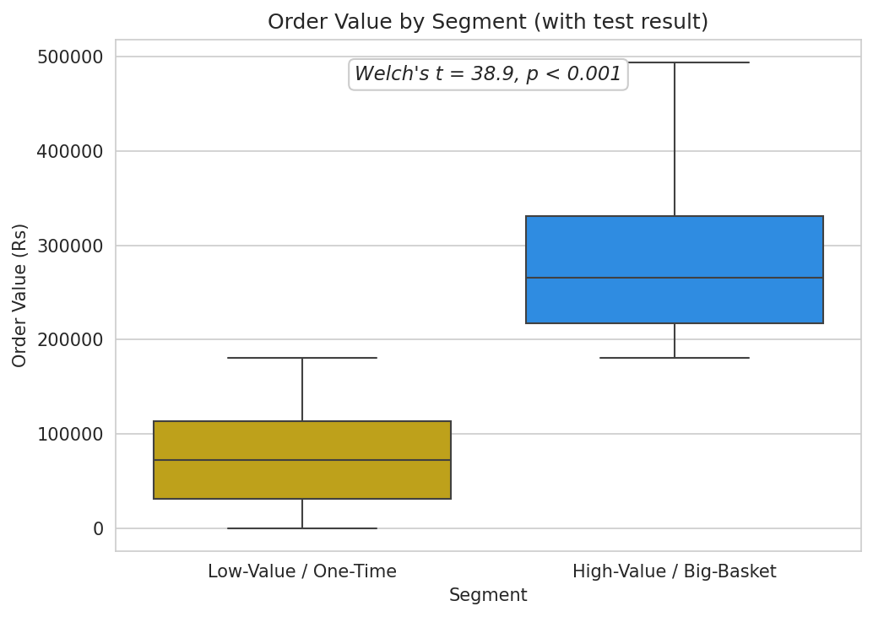
The Result: Statistically Confirmed
P-VALUE
MEAN DIFFERENCE
95% CI
EFFECT SIZE (COHEN'S D)
2.64 × 10⁻¹²⁹
₹2,08,715
₹1,98,171 – ₹2,19,260
3.43
Reject H0.
The gap between segments is far beyond chance — and a Cohen's d of 3.43 means the two groups barely overlap at all.
With a sample this large, even a trivial difference could look "significant" — the effect size is what confirms this is a real, large, actionable gap.
ApexPlanet Sales Analysis | 5

Slide 6
Recommendation
PRIORITY
Convert High-Value / Big-Basket one-time buyers into repeat customers. Each conversion is confirmed worth ~₹2,08,700 more per order than a typical one-time buyer — this is now a statistically justified investment, not a guess.
PROOF IT WORKS
The 52 existing Repeat Customers show this conversion already happens. Study what brought them back and turn it into a deliberate second-order incentive.
WHERE TO FOCUS
Pair the retention push with Electronics — the dashboard confirms it already drives the most revenue of any category, and likely overlaps heavily with the High-Value segment.
ApexPlanet Sales Analysis | 6

Slide 7
Thank You
Dashboard, full analysis code, and the hypothesis-testing notebook are available in the GitHub repository.

