Slide 1
Thing in Betrieb nehmen
Kann sich Thing nicht im WLAN anmelden
Keine oder falsche Credentials
Thing eröffnet Accesspoint zwecks Konfiguration
Konnte sich Thing anmelden
Ermittlung der IP-Adresse über Router oder UDP-Protokoll

Slide 2
Accesspoint konfigurieren (Hellmonsödt)
http://192.168.10.1/config
http://192.168.10.1/config?thingname=sensorbox
http://192.168.10.1/config?ssid=linksysAtHome
http://192.168.10.1/config?password=YJXPF4WAC7
http://192.168.10.1/config?mqttbroker=192.168.0.2
http://192.168.10.1/config?mqttuser=????????
http://192.168.10.1/config?mqttpassword=????????

Slide 3
Accesspoint konfigurieren (Leonding)
http://192.168.10.1/config
http://192.168.10.1/config?thingname=sensorbox
http://192.168.10.1/config?ssid=????
http://192.168.10.1/config?password=?????
http://192.168.10.1/config?mqttbroker=192.168.0.2
http://192.168.10.1/config?mqttuser=?????
http://192.168.10.1/config?mqttpassword=?????
http://192.168.10.1/config?mqttport=1883

Slide 4
ESP konfigurieren per ConfigEspViaAp
Programm
http://192.168.10.1/config?thingname=ds18b20
http://192.168.10.1/config?ssid=???????
http://192.168.10.1/config?password=???????
http://192.168.10.1/config?mqttbroker=192.168.0.2
http://192.168.10.1/config?mqttuser=?????
http://192.168.10.1/config?mqttpassword=???????????

Slide 5
SensorBox
http://192.168.0.63/config
http://192.168.0.63/config?thingname=classroom
http://192.168.0.63/config?ssid=????
http://192.168.0.63/config?password=???????
http://192.168.0.63/config?ssid=?????
http://192.168.0.63/config?password=???????ß
http://192.168.0.63/restart
http://192.168.0.63/config?mqttbroker=mqtts://leobw.synology.me
http://192.168.0.63/config?mqttuser=????????
http://192.168.0.63/config?mqttpassword=????????????
http://192.168.0.63/config?mqttport=8883
http://192.168.0.63/config?ntpserver=pool.ntp.org
http://192.168.0.63/config?co2yellow=700
http://192.168.0.63/config?co2red=1500
http://192.168.0.63/config?co2yellow
http://192.168.0.63/config?co2red
http://192.168.0.63/config?loggerip=192.168.0.2
http://192.168.0.63/sensor?co2
http://192.168.0.63/sensor?motion
http://192.168.0.63/sensor?temperature
http://192.168.0.63/sensor?humidity
http://192.168.0.63/sensor?pressure
http://192.168.0.63/sensor?noise
http://192.168.0.63/sensor?luminosity
http://192.168.0.63/actor?trafficlight
http://192.168.0.63/actor?trafficlight=GREEN
http://192.168.0.63/actor?trafficlight=YELLOW
http://192.168.0.63/actor?trafficlight=ORANGE
http://192.168.0.63/actor?trafficlight=RED
http://192.168.0.63/actor?trafficlight=OFF
http://192.168.0.63/actor?trafficlight=1
http://192.168.0.63/actor?trafficlight=2
http://192.168.0.63/actor?trafficlight=3
http://192.168.0.63/actor?trafficlight=4
http://192.168.0.63/actor?trafficlight=0

Slide 6
Co-Sensorbox

Slide 7
RgbLed_Dht22_Pir_Mhz
http://192.168.0.84/getconfig
http://192.168.0.84/setconfig?mqttbroker=ssdpi&mqttport=8883
http://192.168.0.84/setconfig?mqttuser=openhabian&mqttpassword=piKla87Sie57
http://192.168.0.84/setconfig?loggerip=192.168.0.10
http://192.168.0.84/setconfig?thingname=esplivingroom
http://192.168.0.84/setactor?rgbled=010
http://192.168.0.84/getsensor?co2
http://192.168.0.84/getsensor?temperature
http://192.168.0.84/getsensor?humidity
http://192.168.0.84/getsensor?pir

Slide 8
Gardenhouse
http://192.168.0.50/config?thingname=gardenhouse
http://192.168.0.50/config?ssid=?????
http://192.168.0.50/config?password=????????
http://192.168.0.50/config?mqttbroker=192.168.0.2
http://192.168.0.50/config?mqttuser=????????
http://192.168.0.50/config?mqttpassword=????????
http://192.168.0.50/config?mqttport=1883
http://192.168.0.50/config
http://192.168.0.50/config?ssid
http://192.168.0.50/config?password
http://192.168.0.50/config?mqttbroker
http://192.168.0.50/config?mqttuser
http://192.168.0.50/config?mqttpassword
http://192.168.0.50/sensor?waterlevel
http://192.168.0.50/actor?powerpump
http://192.168.0.50/actor?powermiddle
http://192.168.0.50/actor?powerright

Slide 9
PH-Sensor
http://192.168.0.69/config?thingname=phdemo
http://192.168.0.69/config?ssid=????????
http://192.168.0.69/config?password=????????
http://192.168.0.69/config?mqttbroker=192.168.0.2
http://192.168.0.69/config?mqttuser=????????
http://192.168.0.69/config?mqttpassword=????????
http://192.168.0.69/config?mqttport=1883
http://192.168.0.69/config
http://192.168.0.69/config?ssid
http://192.168.0.69/config?password
http://192.168.0.69/config?mqttbroker
http://192.168.0.69/config?mqttuser
http://192.168.0.69/config?mqttpassword
http://192.168.0.69/sensor?ph

Slide 10
Cistern
http://192.168.0.63/config?thingname=cistern
http://192.168.0.63/config?ssid=????????
http://192.168.0.63/config?password=????????
http://192.168.0.63/config?mqttbroker=192.168.0.2
http://192.168.0.63/config?mqttuser=????????
http://192.168.0.63/config?mqttpassword=????????
http://192.168.0.63/config?mqttport=1883
http://192.168.0.63/config
http://192.168.0.63/sensor
http://192.168.0.63/actor
http://192.168.0.63/sensor?weight
http://192.168.0.63/sensor?power
http://192.168.0.63/actor?powerpump
http://192.168.0.63/actor?powerpump=ON
http://192.168.0.63/actor?powerpump=OFF
http://192.168.0.63/actor?powervalve
http://192.168.0.63/actor?powervalve=ON
http://192.168.0.63/actor?powervalve=OFF

Slide 11
DS18B20-Demo
SingleWire Temperatur
http://192.168.0.55/config?thingname=ds18b20
http://192.168.0.55/config?ssid=????????
http://192.168.0.55/config?password=????????
http://192.168.0.55/config?mqttbroker=192.168.0.2
http://192.168.0.55/config?mqttuser=????????
http://192.168.0.55/config?mqttpassword=????????
http://192.168.0.55/config?mqttport=1883
http://192.168.0.55/config
http://192.168.0.55/config?ssid
http://192.168.0.55/config?password
http://192.168.0.55/config?mqttbroker
http://192.168.0.55/config?mqttuser
http://192.168.0.55/config?mqttpassword
http://192.168.0.55/sensor?temperature
http://192.168.0.55/restart

Slide 12
SsrDemo
http://192.168.0.79/getconfig
http://192.168.0.79/setconfig?mqttbroker=ssdpi&mqttport=8883
http://192.168.0.79/setconfig?mqttuser=openhabian&mqttpassword=piKla87Sie57
http://192.168.0.79/setconfig?ntpserver=192.168.0.2&thingname=ssrdemo
http://192.168.0.79/setactor?switch=1
http://192.168.0.79/getactor?switch
http://192.168.0.79/getconfig?thingname

Slide 13
Miflora Hellmonsödt
Netzwerkkonfiguration merkt sich ESP intern
http://192.168.10.1/config?ssid=linksysAtHome
http://192.168.10.1/config?password=YJXPF4WAC7
http://192.168.10.1/config
Verbindung testen nach Neustart von Config-ESP mit Netzwerkzugang
Miflora hochladen und Rest konfigurieren
http://192.168.0.33/config
http://192.168.0.33/config?thingname=miflorahellmonsoedt
http://192.168.0.33/config?httpmqttgateway=leonding.synology.me/esplogs/mqtt
http://192.168.0.33/config?httpuser=????????
http://192.168.0.33/config?httppassword=piKla87Sie57
http://192.168.0.33/config?ssid
http://192.168.0.33/config?password
http://192.168.0.33/config?httpmqttgateway
http://192.168.0.33/config?httpuser
http://192.168.0.33/config?httppassword

Slide 14
Miflora Leonding
Netzwerkkonfiguration merkt sich ESP intern
http://192.168.0.40/config?ssid=linksysAtHome
http://192.168.0.40/config?password=YJXPF4WAC7
http://192.168.0.40/config
Verbindung testen nach Neustart von Config-ESP mit Netzwerkzugang
Miflora hochladen und Rest konfigurieren
http://192.168.0.40/config
http://192.168.0.40/config?thingname=miflorahmoeg
http://192.168.0.40/config?httpmqttgateway=leobw.synology.me/esplogs/mqtt
http://192.168.0.40/config?httpuser=????????
http://192.168.0.40/config?httppassword=piKla87Sie57
http://192.168.0.40/config?ssid
http://192.168.0.40/config?password
http://192.168.0.40/config?httpmqttgateway
http://192.168.0.40/config?httpuser
http://192.168.0.40/config?httppassword

Slide 15
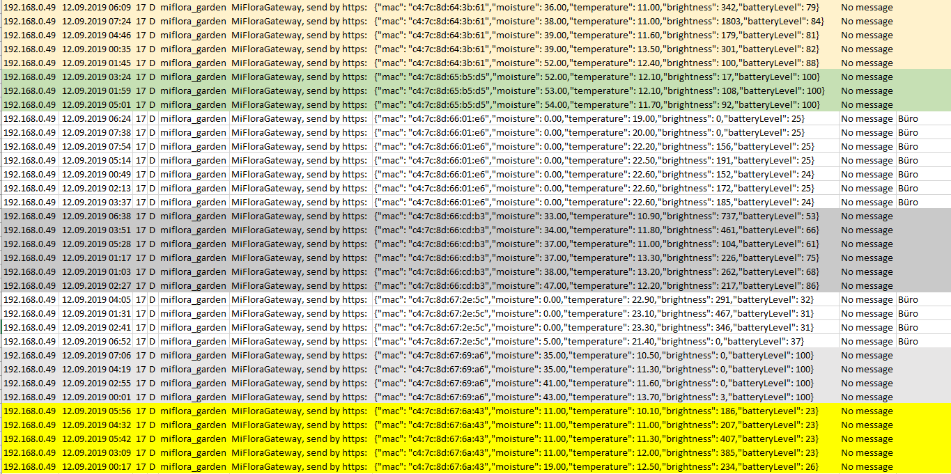

Slide 16
MqttGateway ➔ MiFlora
http://192.168.0.60/getconfig
http://192.168.0.60/setconfig?mqttbroker=ssdpi&mqttport=8883
http://192.168.0.60/setconfig?mqttuser=openhabian&mqttpassword=piKla87Sie57
http://192.168.0.60/getconfigvalue?mqttbroker
http://192.168.0.60/getconfigvalue?mqttpassword
http://192.168.0.60/getconfigvalue?mqttport
http://192.168.0.60/getconfigvalue?ssid
http://192.168.0.60/getconfigvalue?password

Slide 17
tadeot
http://192.168.0.95/config?thingname=tadeot
http://192.168.0.95/config?ssid=????????
http://192.168.0.95/config?password=????????
http://192.168.0.95/config?mqttbroker=192.168.0.2
http://192.168.0.95/config?mqttuser=????????
http://192.168.0.95/config?mqttpassword=????????
http://192.168.0.95/config?mqttport=1883
http://192.168.0.95/config
http://192.168.0.95/config?ssid
http://192.168.0.95/config?password
http://192.168.0.95/config?mqttbroker
http://192.168.0.95/config?mqttuser
http://192.168.0.95/config?mqttpassword
http://192.168.0.95/sensor?co2
http://192.168.0.95/sensor?temperature
http://192.168.0.95/sensor?humidity
http://192.168.0.95/sensor?noise
http://192.168.0.95/sensor?luminosity
http://192.168.0.95/sensor?motion
http://192.168.0.95/restart

Slide 18
Ds18b20
http://192.168.0.95/config?thingname=ds18b20
http://192.168.0.95/config?ssid=????????
http://192.168.0.95/config?password=????????
http://192.168.0.95/config?mqttbroker=192.168.0.2
http://192.168.0.95/config?mqttuser=????????
http://192.168.0.95/config?mqttpassword=????????
http://192.168.0.95/config?mqttport=1883
http://192.168.0.95/config
http://192.168.0.95/config?ssid
http://192.168.0.95/config?password
http://192.168.0.95/config?mqttbroker
http://192.168.0.95/config?mqttuser
http://192.168.0.95/config?mqttpassword
http://192.168.0.95/sensor?temperature
http://192.168.0.95/restart

Slide 19
Office
http://192.168.0.61/config?thingname=office
http://192.168.0.61/config?ssid=????????
http://192.168.0.61/config?password=????????
http://192.168.0.61/config?mqttbroker=192.168.0.2
http://192.168.0.61/config?mqttuser=????????
http://192.168.0.61/config?mqttpassword=????????
http://192.168.0.61/config?mqttport=1883
http://192.168.0.61/config
http://192.168.0.61/config?ssid
http://192.168.0.61/config?password
http://192.168.0.61/config?mqttbroker
http://192.168.0.61/config?mqttuser
http://192.168.0.61/config?mqttpassword
http://192.168.0.61/sensor?co2
http://192.168.0.61/sensor?temperature
http://192.168.0.61/sensor?humidity
http://192.168.0.61/restart

Slide 20
LivingRoom
http://192.168.0.65/config?thingname=office
http://192.168.0.65/config?ssid=????????
http://192.168.0.65/config?password=????????
http://192.168.0.65/config?mqttbroker=leosyn
http://192.168.0.65/config?mqttuser=????????
http://192.168.0.65/config?mqttpassword=synKla87Sie57
http://192.168.0.65/config?mqttport=1883
http://192.168.0.65/config
http://192.168.0.65/config?ssid
http://192.168.0.65/config?password
http://192.168.0.65/config?mqttbroker
http://192.168.0.65/config?mqttuser
http://192.168.0.65/config?mqttpassword
http://192.168.0.65/sensor?co2
http://192.168.0.65/sensor?temperature
http://192.168.0.65/sensor?humidity
http://192.168.0.65/restart

Slide 21
Bmp280
http://192.168.0.62/config?thingname=bmp280demo
http://192.168.0.62/config?ssid=????????
http://192.168.0.62/config?password=????????
http://192.168.0.62/config?mqttbroker=192.168.0.2
http://192.168.0.62/config?mqttuser=????????
http://192.168.0.62/config?mqttpassword=????????
http://192.168.0.62/config?mqttport=1883
http://192.168.0.62/config
http://192.168.0.62/config?ssid
http://192.168.0.62/config?password
http://192.168.0.62/config?mqttbroker
http://192.168.0.62/config?mqttuser
http://192.168.0.62/config?mqttpassword
http://192.168.0.62/sensor?pressure
http://192.168.0.62/sensor?temperature
http://192.168.0.62/sensor?humidity
http://192.168.0.62/restart

Slide 22
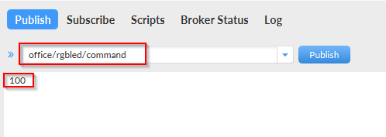
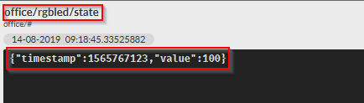
Led per Mqtt setzen
Publish: office/rgbled/command
BGR jeweils 0 oder 1 für Farbe ein/aus
Da nur ein Wert (string) übergeben wird, wird auf JSON verzichtet
Subscribe: office/rgbled/state
aktueller Zustand des Aktors

Slide 23
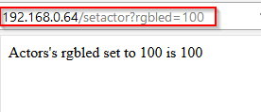
Led per http setzen
http://192.168.0.64/setactor?rgbled=010

