Slide 1
ESP konfigurieren
http://192.168.10.1/setconfig?ssid=linksysAtHome&password=YJXPF4WAC7
http://192.168.10.1/setconfig?ssid=A1-B5035B&password=52809766B6
http://192.168.10.1/setconfig?mqttbroker=ssdpi&mqttport=8883
http://192.168.10.1/setconfig?mqttuser=openhabian&mqttpassword=piKla87Sie57
http://192.168.10.1/setconfig?ntpserver=192.168.0.2&thingname=ssrdemo
http://192.168.0.72/getconfig
http://192.168.0.72/setconfig?mqttbroker=ssdpi&mqttport=8883
http://192.168.0.72/setconfig?mqttuser=openhabian&mqttpassword=piKla87Sie57

Slide 2
Bmp280
http://192.168.0.74/getconfig
http://192.168.0.74/getsensor?pressure
http://192.168.0.74/getsensor?temperature
http://192.168.0.74/getsensor?humidity
http://192.168.0.74/getconfigvalue?mqttbroker
http://192.168.0.74/getconfigvalue?mqttport
http://192.168.0.74/getconfigvalue?mqttuser
http://192.168.0.74/getconfigvalue?mqttpassword
http://192.168.0.74/getconfigvalue?ssid
http://192.168.0.74/getconfigvalue?password

Slide 3
RgbLed_Dht22_Pir_Mhz
http://192.168.0.84/getconfig
http://192.168.0.84/setconfig?mqttbroker=ssdpi&mqttport=8883
http://192.168.0.84/setconfig?mqttuser=openhabian&mqttpassword=piKla87Sie57
http://192.168.0.84/setconfig?loggerip=192.168.0.10
http://192.168.0.84/setconfig?thingname=esplivingroom
http://192.168.0.84/setactor?rgbled=010
http://192.168.0.84/getsensor?co2
http://192.168.0.84/getsensor?temperature
http://192.168.0.84/getsensor?humidity
http://192.168.0.84/getsensor?pir

Slide 4
Gardenhouse
http://192.168.0.50/getconfig
http://192.168.0.50/setconfig?mqttbroker=ssdpi&mqttport=8883
http://192.168.0.50/setconfig?mqttuser=openhabian&mqttpassword=piKla87Sie57
http://192.168.0.50/setconfig?loggerip=192.168.0.10
http://192.168.0.50/setconfig?thingname=gardenhouse
http://192.168.0.50/getconfig?loggerip
http://192.168.0.50/setactor?powerpump=1
http://192.168.0.50/setactor?powermiddle=1
http://192.168.0.50/setactor?powerright=1
http://192.168.0.50/getactor?powerpump
http://192.168.0.50/getactor?powermiddle
http://192.168.0.50/getactor?powerright
http://192.168.0.50/getsensor?waterlevel

Slide 5
Cistern
http://192.168.0.45/getconfig
http://192.168.0.45/setconfig?mqttbroker=ssdpi&mqttport=8883
http://192.168.0.45/setconfig?mqttuser=openhabian&mqttpassword=piKla87Sie57
http://192.168.0.45/setconfig?loggerip=192.168.0.10
http://192.168.0.45/setconfig?thingname=cistern
http://192.168.0.50/getconfig?loggerip
http://192.168.0.50/setactor?powerpump=1
http://192.168.0.50/setactor?powervalve=1
http://192.168.0.50/getactor?powerpump
http://192.168.0.50/getactor?powervalve
http://192.168.0.50/getsensor?weight
http://192.168.0.50/getsensor?power

Slide 6
SsrDemo
http://192.168.0.79/getconfig
http://192.168.0.79/setconfig?mqttbroker=ssdpi&mqttport=8883
http://192.168.0.79/setconfig?mqttuser=openhabian&mqttpassword=piKla87Sie57
http://192.168.0.79/setconfig?ntpserver=192.168.0.2&thingname=ssrdemo
http://192.168.0.79/setactor?switch=1
http://192.168.0.79/getactor?switch
http://192.168.0.79/getconfig?thingname

Slide 7
Miflora Hellmonsödt
http://192.168.10.1/config?thingname=miflorahellmonsoedt
http://192.168.10.1/config?ssid=linksysAtHome
http://192.168.10.1/config?password=YJXPF4WAC7
http://192.168.10.1/config?httpmqttgateway=leonding.synology.me
http://192.168.10.1/config?httpuser=gerald
http://192.168.10.1/config?httppassword=piKla87Sie57
http://192.168.10.1/config
http://192.168.10.1/config?ssid
http://192.168.10.1/config?password
http://192.168.10.1/config?httpmqttgateway
http://192.168.10.1/config?httpuser
http://192.168.10.1/config?httppassword

Slide 8
Miflora Leonding
http://192.168.0.60/getconfig
http://192.168.0.60/setconfig?mqttbroker=ssdpi&mqttport=8883
http://192.168.0.60/setconfig?mqttuser=openhabian&mqttpassword=piKla87Sie57
http://192.168.0.60/getconfigvalue?mqttbroker
http://192.168.0.60/getconfigvalue?mqttpassword
http://192.168.0.60/getconfigvalue?mqttport
http://192.168.0.60/getconfigvalue?ssid
http://192.168.0.60/getconfigvalue?password

Slide 9
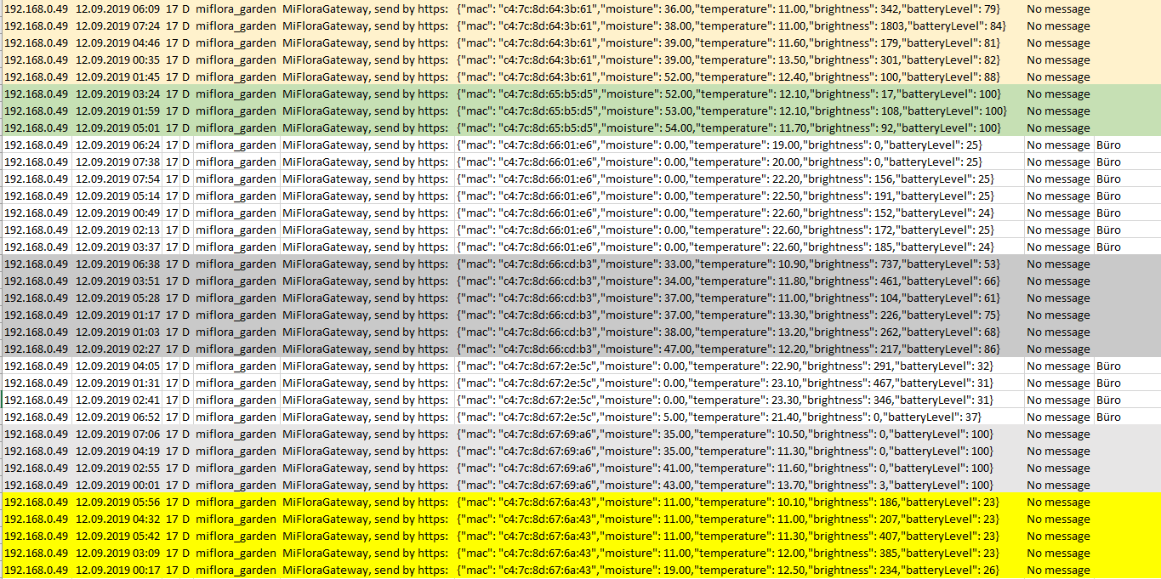

Slide 10
MqttGateway ➔ MiFlora
http://192.168.0.60/getconfig
http://192.168.0.60/setconfig?mqttbroker=ssdpi&mqttport=8883
http://192.168.0.60/setconfig?mqttuser=openhabian&mqttpassword=piKla87Sie57
http://192.168.0.60/getconfigvalue?mqttbroker
http://192.168.0.60/getconfigvalue?mqttpassword
http://192.168.0.60/getconfigvalue?mqttport
http://192.168.0.60/getconfigvalue?ssid
http://192.168.0.60/getconfigvalue?password

Slide 11
Office
http://192.168.0.45/config?thingname=office
http://192.168.0.45/config?ssid=A1-B5035B
http://192.168.0.45/config?password=52809766B6
http://192.168.0.45/config?mqttbroker=ssdpi
http://192.168.0.45/config?mqttpassword=piKla87Sie57
http://192.168.0.45/config
http://192.168.0.45/config?ssid
http://192.168.0.45/config?password
http://192.168.0.45/config?mqttbroker
http://192.168.0.45/config?mqttpassword
http://192.168.0.45/sensor?co2
http://192.168.0.45/sensor?temperature
http://192.168.0.45/sensor?humidity

Slide 12
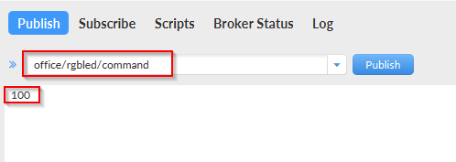
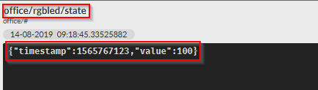
Led per Mqtt setzen
Publish: office/rgbled/command
BGR jeweils 0 oder 1 für Farbe ein/aus
Da nur ein Wert (string) übergeben wird, wird auf JSON verzichtet
Subscribe: office/rgbled/state
aktueller Zustand des Aktors

Slide 13
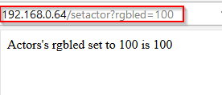
Led per http setzen
http://192.168.0.64/setactor?rgbled=010

