Slide 1
Project Work – S2 - Week 1

Slide 2
Tasks
Pick biometrics for hand recognition based on the research papers that I have read.
Create a plan with the steps needed for the creation of the hand recognition algorithm.
Explore how feature extraction can be done.

Slide 3
Steps
Collect and label different dataset of images of hands in various poses and angles.
Pre-process the images to convert them into the appropriate format for the feature extraction stage.
Extract features from the images using edge detection or blob detection, etc.
Train a model such as CNN, RNN, LSTM, Transfer Learning
Train a SVM model (will decide later).
Evaluate the performance of the model using evaluation metrics

Slide 4
Hand Biometrics
Hand shape
Palm print
Finger geometry
Knuckle pattern
Nail fold
Hand texture

Slide 5
Example in Hand Shape extraction
Hand Segmentation: segment the hand region from images using color-based thresholding, edge detection, or semantic segmentation.
Convex Hull: Once I have the hand region, I can find the convex hull of the hand which will give me the outer boundary of the hand.
Hand Shape feature extraction: Can use the convex hull as a feature to represent the hand shape.
Normalization: In order to have a consistent input size to the network, I can resize the image to a fixed size, and also may need to normalize the image values to be in a range of [0,1].

Slide 6
CNN
Convolutional layers
Pooling layers
Fully connected layers
Dropout layers
Softmax layer

Slide 7
Python or Matlab?
Python
Matlab
Widely used in machine and deep learning.
Large number of libraries and frameworks.
  TensorFlow, Keras, PyTorch, OpenCV.
Open-source programming language, which makes it more accessible and easier to use.
Commonly used in engineering and scientific applications.
Many toolboxes available for image processing, machine learning, and deep learning.
User-friendly interface and a wide range of visualization tools.

Slide 8
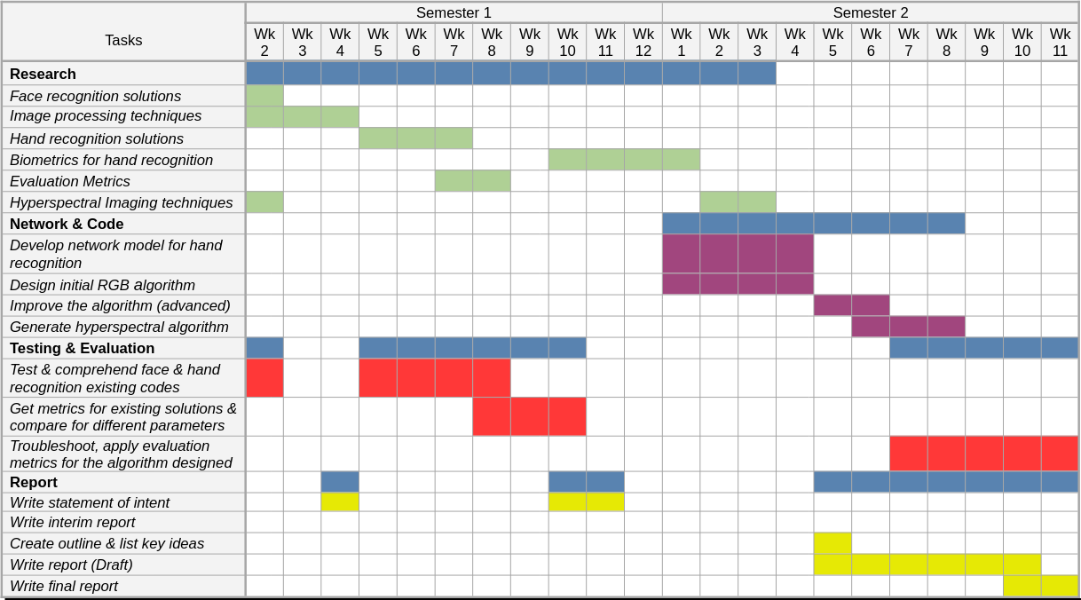
Gantt Chart - Progress
On time according to the Gantt Chart

Slide 9
Questions
CNN streams and layers?
Python or Matlab?
  Matlab was the 1st option for the creation of the algorithm.
  Python has more resources online for Deep Learning Networks, and more libraries.
Low-end hardware
  Do I need to work in a computer with better CPU and GPU?

Slide 10
Next goals
Create an initial CNN with the required streams and layers.
Start writing code for the hand recognition algorithm.

