Slide 1
Project Work – S2 - Week 4

Slide 2
Tasks
Split train and test data automatically from csv.
Train and test previous created network.
Pre-process images using guided filter following the “11k hands” method.
  Smoothed image & High detailed image
Create a two-stream CNN for each image.
Train and evaluate it.

Slide 3
Split train and test data
Creates an empty dictionary id_counts to store the count of images for each ID.
Iterates through a DataFrame df to count the number of images for each ID and updates the id_counts dictionary accordingly.
Creates an empty list test_indices to store the indices of the test data.
Iterates through the DataFrame df again to find the last 2 images for each ID and appends their indices to test_indices.
Splits the DataFrame into two separate ones, train_df and test_df based on the test_indices.

Slide 4
Evaluation of initial code
The accuracy of the model is 0.79 indicating that the model correctly classified 79.68% of the test dataset.
The loss of the model is 4.82, indicating that the predicted and true labels have a relatively high dissimilarity.

Slide 5
Pre-processing
The image is normalized, dividing by 255 to scale the pixel values between 0 and 1.
Guided filter is applied to the normalized image.
  Smooth out the image and preserve edges.
RGB to BGR colour conversion of the smoothed image.
Create high detailed image by dividing the normalized RGB image by the BGR image.
The smoothed image and the high detailed image are resized to 224 x 224.

Slide 6
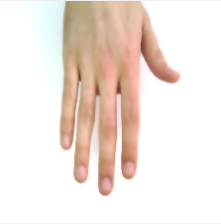
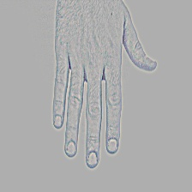
Pre-processed images
Smoothed
High Detailed

Slide 7
Two-stream CNN network
Define the shape of the input images, (224,224,3).
Create the two streams for each image.
Load pre-trained VGG16 network for each stream.
Add prefix to the layer names in the second stream.
  Had a error as stream has to be unique.
Merge the two streams in a fusion layer.
Add a ‘relu’ dense layer for each stream, and a “softmax” layer for the 32 classes.

Slide 8
Evaluation of two-stream CNN
The two stream network has a test accuracy of 3.1%.
  The model is not able to accurately predict the labels of the test data.
The test loss is 3.64.
  The model's predictions are far from the true labels, and it has not learned a meaningful relationship between the inputs and outputs.

Slide 9
Next steps
Evaluate the previous models with different dense layer values, to prevent overfitting but have as high model capacity as possible.
Use the extracted features of the CNN as inputs to the SVM classifier, train, evaluate.
Capture hand image of myself, pre-process them accordingly ,blend them with the dataset, and test if it works. [Optional]

Slide 10
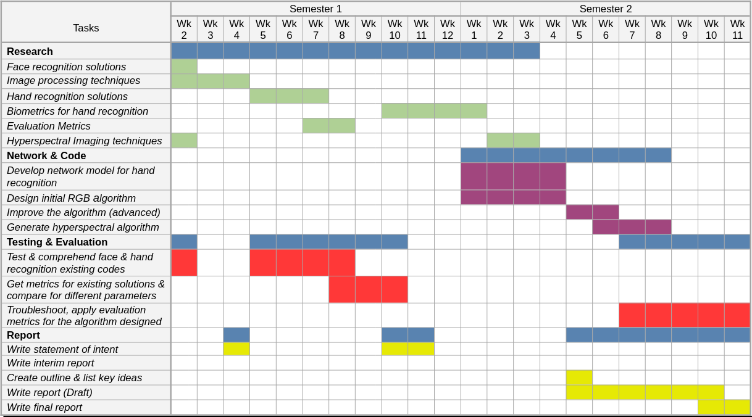
Gantt Chart - Progress
On time according to the Gantt Chart

