Slide 1
Project Work – S2 - Week 7

Slide 2
Tasks
Find evaluation metrics to use for my model.
Evaluate the model for 3 different pre-processes
  Simple Pre-Processing BGR
  High Detailed Pre-Processing BGR
  High Detailed Pre-Processing Gray
Find ways to improve the model.

Slide 3
Unexpected Issue
Different evaluation metrics every time the CNN model is trained.
  Found randomly when I was capturing the evaluation metrics.
  Issue that needs to be investigated more.

Slide 4
Reasons of Different Evaluation Metrics
Small Dataset
  Small changes in data split
Model Architecture
  Layers, Neurons can influence stability
Hyper-parameters
  Learning Rate, Batch Size, Epochs

Slide 5
Changing Batch Size (Epoch 15)
Batch=16 | Train 1 | Train 2 | Train 3
Accuracy | 68% | 78% | 71%
Loss | 9.04 | 8.11 | 11.74
Batch = 8 | Train 1 | Train 2 | Train 3 | Train 4 | Train 5
Accuracy | 81% | 84% | 81% | 75% | 81%
Loss | 8.27 | 14.19 | 9.79 | 10.3 | 5.89
Batch = 10 | Train 1 | Train 2 | Train 3 | Train 4 | Train 5
Accuracy | 80% | 81% | 79% | 82% | 79%
Loss | 13.3 | 5.1 | 6.7 | 11.6 | 9.12

Slide 6
With or Without Validation Data
Validation | Train 1 | Train 2 | Train 3 | Train 4 | Train 5
Accuracy | 80% | 81% | 79% | 82% | 79%
Loss | 13.3 | 5.1 | 6.7 | 11.6 | 9.12
No Validation | Train 1 | Train 2 | Train 3 | Train 4 | Train 5
Accuracy | 81% | 78% | 84% | 85% | 78%
Loss | 3.41 | 6.95 | 4.14 | 5.8 | 11.2

Slide 7
Evaluation Metrics Used
Accuracy: Percentage of correctly classified instances.
Precision: Proportion of true positives, correctly identified hands.
Recall: Proportion of true positives among all the actual positives.
F1-Score: Harmonic mean of precision and recall

Slide 8
Simple Pre-Processing
 | Train 1 | Train 2 | Train 3 | Train 4 | Average
Accuracy | 87.5% | 79.6% | 85.9% | 82.8% | 83.95%
Precision | 87% | 76% | 86% | 80% | 82.25%
Recall | 88% | 80% | 86% | 83% | 84.25%
F1-Score | 86% | 76% | 84% | 80% | 81.5%
Loss | 17.95 | 12.82 | 13.8 | 24.26 | 17.2
Big losses in every train run

Slide 9
High Detailed BGR
 | Train 1 | Train 2 | Train 3 | Train 4 | Average
Accuracy | 84.3% | 83.6% | 83.2% | 84.3% | 83.85%
Precision | 83.5% | 81% | 83% | 82% | 82.37%
Recall | 84% | 80% | 81% | 84% | 82.25%
F1-Score | 80% | 80% | 80% | 82% | 79%
Loss | 6.07 | 11.67 | 10.89 | 7.79 | 9.1
Similar to the previous evaluation metrics but smaller Loss.

Slide 10
High Detailed Gray
 | Train 1 | Train 2 | Train 3 | Train 4 | Average
Accuracy | 79.6% | 84.3% | 73.4% | 85.9% | 80.8%
Precision | 76% | 82% | 68% | 84% | 77.5%
Recall | 80% | 84% | 73% | 86% | 80.75%
F1-Score | 76% | 81% | 68% | 83% | 77%
Loss | 9.89 | 10.14 | 9.33 | 10.23 | 9.89
Worse evaluation metrics from High Detailed BGR

Slide 11
Another commit to solve the issue
Pre-Processing might vary in every run.
  Pre-Processed the images and saved them in a folder.
  Load the images from the folder and train to see if the evaluations are stable.
  Still the issue persists.

Slide 12
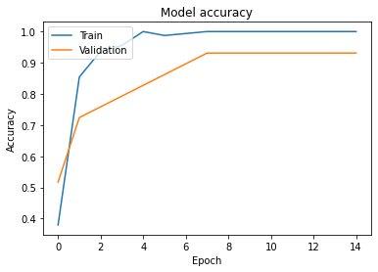
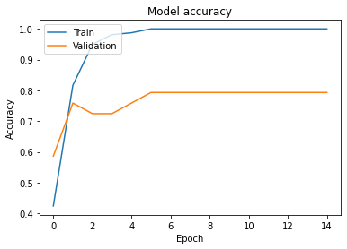
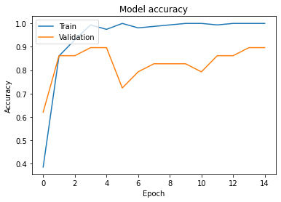
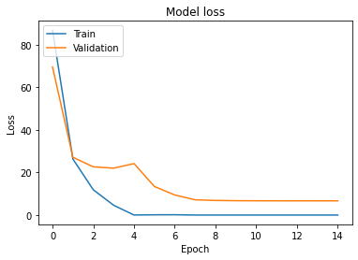
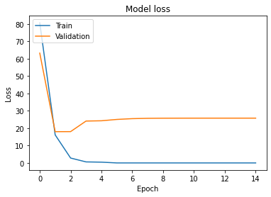
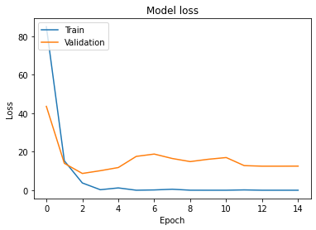
Simple Pre-Processing Graphs

Slide 13
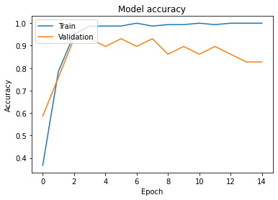
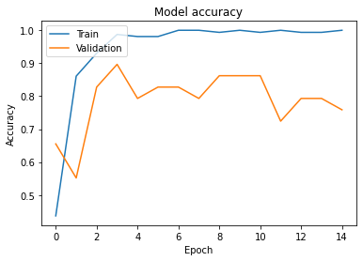
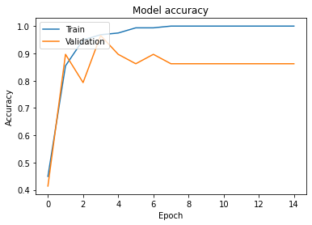
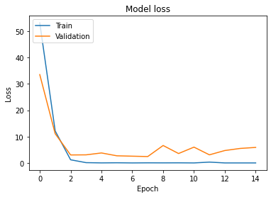
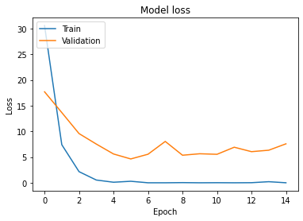
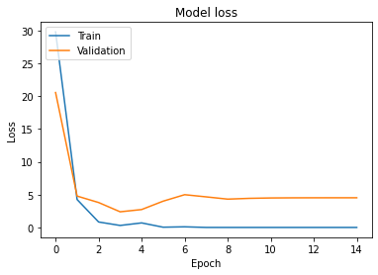
High-Detailed BGR Graphs

Slide 14
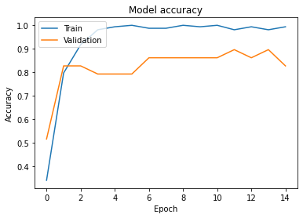
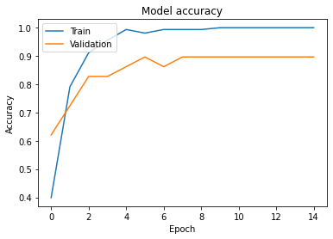
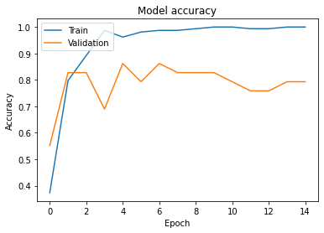
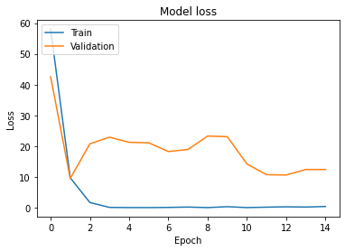
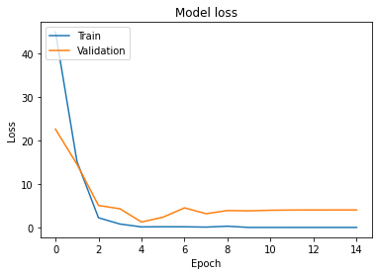
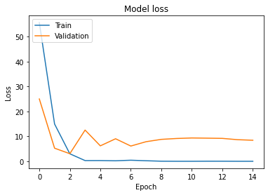
High-Detailed Gray Graphs

Slide 15
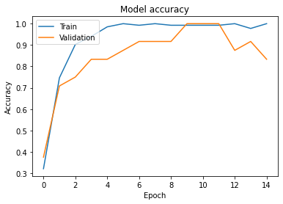
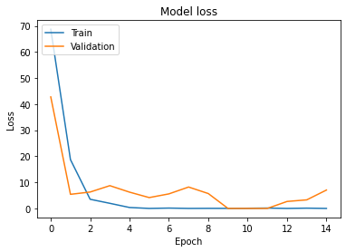
Smoothed Image
Accuracy | Precision | Recall | F1-Score | Loss
4.68% | 3 | 5 | 2 | 7.35

Slide 16
Next steps
Fine tune the model.
Fix the issue with the smoothed image.
Create SVM classifier for smoothed image, high detailed image, and fusion layer.
Evaluate the model.

Slide 17
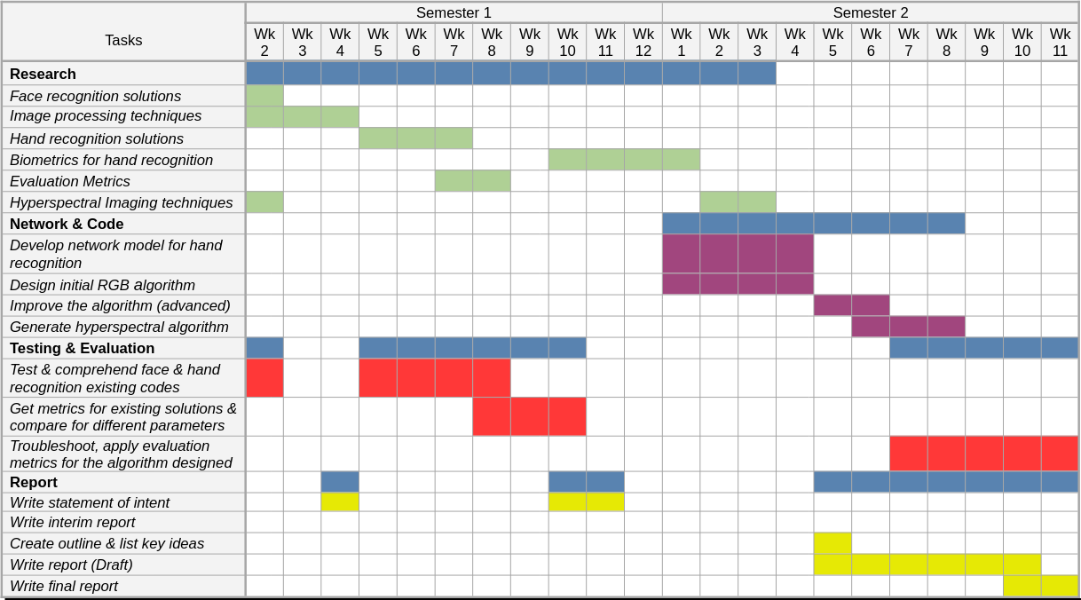
Gantt Chart - Progress
On time according to the Gantt Chart

