Slide 1
Project Work – Week 10

Slide 2
Tasks
Test and see how the ID identification code of the “11k hands” works.
Isolate images with the same hand position form, and list the to folders.
Train & create new model with those images.
  Get new evaluation metrics and compare.
Research and read papers about hand or face recognition techniques.

Slide 3
Issues
Could not extract evaluation metrics for ID identification.
  Needed to complete other tasks.
  Will continue after I have finished with interim report.
New confusion matrix for isolated images dataset is incorrect.
  Possible issue might be the small amount of images per user that were used for training.

Slide 4
ID identification “11k hands”
Hand image acquisition
  Customized scanners or digital scanners and cameras
Preprocessing extracting the region of interest
  Extracting the region of interest (RoI)
Extract geometrical and local features from RoI
  Feature Extractors (Radon transform, LBP extractor, Gabor filter, scale invariant feature transform (SIFT) extractor, customized shape, geometrical, or figure feature extractors.
Matching Process
  extracted features are used to drive the final decision, which is taken based on either a similarity metric or by an off-the-shelf classifier

Slide 5
Train new model
Downloaded the csv with all the hand dataset & filtered only the dorsal hand for male & female.
  Created txt files in order to use get_data.m
Isolated pictures with open hand and arranged them correctly.
After that, trained the new model
  1st try crashed, 2nd done but confusion matrix was incorrect [0 0 ; 0 0].

Slide 6
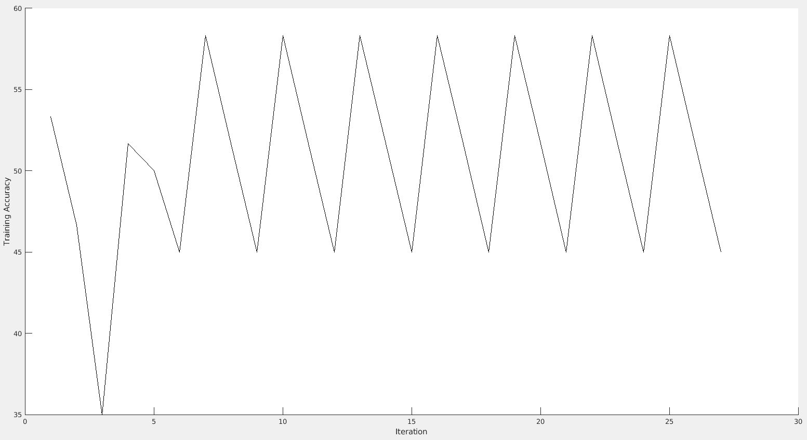
Train Accuracy vs Iteration

Slide 7
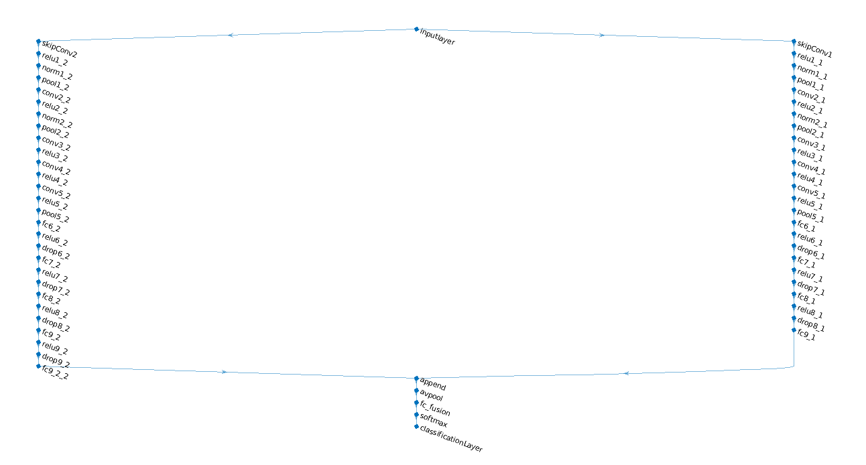
Two stream network model ???

Slide 8
Hand Geometry Identification
Based on the measurements of the shape of the contour of the hand.
Advantages
  Medium cost
  Low computational cost algorithms
  Low template size
  Very easy and attractive to users
  Lack of relation to police, justice, criminal records ???

Slide 9
Feature Extraction
Capture a sample of the user’s biological data, process it, and extract set of features.
  Image Capture
  Pre-processing
  Feature measurement
  Feature selection

Slide 10
Pre-processing
After the image is captured pre-processing is performed
Convert image into a black and white
  Arithmetic operation: Ibw = << Ir + Ig> - Ib >
  Edge detection algorithm (Sobel Function)

Slide 11
Measurements
Widths: Each of the four fingers, palm, three interfinger points.
Heights: The middle & little finger, palm
Deviations: middle point of finger – middle point of the straight line between interfinger point and last height where finger is measured.
Angles: Between intefinger points and the horizontal.

Slide 12
Feature Selection
31 features extracted.
Performed statistical analysis – discrimirability of the features.
  Ratio of interclass and intraclass variabilities.??
  Higher ratio, more discriminant the feature is.
Features reduced to 25.

Slide 13
Classification
Euclidean distance
Hamming distance
Gaussian Mixture Models (GMMs)
Radial Basis Function Neural Networks (RBF)

Slide 14
Results
GMM shows better results
The Equal Error Rate remains similar in each technique for different vector sizes.
FAR & FRR is:
  More accurate: 9 features
  Smoother: 25 or 21 features
GMM has higher computational cost & template size

Slide 15
Face Recognition
Most biometric identification system involve two main steps:
  Feature extraction: Analyse biometrics and extract features.
  Feature matching: Compare extracted features to input features.

Slide 16
Residual CNN
“Directly learns a mapping from face images to a compact Euclidean space where distances directly correspond to a measure of face similarity”.

Slide 17
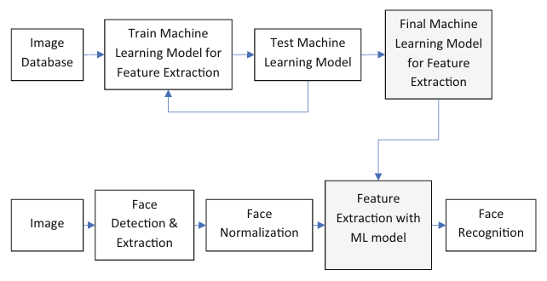
Process flow for building and using a face recognition system

Slide 18
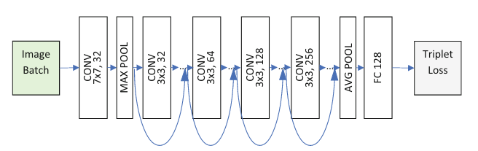
RCNN for feature extraction

Slide 19
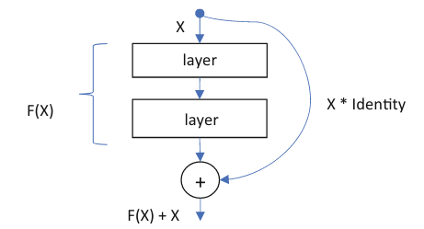
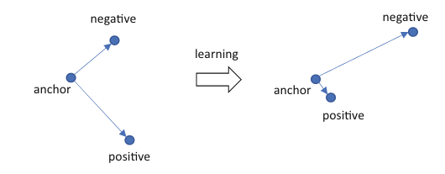
Difference from Standard CNN
Shortcut connection in a neural network
Triplet loss learning

Slide 20
Next goals
Finish the face detection paper
  Biometric (face) detection methods
  Histogram of oriented gradients (HOG) method
  Face normalisation
  Feature Extraction and Face Recognition
Read papers about important hand biometrics for hand recognision.
Research about building my own CNN model
Finish Interim Report.

