Slide 1
Project Work – Week 8

Slide 2
Tasks
Evaluation Metrics Research.
Fix the error in get_data.m, in order to create image folders for male and female.
Use evaluation metrics with the classifier/CNN model for different hand dataset and compare.
Use the same method for combined hand datasets.

Slide 3
Issues
SVM confusion matrix doesn’t complete even after 2 hours. - Continued with CNN model
Other hand dataset did not categorize male or female images. - Did it myself
Could not extract confusion matrix from the new hand datasets .
  Pre-processing runs only in some images (none in female folder).
  Possible issue might be the images background.

Slide 4
get_data.m error
Problem
Error using textscan - Invalid file identifier
Could not find a file (fileID = -1)
Possible Linux issue
Fix
Entered into debugging
Checked the folder paths and names
Erased “\” and “//”
Tested and Verified the get_data.m

Slide 5
Classification Metrics
Accuracy
Precision
Recall
F1-Score
Specificity
Confusion Matrix

Slide 6
CNN Confusion Matrix Extraction
Run get_data.m for male and female folders.
Apply pre-processing to all images (male, female)
Load CNN network.
Get actual classes from the image labels.
Get predicted classes from network and images.
Extract confusion matrix from confusionmat().

Slide 7
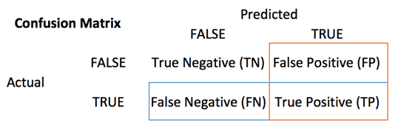
Confusion Matrix
Experiment 1 - Dorsal
Experiment 1- Palmar
N = 1000 | Female | Male
Female | 473 (TN) | 27 (FP)
Male | 33 (FN) | 467 (TP)
N = 1000 | Female | Male
Female | 463 (TN) | 37 (FP)
Male | 110 (FN) | 390 (TP)

Slide 8
Accuracy
Gender recognition from dorsal hand images is 9% more accurate than palmar.
Possible ways to improve the palmar accuracy by extracting more features
Accuracy (dorsal) = 0.94 or 94%
Accuracy (palmar) = 0.85 or 85%

Slide 9
Precision
Specific performance metric
  Class distribution imbalanced
Not much information
  500 samples for each gender
Precision (dorsal) = 0.945 or 94.5%
Precision (palmar) = 0.913 or 91.3%

Slide 10
Recall
For dorsal hand images True Positives (male) are predicted more accurately .
Better sensitivity.
Again more feature extraction might improve it.
Recall (dorsal) = 0.934 or 93.4%
Recall (palmar) = 0.78 or 78%

Slide 11
F1-Score
Metric to combine precision and recall
  Harmonic mean of precision & recall
Trade-off
  Higher precision means less recall?
F1Score (dorsal) = 0.939
F1Score (palmar) = 0.841

Slide 12
Specificity
True Negative Rate
  Ability to predict true negative (Female)
Similar ability to predict if a prediction does not belong to a specific category.
Specificity (dorsal) = 0.946 or 94.6%
Specificity (palmar) = 0.926 or 92.6%

Slide 13
Next goals
Debug the MATLAB code for SVM confusion matrix extraction.
Debug the pre_processing.m to check the issue with the new hand dataset.
  Possible need to edit image backgrounds.
Get evaluation metrics for other hand dataset, and combination of hand dataset.
Train a new model, and repeat the process.

