Slide 1
Project Work – Week 9

Slide 2


Tasks
Debug the MATLAB code for SVM confusion matrix extraction.
Debug the pre_processing.m to check the issue with the new hand dataset.
  Possible need to edit image backgrounds.
Get evaluation metrics for other hand dataset, and combination of hand dataset.
Train a new model, and repeat the process.

Slide 3
Issues
CNN and SVM evaluation metrics for hand dataset 2 were unexpecting.
  Possible wrong allocations of female and male images in folders.
Spent too much time organising the dataset 2 on a spreadsheet.
  Wasted around 2 hours creating a txt file that I didn't need.

Slide 4
SVM evaluation metrics
N=1000 | Female | Male
Female | 496 (TN) | 4 (FP)
Male | 15 (FN) | 485 (TP)
Accuracy: 0.981 or 98.1%
Precision: 0.991 or 99.1%
Recall: 0.97 or 97%
F1-Score: 0.98
Specificity: 0.992 or 99.2%

Slide 5
CNN & SVM comparison
 | CNN (dorsal) |  | SVM (dorsal)
N | Female | Male | Female | Male
Female | 473 | 27 | 498 | 9
Male | 33 | 467 | 15 | 485
 | CNN (dorsal) | SVM (dorsal)
Accuracy | 94% | 98.1%
Precision | 94.5% | 99.1%
Recall | 93.4% | 97%
F1-Score | 0.939 | 0.98
Specificity | 94.6% | 99.2%

Slide 6
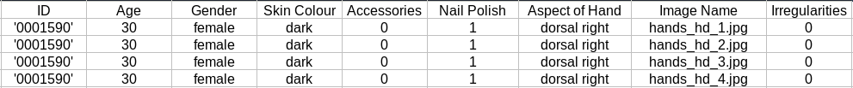
Hand Dataset 2
Created a spreadsheet with ID, age, gender, skin color, accessories, nail polish, aspect of hand of each photo.

Slide 7
CNN & SVM evaluation metrics dataset 2
 | CNN |  | SVM
N=300 | Female | Male | Female | Male
Female | 11 (TN) | 139 (FP) | 15 (TN) | 135 (FP)
Male | 11 (FN) | 139 (TP) | 13 (FN) | 137 (TP)
For CNN there are 278 male predictions
There is a small improvement in SVM but still there are mostly male predictions
  The folder must contain wrong pictures or the model does not work correctly.

Slide 8
CNN & SVM evaluation metrics dataset 2
 | CNN | SVM
Accuracy | 50% | 50.6%
Precision | 50% | 50.3%
Recall | 92.6% | 91.3%
F1-Score | 0.649 | 0.648
Specificity | 7.3% | 10%
Accuracy and precision show that half of the time the predictions are right.
Recall is high but F1-score is lower as the precision very low.
Low specificity as females are not predicted

Slide 9
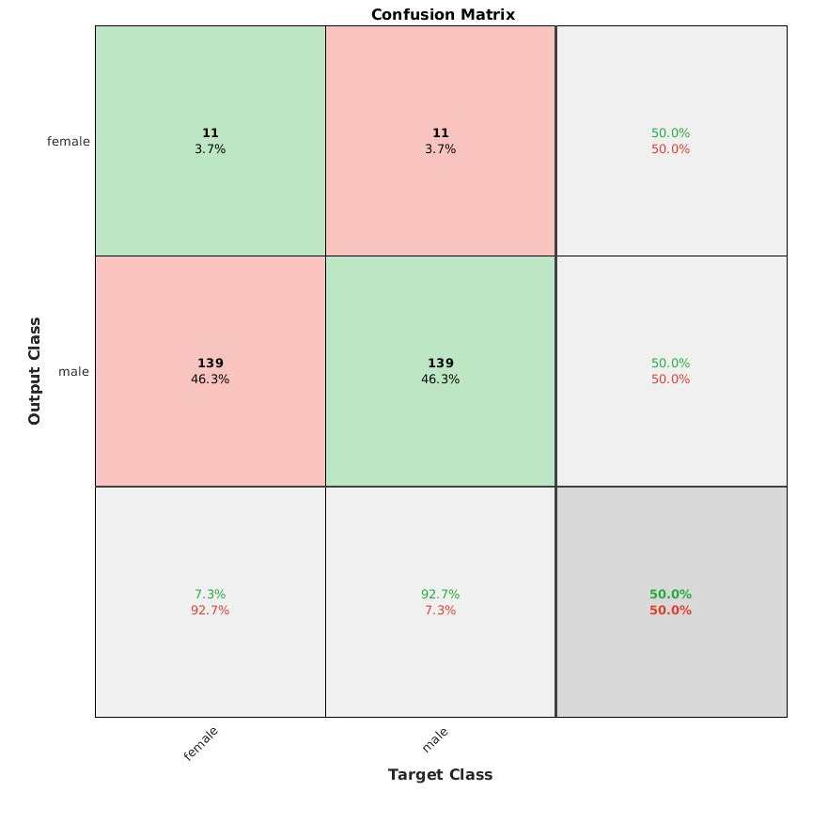
Plot classification confusion matrix for CNN

Slide 10
Next goals
Create a combination of hand dataset and compare.
  No need for get features and apply pre- processing again.
  Might need to change dataset.
Train a new model, and repeat the process.
  But the results will be bad again.
Need to find dataset with gender and ID list.

