Slide 1
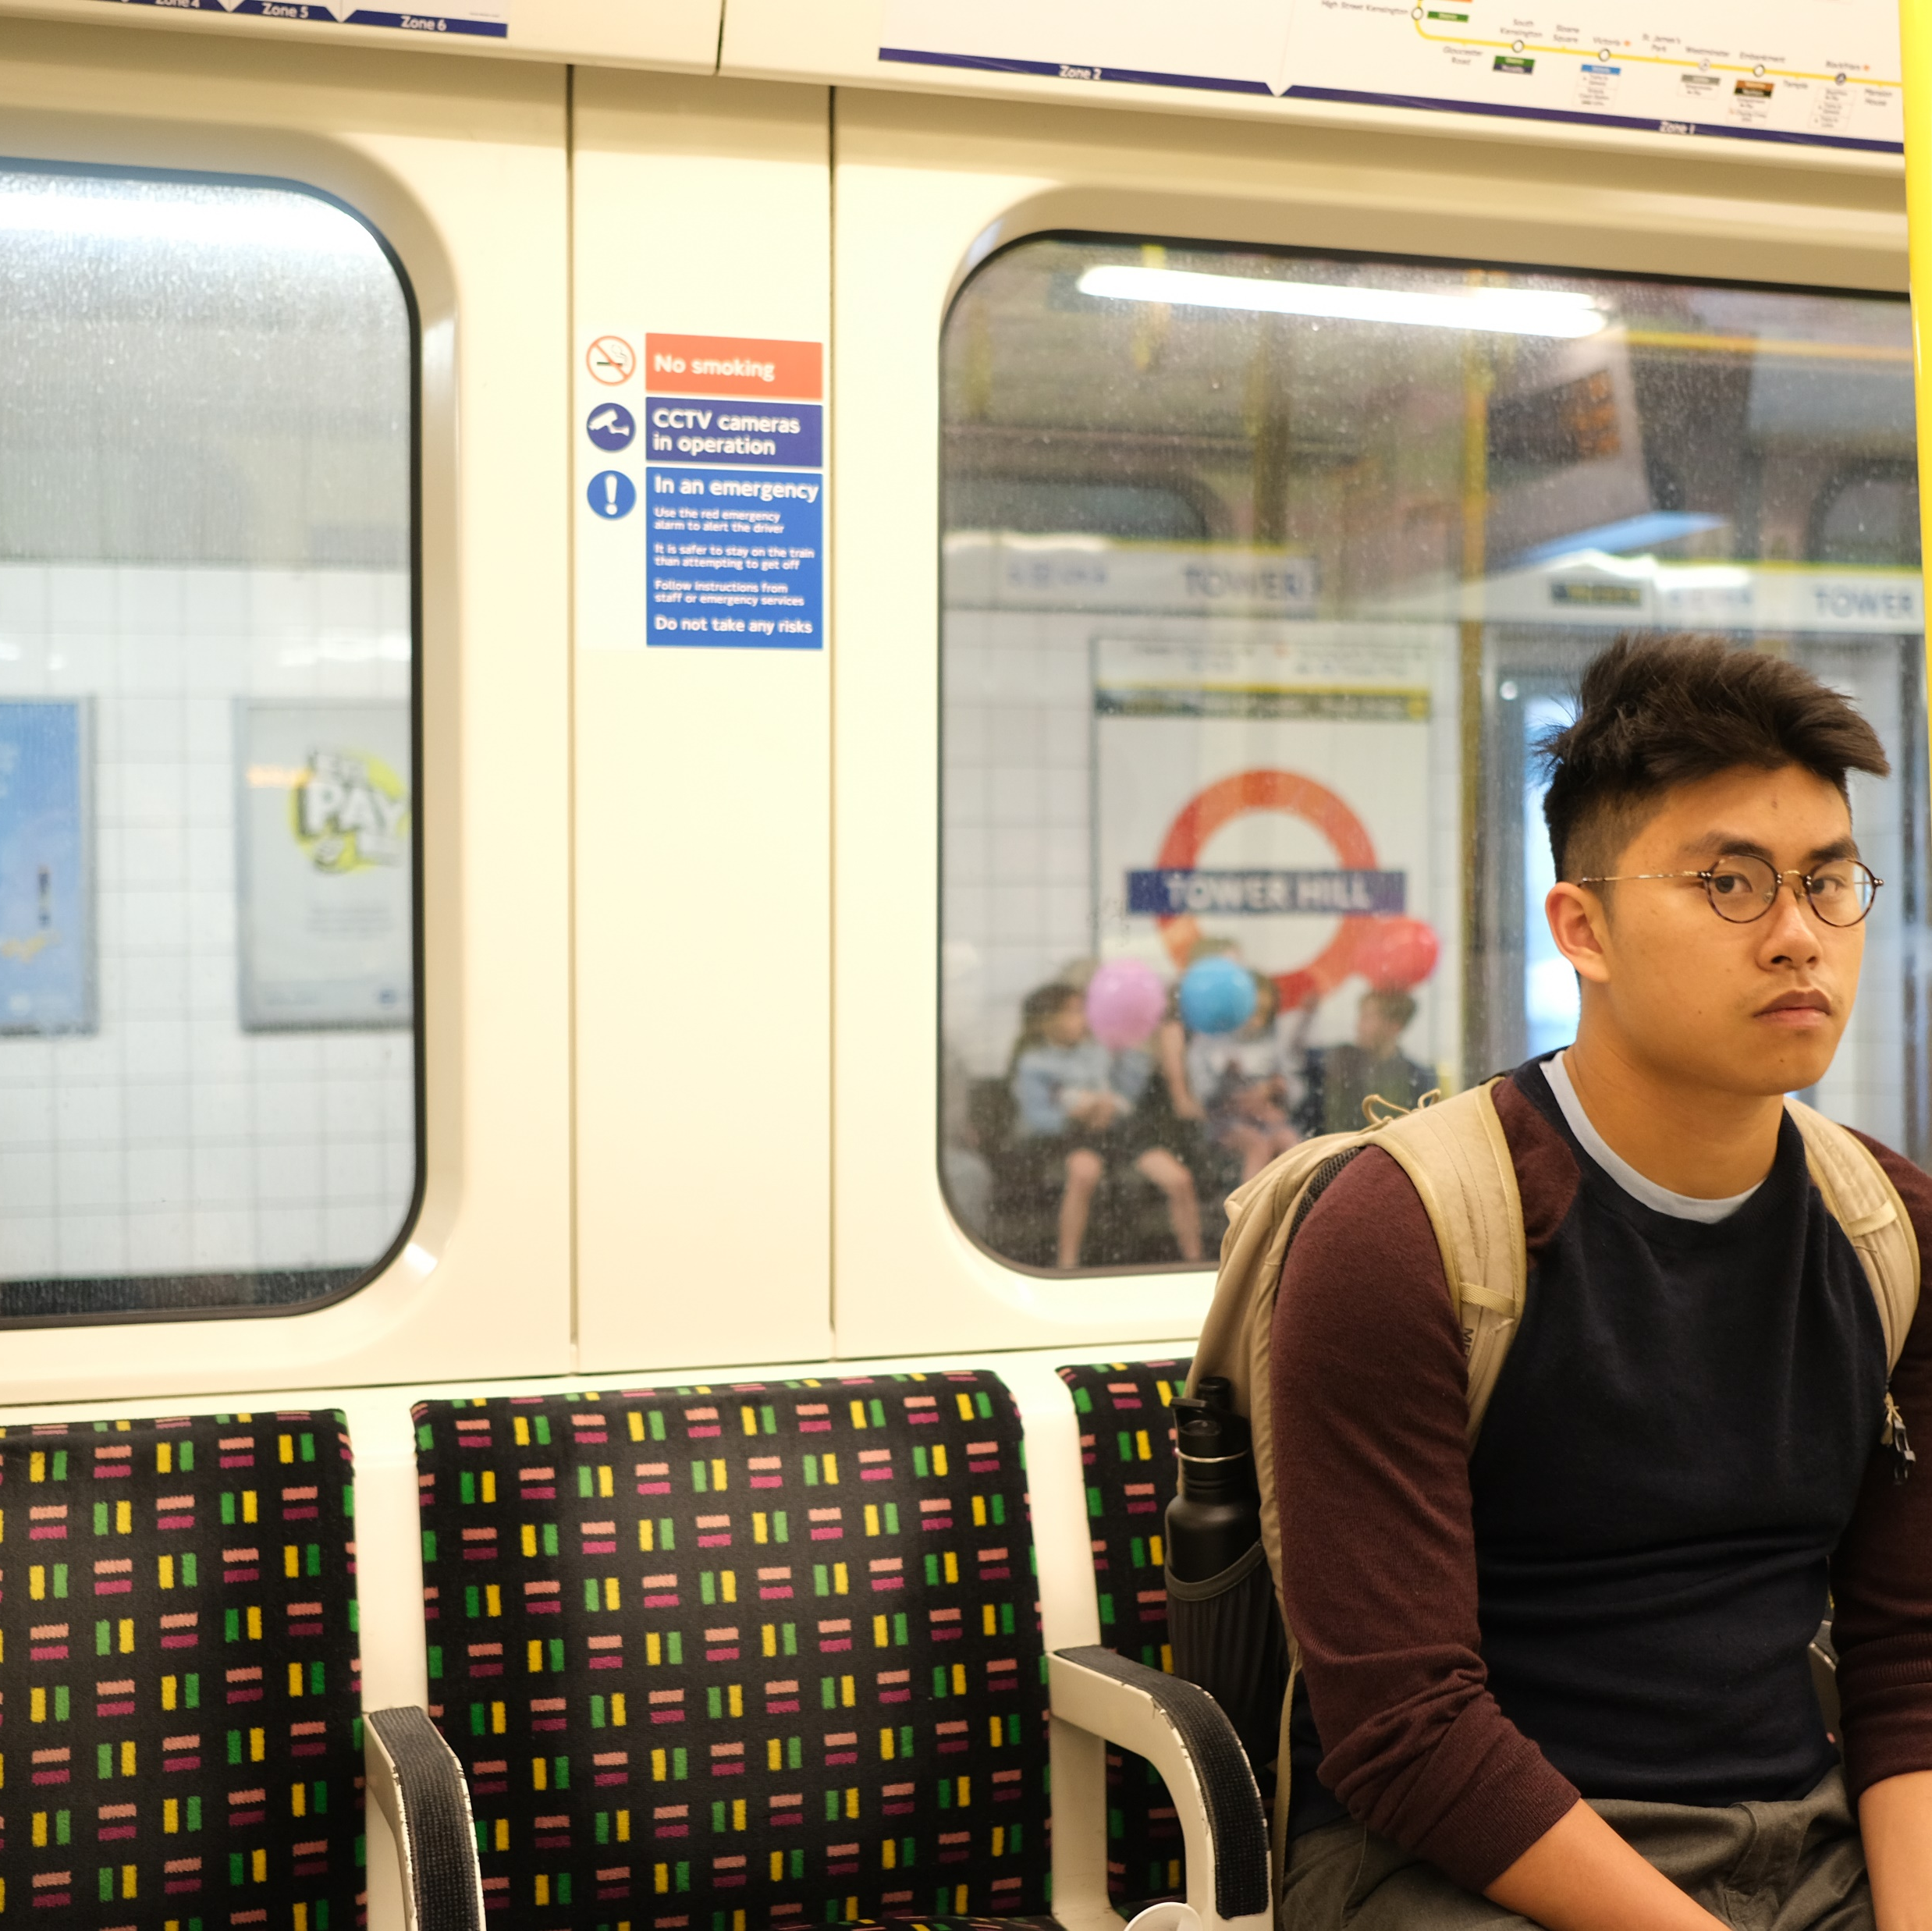
About
Creatives
This sets the mood…
Feel free to pause/play as you wish…
Player 5
https://giphy.com/gifs/falcaolucas-gw3MROIiJp44tg0E

