Slide 1
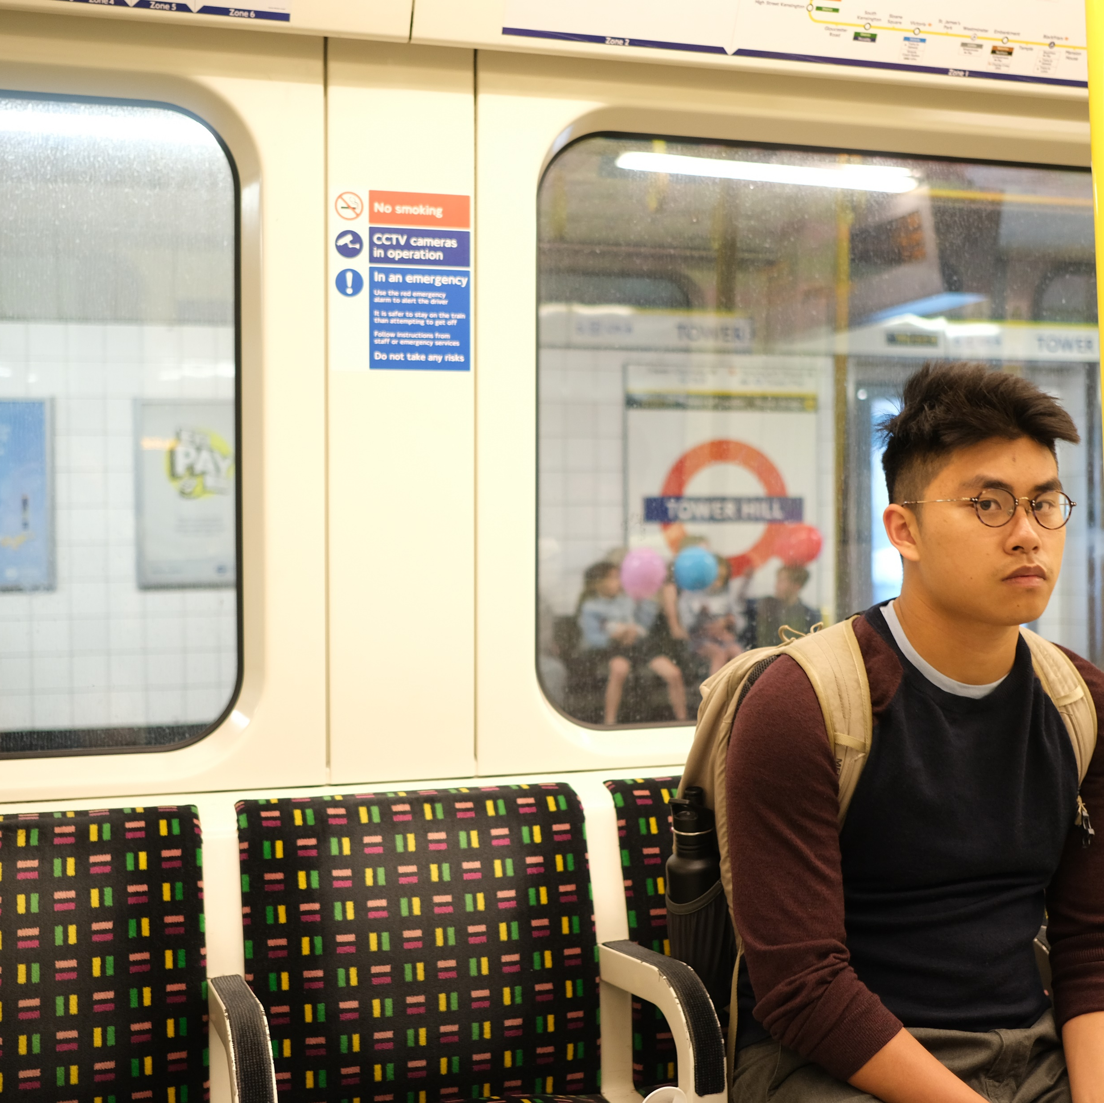




About
Creatives
expand. explore. create. conquer
-- A$AP
Alright, writing code for this website has been a PROCESS. I’d rather be scripting in python to build something actually useful for people. But here we are, I built this as an exercise in learning something new and making something passably beautiful in the process. Enjoy.

Slide 2
About
Creatives
Under construction…

