Slide 1
Reprodusible Research Term Project
R. Arda Kaya – Gamze Kopal – Evrim Bilgen

Slide 2
Goal of the research
Original research aims to understand customer loyalty based on a survey.
The questions are created to detect behavioral patterns among customers of Starbucks and the analysis hopes to understand what determines customer loyalty.
Logistic regression applied
Sample group is coming from Malaysia

Slide 3
Our goal
Adding 20 more observations but coming from Poland and try to understand how different demographics affect sample quality and result accuracy

Slide 4
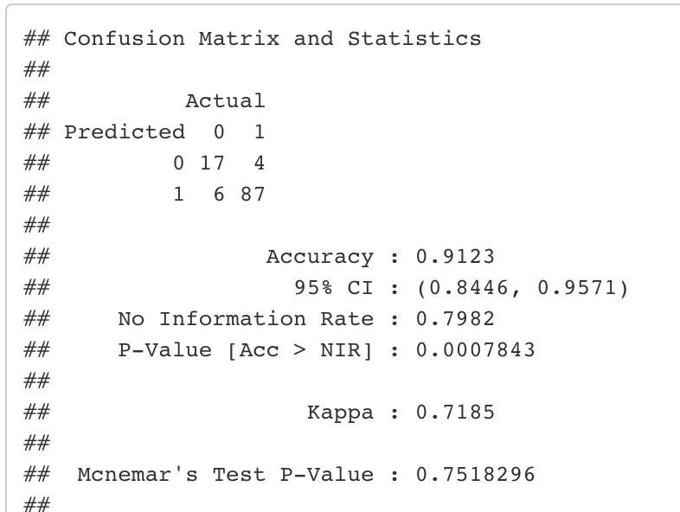
Results
Original Research
As you can see on the right, the accuracy of logistic regression is .91. Based on the provided answers, the researches trying to predict if a user will continue buying at Starbucks or not. The result of .91 may be misleading because of multiple reasons. The original data was critically imbalanced. Y axis of data does not contain enough “No” answer to be able to predict False Positives correctly. Moreover the sample size is not enough to be able to perfom Logistic regression successfully.

Slide 5
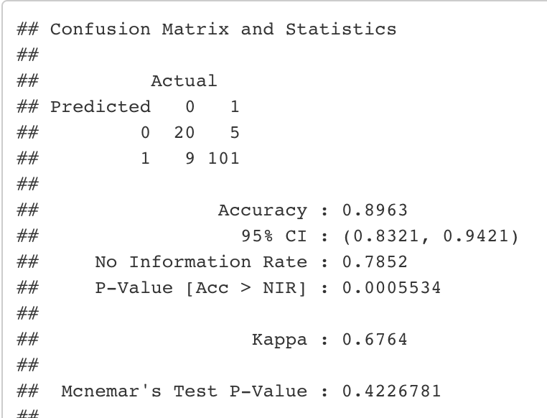
Results
Our Research
Our accuracy is slightly less than the original research. It is not a huge difference to make sharp conclusions but we beleive that when homogeneity of sample increase, it is harder to overfit the data and easier to generate more realistic results. The mistake of original research was assuming that collecting data from one part of world will give general answers about “Customer loyalty”. However the results shows, if we can increase the homogeneity of dataset, we will only predict the “Customer loyalty” of people who belongs to a specific culture/demography/geography

Slide 6
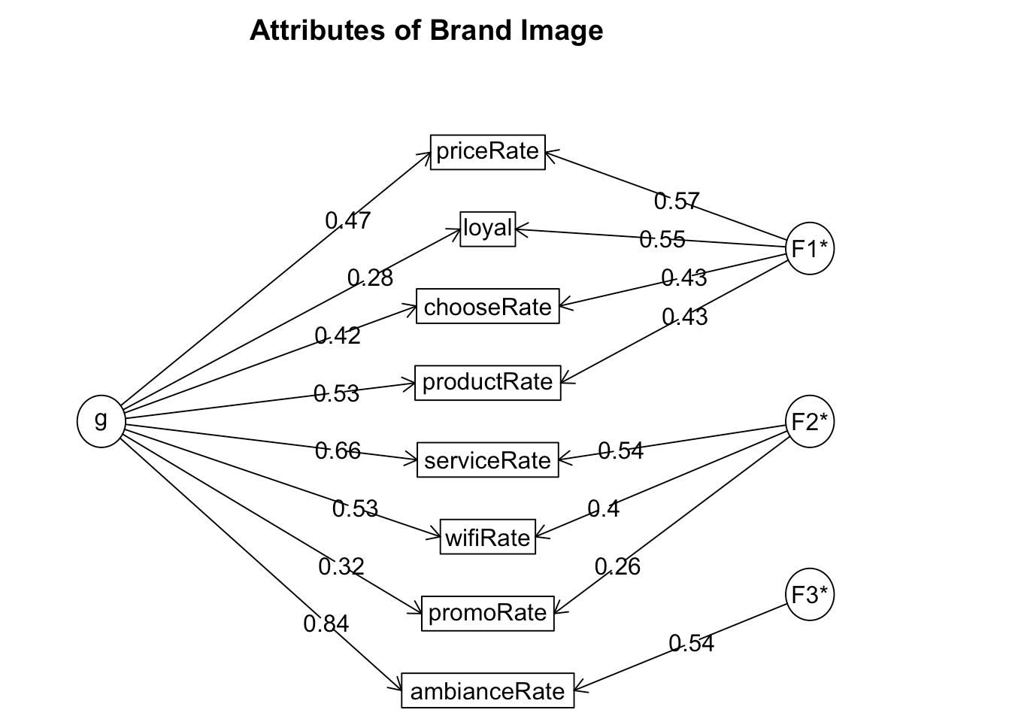
Results
Original Research

Slide 7
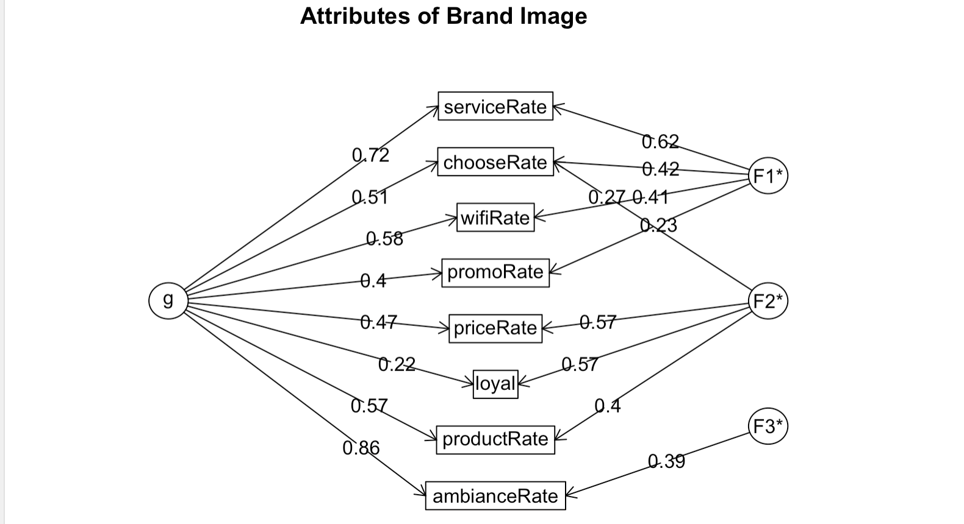
Results
Our Research

Slide 8
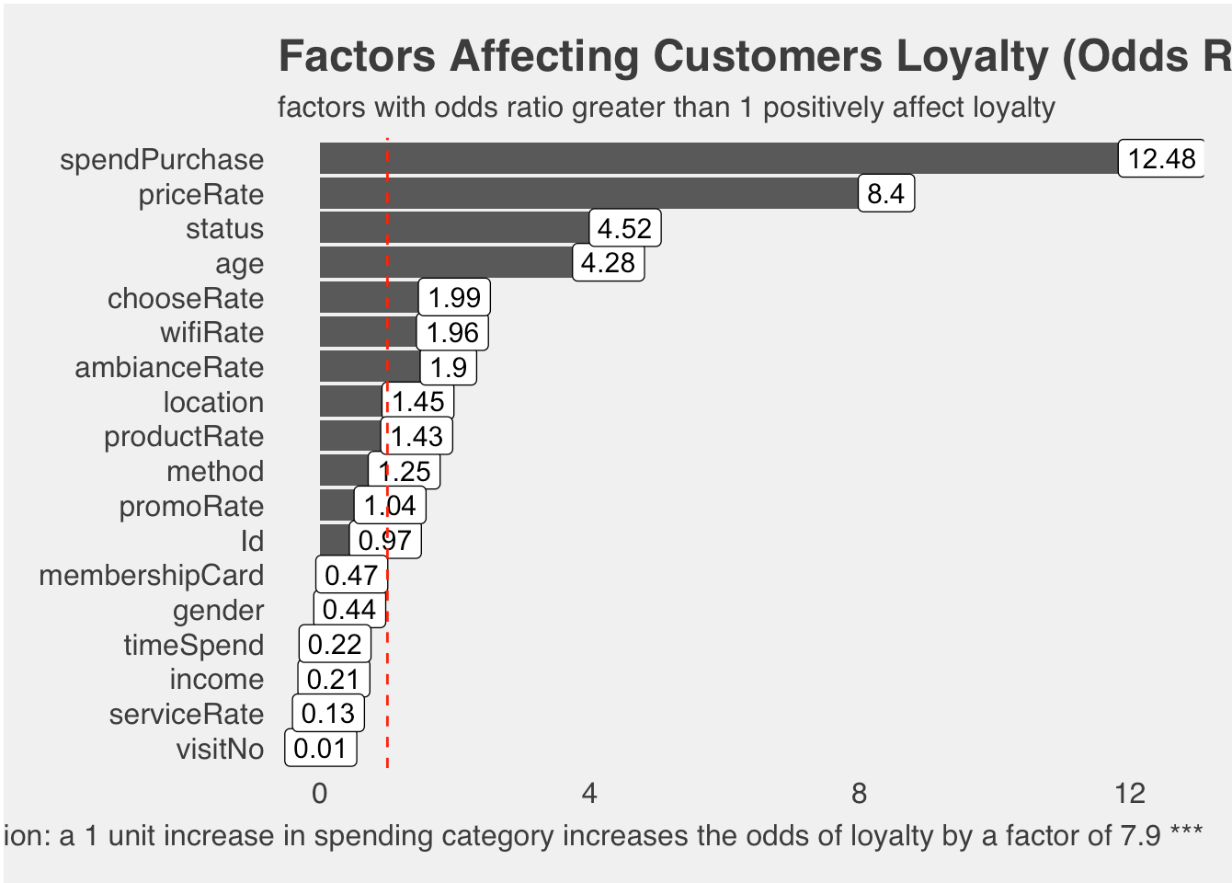
Result
Original Research
As you can see on the right, price and purchased amount directly affects Customer loyalty in Malaysia. SpendPurchase priceRate
0 Zero Scaled 1-5
1 Less than RM20 Very bad - Excellent
2 RM 20 to RM40
3 More than RM40

Slide 9
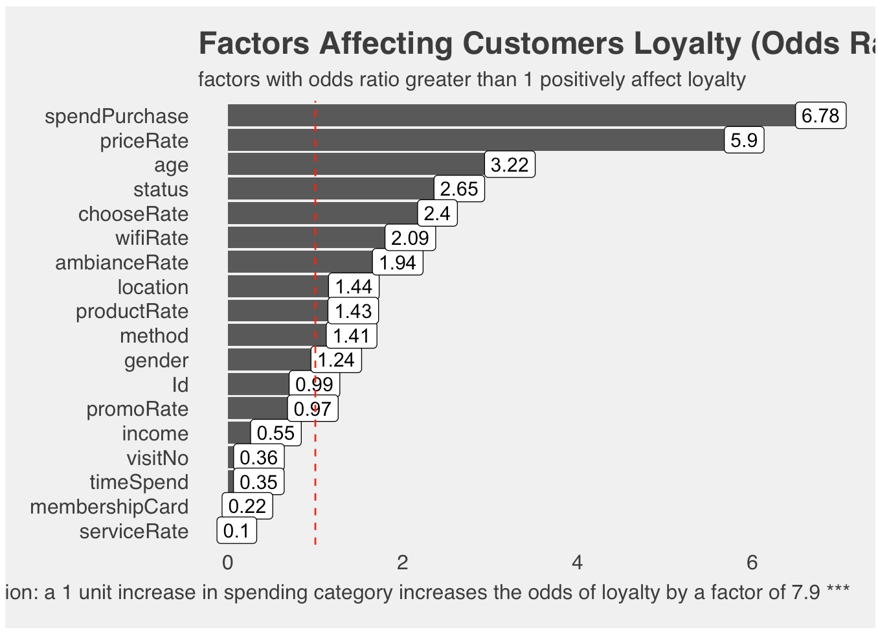
Result
Our Research
When we add the data coming from Poland, the importance of price and purchased amount decreased slightly. However they are still most important factors related to customer loyalty analysis SpendPurchase priceRate
0 Zero Scaled 1-5
1 Less than RM20 Very bad - Excellent
2 RM 20 to RM40
3 More than RM40

Slide 10
Conclusion

