Slide 1
Fake News Detection on LIAR
Разпознаване на фалшиви новини — classify a statement by its truthfulness
Габриела Костева, 2MI3400845
Deep Learning project · LIAR dataset + Streamlit web app

Slide 2
Problem & motivation
Why this matters
▪ Misinformation spreads faster than human fact-checking can keep up
▪ Goal: given a short statement, automatically predict how truthful it is
▪ Two framings of the same problem:
– six-class — the full truth scale: pants-fire → false → barely-true → half-true → mostly-true → true
– binary — a fake / real collapse of that scale
▪ Delivered as an interactive web app, not just a notebook

Slide 3
Related work & techniques
Step 1 — literature
▪ Wang (2017), "Liar, Liar Pants on Fire" — introduces the LIAR benchmark
– Reported ceilings: ≈0.27 six-class / ≈0.65 binary accuracy (text-only)
▪ Fake-news detection surveys: linguistic, neural and transformer approaches
▪ Word-embedding evolution explored in this project:
– TF-IDF → Word2Vec / GloVe / FastText → contextual (BERT family)
– Recurrent encoders (LSTM / GRU) for sequence modelling

Slide 4
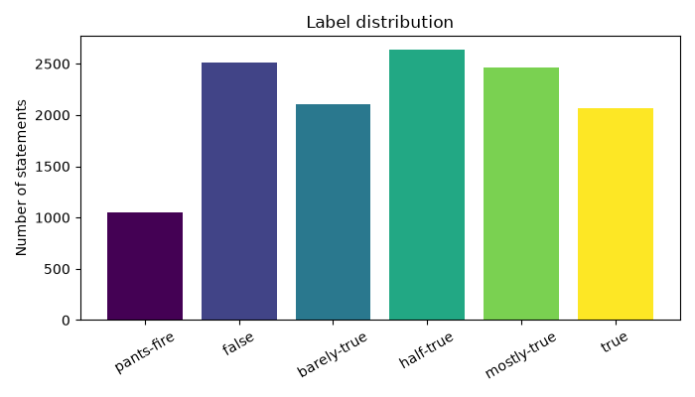
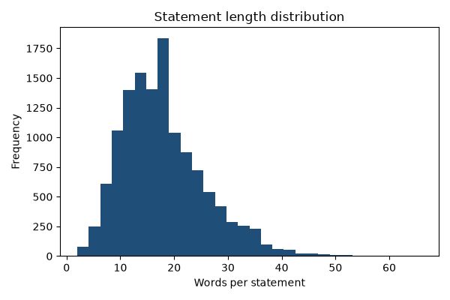
The data
Step 2 — 12,836 statements, official train/valid/test split
14 features: statement + speaker / party / subject / context + 5 credit-history counts. Labels ≈ balanced 6-way; statements ≈ 18 words.

Slide 5
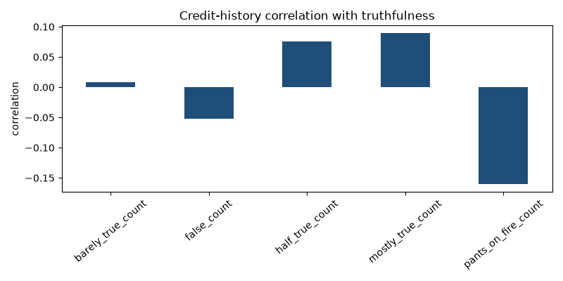
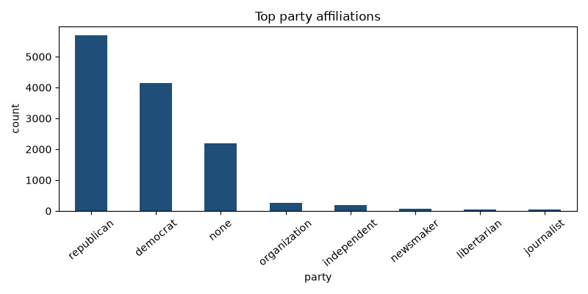
Exploratory analysis
Step 2 — statistical dependencies & anomalies
Speaker credit-history and party affiliation correlate with truthfulness. Anomalies: 129 missing contexts, 26 duplicate statements.

Slide 6
Why LIAR is hard
Setting expectations
▪ Only one short sentence — no article body, no external evidence
▪ Adjacent labels are subjective (barely-true vs half-true vs mostly-true)
▪ Six near-balanced classes → random chance ≈ 16.7%
▪ Published deep models mostly land in the 0.25–0.29 six-class range
▪ So absolute six-class accuracy looks modest by nature — macro-F1 vs the baseline is the honest measure of progress

Slide 7
Pipeline & preprocessing
Step 2–3 — from raw TSV to tensors
▪ clean_text: lowercase, strip URLs / punctuation, keep digits
▪ Vocabulary: frequency-capped token→id map with <pad> and <unk>
▪ Statements encoded to fixed-length padded id sequences
▪ Majority-class baseline = the reference every model must beat
▪ Macro-F1 chosen as the primary metric (robust to class imbalance)

Slide 8
Embedding experiments
Step 3 — how words become vectors
▪ TF-IDF + logistic regression — sparse bag-of-words baseline
▪ Learned nn.Embedding layer — trained end-to-end with the RNN
▪ Word2Vec & FastText — trained on the LIAR corpus
▪ GloVe — pre-trained 100-d vectors loaded from file
▪ Take-away: corpus-trained Word2Vec / FastText gave the best macro-F1

Slide 9
Recurrent models
Step 4 — GRU & LSTM variants
▪ LSTM vs GRU on an identical setup
▪ Regularisation: dropout and AdamW weight decay
▪ Capacity sweep: wider hidden state and a second layer
▪ Masked mean pooling over real tokens → linear classifier head

Slide 10
Transformer models
Step 5 — contextual fine-tuning (opt-in)
▪ BERT, RoBERTa, DistilBERT and GPT-2 via HuggingFace
▪ AutoModelForSequenceClassification, one code path for all four
▪ Trade-off: higher potential accuracy vs much higher compute cost
▪ Opt-in in the pipeline (python run.py --transformers) to stay laptop-friendly

Slide 11
Results — six-class
Macro-F1 is the primary metric
Model | Accuracy | Macro-F1 | vs baseline (F1)
Baseline (majority class) | 0.208 | 0.057 | —
TF-IDF + Logistic Regression | 0.261 | 0.261 | +355%
LSTM (learned embedding) | 0.278 | 0.279 | +386%
GRU (learned embedding) | 0.281 | 0.278 | +385%
BiLSTM + Word2Vec (best) | 0.292 | 0.293 | +411%
Best six-class model: BiLSTM + Word2Vec — macro-F1 0.293, accuracy 0.292.

Slide 12
Results — binary (fake / real)
The same models, easier task
Model | Accuracy | Macro-F1 | vs baseline (F1)
Baseline (majority class) | 0.567 | 0.362 | —
TF-IDF + Logistic Regression | 0.645 | 0.631 | +74%
BiGRU + dropout | 0.652 | 0.636 | +76%
BiLSTM + Word2Vec | 0.651 | 0.640 | +77%
BiLSTM + FastText (best) | 0.642 | 0.641 | +77%
Best binary model: BiLSTM + FastText — macro-F1 0.641, accuracy 0.642.

Slide 13
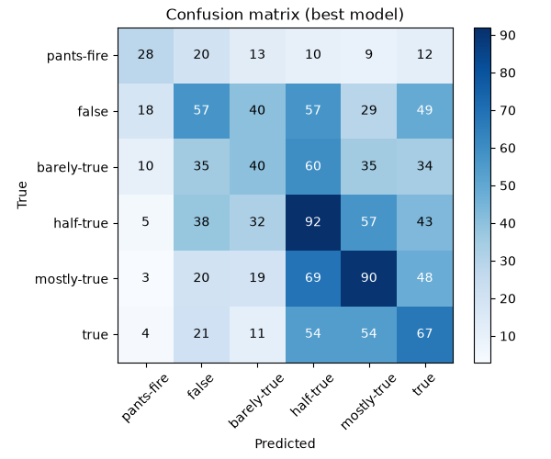
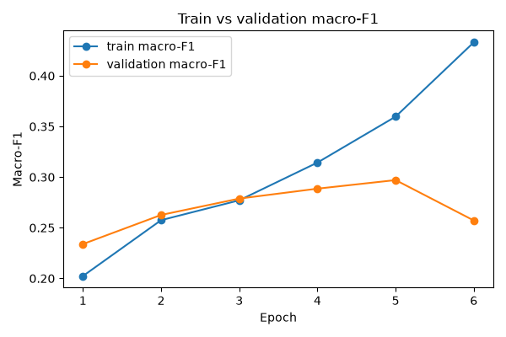
Best model diagnostics
Six-class — confusion matrix & learning curves
Errors concentrate on adjacent truth labels; train/val macro-F1 tracks closely (early stopping prevents overfitting).

Slide 14
Web application
Step 6 — Streamlit demo
▪ Type or pick a statement, choose six-class or binary
▪ Returns the predicted label, a plain-language explanation, confidence and a probability bar chart
▪ Loads the saved best model; falls back to TF-IDF if no artifact exists
▪ Tip: use real political-style claims — generic facts are out-of-domain

Slide 15
Testing & engineering
Quality bar
▪ Behaviour-driven unit tests: test_when_<condition>_then_<expectation>
▪ 100% statement coverage of the src package
▪ Clean yapf / isort / mypy
▪ Reproducible: fixed seeds; Word2Vec/FastText/TF-IDF keep it runnable offline
▪ Turn-key: one command runs baseline → embeddings → RNNs → report + figures

Slide 16
Limitations & future work
Where to go next
▪ English only, no external evidence retrieval, subjective ordinal scale
▪ Metadata fusion — add speaker / party / credit-history as features
▪ Ordinal-aware loss that respects the truth ordering
▪ Transformer fine-tuning at full scale on GPU
▪ Probability calibration and explainability for the verdicts

Slide 17
Thank you — Questions?
Fake News Detection on LIAR · six-class & binary · Streamlit demo

