Slide 1

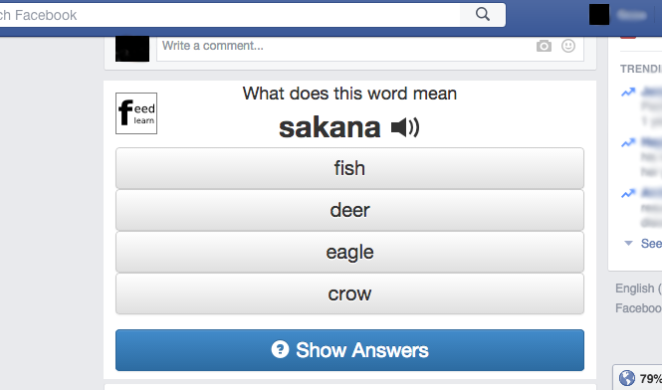
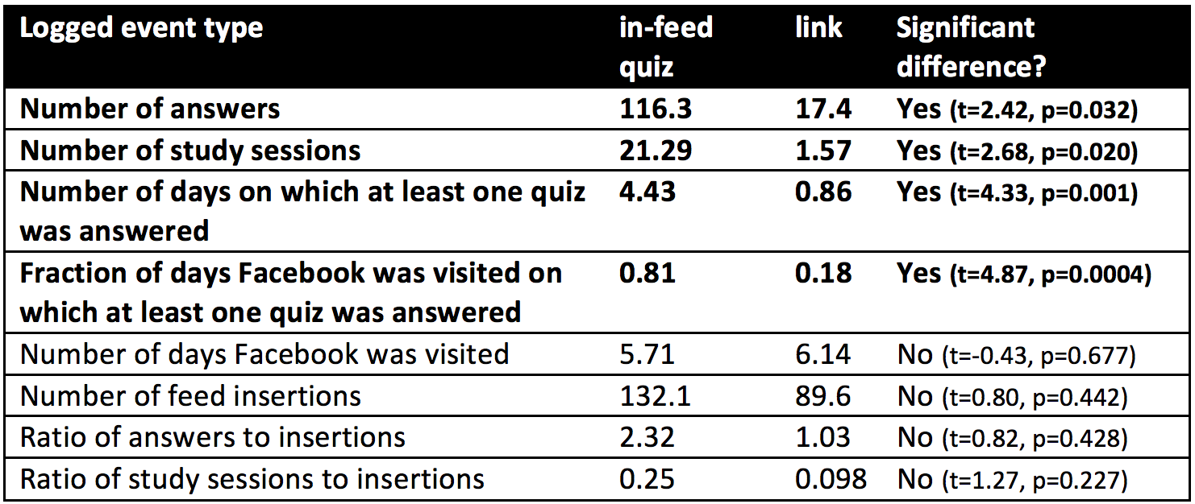
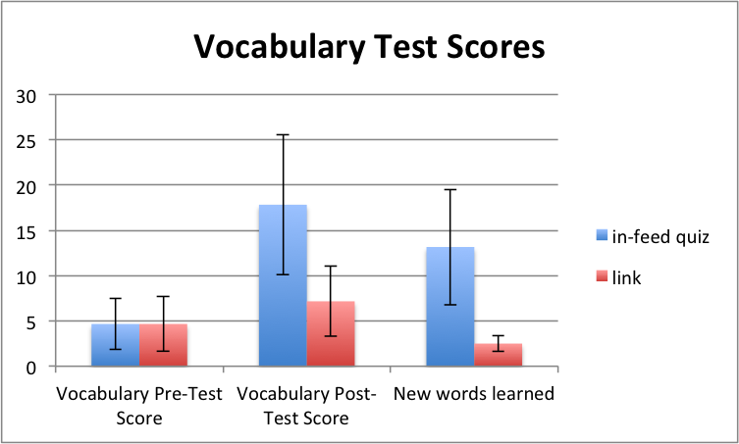
Geza Kovacs
Stanford University
FeedLearn: Using Facebook Feeds for Microlearning
Facebook’s widespread use presents a good opportunity for microlearning
71% of American adults with an internet connection use Facebook
Of these, 63% visit Facebook at least once a day, and 40% visit it multiple times per day
Microlearning on Facebook Feeds Today
“Word of the Day” post from KoreanClass101, which has 70,000 subscribers
Some services show a “word of the day” in your feed
Not interactive, not personalized, no spaced repetition, manually generated
FeedLearn: Microlearn directly in your Facebook feed
Shows interactive vocabulary quizzes in your feed
Quizzes occur every 10 feed items, similar to sponsored content
Can answer quizzes inside feed, without leaving Facebook
Personalized, automatically generated quizzes
Quizzes generated from vocabulary scraped from Wiktionary
Uses spaced repetition algorithm (Memreflex) to schedule words
Implemented as a Chrome Extension
Facebook’s API doesn’t let developers add interactive content to feeds
Preliminary User Study
12 participants studying 50 basic Japanese nouns across a week
6 had interactive quizzes inserted into feeds, 6 had links inserted into feeds
Took a pre-test at the beginning of week, and a post-test afterwards
Users in the in-feed quiz condition answered more quizzes, scored higher on vocabulary tests, and answered questions on more days of the week

