Slide 1

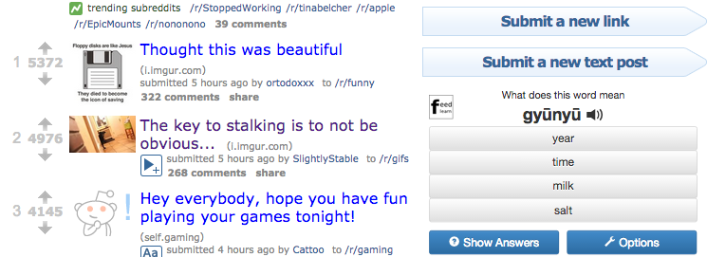
Regular Advertisements (without our extension)
Advertisements replaced with Edvertisements

Slide 2
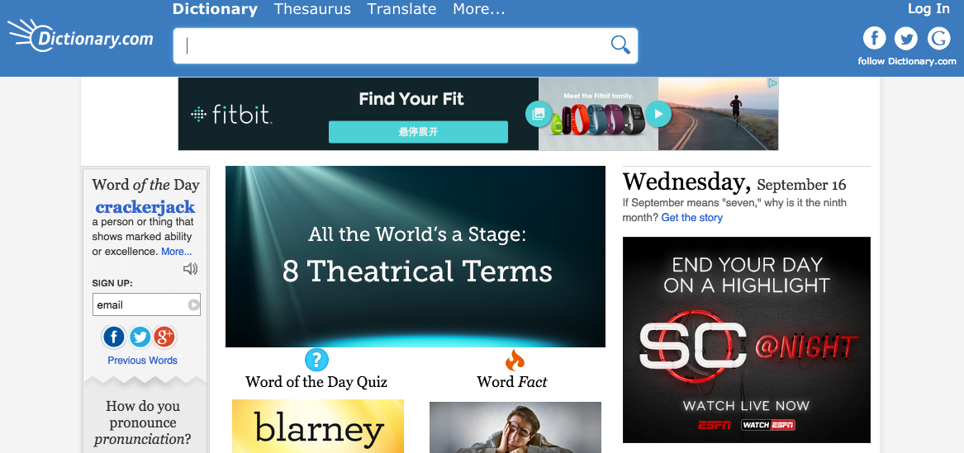
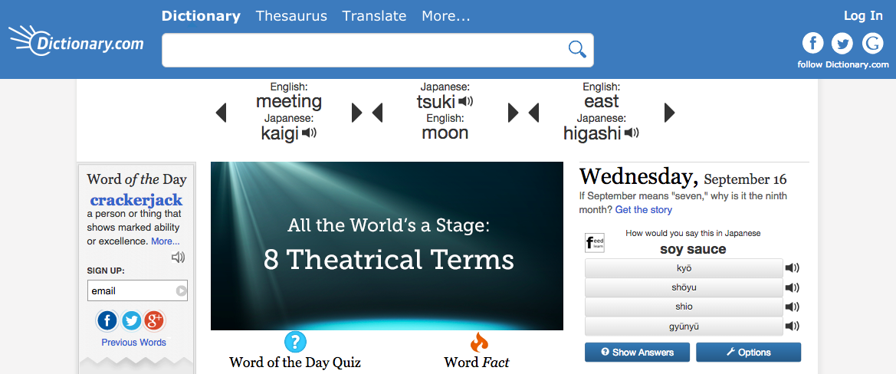
Regular Advertisements (without our extension)
Advertisements replaced with Edvertisements

Slide 3
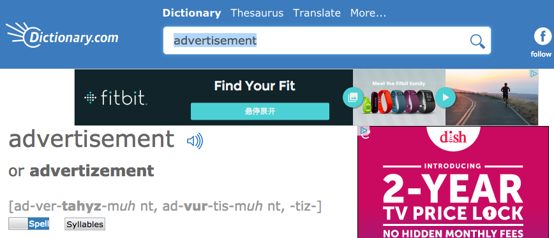
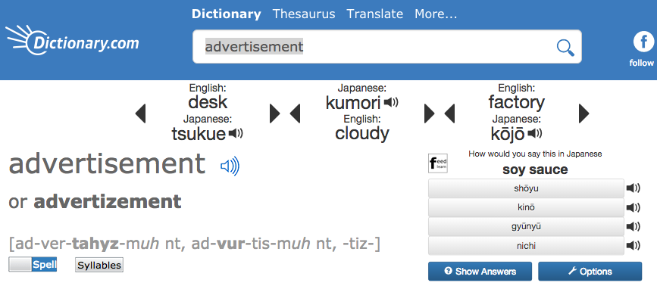
Regular Advertisements (without our extension)
Advertisements replaced with Edvertisements

Slide 4
Regular Advertisements (without our extension)
Advertisements replaced with Edvertisements

Slide 5
Regular Advertisements (without our extension)
Advertisements replaced with Edvertisements

Slide 6
Regular Advertisements (without our extension)
Advertisements replaced with Edvertisements

