Slide 1
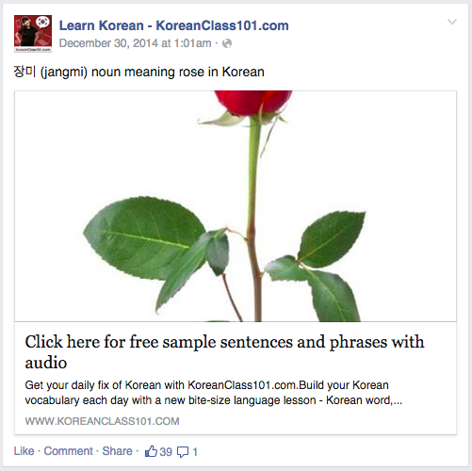
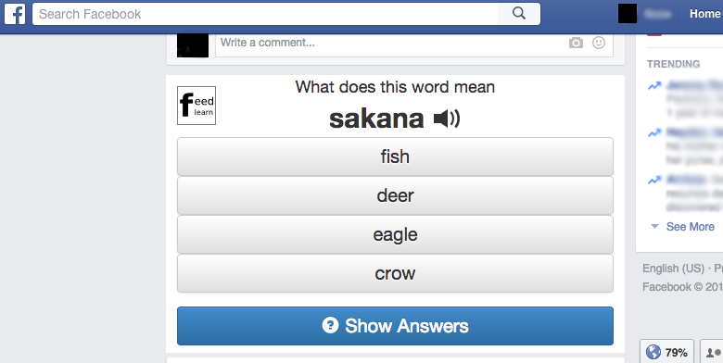
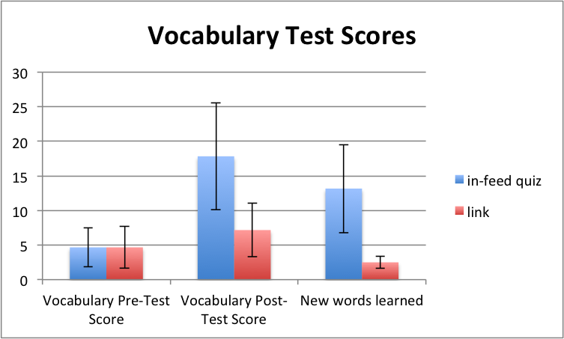
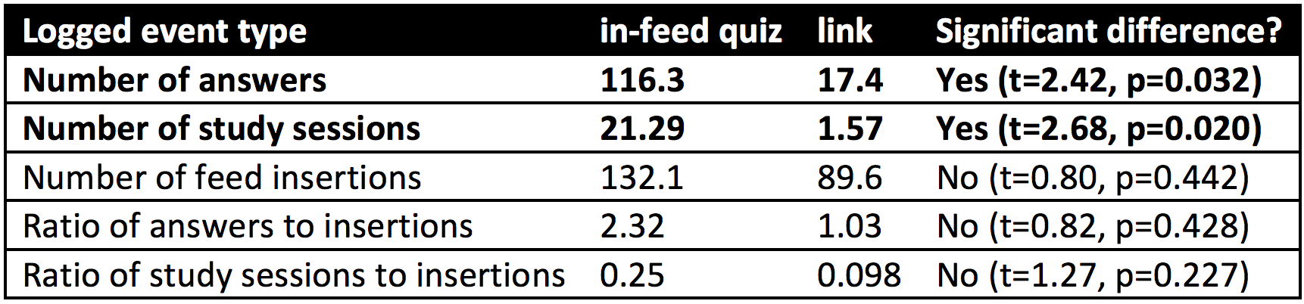
Geza Kovacs
Stanford University
FeedLearn: Using Facebook Feeds for Microlearning
Why is Facebook a good platform for Microlearning? Because people visit it often
71% of American adults with an internet connection use Facebook
Of these, 63% visit Facebook at least once a day, and 40% visit it multiple times per day
Microlearning on Facebook Feeds Today
Some services show a “word of the day” in your feed
Not interactive: need to visit their site to do the quizzes.
Not personalized: all subscribers will see the same daily word posted
No spaced repetition: older ones are never repeated.
“Word of the Day” post from KoreanClass101, which has 70,000 subscribers
FeedLearn: Lets you do vocabulary quizzes directly inside your Facebook feed
Shows interactive vocabulary quizzes into your feed
Can answer quizzes without leaving Facebook
Personalized, automatically generated quizzes
Quizzes generated from vocabulary scraped from Wiktionary
Uses spaced repetition algorithm to schedule words
Implemented as a Chrome Extension
Facebook’s API doesn’t let developers add interactive content to feeds
Preliminary User Study
12 participants studying 50 basic Japanese nouns across a week
6 had interactive quizzes inserted into feeds, 6 had links inserted into feeds
Took a pre-test at the beginning of the week, and a post-test afterwards
Users in the in-feed quiz condition answered more quizzes and scored higher on vocabulary tests

