Slide 1
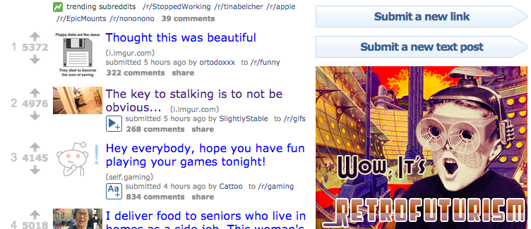
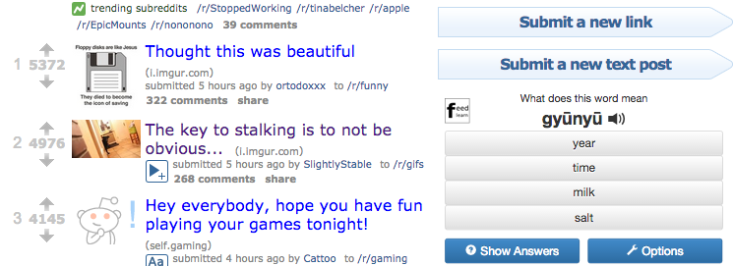
Regular Advertisements (without our extension)
Advertisements replaced with Edvertisements

