Slide 1
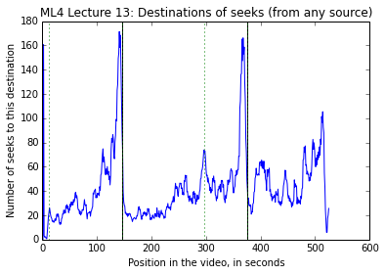
Seek Destinations in ML4 Lecture 13 (from all sources)
First in-video quiz
Slide transition
Second in-video quiz
Destinations of seeks in a video with 2 in-video quizzes (Machine Learning, Lecture 13 on Coursera), from all sources. The most common places users seek to are right before the in-video quizzes (Coursera does not allow users to go directly to in-video quizzes, so this is how users would go to the in-video quiz question). There are also peaks in seeking to the beginning, end, and slide transitions.

Slide 2
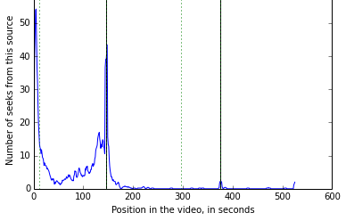
Sources of seeks to In-Video Quiz 1 in ML4 Lecture 13
First in-video quiz
Slide transition
Second in-video quiz
Sources of seeks that go to (immediately before) the first in-video quiz. Many users seek to the first in-video quiz from the very beginning of the video, and others seek forward to the in-video quiz from the section that immediately precedes it (which is the material tested in the in-video quiz).

Slide 3
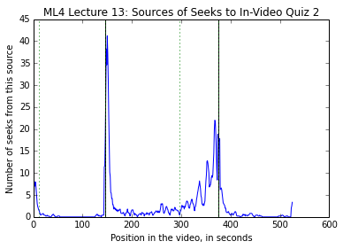
Sources of seeks to In-Video Quiz 2 in ML4 Lecture 13
First in-video quiz
Slide transition
Second in-video quiz
Sources of seeks that go to (immediately before) the second in-video quiz. Many users seek to the second in-video quiz immediately after answering the first in-video quiz, and others seek forward to the in-video quiz from the section that immediately precedes it (which is the material tested in the in-video quiz).

Slide 4
A
B
C
D
E
F

Slide 5
A
B
C
D
E
F

Slide 7
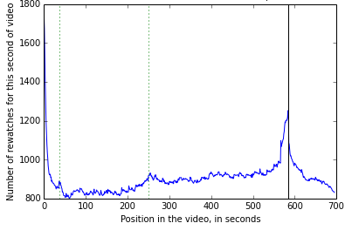

Slide 8
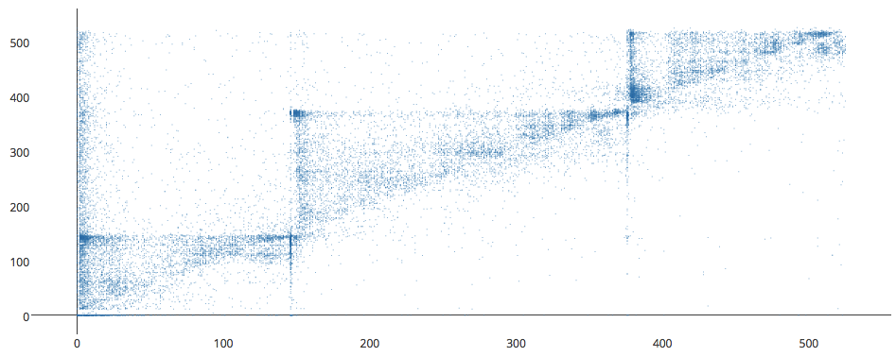
In-video quiz 2 (t=376)
Destination of seek event (position in video, in seconds)
In-video quiz 1 (t=146)
In-video quiz 1 (t=146)
In-video quiz 2 (t=376)
Start of seek event (position in video, in seconds)
Seeks sources and destinations within a Coursera lecture video (Machine Learning, lecture 13), shown as a scatter plot on the left, and a 2D histogram on the right. A point at coordinate (x,y) represents a seek event starting from time x, going to time y in the video. Points above the diagonal are seeks going forward, and points below the diagonal are seeks going back. We see there are many seeks from the start of the video to the first in-video quiz, as shown at point (0,146); there are also many seeks from immediately after the first in-video quiz to the second in-video quiz, as shown at point (146,376). As we can see at lines y=146 and y=376, users do not tend to skip past the in-video quizzes to the next subsection, and they do not tend to skip back to previous subsections. If we look at backwards seeks (points below the diagonal), they mostly originate at the in-video quizzes (x=146 and x=376), and go to points in the immediately preceding section.

Slide 9
Scatter Plot of Seek Sources and Destinations in ML4 Lecture 13 on Coursera
In-video quiz 2 (376 seconds)
Destination of seek event (position in video, in seconds)
In-video quiz 1 (146 seconds)
In-video quiz 1 (146 seconds)
In-video quiz 2 (376 seconds)
Start of seek event (position in video, in seconds)

Slide 10
Scatter Plot of Seek Sources and Destinations in ML4 Lecture 13 on Coursera
In-video quiz 2 (376 seconds)
Destination of seek event (position in video, in seconds)
In-video quiz 1 (146 seconds)
In-video quiz 1 (146 seconds)
In-video quiz 2 (376 seconds)
Start of seek event (position in video, in seconds)

Slide 11
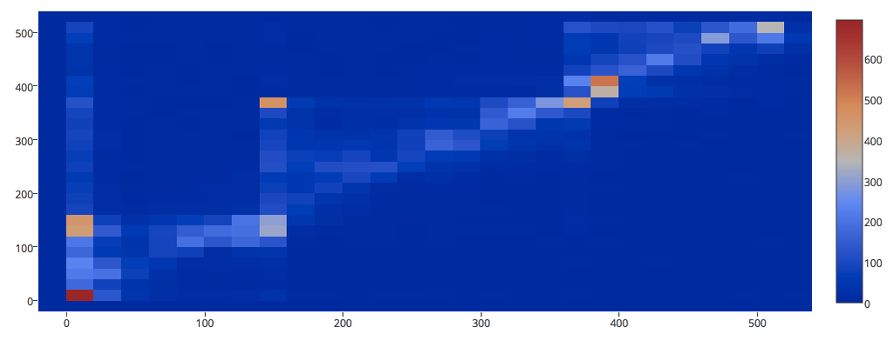
In-video quiz 2 (t=376)
Destination of seek event (position in video, in seconds)
In-video quiz 1 (t=146)
In-video quiz 1 (t=146)
In-video quiz 2 (t=376)
Start of seek event (position in video, in seconds)
Seeks sources and destinations within a Coursera lecture video (Machine Learning, lecture 13), shown as a scatter plot on the left, and a 2D histogram on the right. A point at coordinate (x,y) represents a seek event starting from time x, going to time y in the video. Points above the diagonal are seeks going forward, and points below the diagonal are seeks going back. We see there are many seeks from the start of the video to the first in-video quiz, as shown at point (0,146); there are also many seeks from immediately after the first in-video quiz to the second in-video quiz, as shown at point (146,376). As we can see at lines y=146 and y=376, users do not tend to skip past the in-video quizzes to the next subsection, and they do not tend to skip back to previous subsections. If we look at backwards seeks (points below the diagonal), they mostly originate at the in-video quizzes (x=146 and x=376), and go to points in the immediately preceding section.

Slide 12
Scatter Plot + Histogram of Seek Sources and Destinations in ML4 Lecture 13 on Coursera
Seeks sources and destinations within a Coursera lecture video (Machine Learning, lecture 13), shown as a scatter plot on the top, and a 2D histogram on the bottom. A point at coordinate (x,y) represents a seek event starting from time x, going to time y in the video. Points above the diagonal are seeks going forward, and points below the diagonal are seeks going back. We see there are many seeks from the start of the video to the first in-video quiz, as shown at point (0,146); there are also many seeks from immediately after the first in-video quiz to the second in-video quiz, as shown at point (146,376). As we can see at lines y=146 and y=376, users do not tend to skip past the in-video quizzes to the next subsection, and they do not tend to skip back to previous subsections. If we look at backwards seeks (points below the diagonal), they mostly originate at the in-video quizzes (x=146 and x=376), and go to points in the preceding section.

Slide 13
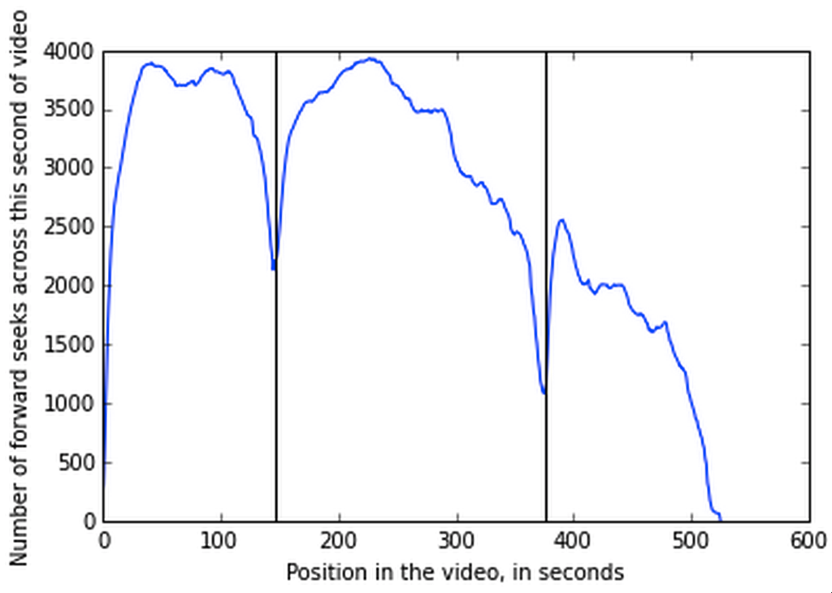
Video portions seeked forward over in ML4 Lecture 13
First in-video quiz
Second in-video quiz
Number of times a forward seek crossed a given second of video, summed over all views. Dips occur at in-video quizzes, indicating that users are not attempting to skip over the in-video quizzes or seeking to a following section without doing the in-video quiz.

Slide 14
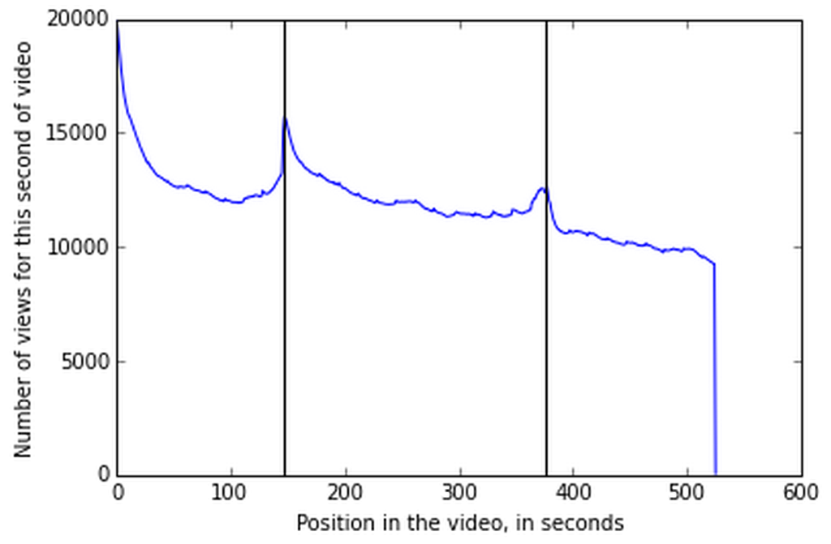
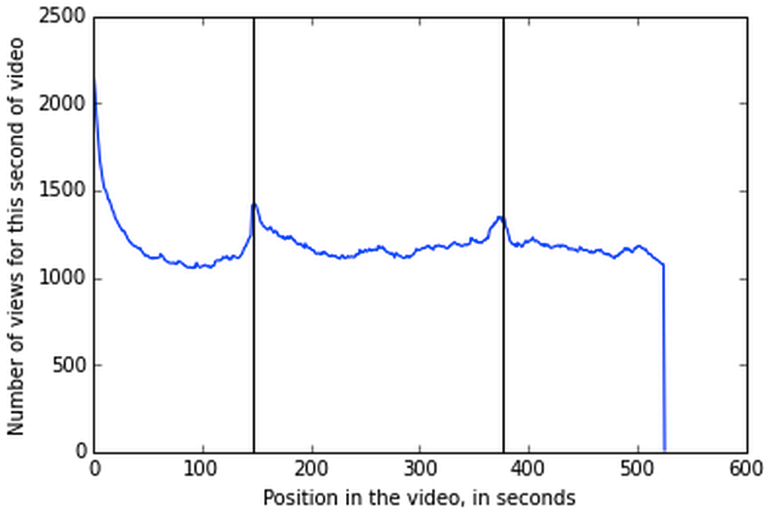
Number of times each second of video was watched, ML4 Lecture 13
Number of times each second of video was watched in reviewing sessions
Number of times a times each second of video was watched, summed across all users and all watching sessions. There are peaks at the in-video quizzes, indicating the users are engaging more with in-video quizzes and the content surrounding them. The steady decline over time is due to in-video dropout (Kim 2014).
Number of times a times each second of video was watched, summed across all users, but restricted to only reviewing sessions, which we define as watches which occur at least 1 hour after the first time the user first watched the video. We still see peaks in user engagement around the in-video quizzes during reviewing sessions.

