Slide 1
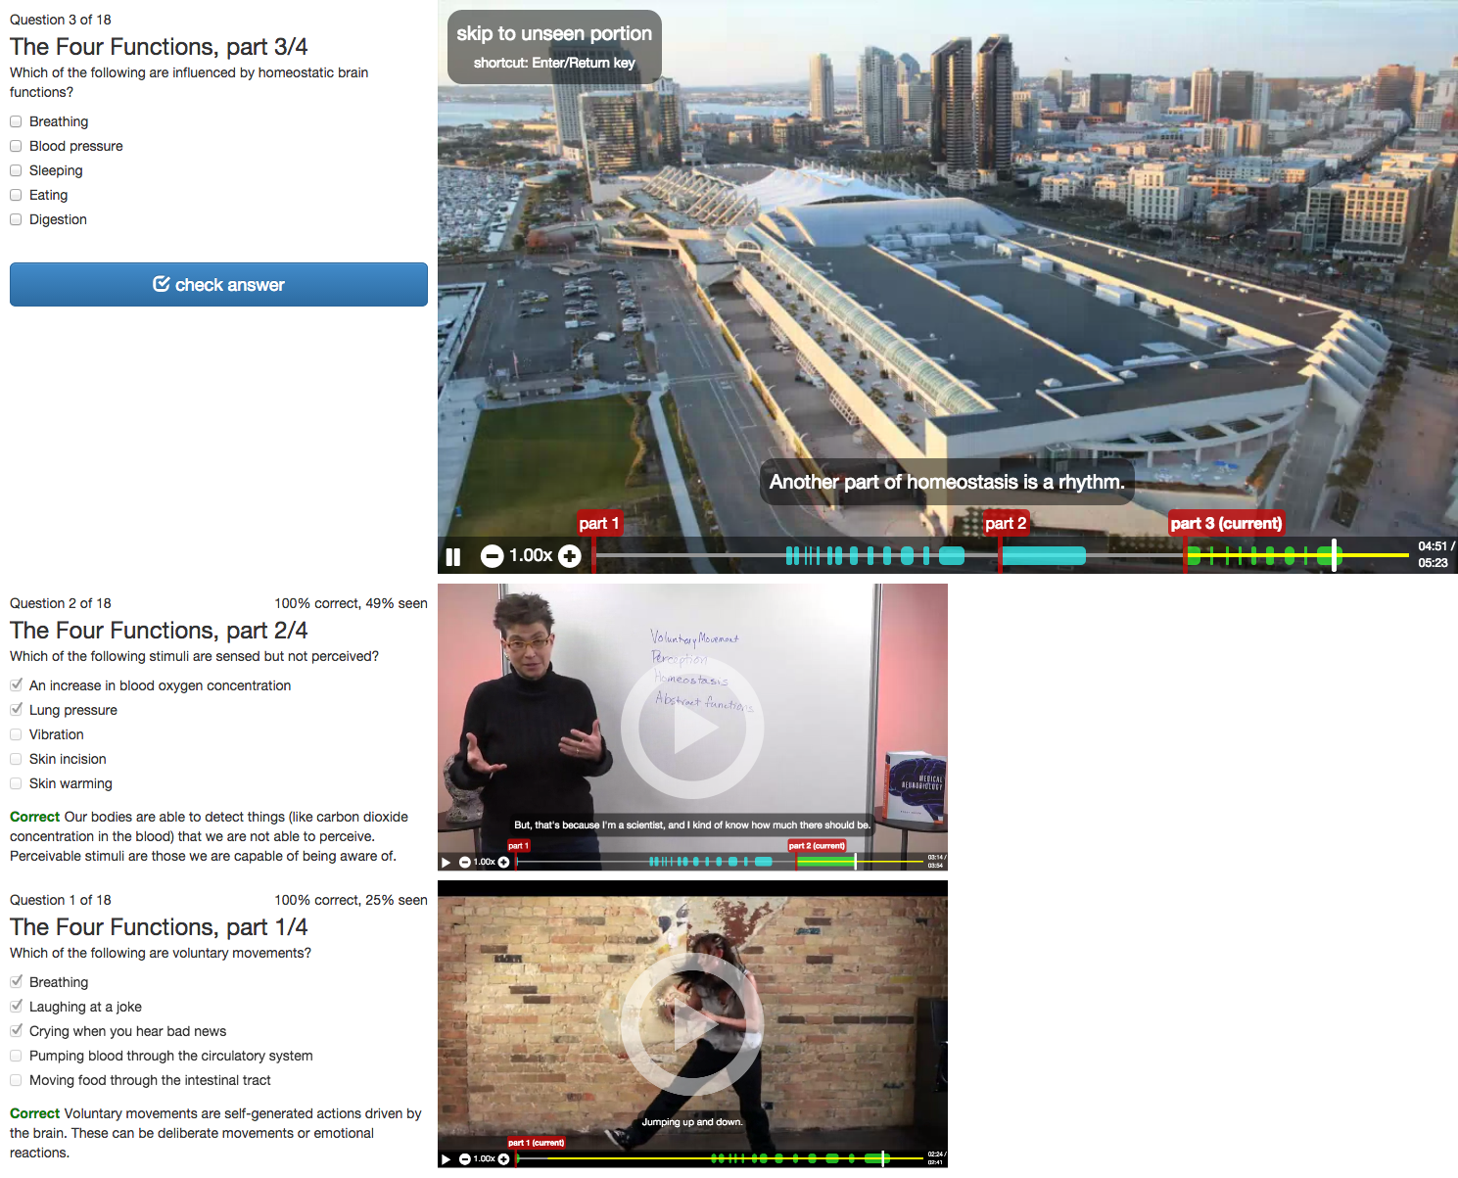
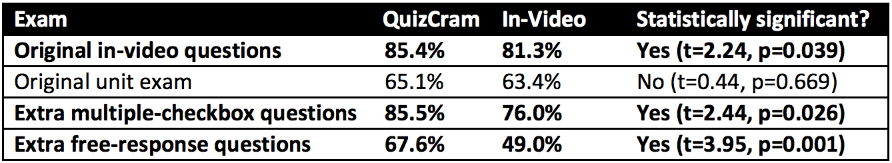
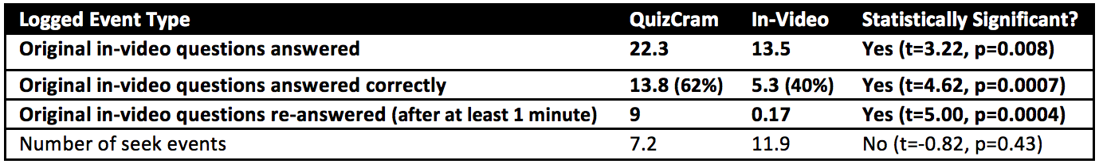
Geza Kovacs
Stanford University
QuizCram: A Question-Driven Video Study Interface
1. How can online lectures be improved?
Eliminate the need to seek to and from in-video quizzes
In-video quizzes are the most common seek destination in Coursera lectures
Users often skip forward to quizzes, or from one quiz to the next
Increase emphasis on testing and review
Repeated testing and spaced review improves retention
However, MOOC users primarily watch videos, don’t do problems or exams
Only 11% of users who finish watching a lecture ever open it again
2. QuizCram: Question-Driven Video Viewing
Shows a question associated with each part of the video
If you know the answer, answer question to navigate to the next section
Review using a timeline of past questions and videos
Can refer back to past questions, or resume watching a previous video
Keeps track of seen parts and suggests parts to review
Suggestions based on past performance, parts seen and recency of review
Can be automatically generated from in-video quizzes
Can also add additional questions for a more quiz-driven experience
Progressbar shows seen parts of video and parts relevant to the question
Timeline of past videos and questions allows easy navigation and review
3. User Study: QuizCram vs In-Video Quizzes
4. Study Procedure
Within-subjects study over 2 days with 18 participants
Materials from Neurobiology course on Coursera
2 parts, each with 5 videos, 9 in-video quizzes, and unit exam
Day 1: Study both sets of videos for 40 minutes, one with each tool
Day 2: Take a set of exams on the studied materials
Unit exams, in-video quizzes, extra multiple-checkbox and free-response questions
5. Results: improved retention on in-video questions and more questions reviewed with QuizCram
Exam scores showed improved retention on in-video questions
Logs showed that users answered and reviewed questions more with QuizCram

