Slide 1
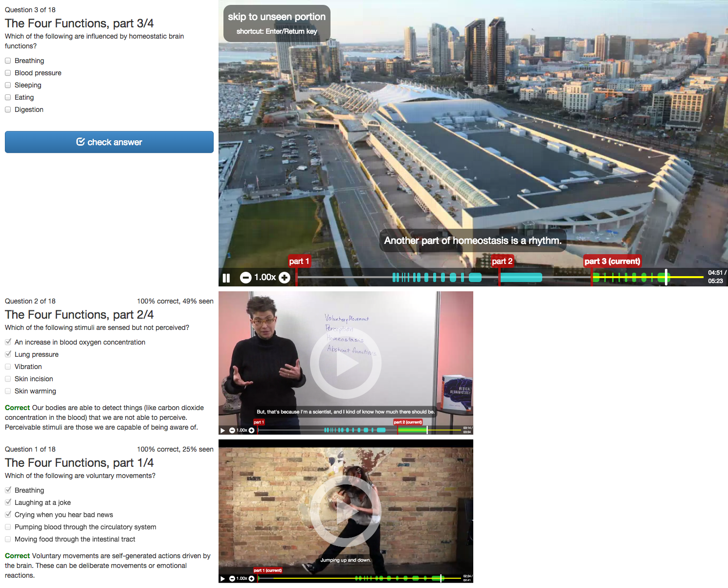
Current question
Previous questions
Progress bar highlights seen parts of video and parts relevant to the question
Timeline of past videos and questions allows easy navigation and review

