Slide 1
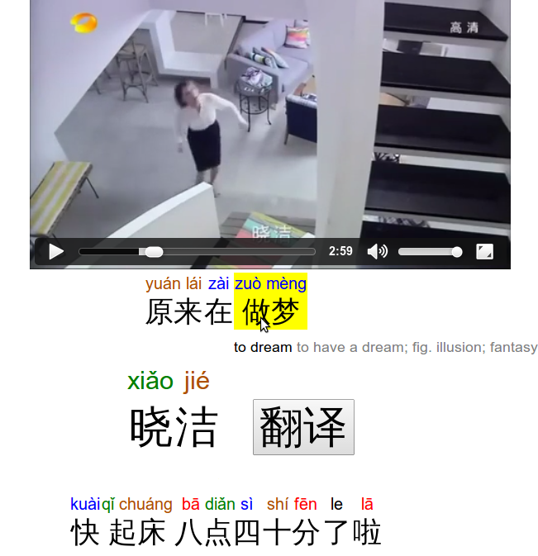
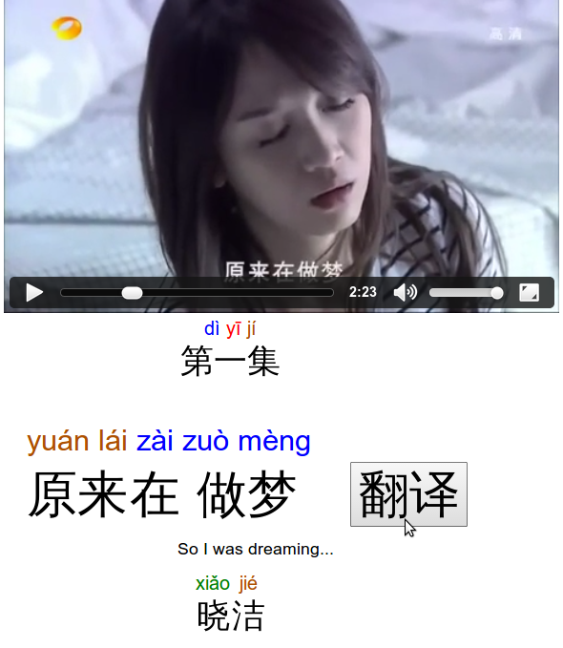
Click a line of dialog to replay it
Click to show translation for this line of dialog

