Slide 1
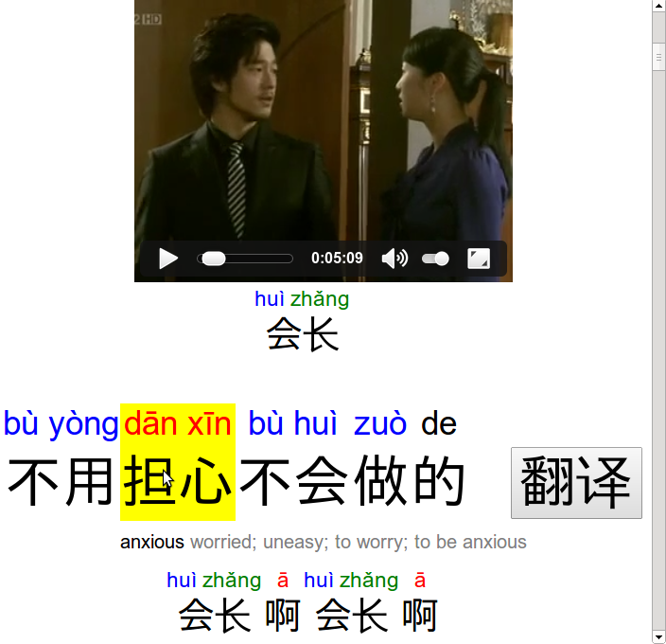
View pronunciations of characters with tone-colored pinyin
Review the previous line of dialog, and click to replay it
Hover over words to show their definitions
Click to show full English translation for this line of dialog

