Slide 1
Determining the Fastest Cooling Rod
Gabriel Kret, Jonas Margono, Maria Alvarado
Notes:
Maria

Slide 2
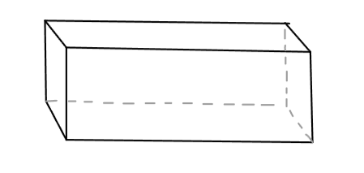
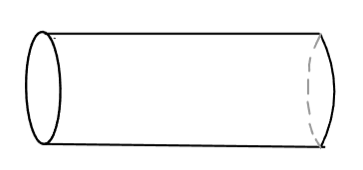
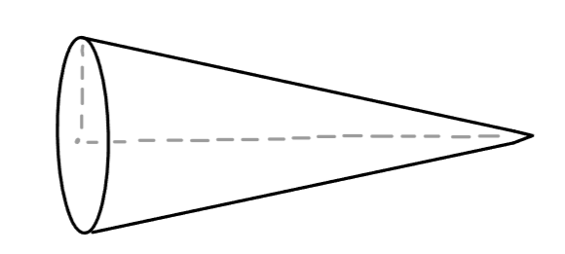
Project Objective
Determine which shape rod will cool the fastest
Square Rod
Circular Rod
Cone
L
D
L
w
L
R
Notes:
Maria Talk about given parameters

Slide 3
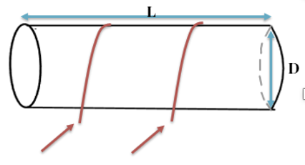
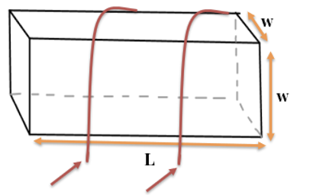
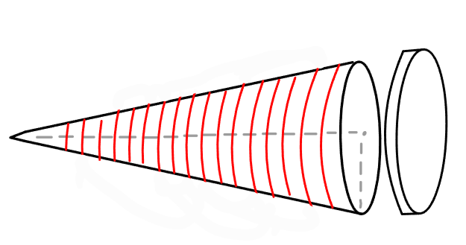
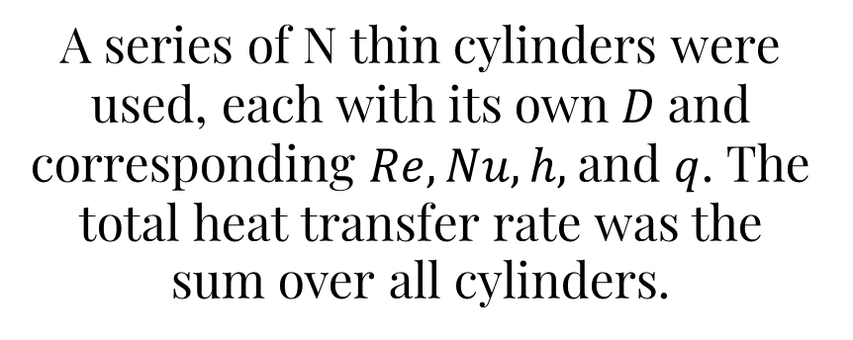

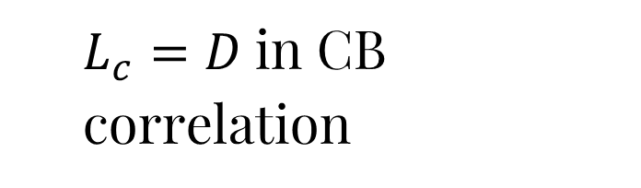

Forced External Convection
Compute Reynolds number $Re=\frac{ρVL_{c}}{μ}$
Apply Churchill-Bernstein (CB) correlation to compute $Nu$
Circular Rod
Square Rod
Cone
L
R
$L_{c}=D$in CB correlation
$L_{c}=w$in the CB correlation. We chose to use the CB for the square rather than the Hilpert correlations in Table 7.3 because the values obtained using the CB correlation more closely aligned with the results from Project 1 which showed that the square rod had a significantly lower time constant than the circular rod.
A series of N thin cylinders were used, each with its own $D$and corresponding $Re, Nu, h,$and $q$. The total heat transfer rate was the sum over all cylinders.
Notes:
Maria Talk about given parameters

Slide 4

Forced External Convection
Compute Reynolds number $Re=\frac{ρVL_{c}}{μ}$
Apply Churchill-Bernstein correlation to compute $Nu$
Calculate $h$ (Eq. A.8) and then $q$ (Eq. A9)
For the cylinder, $L_{c}=D.$
For the square rod, $L_{c}=w.$
For the cone, a series of N thin cylinders were used, each with its own $D$and corresponding $Re, Nu, h,$and $q$. The total heat transfer rate was the sum over all cylinders.
Shape | Re | Nu | h (W/m²K) | q (W)
Cylinder | 1500 | 19.59 | 59.15 | 21.58
Square | 1178 | 17.33 | 66.60 | 24.30
Cone | Varies | Varies | 40.05 (Average) | 9.66
Notes:
Maria

Slide 5
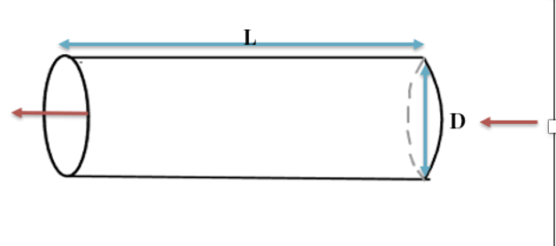
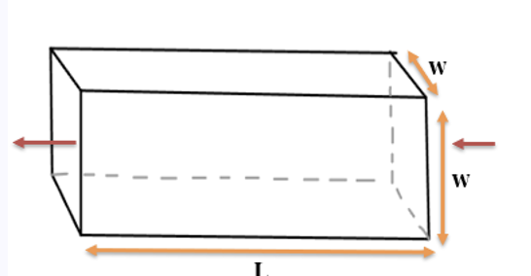

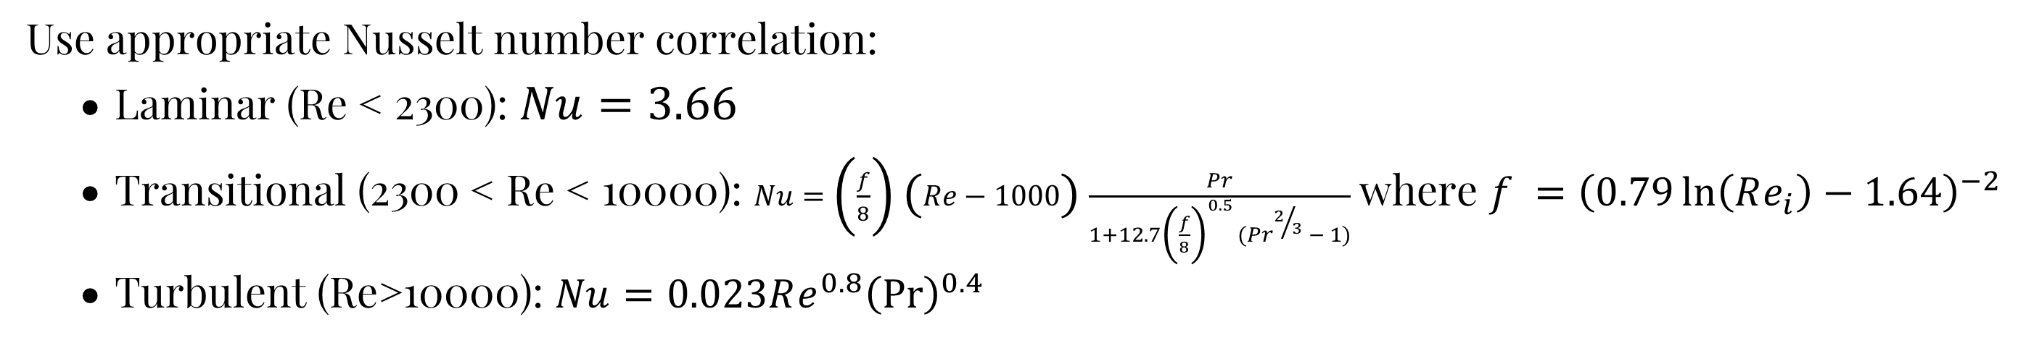
Forced Internal Convection
Each of the shapes were assumed to be thin walled such that the internal dimensions can be considered equal to the outside dimensions in Section 5 analysis. Thus, taking the internal surface area to be equal to the external surface area.
Circular Rod
Square Rod
Cone
dx
Use appropriate Nusselt number correlation:
Laminar (Re < 2300): $Nu=3.66$
Transitional (2300 < Re < 10000): $Nu=\left(\frac{f}{8}\right)\left(Re−1000\right)\frac{Pr}{1+12.7{\left(\frac{f}{8}\right)}^{0.5 }{(Pr}^{2/3} − 1)}$ where $f ={\left(0.79\ln\left(Re_{i}\right)−1.64\right)}^{−2}$
Turbulent (Re>10000): $Nu=0.023Re^{0.8}{\left(Pr\right)}^{0.4}$
Notes:
Gabriel Talk about given parameters

Slide 6

Forced Internal Convection
Use characteristic dimensions (diameter for cylinder and cone, width for square)
Compute $Re$and determine flow regime
Use appropriate Nusselt number correlation (Laminar vs Transitional vs Turbulent)
Calculate $h$and $q$ using Eq. A8 and Eq. A9, respectively.
Cone treated as a series of segments, each evaluated separately with the above method, and summed.
Shape | Re | Nu | h (W/m²K) | q (W)
Cylinder | 1500 | 3.66 | 11.05 | 4.03
Square | 1178 | 3.66 | 14.07 | 4.18
Cone | Varies | Varies | 16.64 | 2.27
Notes:
Gabriel

Slide 7
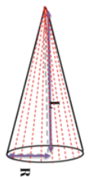
Free Convection
Circular Rod
Square Rod
Cone
L
w
R
L
D
w
L
Calculate Ra and use empirical constants from Table 9.2
Modeled as two vertical, top plate, and bottom plate.
Modeled as circular base and multiple inclined plates.
Modeled as cylinders of decreasing diameter.
Notes:
gabriel

Slide 8
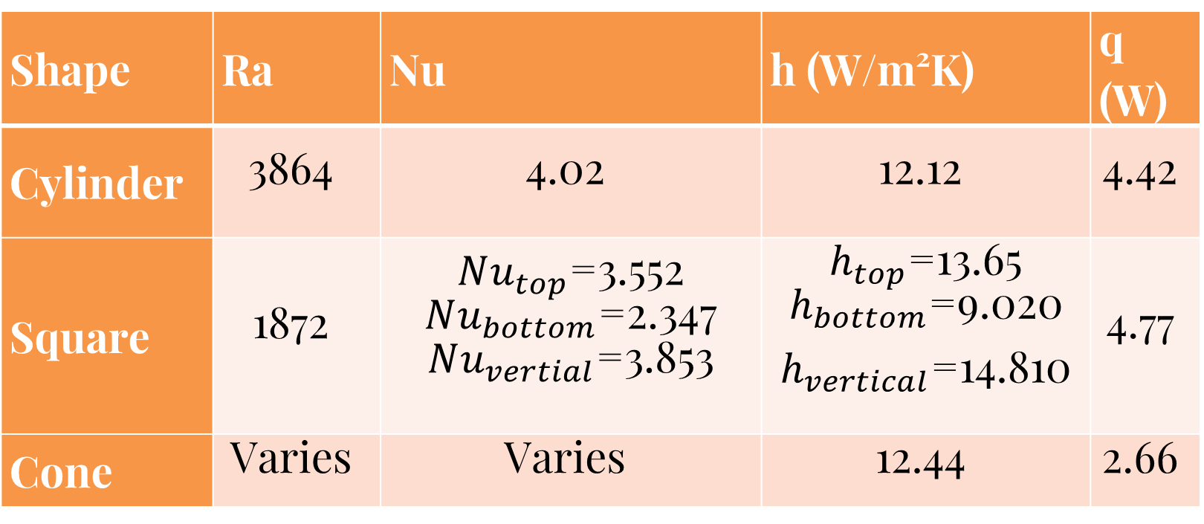

Free Convection: Results
Use characteristic dimensions (diameter for cylinder and width for square, inclined plates and circle for cone)
Compute the Rayleigh number (vertical and horizontal plates for varying geometries)
Use appropriate Nusselt number correlation
Calculate $h$and $q$ using Eq. A8 and Eq. A9, respectively
Cone treated as a series of segments and summed.
Shape | Ra | Nu | h (W/m²K) | q (W)
Cylinder | 3864 | 4.02 | 12.12 | 4.42
Square | 1872 | $Nu_{top}$=3.552 $Nu_{bottom}$=2.347 $Nu_{vertial}$=3.853 | $h_{top}$=13.65 $h_{bottom}$=9.020 $h_{vertical}$=14.810 | 4.77
Cone | Varies | Varies | 12.44 | 2.66
Notes:
gabriel

Slide 9
Results
Shape | Ch7 -- Forced External (q) | Ch8 – Forced Internal (q) | Ch9 – Free Convection (q)
Cylinder | 21.58 W | 4.03 W | 4.42 W
Square | 24.30 W | 4.18 W | 4.77 W
Cone | 9.66 W | 2.27 W | 2.66 W
Overall, the square has the highest heat transfer rate for all methods of convection.
To better understand the performance difference, the following ratios (normalized to the square rod performance) can be analyzed:
Shape | Forced External | Forced Internal | Free Convection
Cylinder | 0.89 | 0.96 | 0.93
Square | 1.00 | 1.00 | 1.00
Cone | 0.40 | 0.54 | 0.56
Notes:
Jonas

Slide 10
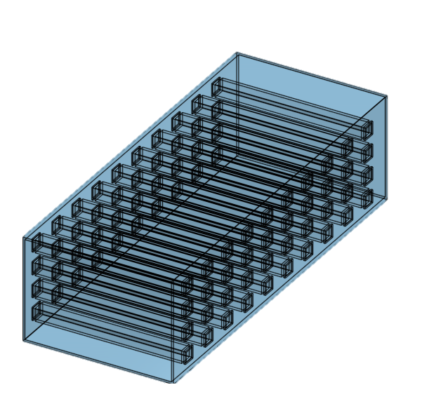
Application: Heat Exchanger
Heat Exchanger Enhancement
Adding square tubes to a shell and tube heat exchanger will increase the heat exchange
Due to the increased turbulence the heat transfer rate will be higher.
However, round tubes are more cost effective and lighter at the same structural strength.
Model of sample heat exchanger in cross flow:
Duct (shell)
Square Tubes
Tube Fluid Inlet
ShellFluid Inlet
Notes:
jonas

Slide 11
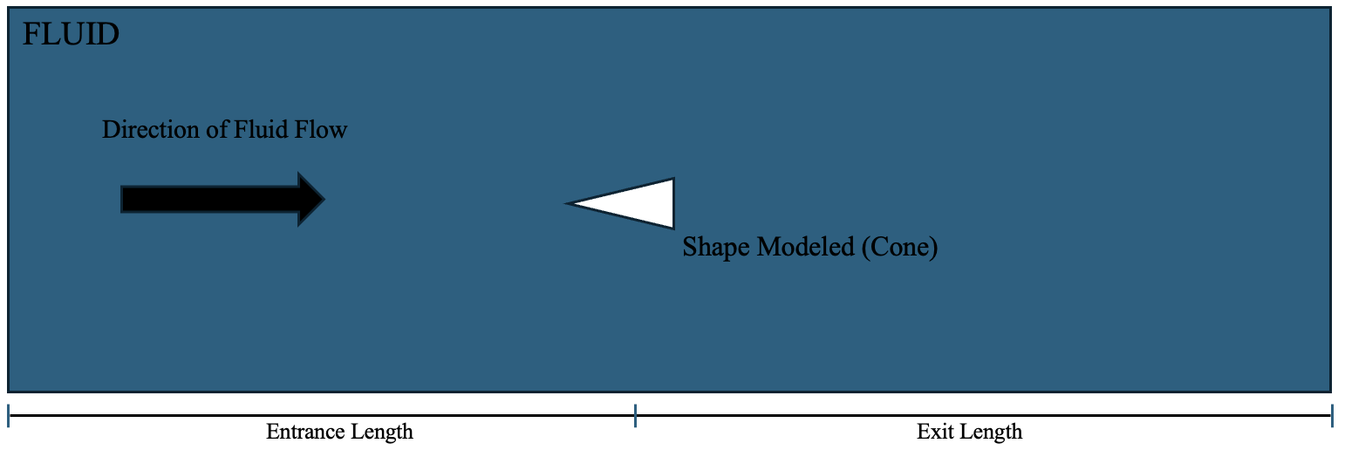
Proposed Experiment: CFD Analysis
Use computation fluid dynamics to measure heat flux through the shape
Compute the heat transfer coefficient for a range of Reynolds numbers
Use a regression analysis to find the c and m values for the Hilpert correlation
CFD Analysis diagram
Notes:
jonas

Slide 12
THANK YOU

