Slide 1

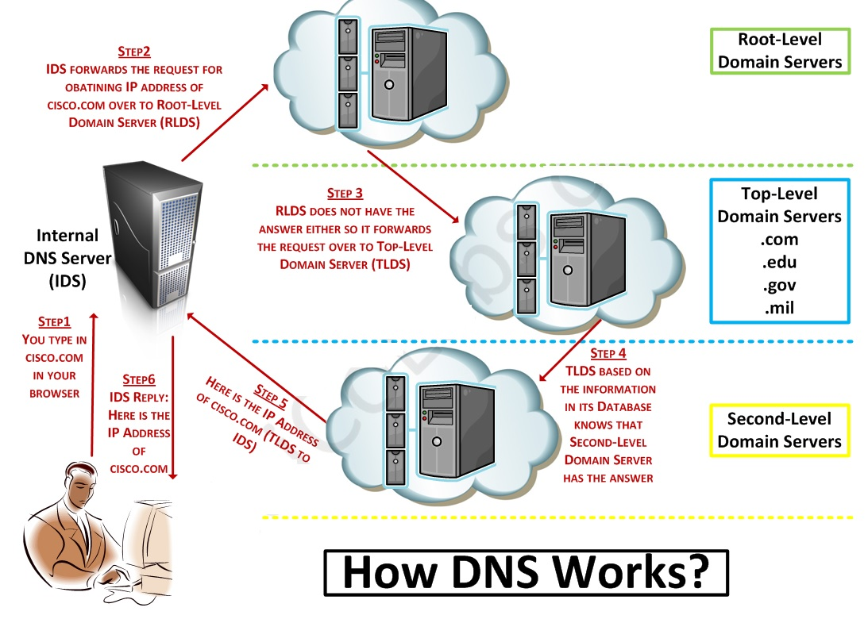
Shikhar Verma
Notes:
Shikhar Verma - IT Professional Trainer

Slide 2

The Domain Name Service (DNS) is an internet service that converts domain names into their corresponding IP Addresses and vice versa.
Any computer on the internet can maintain a file that manually associates IP addresses with domain names. On Linux and Unix systems, this file is called the /etc/hosts file. Here you can enter the IP Addresses and domain names of computer you commonly access.
Using this method, however each computer needs a complete listing of all others computers on the Internet, and this listing must be updated constantly.
The DNS has been implemented to deal with the task of translating the domain name of any computer on the Internet to its IP Address.
Shikhar Verma

Slide 3
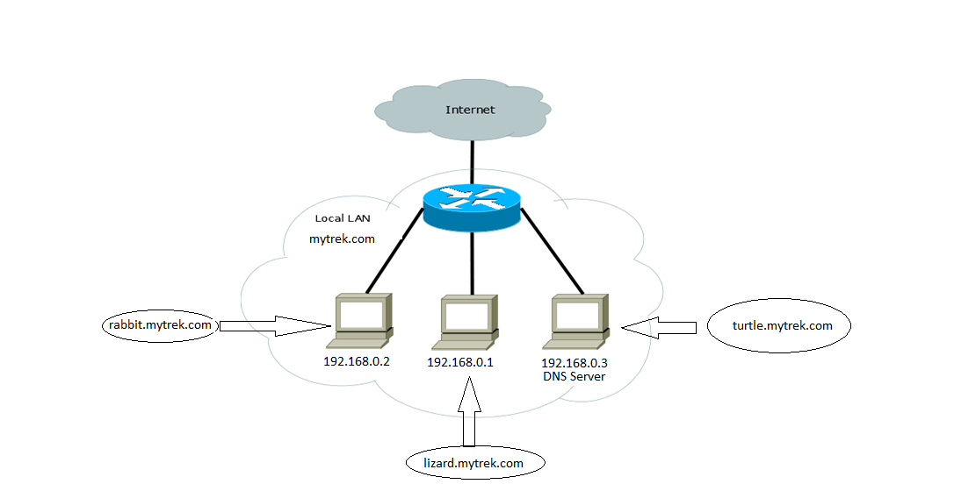


Slide 4

User at rabbit.mytrek.com wants to connect to lizard.mytrek.com, so it will query to the respective dns server and dns server looks up the name lizard.mytrek.com and find its IP Address 192.168.0.3
Using the IP address for lizard.mytrek.com, the user at rabbit.mytrek.com can now connect to that host.
Communication between two systems is happens with IP Address only.
When a user wants to access remote host, it enters its fully qualified domain name to access a remote host, a resolver program queries the local network’s DNS Server to provide the IP Address of a remote host. With the IP address the user can then access the remote host.
Shikhar Verma

Slide 5
The Domain Name System of the Internet
The domain name system of the internet works in a inverted tree structure.At the top of the tree is the root name server.The root server is followed by TLD's or Top Level Domains,and then TLD's are followed by SLD's or Second Level Domains. All of these are seperated by dots.
The root server is represented by a .(a dot).
TLD's are split into two types as follows.
Shikhar Verma

Slide 6
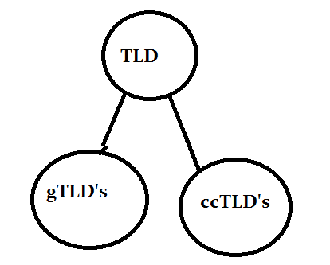
TLD’s (Top Level Domain) are split into two types as follows.
Shikhar Verma

Slide 7
Generic Top Level Domains(gTLD's) are TLD's like .com,.net,.org,.edu etc.
Country Code Top Level Domains are domains such as .in,.us,.uk etc.
Now when we call www.example.in a domain name, this domain name is a combination of gTLD,SLD(Secondry Level Domain) and the host name. We will come back to this in some time.
When we normally call a domain like google.com its the combination of TLD,SLD.
Shikhar Verma

Slide 8
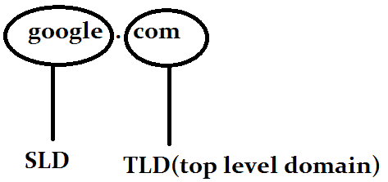
Shikhar Verma

Slide 9
Each and every node in this Domain Name system is assigned to an authority or organization for its administration. And that organization resposible for a particular node is authoritative for that node.The term authoritative will be used many times in DNS system.
It is very much important to understand the fact that, the left most part (www) in any address, like for example www.example.in, is the hostname. WWW is used by websites only by convention, there is no rule to use www for a website. A web site can also be named xyz.example.com.
Shikhar Verma

Slide 10
what happens when I type www.example.com in the address bar of the browser?
The root name server(.) is the most important resource in the name server hierarchy. when any name server is asked for an information which it does not have, the first thing that name server does is asking one of the (.)root name server.
there are 13 root name servers as follows.
a.root-servers.net.
b.root-servers.net.
c.root-servers.net.
d.root-servers.net.
e.root-servers.net.
f.root-servers.net.
g.root-servers.net.
h.root-servers.net.
i.root-servers.net.
j.root-servers.net.
k.root-servers.net.
l.root-servers.net.
m.root-servers.net.
Shikhar Verma

Slide 11
what happens when I type www.example.com in the address bar of the browser?
Now the ip address of all the root servers mentioned above are known to all the DNS software packages, by default. Which means all the DNS servers can reach these root servers without any other DNS server.
Step1: the client types www.example.com in his browser
Step2: the operating system looks at /etc/host file,first for the ip address of www.example.com(this can be changed from /etc/nsswitch), then looks /etc/resolv.conf for the DNS server IP for that machine
Step3: the dns server will search its database for the name www.example.com, if it finds it will give that back, if not it will query the root server(.) for the information.
Shikhar Verma

Slide 12
what happens when I type www.example.com in the address bar of the browser?
Step4: root server will return a referral to the .com TLD name server(these TLD name servers knows the address of name servers of all SLD's).In our case we searched for www.example.com so root server will give us referral to .com TLD servers.
If it was www.example.net then root server will give, .net TLD servers refferal.
Step5: Now One of the TLD servers of .com will give us the referral to the DNS server responsible for example.com domain.
Step6: the dns server for example.com domain will now give the client the ip address of www host(www is the host name.)
Shikhar Verma

Slide 13
Now lets practically have a look at how this process works.
[root@myvm1 ~]# dig +trace www.google.com
; <<>> DiG 9.3.4-P1 <<>> +trace www.google.com
;; global options: printcmd
. 5 IN NS a.root-servers.net.
. 5 IN NS b.root-servers.net.
. 5 IN NS c.root-servers.net.
. 5 IN NS d.root-servers.net.
. 5 IN NS e.root-servers.net.
. 5 IN NS f.root-servers.net.
. 5 IN NS g.root-servers.net.
. 5 IN NS h.root-servers.net.
. 5 IN NS i.root-servers.net.
. 5 IN NS j.root-servers.net.
. 5 IN NS k.root-servers.net.
. 5 IN NS l.root-servers.net.
. 5 IN NS m.root-servers.net.
;; Received 228 bytes from 192.168.159.2#53(192.168.159.2) in 49 ms

Slide 14
Now lets practically have a look at how this process works.
com. 172800 IN NS a.gtld-servers.net.
com. 172800 IN NS b.gtld-servers.net.
com. 172800 IN NS c.gtld-servers.net.
com. 172800 IN NS d.gtld-servers.net.
com. 172800 IN NS e.gtld-servers.net.
com. 172800 IN NS f.gtld-servers.net.
com. 172800 IN NS g.gtld-servers.net.
com. 172800 IN NS h.gtld-servers.net.
com. 172800 IN NS i.gtld-servers.net.
com. 172800 IN NS j.gtld-servers.net.
com. 172800 IN NS k.gtld-servers.net.
com. 172800 IN NS l.gtld-servers.net.
com. 172800 IN NS m.gtld-servers.net.
;; Received 504 bytes from 198.41.0.4#53(a.root-servers.net) in 153 ms
Shikhar Verma

Slide 15
Now lets practically have a look at how this process works.
google.com. 172800 IN NS ns2.google.com.
google.com. 172800 IN NS ns1.google.com.
google.com. 172800 IN NS ns3.google.com.
google.com. 172800 IN NS ns4.google.com.
;; Received 168 bytes from 192.33.14.30#53(b.gtld-servers.net) in 12 ms
www.google.com. 300 IN A 74.125.236.48
www.google.com. 300 IN A 74.125.236.50
www.google.com. 300 IN A 74.125.236.51
www.google.com. 300 IN A 74.125.236.49
www.google.com. 300 IN A 74.125.236.52
;; Received 112 bytes from 216.239.34.10#53(ns2.google.com) in 108 ms
Now you can clearly see from the dig with trace output that, the request first went to root servers. a.root-servers.net replied me with the addresses of all .com gtld servers, and b.gtld-servers.net gave me the name servers for google.com and finally ns2.google.com replied me with the ip address of www.google.com

Slide 16
Working Procedures of DNS:
1. When your computer need to connect with a host on the Internet (e.g. MyGreatName.com), you only need to enter the Domain Name (e.g. MyGreatName.com) in the URL of browser. Your computer will then contact the configured or default Name Servers (usually your ISP Name Server), asking for the IP Address of the host (e.g MyGreatName.com).
2. If your ISP Name Server has the information of the IP Address of the query host, it will tell your computer immediately.
3. Assume that your ISP Name Server do not have the information of MyGreatName.com. Your ISP Name Server will ask the DNS Root Name Server immediately the Name Server that has the information of MyGreatName.com.
STOP! You may ask: "How can your ISP Name Server knows the Root Name Server? Which Root Name Server to ask?"
Shikhar Verma

Slide 17
Working Procedures of DNS:
Actually all Name Servers will download and install a file from the FTP server of interNIC. The file is called "named.cache" or "named.root". This file has the IP Addresses of ALL Root Name Servers.
there are 13 root name servers as follows.
a.root-servers.net.
b.root-servers.net.
c.root-servers.net.
d.root-servers.net.
e.root-servers.net.
f.root-servers.net.
g.root-servers.net.
h.root-servers.net.
i.root-servers.net.
j.root-servers.net.
k.root-servers.net.
l.root-servers.net.
m.root-servers.net.
Shikhar Verma

Slide 18
Working Procedures of DNS:
From the above named.cache file, we know that there are 13 Root Name Servers on the Internet (A.ROOT-SERVERS.NET., B.ROOT-SERVERS.NET., ...., M.ROOT-SERVERS.NET.). The Root Name Servers are distributed around the world.
Root Name Servers have all of information of Autoritative Domain Name Servers for the top level domain names (for example: .com, .org, .net, .com.hk, etc ..)
4. When your ISP Name Server do not have the IP address information of MyGreatName.com, it will check the named.cache file and ask for help from the Root NameServer. If the first Root Name Server is out of order or do not have response, your ISP Name Server will ask the second Root Name server.
5. Root Name Server will then tell your ISP Name Server the authoritative Name Server of MyGreatName.com are 212.69.192.10 (Primary
Name Server) and 212.69.192.11 (Secondary Name Server).
Shikhar Verma

Slide 19
Working Procedures of DNS:
Now you should know that why you need to submit information of two Name Servers when register new domain names.
6. Your ISP Name Server now has the IP Address of the Authoritative Name Server of MyGreatName.com. Your ISP Name Server will then contact the Authoritative Name Server of MyGreatName.com (212.69.192.10). The Authoritative Name Server of MyGreatName.com will then check and confirm the information of MyGreatName.com. It then tell the IP Address of MyGreatName.com (212.69.204.148) to your ISP.
7. Your ISP Name Server now has the IP Address of MyGreatName.com, it will tell your computer immediately.
8. Once your computer get the IP Address of MyGreatName.com, your computer can then communicate with MyGreatName.com.
Shikhar Verma

Slide 20
Working Procedures of DNS:
From the working procedures of DNS, you should notice that:
The Root Name Servers on the Internet play a very important role in DNS.
There are a lot of Name servers located around the world.
All Name Servers on the Internet have the information of all Root Name Servers. If the first Root Name Server has no response, the second Root Name Server will be contacted .......
Shikhar Verma

Slide 21

BIND
The DNS server software currently in use on Linux systems is Berkeley Internet Name Domain (BIND). BIND was originally developed at the University of California, Berkeley and is currently maintained and supported by the Internet Software Consortium (ISC).
The name of the BIND name server daemon is named. To operate your machine as a name server, simply run the named daemon with the appropriate configuration.
The named daemon listens for resolution requests and provides the correct IP address for the requested hostname.
Shikhar Verma

Slide 22
Tool
Dig domain: Domain information groper tool to obtain information on a DNS Server. Preferred over nslookup.
Host hostname: Simple lookup of hosts
Nslookup domain: Tool to query DNS Servers for information about domains and hosts
Rndc: Remote name daemon controller
Ndc: Name daemon controller
Shikhar Verma

Slide 23

Domain name Service Configuration
You configure a DNS Server using a configuration file, several zone files and a cache file. The part of a network for which the name server is responsible is called a zone.
A zone is not the same as a domain because in a large domain you could have several zones, each with its own name server.
In this case, each zone has its own zone file. The zone file hold resource records that provide hostname and IP address associations for computers on the network for which the DNS server is responsible.
Zone entries are defined in the named.conf file. Here, you place zone entries for your master slave and forward DNS Servers. The most commonly used zone files are
Shikhar Verma

Slide 24
Domain name Service Configuration
Master Zone: It holds the mapping from domain names to IP addresses for all the hosts on the network.
Slave Zone: These are references to other DNS Servers for your network to help carry work load. A Slave DNS server automatically copies its configuration file, including all zone files from the master DNS Server
Forward Zone: The forward zone lists name servers outside your network that should be searched if your network’s name server fails to resolve an address.
IN-ADDR.ARPA Zone: DNS can also provide reverse resolutions, where an IP address is used to determine the associated domain name addresses.
Shikhar Verma

Slide 25
DNS Servers
There are several kinds of DNS Servers, each perform different types of task under the domain Name Service. These are
Master Server: This is the primary DNS Server for a zone. Each network must have at least one master server which is responsible for resolving names on the network.
Slave Server: These are references to other dns servers for your network to help carry workload. A slave DNS server automatically copies its configuration file, including all zone files from the master DNS Server.
Forwarder Server: A server that forwards unresolved DNS requests to outside DNS Servers and can be used to keep other servers as a local network hidden from the Internet.
Shikhar Verma

Slide 26
DNS Servers
There are several kinds of DNS Servers, each perform different types of task under the domain Name Service. These are
Caching only Server: Caches DNS information it receives from DNS Server and uses it to resolve local request.
Shikhar Verma

Slide 27
named.conf
The configuration file for the named daemon is named.conf, located in /etc directory. It uses a flexible syntax similar to C programs.
The named.conf file contains the main dns configuration and tells BIND where to find the configuration files for each domain you own.
zone "." IN {
type hint;
file "named.ca";
The first zone (.) defines a hint zone specifying the root name servers. The cache file listing these servers is named.ca.
Shikhar Verma

Slide 28
named.conf
zone “techno.com" IN {
type master;
file "fwd.techno.com.db";
The second zone statement defines a zone for techno.com domain. Its type is master and its zone file “fwd.techno.com.db”. The next zone id ised for reverse IP mapping of the previous zone.
zone "137.198.20.in-addr.arpa" IN {
type master;
file "137.198.20.db";
Shikhar Verma

Slide 29
named.conf
The last zone statement defines a reverse mapping zone for the loopback interface, the method used by the system to address itself and enable communication between local users on the system. The zone file used for this local zone is named.local
Shikhar Verma

Slide 30
Resource Records
Resource records are used to associate IP Addresses with fully qualified domain names. You need a record for every computer in the zone.
name [<ttl> [<class>] <type> <rdata> [<comments>]
Each zone files contains a variety of records (SOA, NS,MX,A,PTR and CNAME)
Shikhar Verma

Slide 31
Resource Records
Time to Live Value (TTL)
The very first entry in the zone file is usually the zone’s time to live (TTL) value. Caching DNS server cache the responses to their queries from authoritative DNS Servers.
The purpose of TTL is to reduce the number of DNS queries to the authoritative server (DNS). If the TTL is set to three days, then caching servers use the original stored response from three days before making the query again.
$TTL 3D
Shikhar Verma

Slide 32
Resource Records
Start of Authority: SOA
The zone and reverse mapping files always begin with a special resource record called the start of Authority (SOA) record.
The format for an SOA record follows:
Name {ttl} class SOA origin person-in-charge (
serial number
refresh
retry
expire
minimum);
Shikhar Verma

Slide 33
Resource Records
The first is the serial number. You change the serial number only when you add or change records, so that it can be updated by other servers.
Refresh specifies the time interval for refreshing SOA information.
Retry is the frequency for trying to contact an authoritative server.
Expire is the length of time a secondary name server keeps information about a zone without updating it.
Minimum is the length of time records in a zone line.
Shikhar Verma

Slide 34
Resource Records
Name Server: NS
The name server record specifies the name of the name server for its zone.
IN NS turtle.mytrek.com.
Address Record: A and A6
Resource records of type A are address records that associate a fully qualified domain name with an IP address.
Turtle.mytrek.com IN A 192.168.100.3
Shikhar Verma

Slide 35
Resource Records
Mail Exchanger: MX
This record specifies that the mail server is used for this zone.
mytrek.com IN MX 10 turtle.mytrek.com
Aliases: CNAME
The term CNAME stands for canonical name are used to specify alias name for a host in the zone.
mytrek IN A 192.168.0.4
ftp.mytrek.com IN CNAME turtle.mytrek.com
Shikhar Verma

Slide 36
Resource Records
Pointer Record: PTR
A PTR record is used to perform reverse mapping an IP address to a host.
IN PTR turtle.mytrek.com
Shikhar Verma

Slide 37

Steps to configure DNS
Assumptions
Server Name: Server2.gupta.com
IP Address: 20.198.137.211
Install BIND package
BIND stands for Berkeley Internet Name Domain, a software which provides an ability to perform name to ip conversion.
# yum -y install bind bind-utils
Shikhar Verma

Slide 38
Steps to configure DNS
Configure BIND
Configuration file of bind is /etc/named.conf, open up /etc/named.conf file. Comment out the following line, and this will enable BIND to listen on all ip addresses.
#listen-on port 53 { 127.0.0.1; };
#listen-on-v6 port 53 { ::1; };
Add your network in the following line. I’ve added 192.168.12.0/24, and this will allow clients from the mentioned network can query the DNS for the name to ip translation.
allow-query { localhost;192.168.12.0/24; };
If you want to transfer all zones to slave server (192.168.12.6), add the following line (Optional)
allow-transfer { 192.168.12.6; };
Shikhar Verma

Slide 39

Steps to configure DNS
Create Zones
The following is the forward zone entry in named.conf file, written for the itzgeek.local domain. Edit /etc/named.conf.
zone "gupta.com" IN {
type master;
file "fwd.gupta.com.db";
allow-update { none; };
};
gupta.com – Domain name
master – Primary DNS
fwd.gupta.com.db – Forward lookup file
allow-update – Since this is the primary DNS, it should be none

Slide 40

Steps to configure DNS
Create Zones
zone "137.198.20.in-addr.arpa" IN {
type master;
file "137.198.20.db";
allow-update { none; };
};
137.198.20.in-addr.arpa – Reverse lookup name
master – Primary DNS
137.198.20.db – reverse lookup file
allow-update – Since this is the primary DNS, it should be none
Shikhar Verma

Slide 41
Steps to configure DNS
Create zone files
Now, it’s the time to create a lookup file for a created zone. By default, zone lookup files are placed under /var/named directory. Create a zone file called fwd.gupta.com.db for forward lookup under /var/named directory. All domain names should end with a dot (.).
There are some special keywords for Zone Files
A – A record
NS – Name Server
MX – Mail for Exchange
CNAME – Canonical Name
Shikhar Verma

Slide 42
Steps to configure DNS
[root@Server2 named]# vi /var/named/fwd.gupta.com.db
$TTL 86400
@ IN SOA Server2.gupta.com. root.gupta.com. (
2017112807 ;Serial
3600 ;Refresh
1800 ;Retry
604800 ;Expire
86400 ;Minimum TTL
)
@ IN NS Server2.gupta.com.
Server2 IN A 20.198.137.211
Server1 IN A 20.198.137.84
gupta.com. IN MX 10 mail.gupta.com.
www IN A 20.198.137.211
mail IN A 20.198.137.211
shikhar IN CNAME Server2.gupta.com.
Shikhar Verma

Slide 43
Steps to configure DNS
Create a zone file called 137.198.20.db for reverse zone under /var/named directory, create a reverse pointer to the above forward zone entries.
PTR – Pointer
SOA – Start of Authority
Shikhar Verma

Slide 44
Steps to configure DNS
[root@Server2 named]# vi /var/named/137.198.20.db
$TTL 86400
@ IN SOA Server2.gupta.com. root.gupta.com. (
2017112807 ;Serial
3600 ;Refresh
1800 ;Retry
604800 ;Expire
86400 ;Minimum TTL
)
@ IN NS Server2.gupta.com.
211 IN PTR Server2.gupta.com.
211 IN PTR www.gupta.com.
84 IN PTR Server1.gupta.com.
Shikhar Verma

Slide 45
Steps to configure DNS
Once zone files are created, restart bind service.
# systemctl restart named.service
Enable it on system startup.
# systemctl enable named.service
Shikhar Verma

Slide 46
Steps to configure DNS
Verify zones
Visit any client machine and add a DNS server ip address in /etc/resolv.conf if Network Manager does not manage the network.
# vi /etc/resolv.conf
nameserver 20.198.137.211
If Network Manager manages the networking then place the following entry in /etc/sysconfig/network-scripts/ifcfg-eXX file.
DNS1=20.198.137.211
Restart network service.
# systemctl restart NetworkManager.service
Shikhar Verma

Slide 47

END of this Course Module.
http://www.itzgeek.com/how-tos/linux/centos-how-tos/configure-dns-bind-server-on-centos-7-rhel-7.html
http://www.mygreatname.com/how-dns-works/e-04-how-dns-works.htm
https://www.slashroot.in/how-dns-works
Thanks
Shikhar Verma

