Slide 1

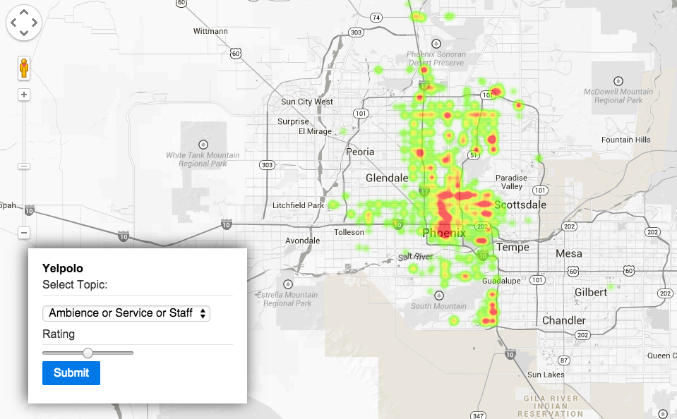
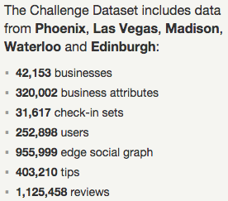

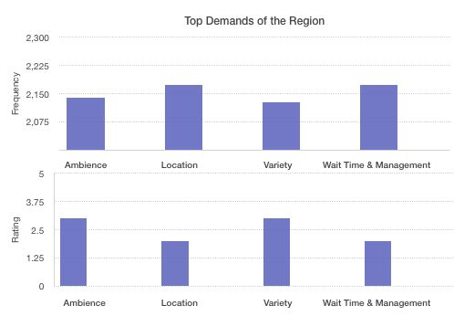
Yelpolo
Revant Kumar, Parminder Bhatia, Ashwini Khare, Gopi Krishnan Nambiar
College of Computing, Georgia Institute of Technology
Motivation/Introduction
Yelp reviews have been a great source of reviews to customers, which help them choose the best businesses in their region. Currently, if a prospective entrepreneur wants to understand the market scenario, he has to read all the reviews in the region to get an idea about the demand in that region. This strategy is neither feasible nor accurate. However, we are looking to provide entrepreneurs trying to set up new business in a particular region with relevant suggestions for establishing a successful business. We have used topic modeling (Online LDA) on various yelp reviews to get users’ preferences and taste in a given geographic location. Our model is able to predict the best matched region for a prospective entrepreneur.
Why this is Important?
Data-set: Yelp
In this project, we have found the inherent features and deduced their ratings which will help businessmen understand the requirement /demand of a region and find regions where chances of their business being a success are maximum. Thus, we have provided a holistic analysis of the region to them before starting their business.
Approach and Methods
Topic Modelling (Online LDA)
Used Gensim LDA Model to perform online LDA on filtered collections. This is a training process which takes number of topics to be generated as input and output for this process is Dictionary file (represents dictionary structure for words), and Corpus (saved in Market Matrix format). Implemented as Online algorithm, addition of new review will update Dictionary and Corpus based on review and save updated files.
Latent Topic Rating
Aggregated Ratings-Ratings for a given topic in a Review will be obtained by averages over all of these review ratings to get the hidden topic rating.
Data Collection and Normalization
Extracted reviews from json and imported to MongoDB collection - Reviews. Split each review into sentences, remove stopwords, extract parts-of-speech tags for all remaining tokens, filters out all words which are not nouns, use Lemmatizer/Stemmer to lookup lemma of each noun. Finally, store each review i.e. reviewId, business name, review text together with nouns’ lemmas to new MongoDB collection called Corpus.
Expirements and Results
The most important topics found after performing online LDA are Ambience, Location, Variety and Wait Time & Management.
It can determined from the figure above that the central part of Phoenix lacks in providing Ambience and Service.
We have incorporated online LDA. So new reviews can be extended with the existing model.
Due to some inherent noise in the data, so not all words in the subtopic correspond to the inferred meaning.

