Slide 1



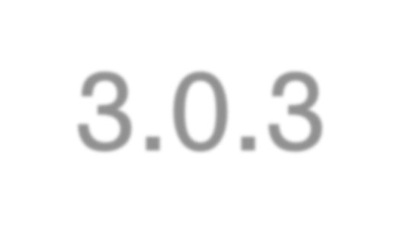







Introduction to Twitter Bootstrap

Slide 2








Outline
Introduction to Twitter Bootstrap Scaffolding
Base CSS Components Javascript Plugin

Slide 3

What is Bootstrap?
Sleek, intuitive, and powerful mobile first front- end framework for faster and easier web development.

Slide 4

Categories
Scaffolding | Base CSS
Grid System Layout … | Table Form Button …
Components | Javascript Plugin
Glyphicons Dropdowns Button Dropdowns Navbar Pagination … | Modal Scrollspy Button Carousel …

Slide 5

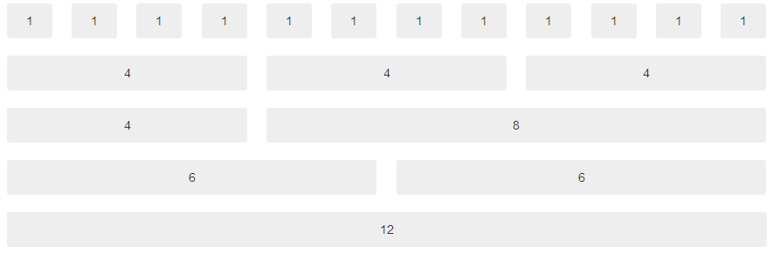






Scaffolding
Up to 12 columns Offsetting columns
<div class=“col-md-offset-3”>
Responsive design – can adapt to user device
Nesting columns
Column ordering

Slide 6
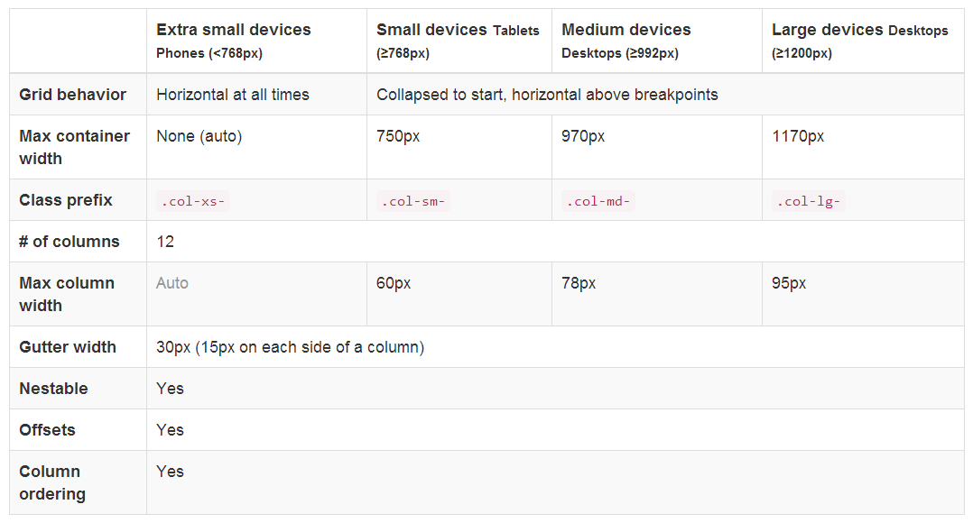
Grid System

Slide 7

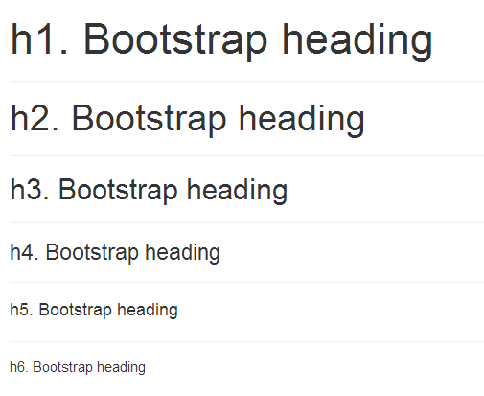


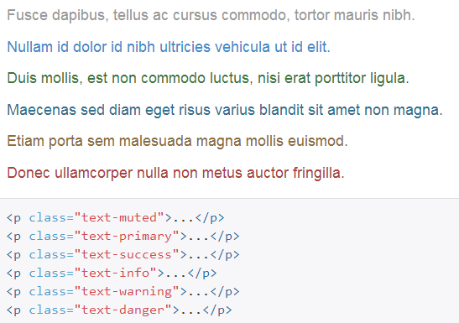

Base CSS
Headings Emphasis Blackquotes

Slide 8






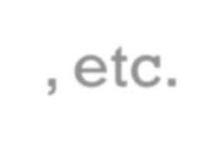

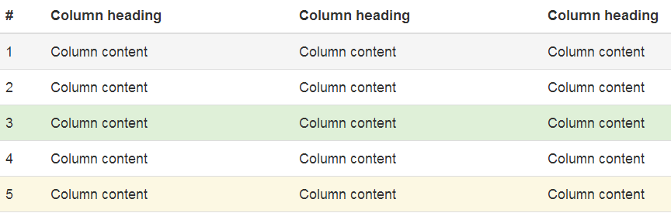



Base CSS
Tables – Hover Rows, Contextual Classes, etc.
Forms – Inline Form, Horizontal Form, etc.

Slide 9
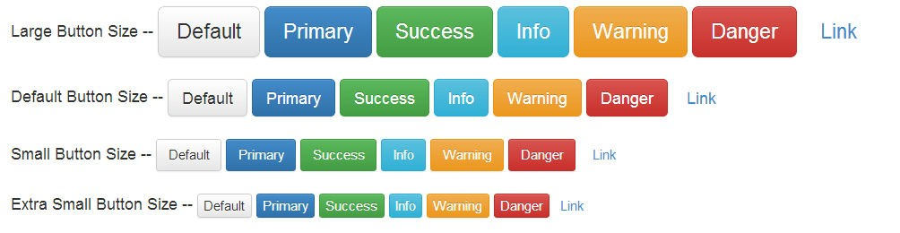























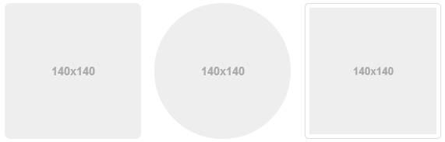







Base CSS
Buttons
<button type=“button” class=“btn btn-primary btn-lg”>Primary</button>
<button type=“button” class=“btn btn-success”>Success</button>
<button type=“button” class=“btn btn-info btn-sm”>Info</button>
<button type=“button” class=“btn btn-warning btn-xm”>Warning</button>
Images
<img class=“img-rounded”>
<img class=“img-circle”>
<img class=“img-thumbnail”>

Slide 10

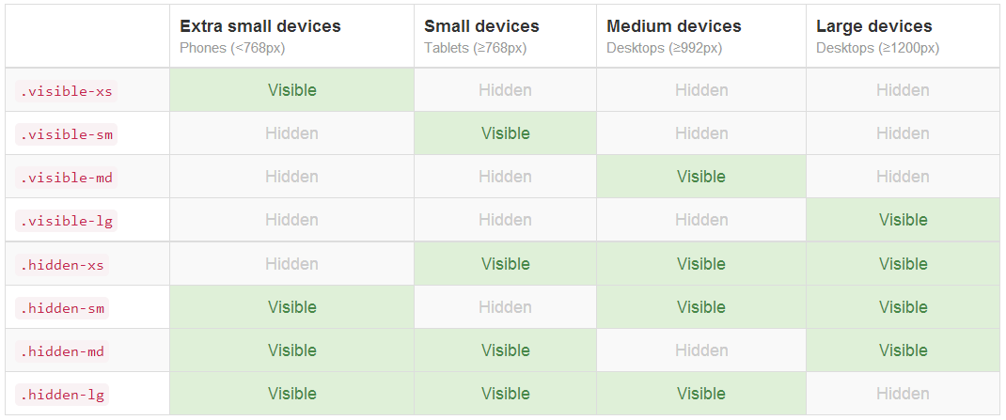
Base CSS
Responsive Utilities

Slide 11

















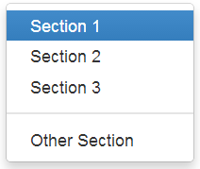
Components
Glyphicons
<span class=“glyphicon glyphicon-star”></span>
<span class=“glyphicon glyphicon-search”></span>
<span class=“glyphicon glyphicon-question-sign”></span>
<span class=“glyphicon glyphicon-remove”></span>
Dropdowns
10

Slide 12
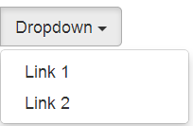




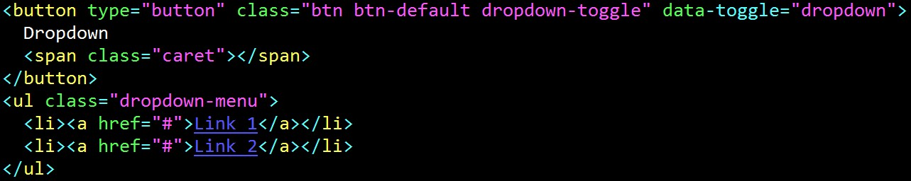
Components
Button Dropdowns Navbars
:w

Slide 13
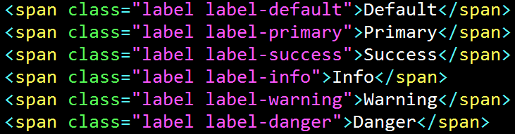





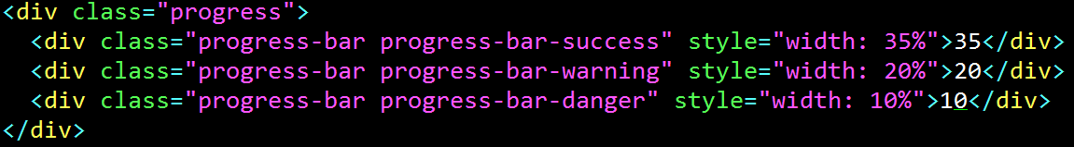
Components
Labels
Alerts
Progress bars

Slide 14

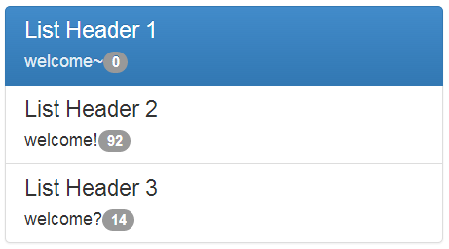

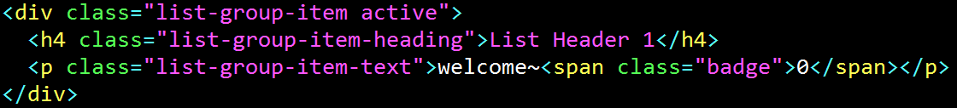

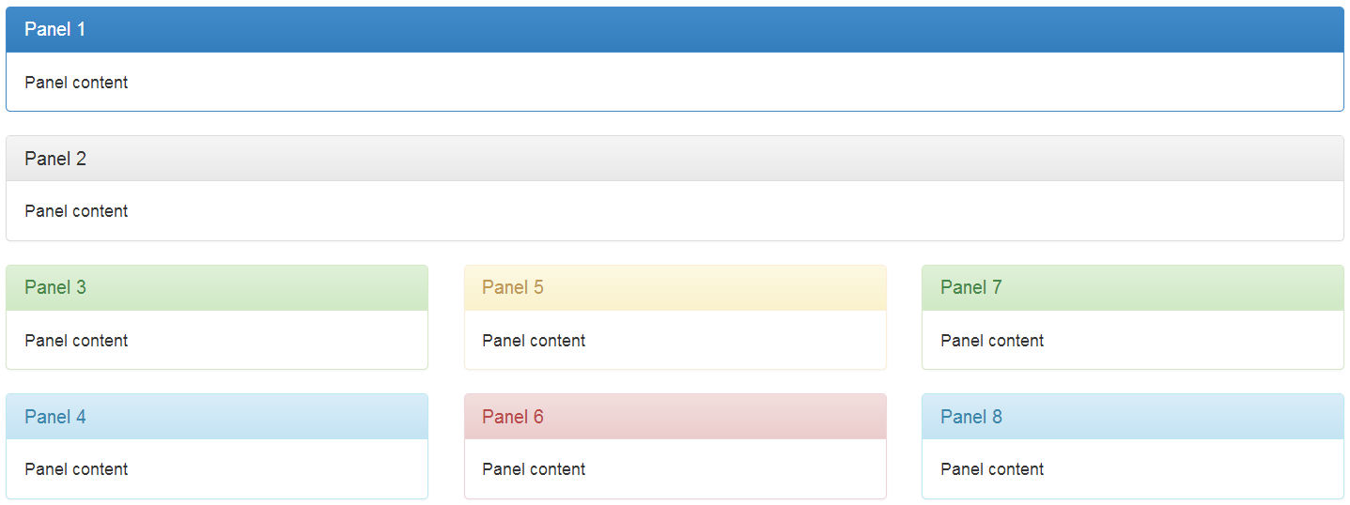
Compoments
Lists Panels

Slide 15

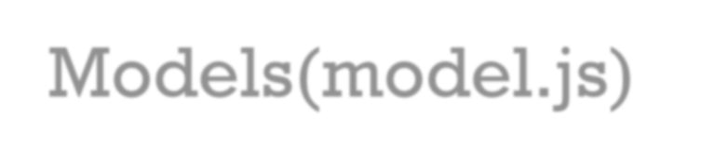


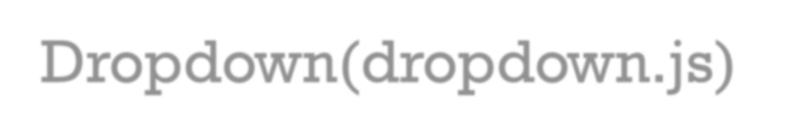


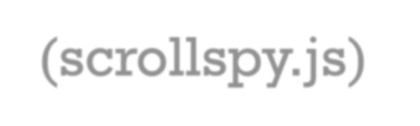


Javascript
Models(model.js) – popup message box Dropdown(dropdown.js) – for dropdown menu ScrollSpy(scrollspy.js)
– automatically updating on scroll position

Slide 16

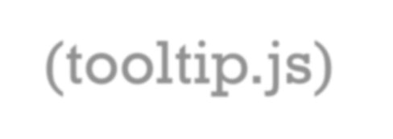





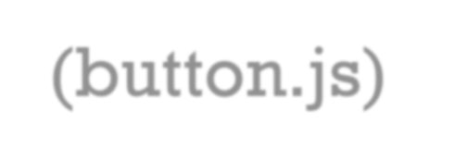

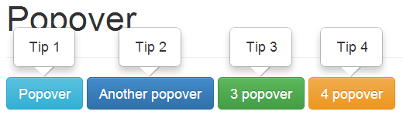
Javascript
Tooltips(tooltip.js) – show tips when hover over Popovers(popover.js) – show tips when click Buttons(button.js) – Checkbox, Radio

Slide 17

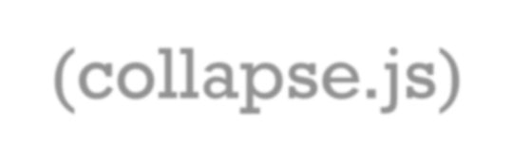


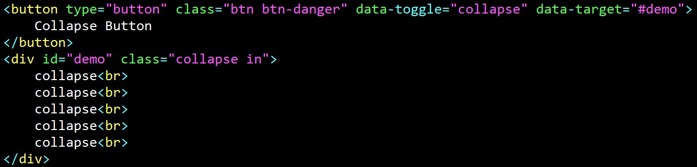
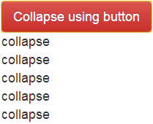

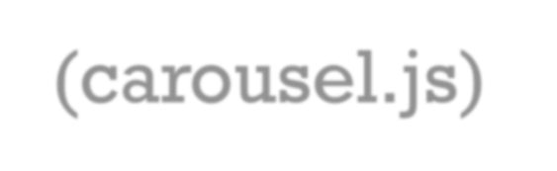


Javascript
Collapse(collapse.js) – collapse components
Carousel(carousel.js) – slideshow

