Slide 1
SoC 102: Design
중간점검: Basic Sequential Logic Circuit / Synthesis / PNR
한만혁

Slide 2
100진 카운터

Slide 3
Design: State Machine
rst_n
btn_0
(btn == 1)
btn_0
(btn == 1)
IDLE
RUN
STOP

Slide 4
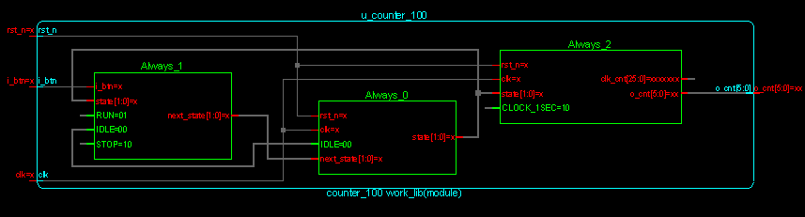
Design: Schematic

Slide 5
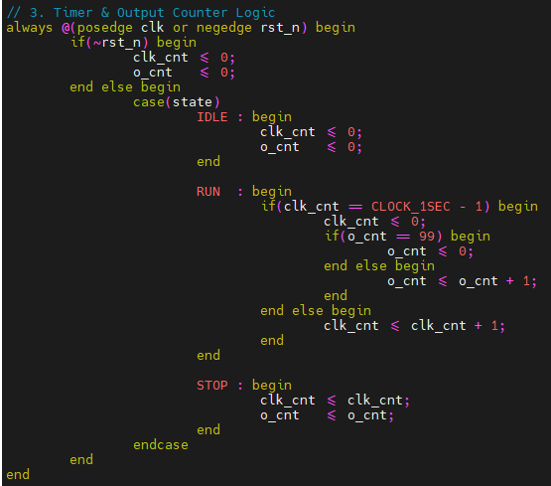
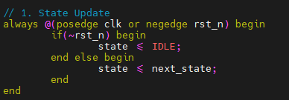
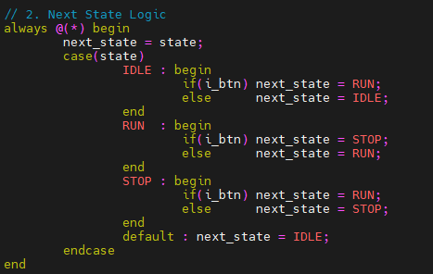
Design: RTL Coding

Slide 6
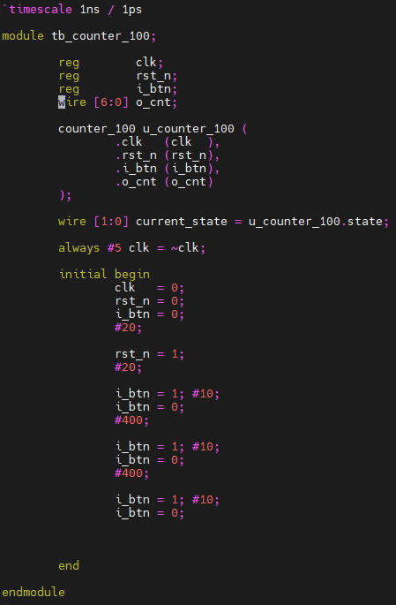
Testbench

Slide 7
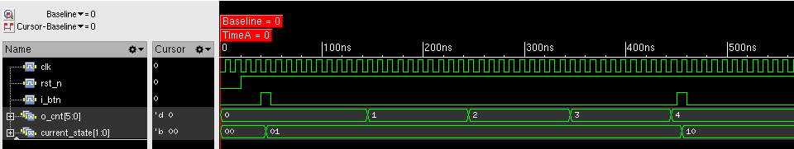
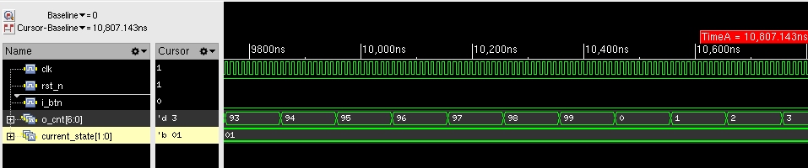
Design: Waveform
i_btn == 1, IDLE(2’b00) -> START(2’b01)
i_btn == 1, START(2’b01) -> STOP(2’b10)
3) o_cnt == 99 -> 1

Slide 8
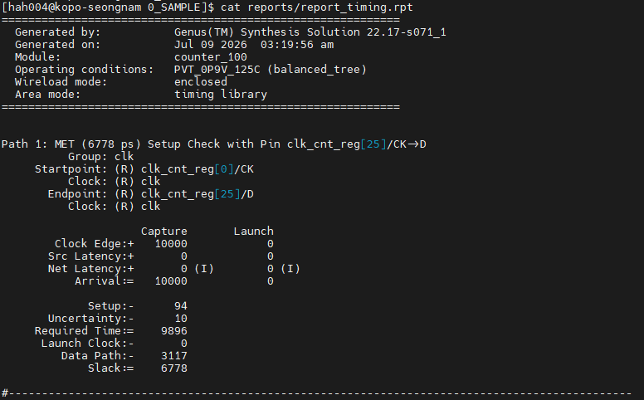
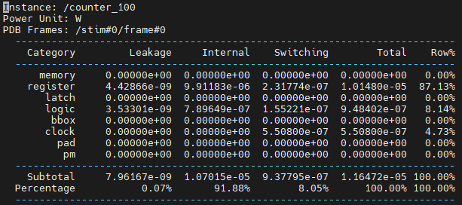
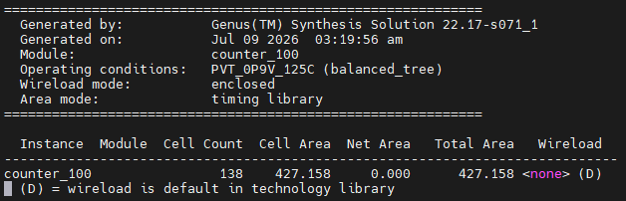
Synthesis
Power
PPA Metrics | 합성 결과 | 비고
Performance | 6,77ps(6.778ns) | Worst-Case 조건 만족
Area | 427.158um^2 | Cell 138개 최적화
Power | 11.65uW | Leakage: 7.96nW / Dynamic: 11.64uW
Performance
Area

Slide 9
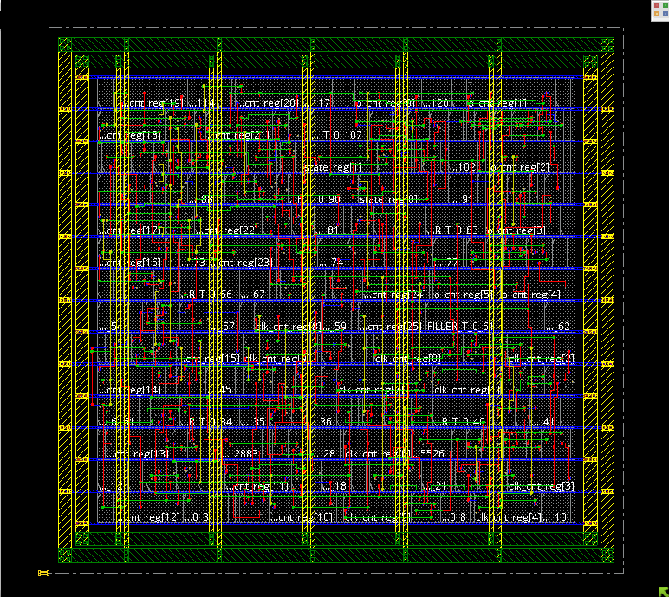
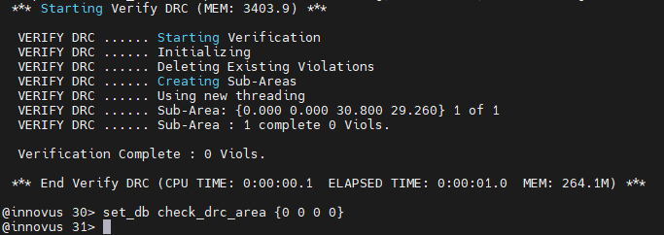
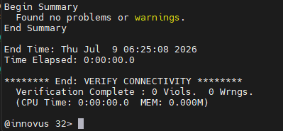
APR
DRC: 0 Viols
Connectivity: no probloms or warnings

