Slide 1
UVM Driver
A driver is written by extending the uvm_driver
uvm_driver is inherited from uvm_component
Methods and TLM port (seq_item_port) are defined for communication between sequencer and driver
The uvm_driver is a parameterized class
parameterized with the type of the request sequence_item and the type of the response sequence_item

Slide 2
UVM Driver Methods
get_next_item - blocks until a REQ sequence_item is available in the sequencer
try_next_item - non-blocking variant of the get_next_item() method
item_done - completes the driver-sequencer handshake and it should be called after a get_next_item() or a successful try_next_item() call
put - non-blocking and is used to place an RSP sequence_item in the sequencer.
Notes:
Real interface object is retrieved from the database directly into a local variable using uvm_config_db::get() method.
Get the next data item from sequencer using seq_item_port. get_next_item() in run_phase.
Call drive task to send data in accordance with a bus protocol

Slide 3
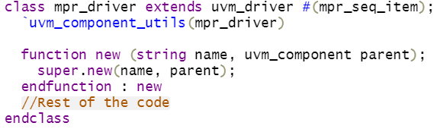
UVM Driver
Step 1: Create a custom class inherited from uvm_driver, register with factory and call new

Slide 4
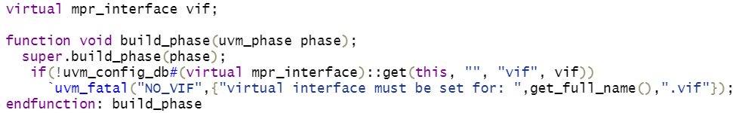
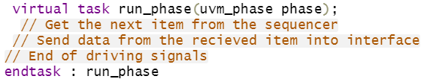
UVM Driver
Step 2: Declare a virtual interface handle and get them in build phase
Step 3: Code the run phase
Notes:
Setting of the interface handle vif, type mpr_interface, label vif with global scope
The run phase is the main piece of driver code that decides how it has to translate transaction level objects into pin wiggles at the DUT interface

Slide 5
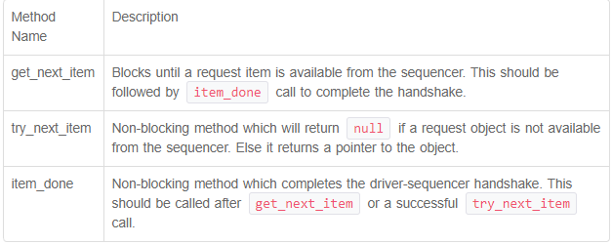
UVM Driver-Sequencer handshake
Notes:
The UVM driver is a parameterized class that drives a specific type of transaction object.

Slide 6
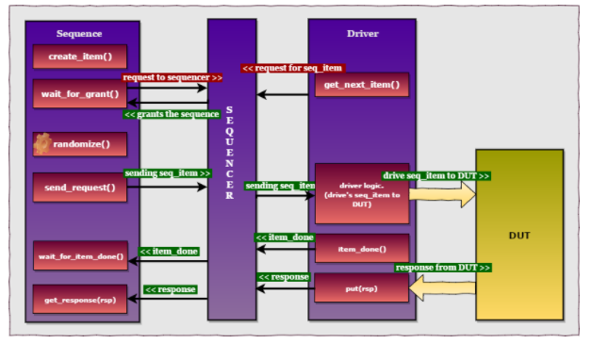
UVM sequence

Slide 7
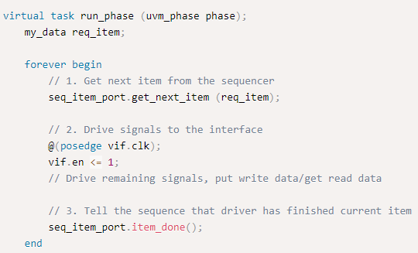
Driver/Sequencer APIs
1. get_next_item followed by item_done
Notes:
The driver-sequencer handshake mechanism allows the driver to get a series of transaction objects from the sequence and respond back to the sequence after it has finished driving the given item so that it can get the next item.
The driver gets an object from the sequence, drives the item and then finishes the handshake with the sequence by calling item_done(). The driver needs to operate only when the sequencer has an object for the driver. finish_item call in the sequence finished only after the driver returns the item_done call

Slide 8
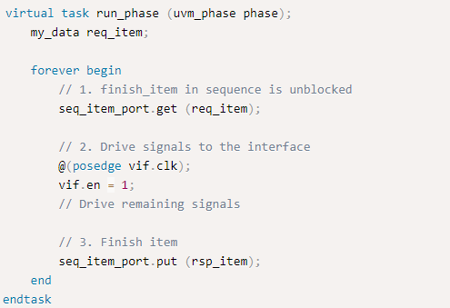
Driver/Sequencer APIs
2. get followed by put
Notes:
The difference between this model and the previous one is that in this, the driver gets the next item and sends back the sequence handshake in one go, before the UVM driver processes the item. Later, the driver uses the put method to indicate that the item has been finished. So, finish_item call in the sequence is finished as soon as get() is done.

Slide 9
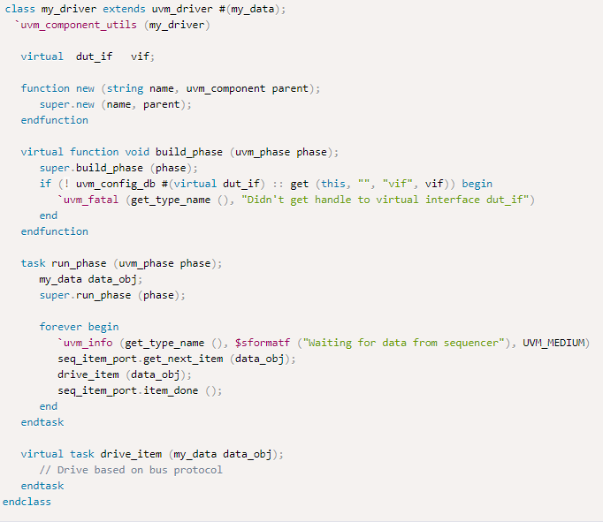
Notes:
In this driver example code,
Driver is extended from uvm_driver.
A virtual interface handle vif is declared and assigned later in the build_phase()
Real interface object is retrieved from the database directly into a local variable using uvm_config_db:get() method
Get the next data item from sequencer using seq_item_port.get_next_item() in run_phase
Call drive task to send data in accordance with a bus protocol.
Indicate to the sequencer that the data item has been driven using seq_item_port.item_done().

Slide 10

UVM Driver
The base driver has a uvm_seq_item_pull_port through which it requests for new transactions from the export connected to it.
The driver’s port and sequencer’s export are connected during the connect_phase() of an environment/agent class.
Notes:
The driver has a TLM port of type uvm_seq_item_pull_port that can accept the parameterized request object from the uvm_sequencer. It can also provide a response object back to the sequencer and usually the class type of both request and response items are the same. However, they can be different if explicitly specified.
The ports on driver are typically connected to exports of a sequencer component in the parent class where the two are instantiated. The RSP port needs connecting only if the driver will use it to write responses to the analysis export in the sequencer.

Slide 11

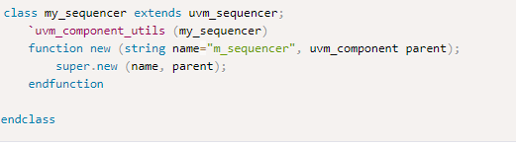
UVM Sequencer
Generates data transactions as class objects and send it to the driver for execution
Custom sequencer
Notes:
The uvm sequencer base class contains all the functionality required to allow a sequence to communicate with a driver. The base class is parameterized by request and response item types that can be handled by the sequencer.
Generation of objects within the sequencer is very limited in terms of flexibility and re-usability. This limitation can be overcome with sequences.
It is not really required to create a custom sequencer to execute every sequence or for every agent. But, you can create your version of the UVM sequencer with additional features and create instances of it throughout the testbench.

Slide 12
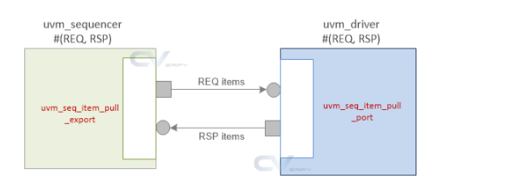
Driver-Sequencer Handshake
Notes:
The driver class contains a TLM port called uvm_seq_item_pull_port that is connected to a uvm_seq_item_pull_export in the sequencer in the connect phase of a UVM agent. The driver can use TLM functions to get the next item from the sequencer when required.
Declaration for TLM ports can be found in the class definitions of uvm_driver and uvm_sequencer

Slide 13
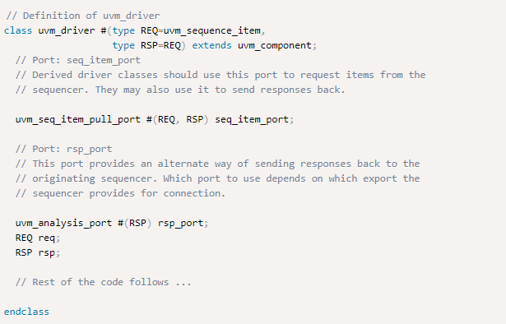
Driver port

Slide 14
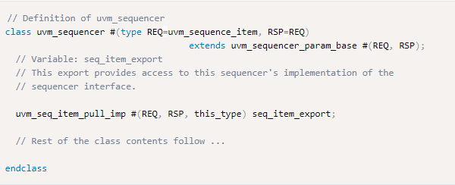
Sequencer port
A uvm_sequencer has an inbuilt TLM pull implementation port called seq_item_export that is used to connect with the driver’s pull port.
Notes:
A uvm_sequencer has an inbuilt TLM pull implementation port called seq_item_export that is used to connect with the driver’s pull port.

Slide 15
Connection of driver & sequencer
The port in uvm_driver is connected to the export in uvm_sequencer in the connect phase of the UVM component in which both driver and sequencer are instantiated, typically in a uvm_agent.
The connect between driver and sequencer is a one-to-one connection.
Multiple drivers aren’t connected to a sequencer nor are multiple sequencers connected to a single driver.
Once the connection is made, the driver can utilize the API calls in the TLM port definitions to receive sequence items from the sequencer.
Notes:
The port in uvm_driver is connected to the export in uvm_sequencer in the connect phase of the UVM component in which both driver and sequencer are instantiated, typically in a uvm_agent.
The connect between driver and sequencer is a one-to-one connection. Multiple drivers aren’t connected to a sequencer nor are multiple sequencers connected to a single driver. Once the connection is made, the driver can utilize the API calls in the TLM port definitions to receive sequence items from the sequencer.

Slide 16
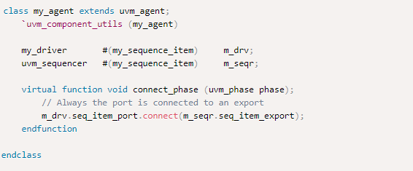
Connection of driver & sequencer
Notes:
The port in uvm_driver is connected to the export in uvm_sequencer in the connect phase of the UVM component in which both driver and sequencer are instantiated, typically in a uvm_agent.
The connect between driver and sequencer is a one-to-one connection. Multiple drivers aren’t connected to a sequencer nor are multiple sequencers connected to a single driver. Once the connection is made, the driver can utilize the API calls in the TLM port definitions to receive sequence items from the sequencer.

