Slide 1

Basic Data Types – Structure
Structure – a collection of data types
Structure Declaration : struct { logic [3:0] addr; int data; } IR; IR.addr = 4’b0010; | User-defined structure : typedef struct { logic [3:0] addr; int data; } instruction; instruction IR; | Packed structure : struct packed { logic [3:0] addr; int data; } IR; IR = 36’hA013BCD34;
Signed Packed structure : struct packed signed { bit [3:0] addr; int data; } IR; //signed 2-state IR = 36’hA013BCD34; | Unsigned Packed structure : struct packed unsigned { logic [3:0] addr; int data; } IR; //signed 4-state IR = 36’hA013BCD34; | structure literal : typedef struct { int a; shortreal b; } ab; ab c; c = ‘{0,0.0}
Notes:
The data types – structure, union, arrays, dynamic arrays, associative arrays and queues are frequently used in writing TBs in SV.
Keyword struct to declare a structure. The contents of the struct can be accessed using struct_name.member_name (eg: IR.addr) and values can be assigned as well.
In user-defined structure example, instruction is a type of struct. The instance of this structure declared will be ‘instruction IR’. This implies that IR is an instance of type instruction defined by a struct.
By default, struct and user-defined struct are unpacked.
A packed data type is used as a single vector. In packed structure example, 4 bits logic +32 bits of int = 36 bits. The assignment of 36’h is made to IR.
While packed structure can have signed or unsigned data types, unpacked structure cannot have these types.
In the last example, another method of assigning a value to an unpacked struct has been shown (with ’{} ). The instance of the struct needs to be taken first as it is a typedef struct.
Shortreal is a datatype used to represent floating point numbers. uses 32 bits. 1 bit for the sign, 8 bits for the exponent, and 23 bits for the fraction or mantissa.. Eg: shortreal a = 3.14, b = 1.41, result;

Slide 2
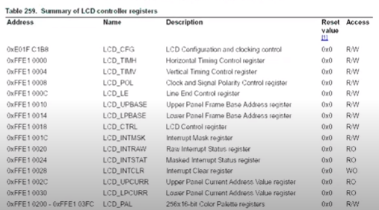

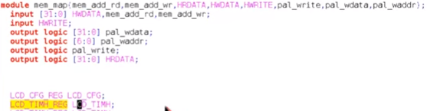

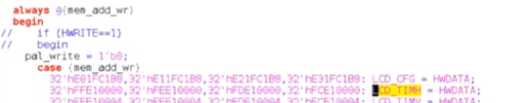
Basic Data Types – Structure
Notes:
Structures are mainly used for register description.
Verification projects will usually have a separate chapter for register description.
For example, the register LCD_TIMH will be defined as a typedef struct packed and named as LCD_TIMH_REG.
In a main memory map module, the instance of this register definition will be taken as LCD_TIMH
In the memory map module, the instance will be used. For always @(mem_add_rd), whenever there is a change in the memory address, it will enter the case statement. Since LCD_TIMH has the address 0xFFE10000, if the mem_add_rd has that value, the read data HRDATA will be assigned with LCD_TIMH value.
Similarly, if you want to write into the register, based on mem_add_wr,

Slide 3
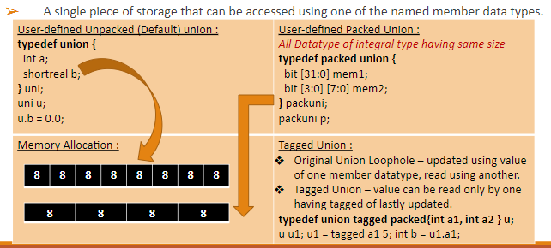
Basic Data Types – Union
Notes:
Union is a single piece of storage that can be accessed using one of the named member data types.
All unions share the same memory. Difference between union and structure is that in union, the int a and shortreal b will share the same memory.
In packed union, all datatypes of integral types will be inside the packed union and will have the same size.
Considering memory allocation, unpacked union will have 32 + 32 = 64 locations (bits) of memory. The other, packed union will have only 32 bits of memory location.
The loophole with packed union is that, due to shared memory, if you update the value of union using mem1 and then try to read the value of the union using mem2, the value will be wrong for mem2.
In tagged union, this value can be read only by one having tagged of last updated. This means that if mem1 was last updated in the tagged union, mem2 can’t read it, only mem1 can read it.
u1 = tagged a1 5 means that u1 has been tagged with a1 with value 5. for int b = u1.a1, the value can be assigned.

Slide 4
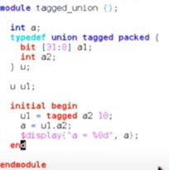


Basic Data Types – Union
a = 10
Notes:
While using tagged union, one more switch needs to be added while compiling the code:- vcs –sverilog –lca
On running this code, a will get the value 10.
If instead of a = u1.a2, you rewrite the line as a = u1.a1, there will be a compilation error.

Slide 5
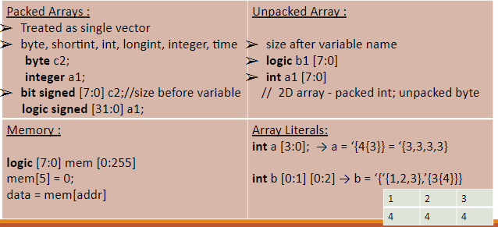
Basic Data Types – Arrays
Notes:
Combination of packed and unpacked arrays form memory.
The inbuilt data types that can be used as packed arrays are byte, shortint, int, longint, integer, time. Both shortint and longint are 2’s complement signed integers. Shortint is 16 bits and longint is 64 bits.
In packed arrays, byte can be represented as bit signed [7:0], and integer can be represented as logic signed [31:0]. The size of the array comes before the variable name in packed arrays.
In unpacked arrays, the size is given after the variable name. The second example is a 2d array as int itself is a packed array and [7:0] is an unpacked byte.
A memory has unpacked and packed arrays. The example shows a 256x8 memory. Any member can be accessed such as mem[5] = 0. To read any memory location, data = mem[addr].
There are array literals. For an unpacked array a[3:0], if all members need to be assigned the value 3, use ‘{4{3}}.
Another example of multi-dimensional array is b[0:1][0:2]. The assignment of values has been shown above.

Slide 6
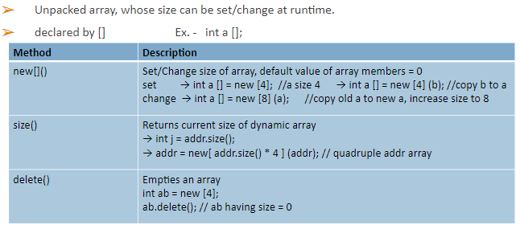
Basic Data Types – Dynamic Array
Notes:
Dynamic array is unpacked array whose size can be set/changed at runtime.
A dynamic array is declared by []. For example int a[];
In order to create a new dynamic array, use new[](). This will set/change the size of the array and the default value of the array members will be 0.
In the first example, a new dynamic array a is created with size 4. In the second example, a dynamic array of size 4 is created and the contents of b are copied into array a. In the third example, it considers a dynamic array already declared previously, as shown in example (let’s say of size 4). In this example, a new array a of size 8 is created and the previous values of a are copied into new array a.
In size(), int j = addr.size() will return the size of the variable addr into j. In order to make a quadruple addr array, the size of the addr variable is multiplied by 4.
To delete an array during runtime, ab.delete() is the syntax.

Slide 7
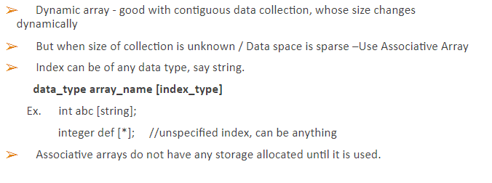
Basic Data Types – Associative Array
Notes:
Dynamic array holds good for contiguous data collection with size changing dynamically.
If size of the collection is unknown, or the data space is sparse, associative arrays are used. Data space being sparse means, let’s say for example, you specifically want memory locations 1, 1000 and 1 million for your array. For dynamic array, the size of the array will then be 1 million, for only three members. However, in associative array, the array with size 3 can use the mentioned locations distinctly.
Yet another property of associative array is that its index can be of any data type, not just integer. The example shows int abc[string]. This implies the associative array data type is integer while the index type is string. The other example integer def[*] , * gives an unspecified data type for that array, meaning that any data type can be provided for the index.
Associative arrays don’t have any storage allocated with them until it is used. Only when you assign some value to the array as elements, the array gets allocated memory. Not when you just create an empty array.

Slide 8
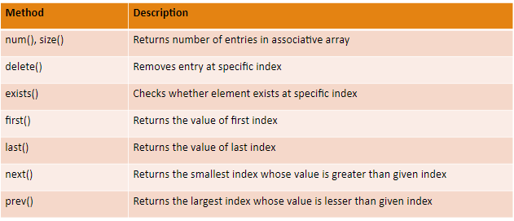
Basic Data Types – Associative Array

Slide 9
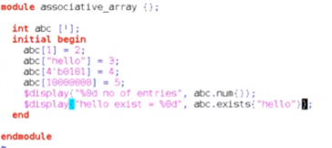

Basic Data Types – Associative Array

Slide 10
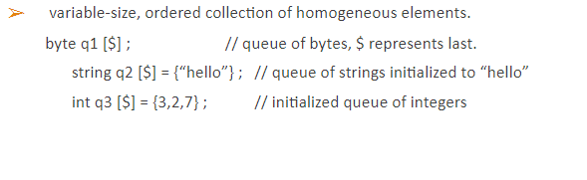
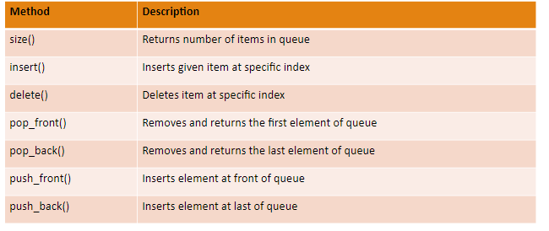
Basic Data Types – Queue
Notes:
Queue is a variable size, ordered collection of homogenous elements. This increments and decrements automatically at runtime, but it needs to be an ordered collection.
With the last 4 methods for queue, it is possible to make FIFO and LIFO structures.

Slide 11
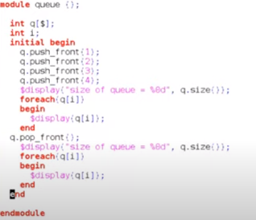
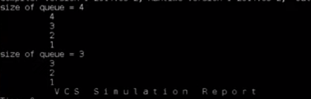
Basic Data Types – Queue

Slide 12
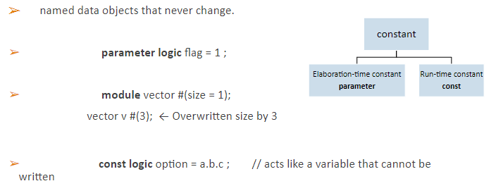
Basic Data Types – Constant/Parameter
Notes:
Unlike variables, whose values can be changed at any point in the program, constants are named data objects that never change.
Constants are of two types: elaboration time constant (parameter) and run-time constant (const).
While parameter values can be assigned or over-written during instantiation, const type variables cannot be written. In the last example, a.b.c is a type of hierarchy through which the value of c will be assigned to option. At elaboration time, the program doesnt know the value of c. But at runtime, the value of c gets assigned, and once assigned, it cannot get over-written.

Slide 13
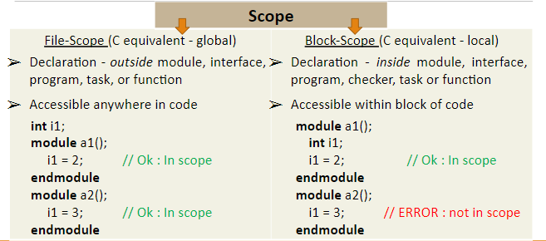
Basic Data Types – Scope & Lifetime
Notes:
Scope implies in what place the data can be accessed.

Slide 14
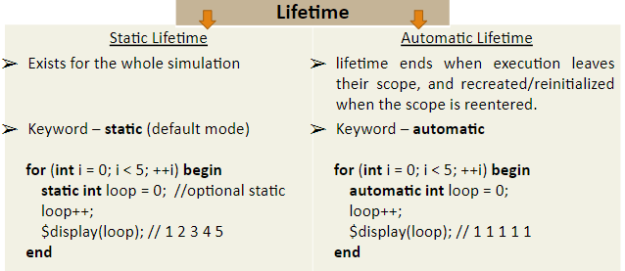
Basic Data Types – Scope & Lifetime
Notes:
Lifetime implies upto what point the value of the variable is available or upto what point a variable holds its value.

Slide 15
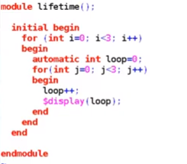
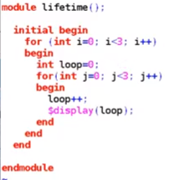
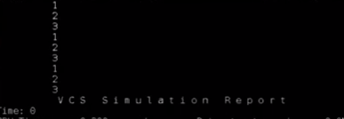

Basic Data Types – Scope & Lifetime
Notes:
If instead of automatic, the variable loop is a static (need not explicitly mention static as it is by default static), the result changes.

Slide 16
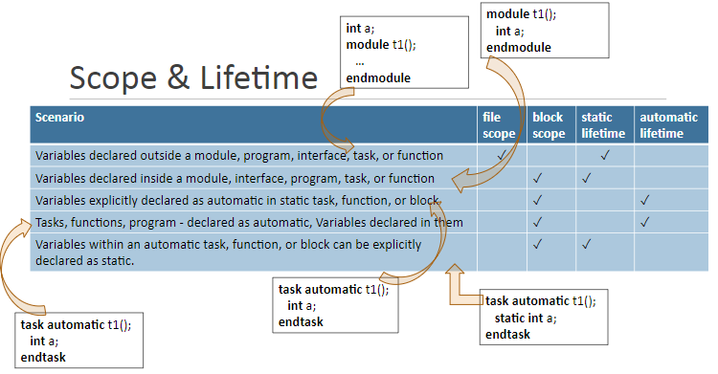

Slide 17
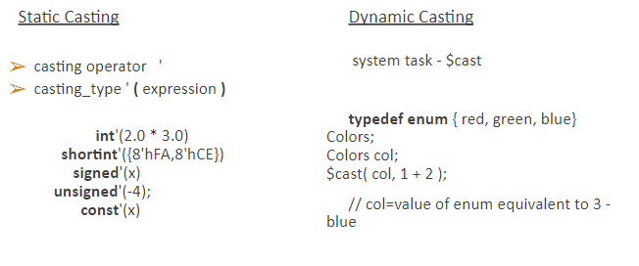
Basic Data Types – Casting
Notes:
Casting means to change the data type from one to another.
For dynamic casting you cant get a compile time error since it checks and assigns value at runtime only. While in static casting, if some expression is not valid, it can throw a compile time error.

