Slide 1
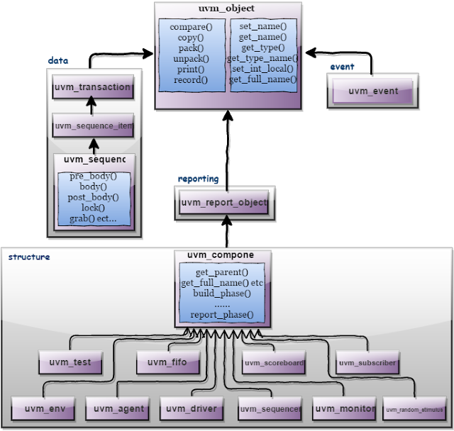
UVM Class Libraries - Recap

Slide 2
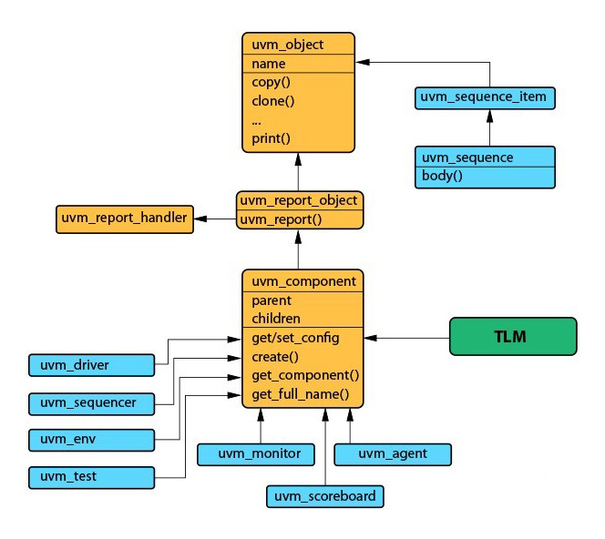
uvm_object - Recap
Utility macros: `uvm_object_utils(type)
Field macros:
`uvm_field_*(field, flag)
Notes:
uvm_object:
This is the main class
Core class based operational methods (create, copy, clone, compare, print, record, etc..), instance identification fields (name, type name, unique id, etc.) and random seeding are defined in it.
All uvm_transaction and uvm_component were derived from the uvm_object. Classes derived from uvm_object must implement the pure virtual methods such as create and get_type_name.
For example: uvm_object is used to write a uvm_sequence item. The virtual methods in uvm_object can make sequence_item purposeful.
uvm_object has utility macros & field macros. The utility macros provide implementations of the basic methods such as create. When you are trying to write objects without any field macros, its written as `uvm_object_utils(type).
UVM field macros are useful typically for the implementation of methods such as copy, print, pack, unpack, etc. They are invoked inside the `uvm_object_utils_begin and `uvm_object_utils_end. The macro basically has two arguments as part of it:field and flag.

Slide 3
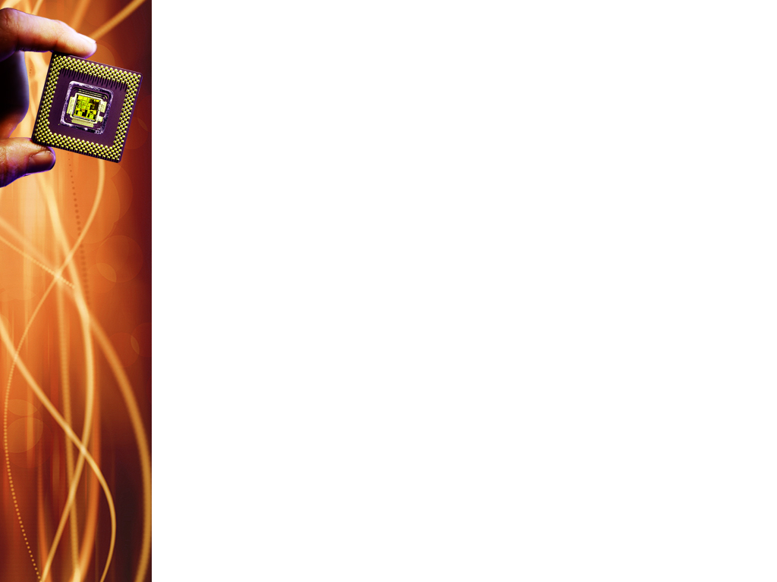
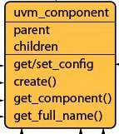
UVM Component
Components are quasi-static objects that exist throughout simulation
Uniquely addressable with hierarchical path (env.agent.driver)
defines configuration, reporting, transaction recording, & factory interfaces
Notes:
"quasi-static objects" refers to UVM components and objects that are created and configured during the build phase of the simulation and remain largely unchanged throughout the runtime of the simulation.
Quasi-static objects include:
Components
Configuration objects

Slide 4
Universal Verification Component (UVC)
Components
Driver
Monitor
Gets transactions from sequencer: get_next_item(item)
Drives transactions on the DUT interface: send_to_dut(item)
Indicates to the sequencer that it is done: item_done()
Connects to the DUT via a SV virtual interface
Collects information from the DUT
Contains events, status, checkers & coverage
Monitor is independent of driver
Agent
Contains instances of sequencer, driver & monitor
Configurable: is_active flag indicates whether agent is active or passive
Is_active == 1 – all agent components constructed
Is_active == 0 – only monitor
Sequencer
Controls generation of stimulus
Upon request from driver, generates sequences of transactions

Slide 5
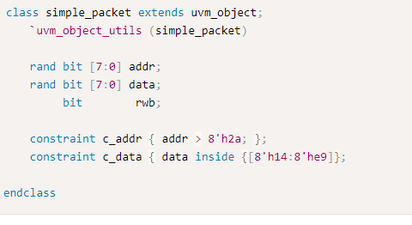
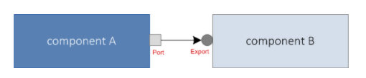
Transaction Level Modeling (TLM)
A modeling style to build highly abstract models of components and systems.
Data is represented as transactions that flow in and out of different components via TLM interfaces.
Notes:
UVM provides a set of transaction level communication interfaces that can be used to connect between components such that data packets can be transferred between them.
Advantages:-
isolates a component from changes in other components
promotes reusability and flexibility (since you can just swap a component with another that also has a TLM interface).
In the example, simple_packet class object will be a transaction that can be sent from componentA to componentB via TLM interface ports port and export.

Slide 6
UVM Factory
Used to manufacture (create) UVM objects and components
A mechanism allows the user to substitute an existing class object by any of its inherited class objects
To improve flexibility and scalability of the testbench
Ex: extend a driver to have few more test scenarios
Only classes extended from uvm_object and uvm_component are supported
The factory provides name based and type based interfaces
type based: far less prone to errors in usage. Errors are caught at compile time.
name based: dominated by string arguments. Errors might only be caught at time of call, if at all
Notes:
For this, the factory needs to know all the types of classes created within the testbench by registration.
Only one instance of the factory is present in a given simulation.
For name based interfaces, the string arguments can be misspelled and provided in the wrong order. Further, name-based interface is not portable across simulators when used with parameterized classes.

Slide 7
UVM Factory
Basic steps
Registration
Construction
Overriding
Notes:
example: In your Ethernet verification environment, you have different drivers to support different interfaces for 10mbps,100mps and 1G. Now you want to reuse the same environment for 10G verification. Inside somewhere deep in the hierarchy, while building the components, as a driver components ,your current environment can only select 10mmps/100mps/1G drivers using configuration settings. How to add one more driver to the current drivers list of drivers so that from the testcase you could configure the environment to work for 10G.

Slide 8



UVM Factory
Registration - Example
class monitor #(type T=int, int mode=0) extends uvm_component
`uvm_component_param_utils(monitor#(T,mode))
endclass

Slide 9


UVM Factory
Construction
static method create() should be used. while constructing the uvm based components or uvm based objects , do not use new() constructor
Syntax
Ex:

Slide 10
UVM Factory
Overriding
Based on the needs, user could override the registered classes or objects

Slide 11
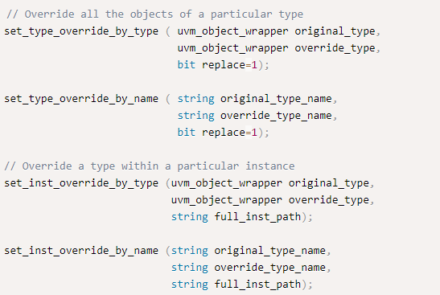
Factory Override Methods
The methods within a uvm_object_wrapper are create_object, create_component, get_type_name
Notes:
The inst_override_by_type/name configures the factory to create an object of the override’s type whenever a request is made to create an object of the original type using a context that matches full_inst_path
The type_override_by_type/name configures the factory to create an object of the override’s type whenever a request is made to create an object of the original type, provided no instance override applies. The original and override types are handles to the types’ proxy objects.
The original type is a superclass of the override type.
The uvm_object_wrapper provides an abstract interface for creating object and component proxies. Instances of these lightweight proxies, representing every uvm_object-based and uvm_component-based object available in the test environment, are registered with the uvm_factory. When the factory is called upon to create an object or component, it finds and delegates the request to the appropriate proxy. The methods within a uvm_object_wrapper are create_object, create_component, get_type_name

Slide 12
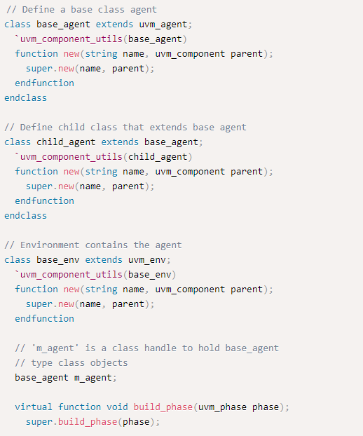
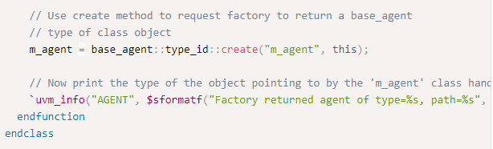
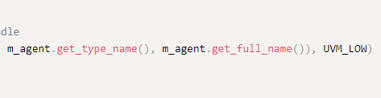
Notes:
This is an example testbench structure comprising of a base agent inside a base environment that is instantiated within the test class

Slide 13
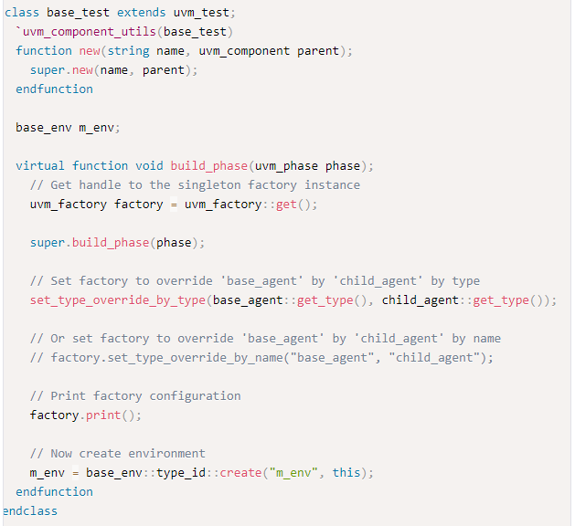
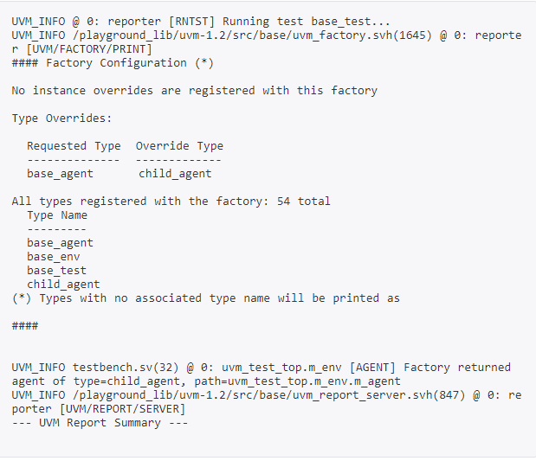
Type Override by Type/Name
Notes:
The simulation log shows that a type override is configured and replaces base_agent with child agent. This is also evident from the info statement that prints the type of the returned object.

Slide 14
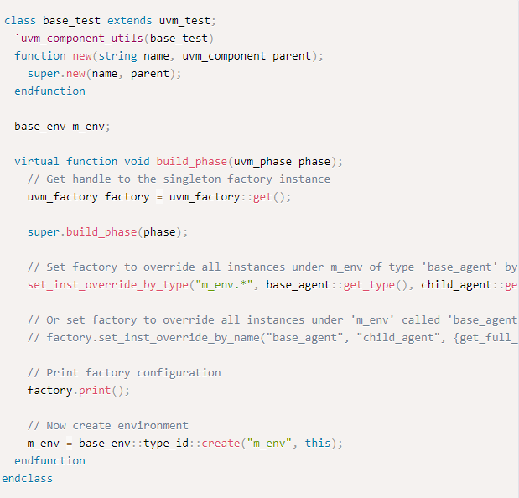
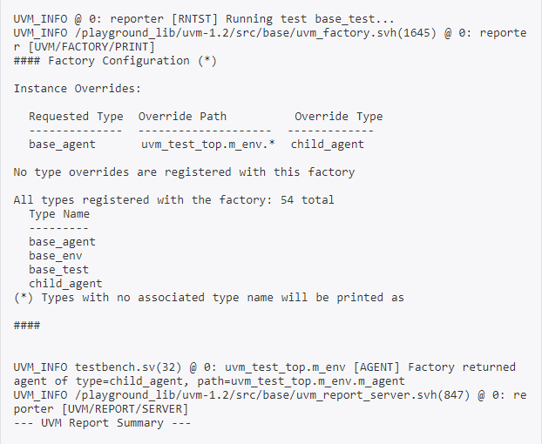
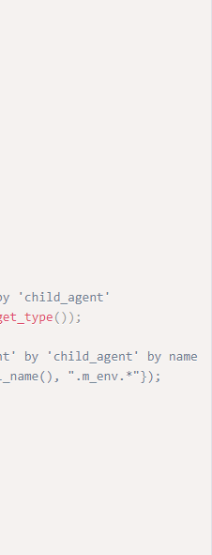
Instance Override by Type/Name
Notes:
This type of override is useful when only a few instances of the given type has to be overridden. A type override by type will replace all instances of the given type by the new type.

Slide 15
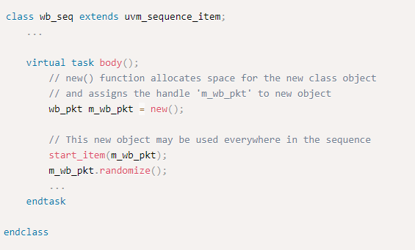
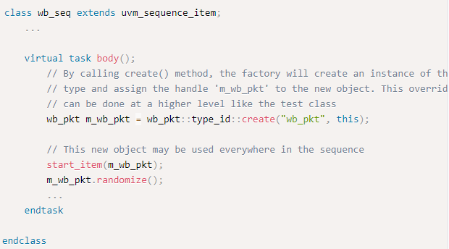
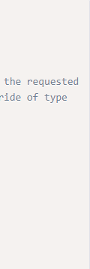
Purpose of UVM Factory
Registering objects and components types with the factory.
Designing components, to use the factory to create objects or components
Configuring the factory with type and instance overrides, both within and outside components.
Notes:
The new function in SV is used to create a class object and is used in UVM as well. Assume that an existing testbench uses Wishbone v1.0 protocol data packet class and is used throughout the testbench in components like driver, monitor, scoreboard, and many other seqeunces. If Wishbone v2.0 is released and the testbench is required to update and start using packet definition for the new protocol, there would be many places in the testbench that would require an update in code which can prove to be cumbersome.
With UVM Factory, users can modify or substitute the type of the item created by the factory without having to modify existing class instantiations. Instead of text substitution of class name of existing data packet, a child class object can be created that makes necessary modifications for 2.0 and the factory can be used to return the newly defined class object in all places within the testbench instead of the first one. The preferred method of object creation in UVM testbench is by using create method.

Slide 16
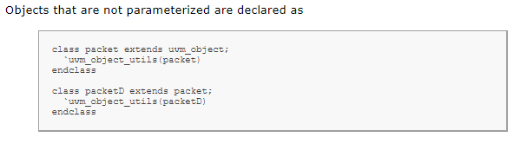
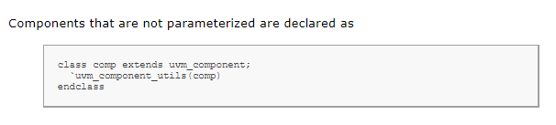
Registering objects and components types with factory
Notes:
When defining uvm_object and uvm_component-based classes, simply invoke the appropriate macro. Use of macros are required to ensure portability across different vendors’ simulators.
The `uvm_*_utils macros for simple, non-parameterized classes will register the type with the factory and define the get_type, get_type_name, and create virtual methods inherited from uvm_object. It will also define a static type_name variable in the class, which will allow you to determine the type without having to allocate an instance.

Slide 17
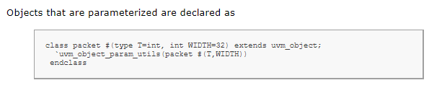
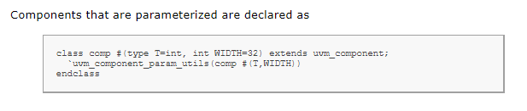
Registering objects and components types with factory
Notes:
The `uvm_*_param_utils macros for parameterized classes differ from `uvm_*_utils classes in the following ways:
The get_type_name method and static type_name variable are not defined. You will need to implement these manually.
A type name is not associated with the type when registering with the factory, so the factory’s *_by_name operations will not work with parameterized classes.
The factory’s print, debug_create_by_type, and debug_create_by_name methods, which depend on type names to convey information, will list parameterized types as <unknown>.
It is worth noting that environments that exclusively use the type-based factory methods (*_by_type) do not require type registration. The factory’s type-based methods will register the types involved “on the fly,” when first used. However, registering with the `uvm_*_utils macros enables name-based factory usage and implements some useful utility functions.

Slide 18
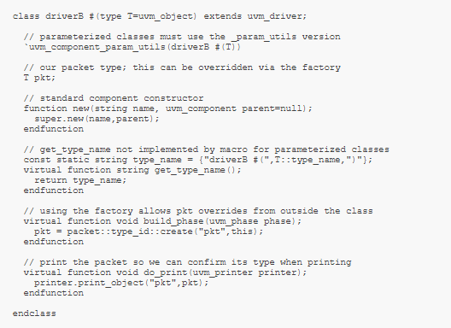
Designing components that defer creation to the factory
Notes:
Having registered your objects and components with the factory, you can now make requests for new objects and components via the factory. Using the factory instead of allocating them directly (via new) allows different objects to be substituted for the original without modifying the requesting class. The following code defines a driver class that is parameterized.

Slide 19
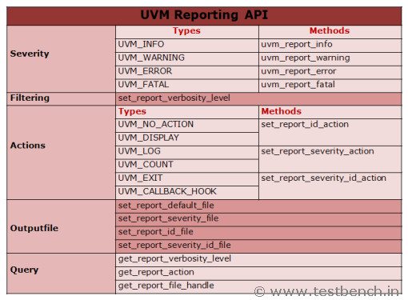
UVM Message facilities
Notes:
Following are the actions defined: UVM_NO_ACTION -- Do nothing UVM_DISPLAY -- Display report to standard output UVM_LOG -- Write to a file UVM_COUNT -- Count up to a max_quit_count value before exiting UVM_EXIT -- Terminates simulation immediately UVM_CALL_HOOK -- Callback the hook method .
Using these methods, user can set the verbosity levels and set actions. function void set_report_verbosity_level (int verbosity_level) function void set_report_severity_action (uvm_severity severity,uvm_action action) function void set_report_id_action (string id,uvm_action action) function void set_report_severity_id_action (uvm_severity severity,string id,uvm_action action)

