Slide 1
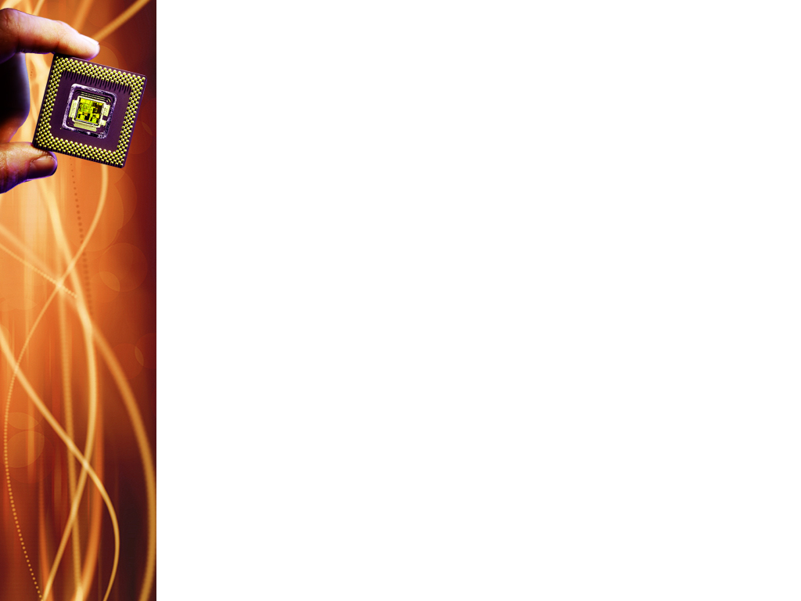
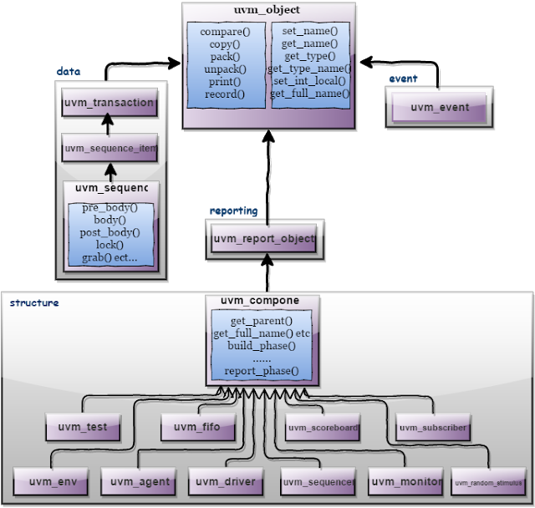
UVM Class Libraries - Recap

Slide 2
UVM Class Libraries - Recap
Base class hierarchy: uvm_void → uvm_root → uvm_object → uvm_report_object → uvm_component
uvm_void – serves as base class for all UVM classes
uvm_root – top level class, implicit, created automatically during simulation, accessed via uvm_package using the varialble uvm_top

Slide 3
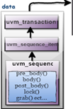
UVM sequence_item
Sequence_item:
Generate the stimulus
Randomized
Data fields represent the following information:
Control information – a type of transfer, transfer size, etc
Payload Information – data content of the transfer
Configuration Information – mode of operation, error behavior, etc
Analysis Information – fields used to capture information from DUT, ex: read data, response, etc
Notes:
NOTE: as analysis information fields will be used for capturing response, except these fields the other fields can be declared as rand and can have constraints associated with it.

Slide 4
UVM sequence_item
sequence_item extended using uvm_sequence_item,
Inherits from the uvm_object via the uvm_transaction class
Therefore uvm_sequence_item is of an object type
Few virtual methods in uvm_object are copy, clone, compare, print, transaction, and recording
Utility Macros and Field Macros of uvm_object are also used

Slide 5
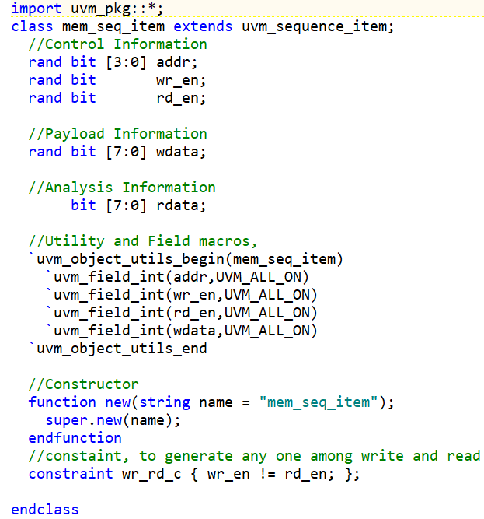
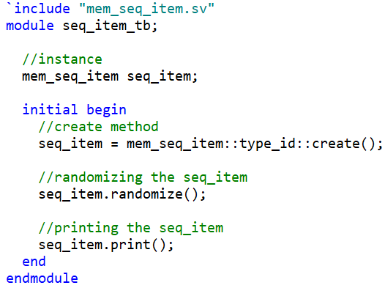
UVM sequence_item example

Slide 6
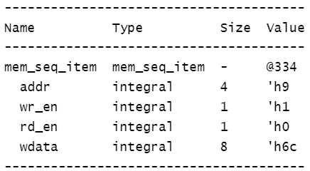
UVM sequence_item example

Slide 7
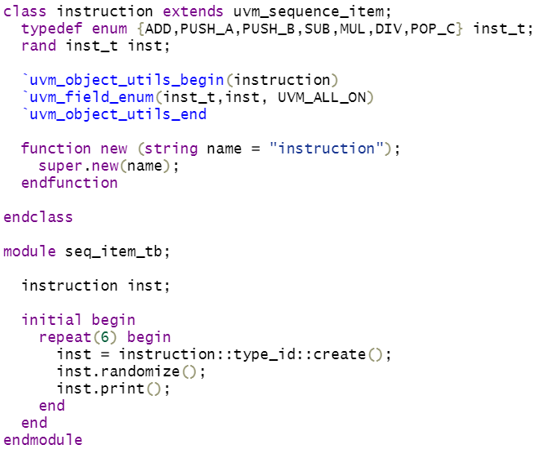
UVM sequence_item example

Slide 8
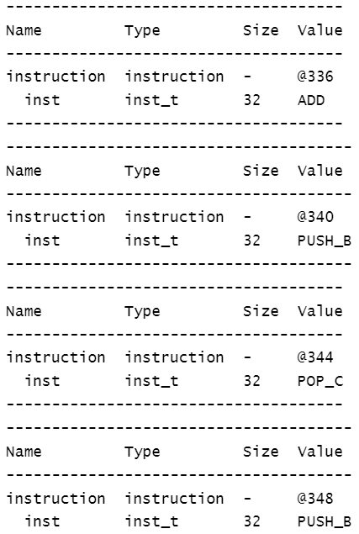
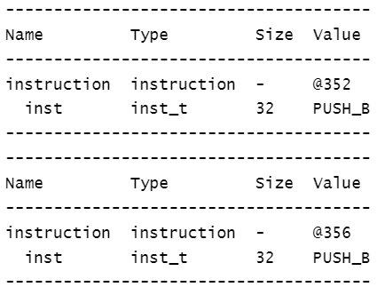
UVM sequence_item example

Slide 9
UVM Sequence Item methods
create() : allocates a new object of the same type as this object and returns it via a base uvm_object handle.
print() : deep-prints this object’s properties in a format and manner governed by the given printer argument

Slide 10
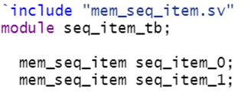



UVM sequence_item copy()
Makes this object a copy of the specified object

Slide 11
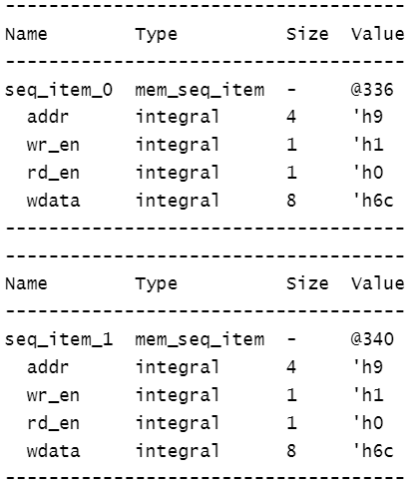
UVM sequence_item copy()
Makes this object a copy of the specified object

Slide 12
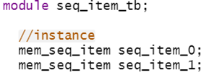
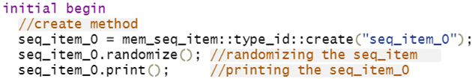

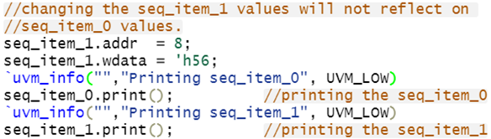

UVM sequence_item clone()
`uvm_info
`uvm_info(ID,MSG,VERBOSITY)
ID is given as the message tag and MSG is given as the message text. The file and line are also sent to the uvm_report_info call.
Creates and returns an exact copy of this object = create() + copy()

Slide 13
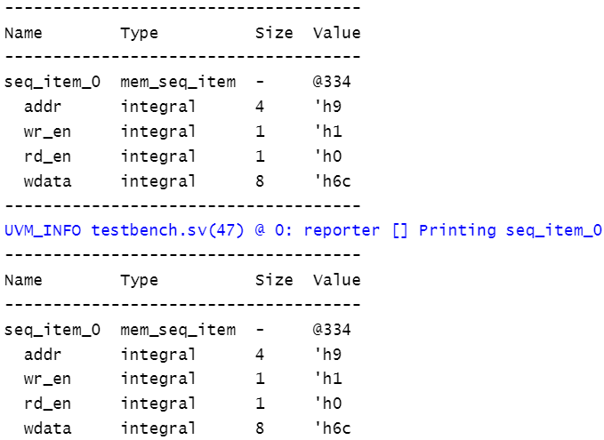
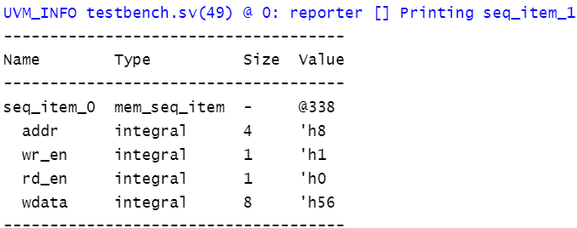
UVM sequence_item clone()

Slide 14


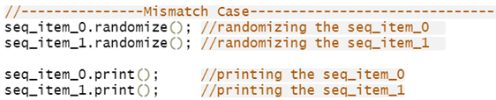

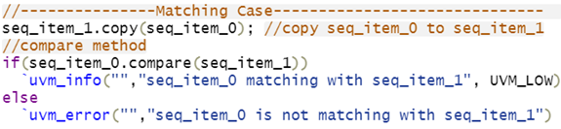

UVM sequence_item compare()
Deep compares members of this data object with those of the object provided in the RHS argument, returning 1 on a match, 0 otherwise.

Slide 15
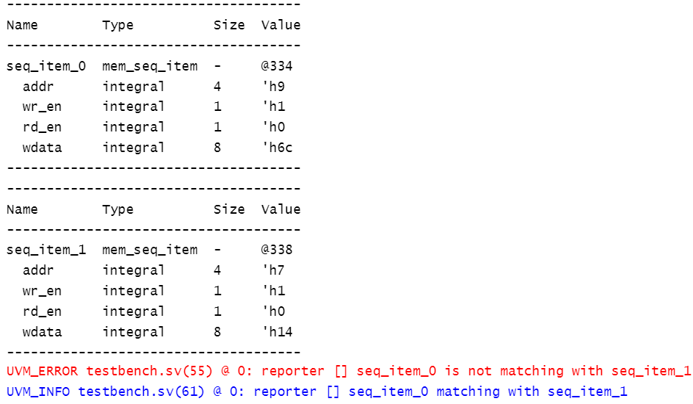
UVM sequence_item compare()

Slide 16
Difference Between UVM_ALL_ON and UVM_DEFAULT
UVM_ALL_ON
Used to enable all UVM reporting and verbosity features. It turns on all verbosity levels and reporting features in the UVM framework.
It sets the verbosity level to the maximum; all messages will be displayed.
Usage: Used when a comprehensive level of information is needed during debugging or when trying to understand intricate issues in the testbench.
Point to Note: Using UVM_ALL_ON can lead to a large amount of output.

Slide 17
Difference Between UVM_ALL_ON and UVM_DEFAULT
UVM_DEFAULT
Sets the reporting and verbosity levels to the UVM’s default settings.
Default verbosity level: UVM_MEDIUM
You get a balanced amount of information
Usage: Commonly used during simulation runs when standard debugging information is sufficient.

Slide 18
UVM sequence_item pack()
The pack methods bit-wise concatenate this object’s properties into an array of bits, bytes, or ints.
The unpack methods extract property values from an array of bits, bytes, or ints.

Slide 19
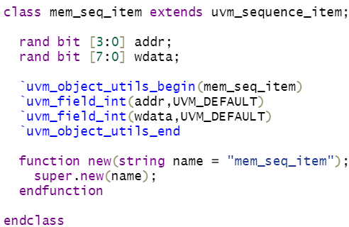
UVM sequence_item pack()

Slide 20
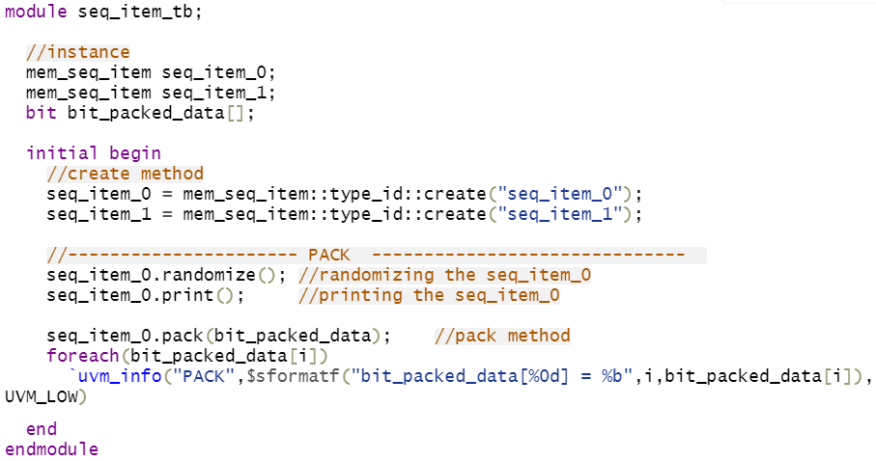
UVM sequence_item pack()

Slide 21
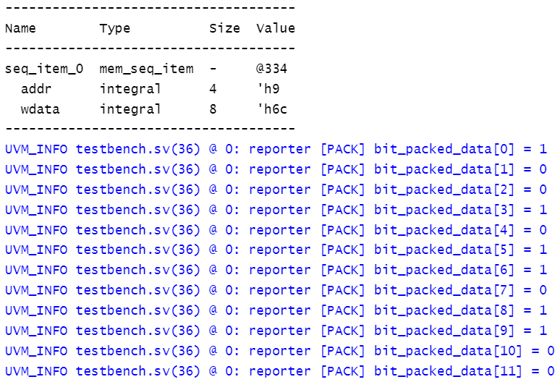
UVM sequence_item pack()

Slide 22
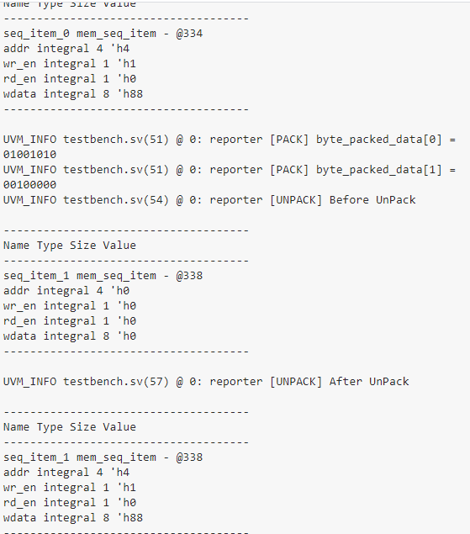
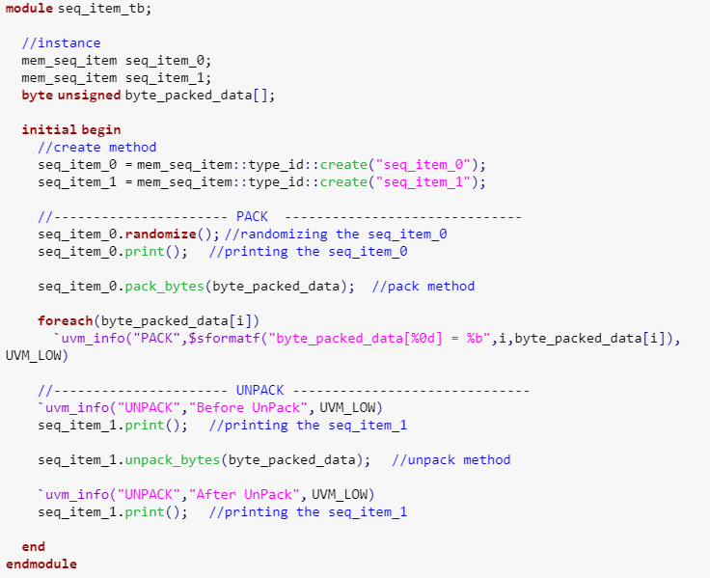
UVM sequence_item pack/unpack to/from array of byte type

Slide 23
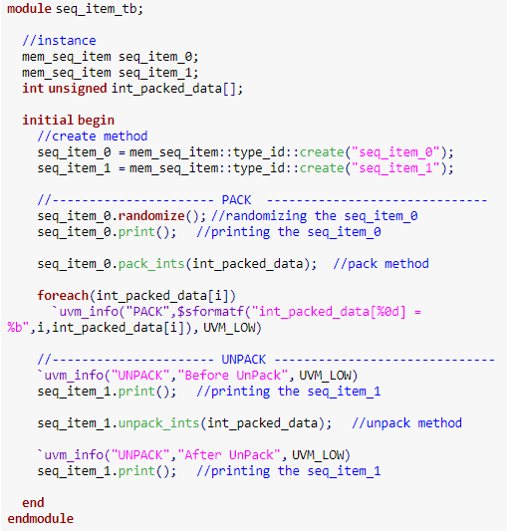
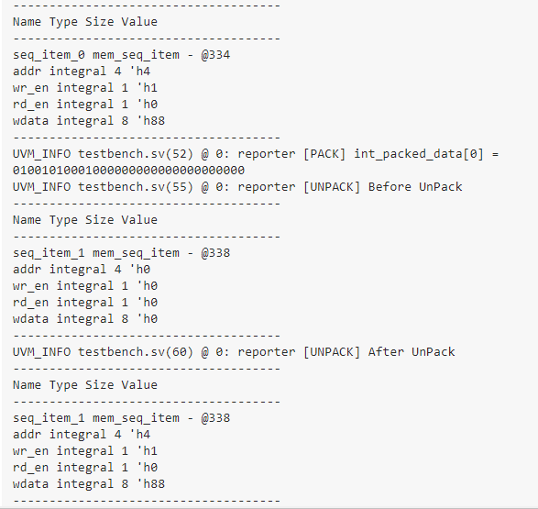
UVM sequence_item pack/unpack to/from array of int type

