Slide 1

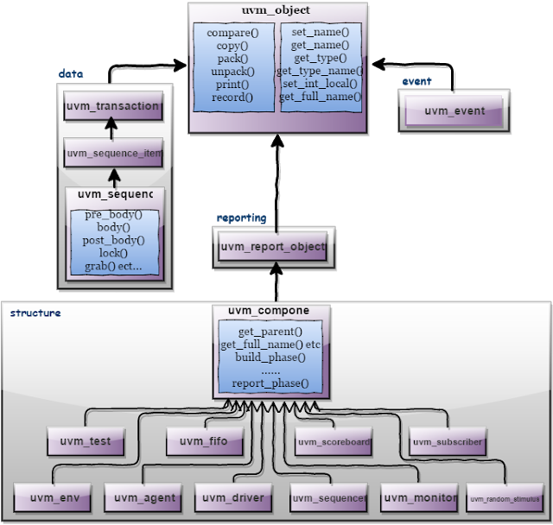
UVM Class Libraries - Recap

Slide 2
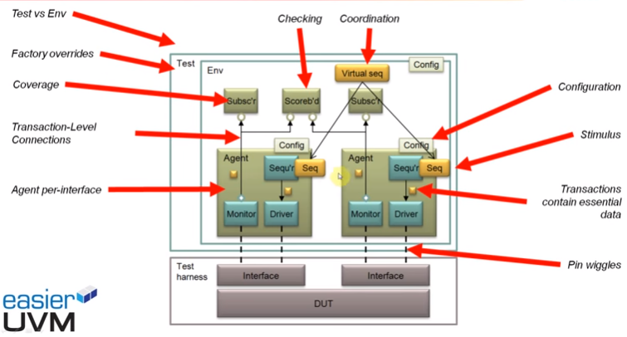

Slide 3
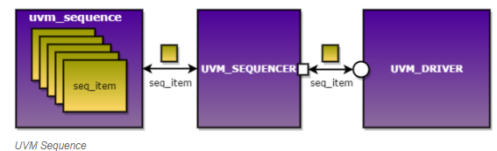
UVM sequence
UVM sequences are made up of several data items that are put together in different ways to create interesting scenarios.
Primary means of generating stimulus in the UVM
A sequence generates a series of sequence_items and sends it to the driver via sequencer.
Advantages
Sequences can be reused.
Stimulus generation is independent of testbench.
Easy to control the generation of transaction.
Sequences can be combined sequentially and hierarchically.
Notes:
1. A sequence generates a series of sequence_items and sends it to the driver via sequencer.
2. They are executed by an assigned sequencer that then sends the data items to the driver. Hence, sequences make up the core stimuli of any verification plan.

Slide 4
UVM sequence
A complete sequence generation requires following 4 classes.
1- Sequence item
2- Sequence
3- Sequencer
4- Driver

Slide 5
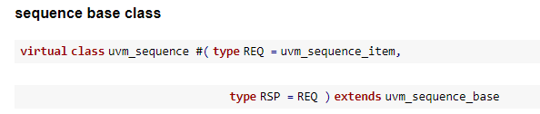

UVM sequence
request/req:
A transaction that provides information to initiate the processing of a particular operation.
response/rsp:
A transaction that provides information about the completion or status of a particular operation.
Notes:
A uvm_sequence is derived from uvm_sequence. The sequence is parameterized with the type of sequence_item, which defines the type of the item sequence that will send/receive to/from the driver.
The sequence has handle req and rsp of mem_seq_item

Slide 6
Creating a UVM sequence
Create a user-defined class inherited from uvm_sequence, register with factory and call new
class my_sequence extends uvm_sequence;
`uvm_object_utils (my_sequence)
function new (string name = “my_sequence”);
super.new(name);
endfunction
endclass
Declare the default sequencer to execute this sequence
//[Optional] my_sequencer is a custom sequencer that is predefined before this sequence definition
`uvm_declare_p_sequencer (my_sequencer)

Slide 7
Difference between m_sequencer and p_sequencer
m_sequencer
contains reference to the sequencer(default sequencer) on which the sequence is running.
m_sequencer is a member variable of the uvm_sequence_item class.
Determined by:
sequencer handle provided in the start method
sequencer used by the parent sequence
sequencer that was set using the set_sequencer method
Notes:
The prefix m_ usually stands for "member" in UVM coding style, suggesting that m_sequencer is a member variable of a class,
It's used by the component to access the sequencer for getting sequence items, among other interactions.

Slide 8
Difference between m_sequencer and p_sequencer
It is automatically set by the UVM framework when the sequence item is sent to a sequencer.
Used in sequences or sequence items to access the sequencer for dynamic sequence or configuration changes during runtime
It is typically a handle to the sequencer instance that a component (usually a driver) is associated with.
In a driver, m_sequencer is often set automatically by the UVM framework when the driver is connected to a sequencer via a configuration mechanism (e.g., uvm_config_db)
Notes:
The prefix m_ usually stands for "member" in UVM coding style, suggesting that m_sequencer is a member variable of a class,
It's used by the component to access the sequencer for getting sequence items, among other interactions.

Slide 9
Difference between m_sequencer and p_sequencer
)
class my_sequence extends uvm_sequence #(my_sequence_item);
// The m_sequencer variable is often implicitly used through the parent class's sequencer reference
virtual task body();
if (m_sequencer != null) begin
// Use m_sequencer to start a sub-sequence or perform other actions
end
endtask
endclass

Slide 10
Difference between m_sequencer and p_sequencer
p_sequencer
a variable, used as a handle to access sequencer properties
p_sequencer is a member of the uvm_sequence class.
It is not a standard UVM identifier
Used within UVM drivers or other components that need to interact with a sequencer.
Defined using the macro `uvm_declare_p_sequencer(SEQUENCER_NAME)
It is a pointer or handle to the sequencer that is currently executing the sequence.
Automatically cast to the correct sequencer type within a sequence when you start the sequence on a specific sequencer type.
Notes:
The prefix p_ usually stands for "pointer" or "port" in various coding styles, but in the context of UVM, p_sequencer is often used as a shorthand or macro within sequences to conveniently cast the generic m_sequencer handle to a more specific sequencer type.
This allows the sequence to interact with its sequencer, typically to access specific methods or properties of the sequencer that are not available through the standard UVM sequence-to-sequencer interface.

Slide 11
Difference between m_sequencer and p_sequencer
)
class my_driver extends uvm_driver #(my_sequence_item);
// Casting the generic uvm_sequencer to a specific sequencer type
function new(string name, uvm_component parent);
super.new(name, parent);
endfunction
virtual task run_phase(uvm_phase phase);
my_sequencer_specific_type p_sequencer;
p_sequencer = my_sequencer_specific_type(m_sequencer); // Casting
// Now p_sequencer can be used to access specific methods or properties
endtask
endclass
Notes:
uvm_phase object represents the current phase of the UVM simulation cycle during which run_phase is being executed. When the run_phase is executed, the UVM framework passes an instance of the uvm_phase class corresponding to the run_phase of the simulation. This allows the task to know which phase is currently active and perform specific actions related to that phase, such as raising or dropping objections to control the flow of the simulation.

Slide 12
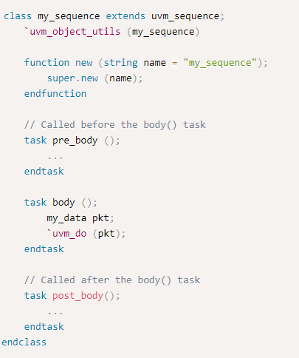
UVM sequence
3. Define the body method
// This task is virtual so that child classes can override this task definition
virtual task body();
//Stimulus for this sequence
endtask
Notes:
my_sequence is inherited from uvm_sequence
It is registered with the factory using `uvm_object_utils because it is a transaction item
The main stimulus is written within the body() task while pre_body() and post_body are useful callbacks to be used if required.
A data packet is created and sent for execution using `uvm_do macro.
pre_body and post_body methods are not invoked in a `uvm_do macro call.
The `uvm_do macro allocates an object of type my_data to pkt, randomize it and send it to the default sequencer associated to this sequence. Use of this macro reduces the code required to achieve the objectives.

Slide 13
UVM sequence
Most important properties of a sequence are:
Body method
m_sequencer handle
The sequence gets executed on calling start of the sequence from the test.
Sequence_name.start(sequencer_name);
sequencer_name specifies on which sequencer the sequence has to run
There are methods, macros and pre-defined callbacks associated with uvm_sequence.
Users can define the methods(task or function) to pre-defined callbacks, these methods will get executed automatically upon calling start of the sequence.
These methods should not be called directly by the user.
Notes:
1. Body method defines what the sequence does. The m_sequencer handle contains the reference to the sequencer on which the sequence is running.

Slide 14
UVM sequence
Body method
The operation which is intended to be done by sequence is defined inside a body method.
Along with a body() method, pre_body, and post_body methods are called by default
These pre_body and post_body tasks are additional (which are useful to perform any operation before and after the execution of the body() method.
pre_body() and post_body() methods are optional.
task pre_body();
...
endtask
task body();
...
endtask
task post_body();
...
endtask

Slide 15
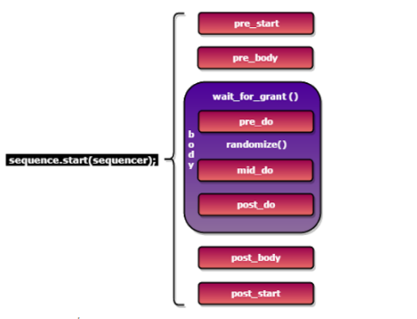
UVM sequence
Notes:
This is the order in which the methods will get called on calling the start of a sequence.
mid_do and post_do are functions. All others are tasks.

Slide 16
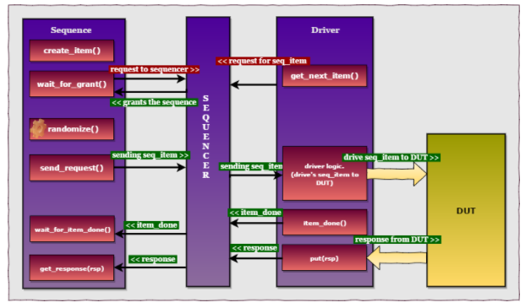
UVM sequence
Notes:
The logic to generate and send the sequence_item will be written inside the body() method of the sequence.
The diagram shows the handshake between the sequence, sequencer and the driver to send the sequence_item.

Slide 17
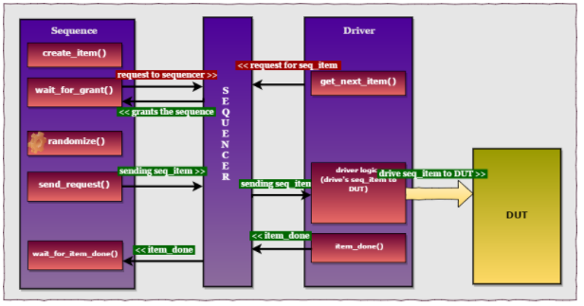
UVM sequence
Notes:
Communication between sequence and driver (without response stage) involves the steps:
create_item()/ create req
wait_for_grant()
randomize the seq
send the req
wait for item done
get response
steps 5 and 6 are optional.

Slide 18
UVM sequence
Steps to write a sequence
Create a seq_item, randomize it, and then send it to the driver.
To perform this operation any one of the following approaches is followed in the sequence.
Using macros like `uvm_do , `uvm_create, `uvm_send etc
Using existing methods from the base class
a. Using wait_for_grant(), send_request(), wait_for_item_done() etc
b. Using start_item/finish_item methods.

Slide 19
UVM sequence
Macros | Description
`uvm_do (seq/item) | Create, randomize and send to the driver will be executed
`uvm_do_with (seq/item, constraints) | `uvm_do + constraints can be defined while randomizing
`uvm_do_pri(seq/item, priority) | `uvm_do + mentioned priority is considered.
`uvm_do_pri_with(seq/item, constraints, priority). | Combination of `uvm_do_with and `uvm_do_pri
`uvm_create(seq/item) | Creates a sequence or item.

Slide 20
UVM sequence
Macros | Description
`uvm_send(seq/item) | Sends seq/item without creating and randomizing it. (So, make sure the seq/item is created and randomized first.)
`uvm_rand_send(seq/item) | Directly sends a randomized seq/item without creating it. So, make sure the seq/item is created first.
`uvm_rand_send_with(seq/item, constr) | Directly sends a randomized seq/item with constraints but without creating it. So, make sure seq/item is created first
`uvm_send_pri(seq/item, Priority) | `uvm_send + priority is also considered.
`uvm_rand_send_pri(seq/item, Priority) | Combination of `uvm_rand_send and `uvm_send_pri
`uvm_rand_send_pri_with(seq/item, Priority, constr) | Combination of `uvm_rand_send_with and `uvm_send_pri.

Slide 21
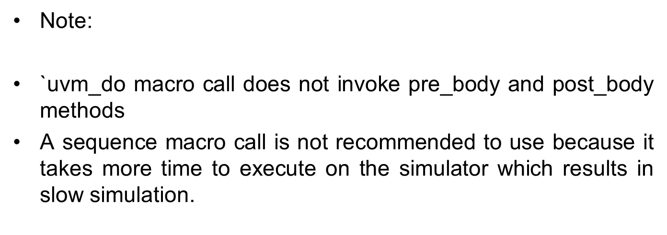
UVM sequence

Slide 22
UVM sequence examples using macros
class my_sequence extends uvm_sequencer #(seq_item);
`uvm_object_utils(my_sequence)
function new (string name = "my_sequence")
super.new(name);
endfunction
task body();
`uvm_do(req);
endtask
endclass
class my_sequence extends uvm_sequencer #(seq_item);
`uvm_object_utils(my_sequence)
function new (string name = "my_sequence")
super.new(name);
endfunction
task body();
`uvm_do_with(req, {req.<variable> == 0;}); // any constraint
endtask
endclass

Slide 23
UVM sequence examples with macros
class my_sequence extends uvm_sequencer #(seq_item);
`uvm_object_utils(my_sequence)
function new (string name = "my_sequence")
super.new(name);
endfunction
task body();
`uvm_create(req);
assert(req.randomize());
`uvm_send(req);
endtask
endclass
class my_sequence extends uvm_sequencer #(seq_item);
`uvm_object_utils(my_sequence)
function new (string name = "my_sequence")
super.new(name);
endfunction
task body();
`uvm_create(req);
`uvm_rand_send(req);
endtask
endclass
Notes:
`uvm_create - Creates a sequence or item.

Slide 24
UVM sequence using base methods
Using wait_for_grant(), send_request(), wait_for_item_done()
Using start_item/finish_item methods

Slide 25
UVM sequence using base items
Methods are defined in the uvm_sequence_base class which is derived from the uvm_sequence_item class
Type | Methods | Description
function | create_item | Creates and initializes request items or sequences and initializes using the factory.
task | wait_for_grant | Issues a request to the current sequencer and it returns when the sequencer has granted the sequence. Hence, it is a blocking method that waits for a grant from the sequencer.
function | send_request(uvm_sequence_item request, bit rerandomize = 0) | Send request items to the driver via the sequencer. If rerandomize = 1, the item will be randomized before sent to the driver.
task | wait_for_item_done() | This task will block until the driver calls put or item_done. It is an optional call.
 | get_response (RSP) | This is optional in case the driver sends back any response

Slide 26
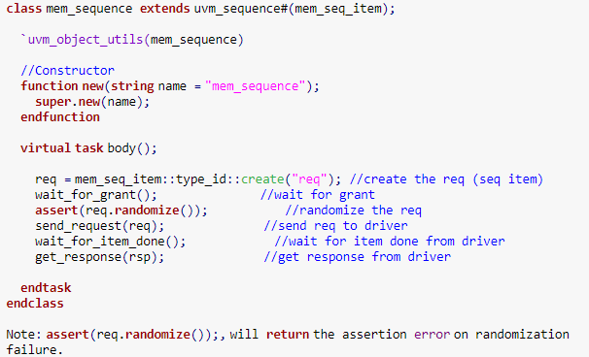
UVM sequence example
Steps:
Create a seq_tem using create() method.
wait_for_grant
Randomize seq_item
send_request(req)
wait_for_item_done()
get_response (rsp)

Slide 27
UVM sequence using base methods
Using start_item/finish_item methods
The start_item and finish_item tasks are also defined in the uvm_sequence_base class.
Both methods initiate the operation of sequence items.
Note: There should be no simulation time consumed between start_item and finish_item call.
Methods | Description
start_item(req) | It blocks until the sequencer grants the sequence and the sequence_item access to the driver.
finish_item(req) | It blocks the driver until it finishes the transfer protocol for the sequence item.

Slide 28
UVM sequence with base methods
Steps:
Create a seq_tem using create() method.
start_item(req)
Randomize seq_item
finish_item(req)
class my_sequence extends uvm_sequencer #(seq_item);
`uvm_object_utils(my_sequence)
function new (string name = "my_sequence")
super.new(name);
endfunction
task body();
req = seq_item::type_id::create("req");
start_item(req);
assert(req.randomize());
finish_item(req);
endtask
endclass
Notes:
Important Note:
Approach B is the same as approach A. The start_item(req) method internally calls wait_for_grant() method to get grant from the sequencer. The finish_item(req) method internally calls send_request() and wait_for_item_done() methods. Hence, start_item and finish_item methods act as wrapper methods over them.

Slide 29
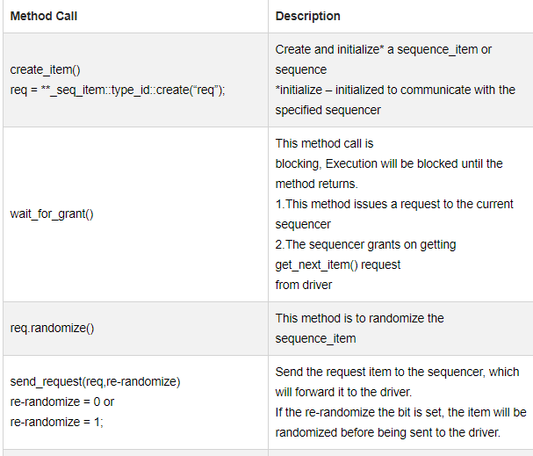

Slide 30
