Slide 1

STARS, WORDS AND FRIENDS
FORECASTING YELP RATINGS WITH TEXT AND SOCIAL NETWORKS
Yelp Open Dataset, Santa Barbara area: reviews, sentiment, friendship network and time series
[Author names and student numbers]
Analysis of Complex Data, MECD · Final project · November 2026
Notes:
Final project for Analysis of Complex Data. The question: can monthly Yelp ratings of business categories be forecast, and does the reviewers’ social network add anything beyond rating history and review text? Replace the author placeholder before presenting.

Slide 2
CONTENTS
01
Data and exploration
02
Text and sentiment
Slides 3–6. Yelp data, rules and test design, first look
Slides 7–12. Preprocessing, model benchmark, aspects, gap
03
Social network
04
Forecasting
Slides 13–17. Structure, homophily, communities, influence
Slides 18–22. Setup, diagnostics, ARIMA, global models
05
Integration
06
Conclusions
Slides 23–25. Does the network help? Aggregate against individual
Slides 26–28. Answer, limitations, next steps
Main question: can the monthly ratings of business categories be forecast, and does the reviewers’ social network add anything beyond rating history and review text?
2
Notes:
Roadmap of the talk. Six blocks: data and exploration, text and sentiment, social network, time series forecasting, the integration of network and forecast, and conclusions. The main question is whether the social network adds anything to forecasts beyond rating history and review text.

Slide 3

DATA AND EXPLORATION
01
IN THIS SECTION
04 Data: Yelp, Santa Barbara area
05 Rules and test design
06 Exploring the reviews
Yelp reviews of the Santa Barbara area, the rules that keep the evaluation honest, and a first look at the data.
Notes:
Section 1: data, test design and exploration.

Slide 4
DATA: YELP, SANTA BARBARA AREA
01
348,014
5,164
reviews, March 2005 to January 2022
businesses in 12 macro categories
Cleaning and design choices
Cities with fewer than 20 businesses are removed, and each business gets one macro category.
3.96
Elite years written as “20,20” are repaired, so Elite status is checked at the time of each review.
155,252
mean stars (median 5), J-shaped
User counters (fans, average stars) describe the end of the data, so they are not used as forecast inputs.
users who wrote them
Only the friendship network is taken from the user file; names are not loaded.
66.7%
471,089
Slow steps are cached, so a rerun takes minutes instead of 2–3 hours.
of users wrote a single review
friendship edges inside the subset
4
Notes:
Dataset: Yelp Open Dataset restricted to state CA, which is the Santa Barbara metropolitan area. After cleaning, 348,014 reviews of 5,164 businesses by 155,252 users. Two details matter: Elite years need repair, and user-level counters would leak the future, so only network structure is taken from the user file.

Slide 5
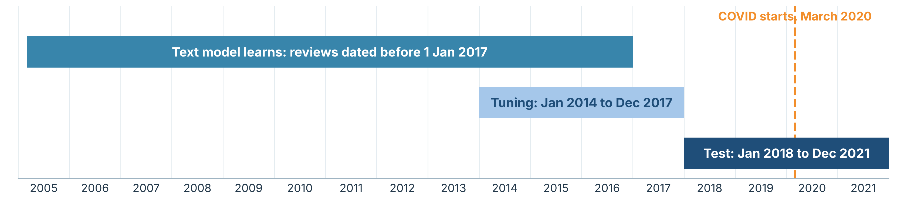
RULES AND TEST DESIGN
01
No self-leakage
Association, not causation
No look-ahead
Baseline first
Splits are by time. A forecast only uses reviews written before its date.
A review’s own sentiment never feeds its own stars; sentiment enters only through earlier reviews.
A model counts only if it beats a simple baseline on data it has not seen.
Friends may rate alike from influence, taste or joint visits. Each test states what it excludes.
5
Notes:
Four rules used throughout. Time-based splits: the text model learns from reviews before 2017, hyperparameters are tuned on 2014-2017, and the 48 test months from 2018 to 2021 are forecast one month at a time (walk-forward). COVID starts in March 2020, so results are reported before and during COVID.

Slide 6
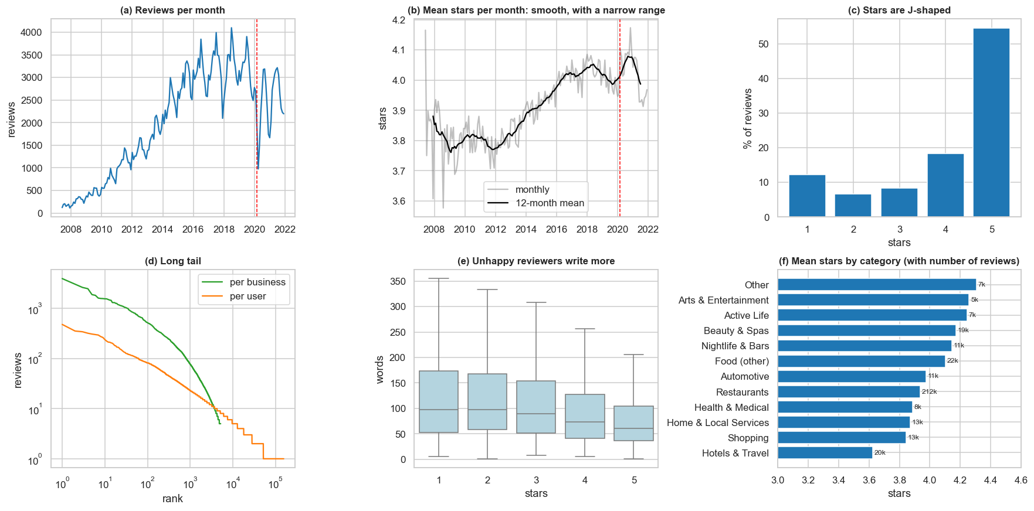
EXPLORING THE REVIEWS
01
Volume peaks, then COVID
Reviews grew until about 2018, then fell in 2020.
Stars are J-shaped
Mean 3.96, median 5; monthly means barely move.
Long tail, noisy ratings
Median 20 reviews per business, 1 per user; businesses explain 21% of a rating’s variance, users 26%.
So aggregate
We forecast a monthly mean per category.
6
Notes:
The EDA concentrates on what shapes modelling. Volume peaks around 2018 and drops with COVID. Stars are J-shaped. A very long tail means most users and businesses have little data: the median business has 20 reviews and the median user 1; the 802 businesses with 100+ reviews hold 70% of all reviews. Individual ratings are noisy, so the forecast target is a category-level monthly mean.

Slide 7
TEXT AND SENTIMENT
02
IN THIS SECTION
08 Text processing
09 Which sentiment model?
10 Aspect-based sentiment
11 What drives the stars
From raw review text to sentiment, aspects and the gap between words and stars.
12 The sentiment-star gap
Notes:
Section 2: text processing and sentiment analysis, including the benchmark of five sentiment models and aspect-based sentiment.

Slide 8
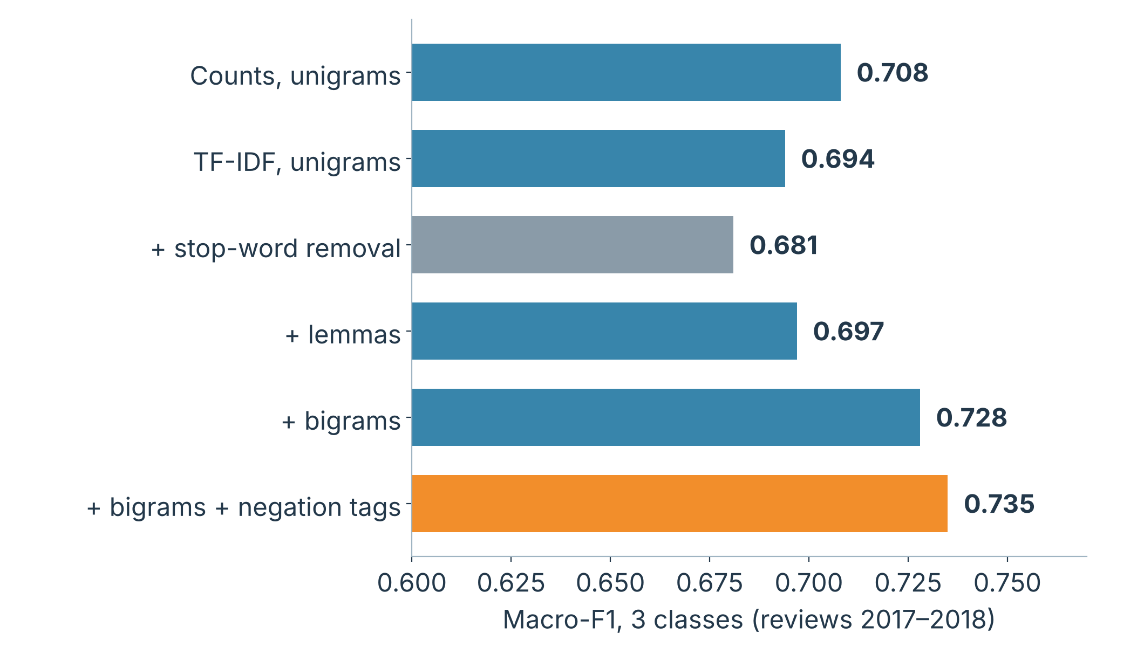
TEXT PROCESSING
02
Tested, not assumed
Six variants, one classifier: train before 2017, test on 2017–2018.
Bigrams plus negation tags win
Macro-F1 0.735 against 0.694 for plain TF-IDF; “not good” becomes one feature.
Stop-word removal hurts
It deletes “not” (0.681). Lemmas add almost nothing (0.697).
Still useful elsewhere
Lemmas and stop-word removal make topics readable.
8
Notes:
Pipeline: normalise (case, URLs), filter language, tokenise, vectorise. Instead of assuming which preprocessing helps, six variants were tested with the same classifier. TF-IDF with bigrams and negation tags is best (macro-F1 0.735). Removing stop words lowers quality because it deletes words like not. Lemmas add almost nothing for classification but make NMF topics readable.

Slide 9
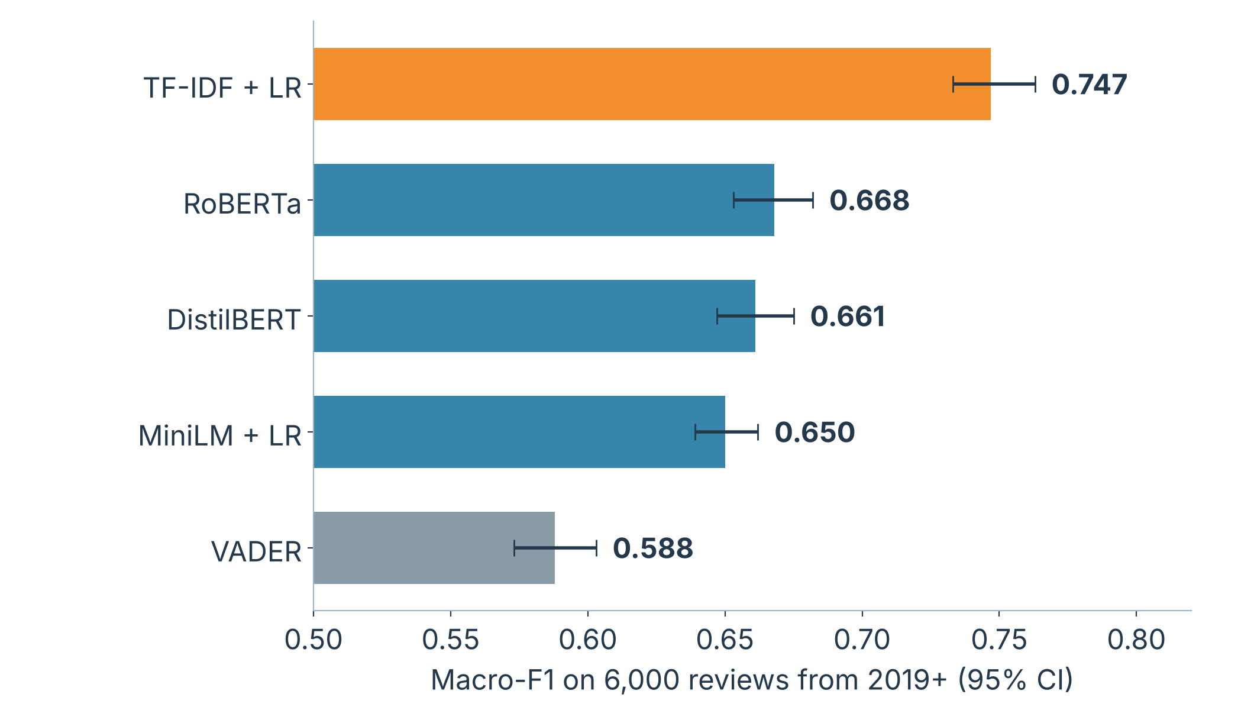
WHICH SENTIMENT MODEL?
02
Domain training wins
TF-IDF + logistic regression: macro-F1 0.747, error 0.42 stars.
Transformers behind
RoBERTa 0.668, DistilBERT 0.661, MiniLM 0.650; VADER last (0.588).
Not a fully even race
TF-IDF learned from 171,000 Yelp reviews; the transformers were only calibrated.
Neutral is hardest
All models struggle with 3-star reviews.
9
Notes:
Five families compared on the same 6,000 reviews written in 2019 or later: VADER lexicon, TF-IDF with logistic regression, MiniLM embeddings with logistic regression, DistilBERT and RoBERTa. Pretrained models get a small calibration step to map output to expected stars. The simple domain-trained model wins. The fair conclusion is that a simple model trained on the domain beats models trained elsewhere, not that TF-IDF beats transformers in general; fine-tuning needs a GPU.

Slide 10
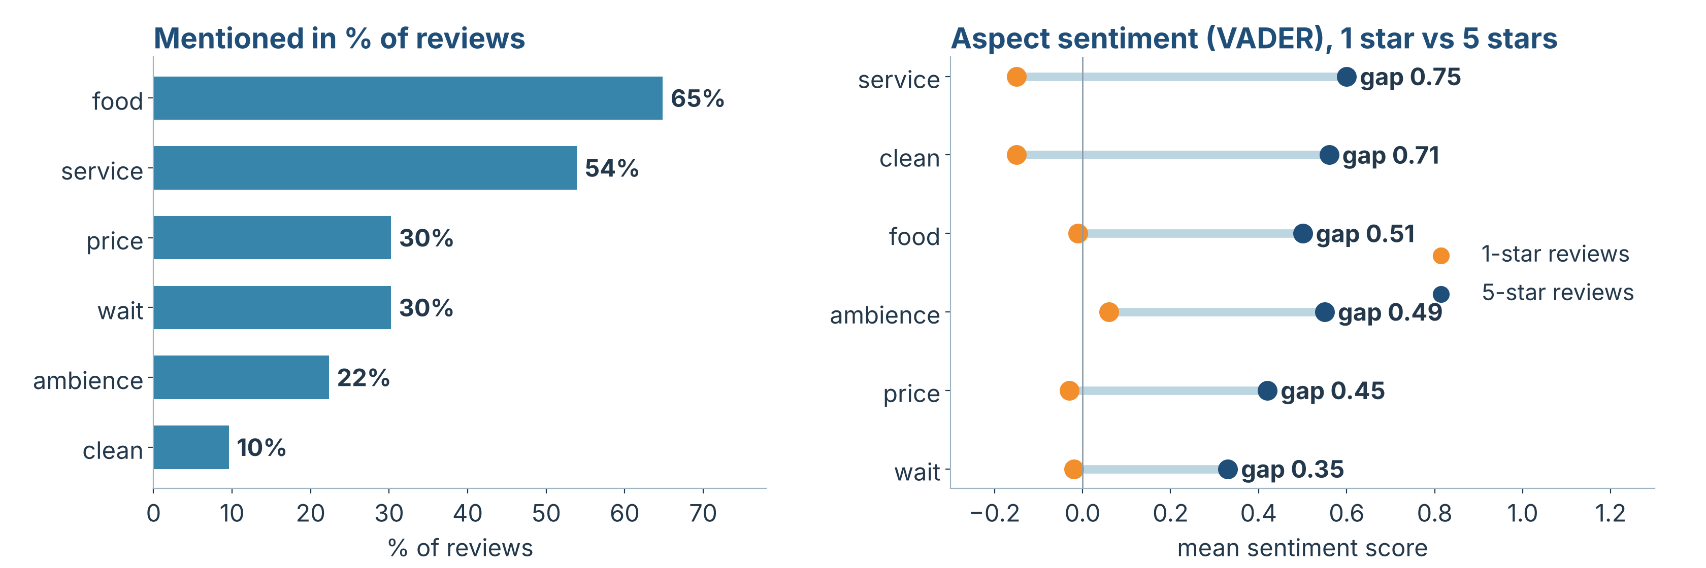
ASPECT-BASED SENTIMENT
02
Six aspects, sentence by sentence
VADER scores each sentence that mentions food, service, price, ambience, wait or cleanliness. 9 of 14 NMF topics match an aspect.
Service and cleanliness separate
Wait and price are weak spots
Gaps between 1-star and 5-star reviews are 0.75 and 0.71; wait has the smallest gap (0.35).
A DeBERTa aspect model agrees with VADER on 56% of pairs, and kappa is near 0 for wait.
10
Notes:
Overall sentiment says a review is negative; aspect-based sentiment says why. Aspects were defined from NMF topics and scored per sentence with VADER because it needs no star labels and so cannot leak ratings. A check against a dedicated DeBERTa aspect model shows modest agreement overall and a blind spot for wait and price, where complaints are factual (we waited 40 minutes).

Slide 11
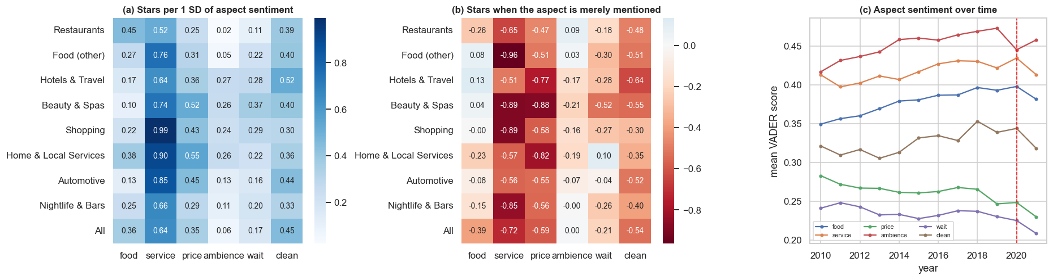
WHAT DRIVES THE STARS
02
Service drives stars everywhere
Context decides the rest
Mentioning is a warning sign
0.52 stars per SD in restaurants against 0.45 for food; up to 0.99 in shopping.
Food matters where it is the product, price where the bill is large (home services 0.55), cleanliness most in hotels (0.52).
Neutral mentions of service, price or cleanliness go with 0.5 to 0.7 fewer stars. These are associations, not causes.
11
Notes:
Regression of a review’s stars on its six aspect sentiments, by category. Panel (a): coefficients per standard deviation. Panel (b): effect of merely mentioning an aspect. Panel (c): aspect sentiment over time, with a dip around 2020-2021. Stars and text are written together, so this describes what explains a rating, not what causes it, and these same-review scores are never forecast inputs.

Slide 12
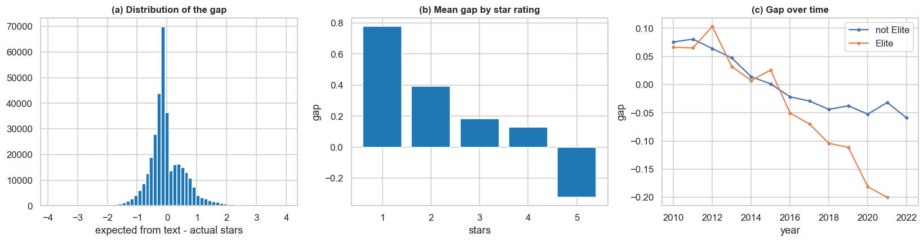
THE SENTIMENT-STAR GAP
02
Definition
Mostly regression to the middle
A slow downward drift
gap = stars expected from the text minus actual stars. Negative means a text gloomier than the rating.
The mean gap is +0.78 at 1 star and −0.32 at 5 stars, so it is compared within a category over time.
From +0.07 in 2010 to −0.20 for Elite reviewers in 2021: more measured texts or an ageing model; the data cannot tell.
12
Notes:
The hypothesis: if people soften ratings but not words, a falling gap could be an early warning for lower stars. This slide only describes how the gap behaves; the real forecasting test is in the time series section, where the recent change in the gap is an input (gap_dev3). Because the gap is biased by regression to the middle and drifts slowly, it is only used relative to its own recent level.

Slide 13
SOCIAL NETWORK
03
IN THIS SECTION
14 The friendship network
15 Homophily: who befriends whom
16 Communities and central users
17 Do friends rate alike?
Who is friends with whom, how the network is organised, and whether friends rate alike.
Notes:
Section 3: social network analysis and the influence test.

Slide 14
THE FRIENDSHIP NETWORK
03
64,154
471,089
96.3%
users with a friend in the subset, of 155,252
undirected friendship edges, one snapshot
of connected users sit in the largest component
0.098
4.26
0.526
average clustering, about 5 times the 0.020 of a random network with the same degrees
mean path length, against 3.72 in the random network
modularity of 1,676 Louvain communities (ARI 0.57 across seeds)
A small world with a heavy-tailed degree distribution: the median user has 4 friends, the best-connected 2,007. Limits: one undated snapshot, and friends outside the area are missing.
14
Notes:
Users are nodes and friendships undirected edges, kept only between users in the subset. Clustering is about five times a random network with the same degrees, so the network is a small world. Louvain finds clear structure (modularity 0.53), but boundaries depend on the seed (adjusted Rand index 0.57), so communities are useful groupings, not exact facts.

Slide 15
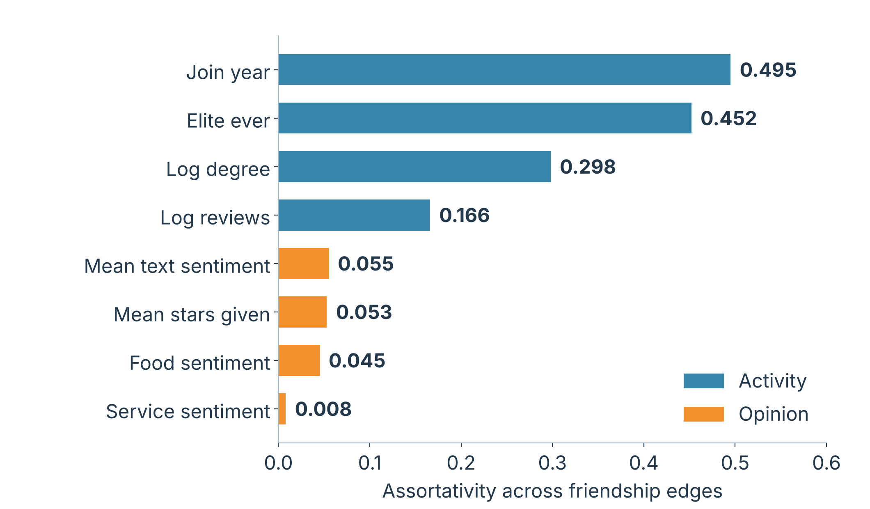
HOMOPHILY: WHO BEFRIENDS WHOM
03
Friends match on activity
Join year 0.495, Elite status 0.452, degree 0.298: people join in waves.
Barely on opinion
Mean stars 0.053 and sentiment 0.055 explain about 0.3% of the variation; service sentiment is 0.008.
Significant is not large
With 100k to 471k edges even tiny correlations have z above 2.
15
Notes:
Assortativity is the correlation of an attribute across the two ends of a friendship, compared with a null model in which attribute values are shuffled 100 times with the network fixed. Activity attributes show strong homophily; opinions show weak homophily. For opinion attributes only users with at least 3 reviews are used. Caveat: user attributes summarise all reviews, so selection and influence cannot be separated here.

Slide 16
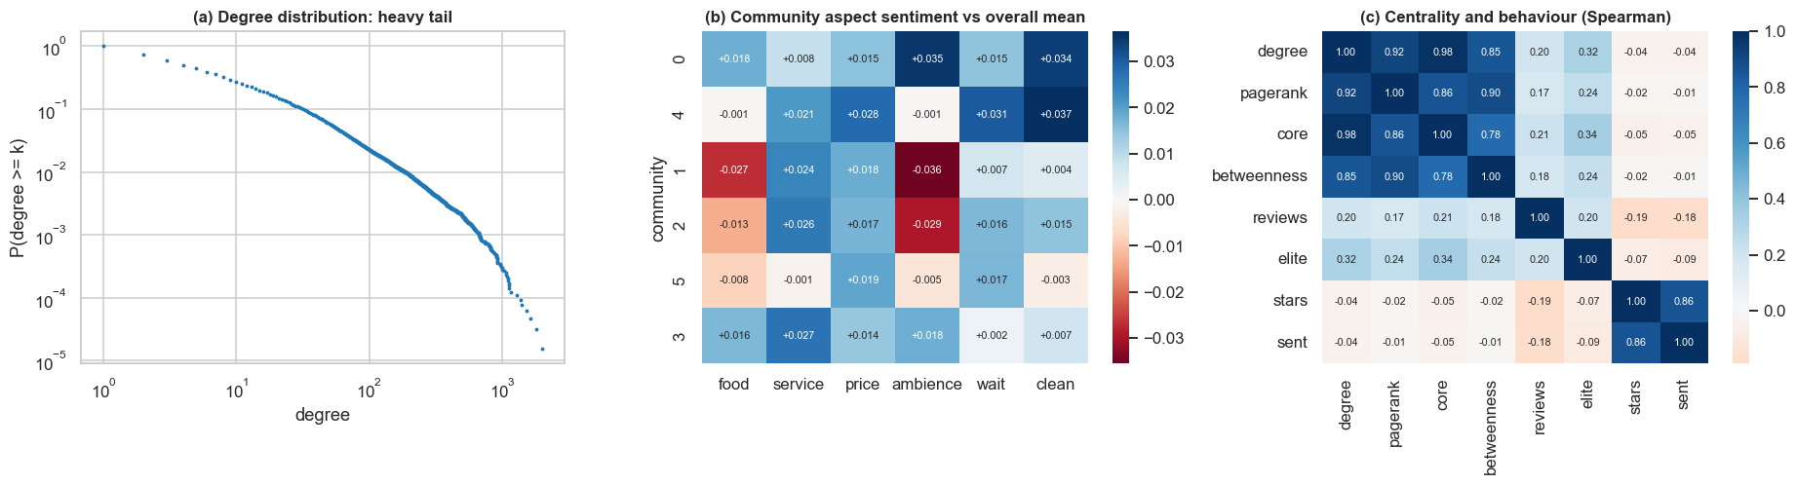
COMMUNITIES AND CENTRAL USERS
03
Six communities, 52% of reviews
Hubs are not opinion leaders
Heavy tail
They differ in who they are: older Elite-heavy groups (40–45% Elite reviews), a visitor-leaning hotel group, and the largest group with 5% Elite.
Degree correlates 0.98 with core number and 0.92 with PageRank; centrality is unrelated to stars (about −0.01 to −0.05).
About 2% of users have 100+ friends. Heavy reviewers rate a little lower (correlation −0.19 with stars).
16
Notes:
Six communities with at least 5,000 reviews hold 52% of all reviews. They differ in age, Elite share, categories and residents versus visitors, but only marginally in opinions (aspect sentiment differences between -0.036 and +0.037). Degree alone captures most of what centrality measures say. The structure of the network is about social activity, not opinions.

Slide 17
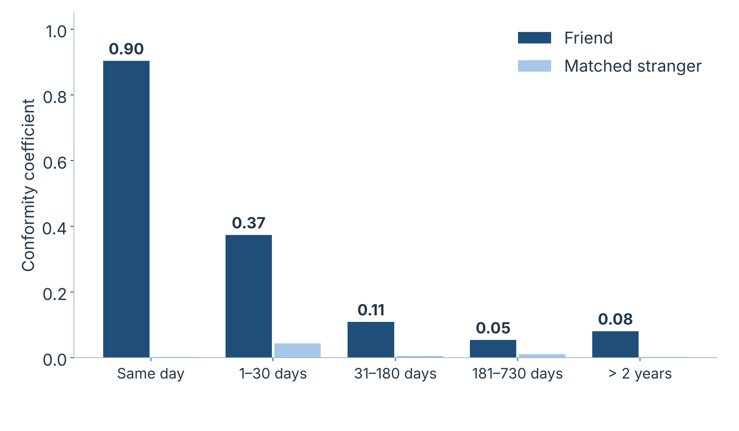
DO FRIENDS RATE ALIKE?
03
Matched design
Each review’s deviation from the business mean, paired with a matched non-friend; business and quarter fixed effects.
Friend 0.127, stranger 0.010
For lags of 1+ days (p < 0.001). Same-day reviews (0.90) are likely joint visits.
Fades with time
0.37 within 30 days, 0.11 at 1–6 months. Friends of friends are no closer than strangers (p = 0.50).
17
Notes:
Yelp does not record who read what, so influence is inferred. The test matches each friend review with a non-friend review of the same business close in time, to hold business and period fixed. Decay with time and the failure of the friend-of-friend link favour something specific to friends over general homophily, but the evidence is compatible with influence without proving it: joint visits within 30 days and an undated friend list remain possible.

Slide 18
FORECASTING
04
IN THIS SECTION
19 Forecasting setup
20 Diagnostics of the series
21 Baselines and ARIMA
22 Global models
Monthly mean stars of 12 business categories, forecast with baselines, ARIMA-type and global models.
Notes:
Section 4: time series forecasting with walk-forward evaluation.

Slide 19
FORECASTING SETUP
04
Three input groups, all built from reviews up to the forecast date
History: 17 inputs
Sentiment: 30 inputs
Network: 7 inputs
Stars this month and two before, 3- and 12-month means, trend, same month last year, volume, spread, market level, season.
Text sentiment, sentiment-star gap and VADER over 1, 3 and 12 months; six aspect scores and their changes.
Connected reviewers, reviews following a friend’s review, PageRank-weighted stars, friends’ recent mood and generosity.
Four baselines
Last month
12-month mean
Long-run mean
Seasonal naive
Is the latest month enough?
The reference for every skill score
Does the level return to a fixed value?
Is there a usable yearly pattern?
Target: mean stars of a category in the next month, for 12 categories. Walk-forward: refit every month, forecast the next, 48 test months (2018–2021). The noise floor, the error even a model knowing the true level could not avoid, is 0.141 before COVID and 0.170 during COVID.
19
Notes:
Businesses are grouped into 12 categories because a single business has too few reviews for a reliable monthly mean; since 2012 every category has at least 15 reviews each month and Restaurants about 1,500. Each input group enters the global models as a whole, so a group is judged by everything it contains rather than by a few inputs picked with hindsight. The same network inputs are also computed on a scrambled placebo graph.

Slide 20
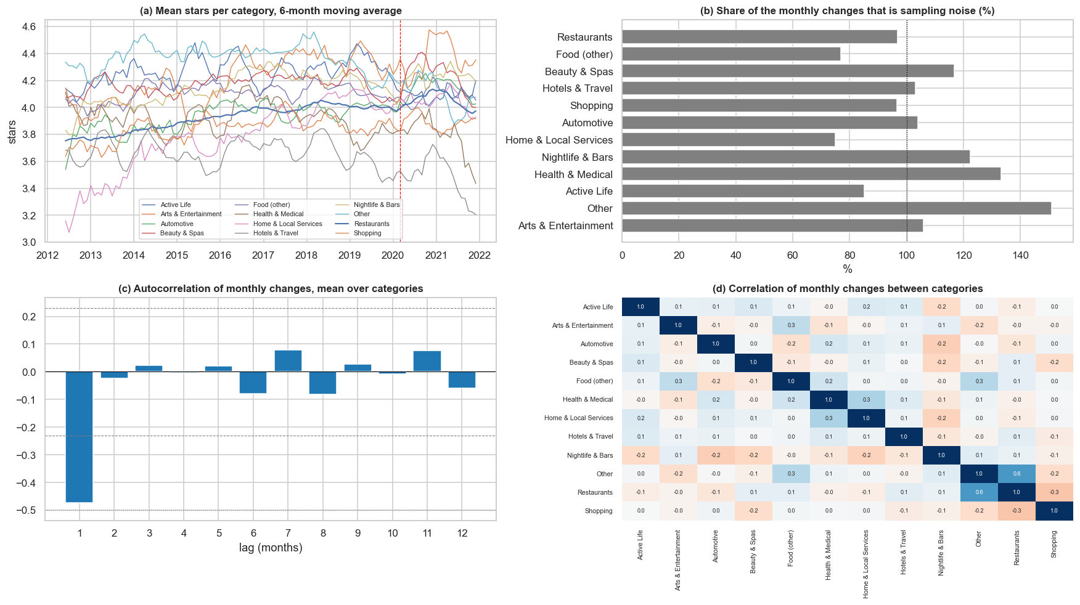
DIAGNOSTICS OF THE SERIES
04
Level plus noise
Restaurants drift up (trend strength 0.88); other series hardly drift, and the season is weak.
Mostly sampling noise
Monthly changes are 75–151% noise; lag-1 autocorrelation is −0.47, close to pure noise (−0.50).
Categories move alone
Changes correlate 0.01 between categories; the exception is Other with Restaurants (0.6).
20
Notes:
STL decomposition, stationarity tests, noise share and autocorrelation of each category series, using 2012-2017. Each series is a slowly moving level plus noise. The consequence: a good forecast averages many months, which is what the 12-month mean and ARIMA(0,1,1) do. Seasonal terms and inputs that try to explain month-to-month changes have little to work with.

Slide 21
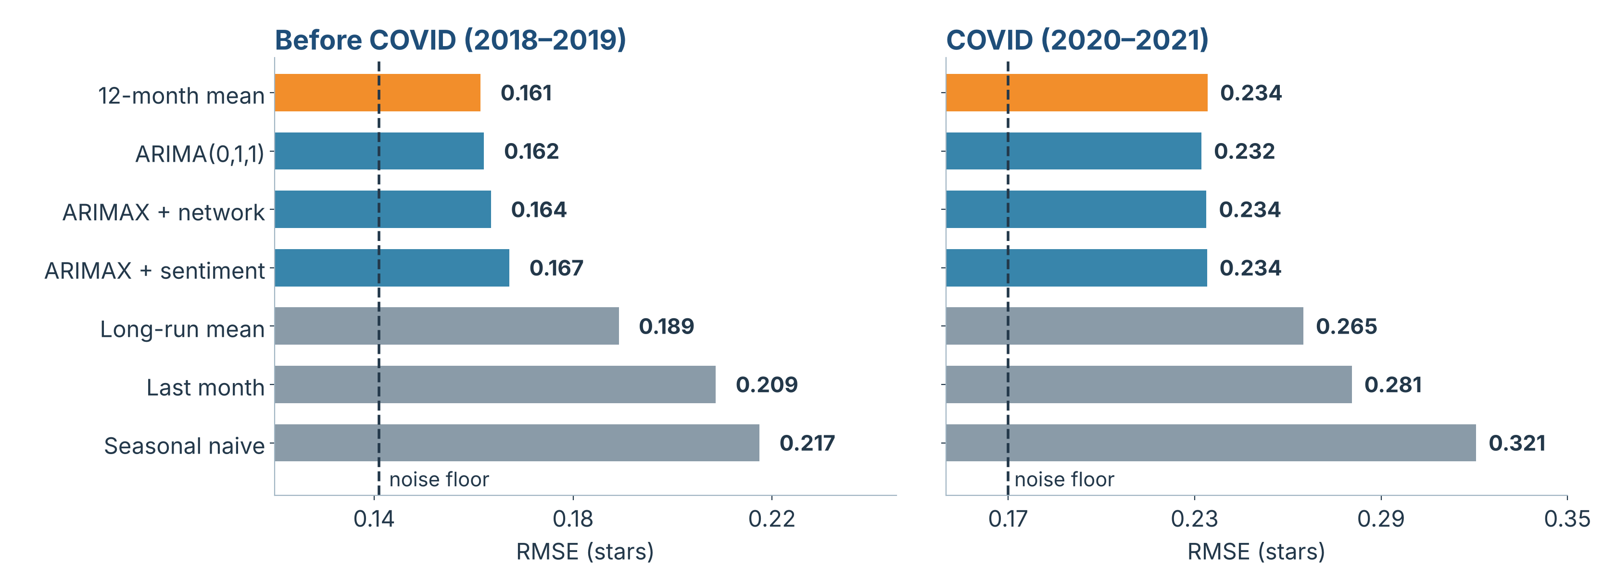
BASELINES AND ARIMA
04
Averaging is essential
ARIMA equals the 12-month mean
Extra inputs make it worse
ARIMA(0,1,1) cuts the MSE of “last month” by 40% before COVID and 32% during COVID (p < 0.001).
RMSE 0.162 against 0.161 before COVID and 0.232 against 0.234 during; seasonal terms change error by under 1%.
ARIMAX + sentiment is 6.3% worse before COVID (p = 0.009); ARIMAX + network is slightly worse too.
21
Notes:
Walk-forward results for the four baselines and the ARIMA family. The 12-month mean is the best simple forecast; ARIMA(0,1,1) behaves like it because its moving-average coefficient is close to -1. The seasonal naive forecast is worst, confirming there is no usable yearly pattern. The recent change in text sentiment and in the gap adds noise rather than information, which is the direct test of the warning-signal hypothesis.

Slide 22
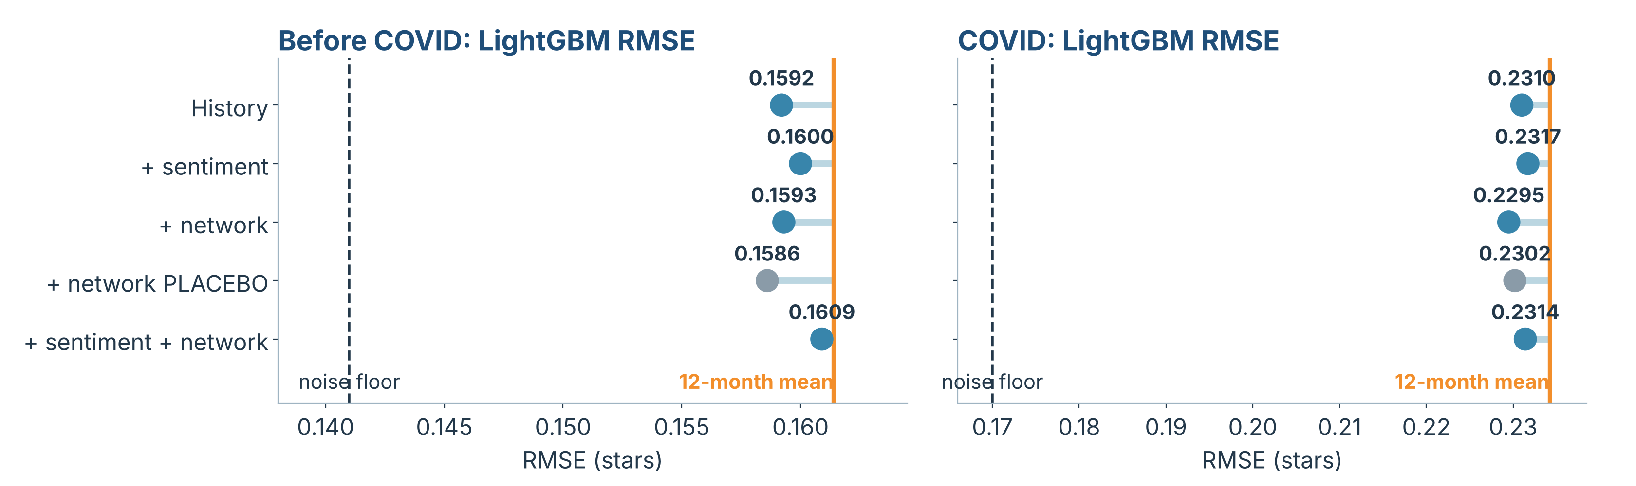
GLOBAL MODELS: LIGHTGBM AND RIDGE
04
Gains are small and unreliable
Network no better than a scrambled one
Sentiment adds nothing
Best models are 2–4% better in MSE than the 12-month mean (p ≥ 0.09) and not better on the 2014–2017 validation years.
LightGBM gets +1.1% and +0.6% MSE, not significant; Ridge −0.8% and −0.7% (p ≥ 0.38).
The placebo graph does as well (0.1586, the lowest before COVID); real against placebo has p from 0.47 to 0.93.
22
Notes:
One model trained on all categories predicts the difference from the 12-month mean, so a model that finds nothing falls back to the baseline. Hyperparameters were chosen on 2014-2017. Each model is fitted with history alone, plus sentiment, plus network, all three, and the two network sets again on the placebo graph. All bars end just to the right of the noise floor. Rolling skill is unstable and depends on the period, not on which inputs the model has.

Slide 23
INTEGRATION
05
IN THIS SECTION
24 Does the network help?
25 Where the network does help
Does the friendship network improve the forecasts, for categories and for individuals?
Notes:
Section 5: integration of network and time series, with a placebo network.

Slide 24
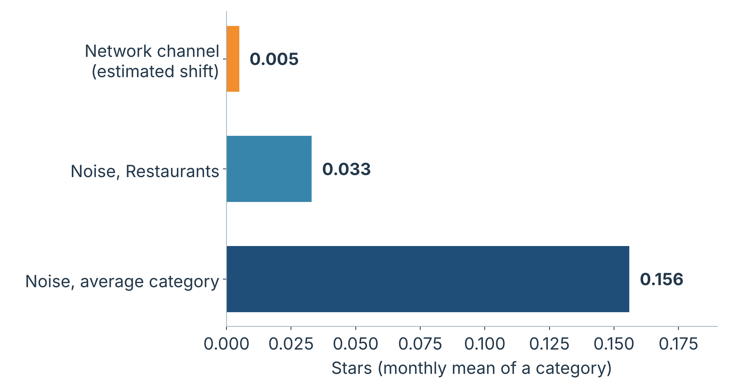
DOES THE NETWORK HELP?
05
The inputs are not broken
No network input correlates above 0.07 with next month’s surprise; placebos correlate just as much.
The channel is too thin
Conformity 0.37 × 1.3% of reviews following a friend within 30 days × 1.00-star spread gives about 0.005 stars.
Noise hides it
Sampling noise is 0.03 stars even for Restaurants and 0.16 on average.
24
Notes:
This is the core of the project. Two safeguards: a pooled Diebold-Mariano test (differences averaged over categories within each month, Newey-West variance) and the placebo network, built by shuffling user identities while keeping the degree distribution. The back-of-the-envelope calculation explains the null: conformity is strong for one person but only about 1.3% of reviews follow a friend within 30 days, so the channel moves a category’s monthly mean by about 0.005 stars.

Slide 25
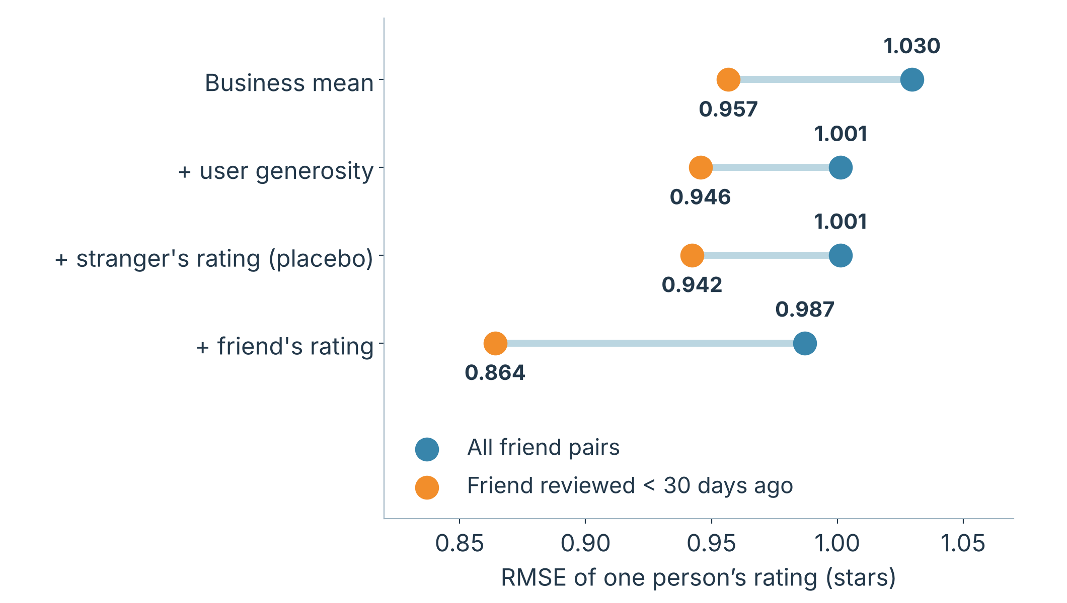
WHERE THE NETWORK DOES HELP
05
RMSE 0.946 to 0.864
When a friend reviewed the business within 30 days (9% lower; train before 2018, test 2018–2019). A matched stranger changes almost nothing (0.942).
Beyond chance
The friend’s rating lowers MSE by 0.028 (95% CI −0.040 to −0.016); the placebo by 0.0001.
Cause unknown
Influence, joint visits or shared taste; the undated friend list may make the gain optimistic.
25
Notes:
If the channel is too thin to move a category’s monthly mean, it may still show for a single person. Knowing what a friend recently said about a business reduces the error of predicting one person’s rating, from 0.946 to 0.864 stars when the friend’s review is less than 30 days old, while a matched stranger’s rating does nothing. The effect is strong for individuals and invisible in aggregates because few people are exposed.

Slide 26
CONCLUSIONS
06
IN THIS SECTION
27 Conclusions
28 Limitations and next steps
The answer to the main question, its limits, and what to do next.
Notes:
Section 6: conclusions and limitations.

Slide 27
CONCLUSIONS
06
Monthly category stars are a slowly moving level plus noise. The 12-month mean is close to the best forecast, and neither review text nor the reviewers’ network improves it reliably.
Question | Result | Evidence
Can next-month stars be forecast? | About as well as a 12-month average; best models are 2–4% better in MSE, not significantly | Strong
Does sentiment help? | No: ARIMAX + sentiment is 6.3% worse before COVID | Strong null
Does the network help the category forecast? | No: not better than history alone or a scrambled network | Strong null, explained
Do friends predict one person’s rating? | Yes: RMSE 0.946 to 0.864 within 30 days; strangers add nothing | Strong for prediction
What explains ratings? | Service, above all, in every category | Descriptive
27
Notes:
Answer to the main question. A category’s monthly stars are a slowly moving level plus sampling noise, and the mean of the last 12 months is already close to the best possible forecast. Neither text nor network improves it reliably, even though a friend’s recent rating clearly helps predict one person’s rating. In practice: use a 12-month average for monitoring a category; a friend’s rating is a useful signal for individual prediction but not for aggregate forecasts.

Slide 28
LIMITATIONS AND NEXT STEPS
06
LIMITATIONS
NEXT STEPS
Only 12 series and 48 test months: limited power for effects of 1–2%.
Friendship is an undated snapshot, and friends outside the area are missing.
Influence is not identified: homophily and joint visits remain possible.
Transformers ran on samples without fine-tuning; VADER is weak for wait and price.
“California” is really the Santa Barbara area, with many visitors.
Forecast at category by city, or cluster, level: more data than a business, more variation than a category.
Fine-tune a transformer on Yelp with a GPU.
Look for quasi-random exposure, for a more causal test.
Collect dated friendship ties, so network inputs are free from look-ahead.
28
Notes:
Limitations: only 12 series and 48 test months, an undated friendship snapshot, influence not identified, transformers run on samples without fine-tuning, and a regional sample. Next steps: forecast at an intermediate level (category by city), fine-tune a transformer, look for quasi-random exposure, collect dated friendship ties.

Slide 29

THANK YOU
QUESTIONS?
Stars, words and friends: forecasting Yelp ratings with text and social networks
[Author names] · Analysis of Complex Data, MECD
Notes:
Thank you. Questions are welcome. The main result: a category’s monthly stars are a slowly moving level plus noise; neither text nor network improves the 12-month average reliably, although a friend’s recent rating helps predict one person’s rating.

