Slide 1
Stars, Words and Friends
Forecasting Yelp ratings with text and social networks
Analysis of Complex Data, FEUP
Yelp Open Dataset: Santa Barbara area, 2005-2022 | November 2026
Notes:
Welcome. This project asks whether a business's ratings can be forecast, and whether the social network of its reviewers helps. Add the authors' names to this slide.

Slide 2
Friends predict a person's rating, not a business's average
6-9 %
0.946 → 0.864
0.005 vs 0.39
lower forecast error (MSE) than a strong baseline, for next-quarter stars of 932 businesses
RMSE for one person's rating, once we know a friend's review from the last 30 days
stars: what this friend channel moves in a quarterly mean, against sampling noise
Text adds a little: lagged sentiment lowers MSE by 0.7 % before COVID, with no reliable gain during COVID
The network adds nothing to the business forecast: it does not even beat a scrambled network
Service stands out: it is the strongest correlate of ratings and of sharp changes in ratings
2
Notes:
This is the main message. Business-level forecasts work modestly and most of the remaining error is noise. A friend's recent rating does help to predict an individual's rating. So few reviews are exposed that the effect never reaches the business average.

Slide 3
One question, six sub-questions and eight assessment criteria
Criterion | How it is covered | Sect.
(i) Data | Cleaning and EDA that shape the design | 2-3
(ii) Recommender | 9 models, tested on later reviews | 7
(iii) Text processing | Preprocessing tested experimentally | 4
(iv) Sentiment | Benchmark, aspects, sentiment-star gap | 5
(v) Social network | Friendship and dated co-review graphs | 6
(vi) Time series | Monthly series and business panel | 8
(vii) SNA + time series | Network inputs, with placebo tests | 9
(viii) Creativity | Influence, events, COVID, breaks, bursts | 6, 9, 10
Can a business's ratings be forecast, and does its reviewers' social network add anything beyond history and text?
How accurate are the forecasts?
Does sentiment help?
Does the network help, and at which level?
Are friends' ratings and visits more alike?
What explains ratings and rating changes?
Do friends improve recommendations?
3
Notes:
The main question drives everything. On the right is how each assessment criterion is covered, using the section numbers of the report.

Slide 4
The data: 348,014 reviews with a long tail of low activity
5,164
155,252
businesses
users
471,089
66.7 %
friendship edges
of users have one review
4
Notes:
The California subset is really the Santa Barbara area. Two thirds of users have one review, and most businesses have few, which shapes the design. Reviews grew until about 2018 and fell with COVID. Mean stars are 3.96 and strongly skewed to five.

Slide 5
Four rules guard against false discoveries
1
No look-ahead
2
No same-review sentiment
All splits are by time. Inputs only use reviews written before the forecast date.
The text nearly reveals its own stars (Spearman 0.80), so sentiment enters only through earlier reviews.
3
Baselines and noise floor
4
Placebos and caution
A model counts only if it beats a simple baseline on unseen data. We also estimate the error no model could avoid.
Scrambled networks and matched strangers test network effects. Association is not reported as causation.
5
Notes:
These rules explain many later choices. Random splits would leak the future. A review's own sentiment nearly reveals its stars, a Spearman correlation of 0.80, so it is never an input. Every model must beat a baseline, and a placebo tests each network effect.

Slide 6
Text processing: test each step instead of assuming it helps
Best: bigrams with negation tags
Negation tags turn "not good" into a signal of its own
Stop-word removal hurts: it deletes words such as "not"
Lemmas add almost nothing for sentiment, but they make topics readable
6
Notes:
Same classifier, trained on 30,000 reviews before 2017, tested on 10,000 from 2017-2018. Bigrams with negation tags win. Stop-word removal hurts because it deletes 'not'. Lemmas help little and are slow, so they are kept for topic modelling only.

Slide 7
Sentiment: a domain-trained model beats pretrained ones
Not an even contest
TF-IDF learned from 171,224 Yelp reviews. The transformers were not fine-tuned, as that needs a GPU.
Neutral 3-star reviews are hardest for all
TF-IDF also scores all reviews on a CPU, so it feeds the forecasts
7
Notes:
All five methods were tested on the same 6,000 reviews from 2019 on, with stars as weak labels. Be clear about the caveat: TF-IDF learned from 171 thousand Yelp reviews, and the transformers were not fine-tuned because there was no GPU. So this does not show that TF-IDF is better than transformers in general.

Slide 8
Aspects: service is the strongest driver in every category
Restaurants too: service 0.52, food 0.45
Merely mentioning service goes with 0.72 fewer stars: people raise it when something went wrong
Check against a dedicated aspect model: modest agreement (kappa 0.25)
Weak spots: wait and price, as "we waited 40 minutes" has no emotional words
8
Notes:
We split reviews into sentences and scored each aspect's sentences with VADER, which is not trained on stars, so it cannot leak ratings. Topic modelling supports the dictionary. A dedicated aspect model agrees only modestly, kappa 0.25, and VADER is particularly weak on wait and price. Merely mentioning service goes with fewer stars: people raise it when something went wrong.

Slide 9
Friends resemble each other in activity, not opinion
0.098
0.53
clustering (0.020 in a random graph)
Louvain modularity
A small world: 64,154 users, path length 4.3
Six communities hold about half of all reviews
Boundaries depend on the seed (ARI 0.57), so they are groupings, not exact facts
9
Notes:
Assortativity is the correlation of an attribute across a friendship. Friends joined at similar times and share Elite status, yet they rate only slightly alike. These values are well above chance, but small. This is the first hint that a friendship tie carries little general information about opinions.

Slide 10
Friends rate and visit alike, and the effect fades
Reading: friends differ from strangers, and a friend of a friend does not (p = 0.50). There is no clear mood contagion. Compatible with influence, but it does not prove it: joint visits and shared tastes remain possible.
10
Notes:
Test A pairs each friend with the non-friend who reviewed the same business closest in time, controlling for how generous each person is. The friend's effect is 0.37 within 30 days and fades. Same-day reviews at 0.90 probably reflect joint visits. Test B matches on friends, city and month. A third test finds no clear mood contagion: the placebo with friends' next month is not significantly smaller. We cannot separate influence from joint visits and shared tastes.

Slide 11
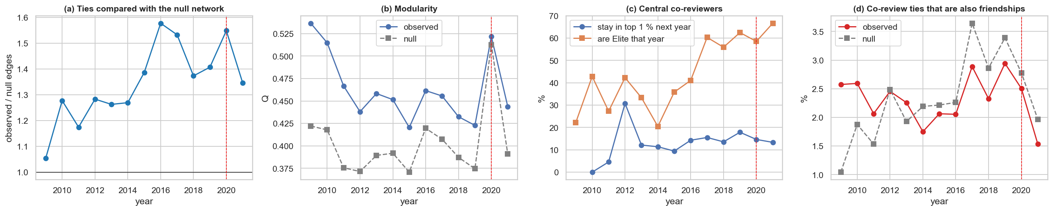
Yearly co-review networks add the dates friendship lacks
Above chance
A false signal avoided
Separate things
1.2-1.6 times the ties of a null network since 2010
The 2020 modularity jump also appears in the null
Co-review ties are no more often friendships than the null
11
Notes:
For each year, two active users are linked if they reviewed at least two of the same businesses. Each year is compared with a null network keeping users' activity and businesses' popularity. Note the 2020 jump in modularity occurs in the null too, so it is an artefact of a sparser network. Co-review ties are not more often friendships than in the null.

Slide 12
Recommender: visits matter most, friends do not help
33 %
1 %
of businesses recommended by the best hybrid
by popularity
Rating models rank poorly: they push highly rated niche places
Adding friends lowers NDCG by 0.003 (CI excludes 0)
Friends do not solve cold start (+0.0007, CI includes 0)
12
Notes:
Trained before 2018, tested on 2018-2019, ranking all candidate businesses. Models that predict ratings rank badly because they promote highly rated niche places. The best hybrid excludes the network: it beats popularity reliably, with a difference of 0.009 and a confidence interval of 0.002 to 0.016, and its lead over implicit ALS is borderline. Adding friends lowers NDCG by 0.003. For 2,150 cold-start users, friends add nothing reliable.

Slide 13
Monthly series: simple level tracking is hard to beat
Diagnostics: strong trend, weak seasonality, unit root
Inputs lagged by a month (sentiment, network lag) give no reliable gain
Granger tests: none survives the Holm correction across 27 tests
Hence the main forecast moves to the business level
13
Notes:
Stars have a strong trend and very weak seasonality, F_S of 0.24, and a unit root, so ARIMA uses d=1. Rolling-origin forecasts one to three months ahead. Lagged sentiment and a network lag of the other communities give no reliable gain, and no Granger test survives the Holm correction.

Slide 14
The main forecast: next-quarter stars for 932 businesses
1
Businesses
2
Target
3
Baseline
4
Models
5
Test
At least 50 reviews before 2018
Mean stars next quarter, with 3+ reviews, weighted by reviews
Empirical-Bayes mean of past stars
Ridge and LightGBM predict the difference from the baseline
Walk-forward over 16 quarters, 2018-2021
Empirical-Bayes baseline
Input group | Examples
History (20) | Past stars, trend, volume, season
Sentiment (36) | Text sentiment, gap, aspects
Friendship (10) | Friends' mood, exposure, PageRank
Co-review (4) | Dated centrality, neighbours' stars
ŷ = (S + κ · m) / (N + κ)
S, N: past stars and reviews of the business; m: market mean; κ = 10
14
Notes:
Selection uses only reviews before 2018, so it does not depend on the future. The empirical-Bayes mean shrinks a business's long-run mean towards the market. Models predict the difference from it, so a model finding nothing falls back on the baseline. Walk-forward means retraining for each of the 16 test quarters. Reviews are the weights, because a mean of 40 reviews is more reliable than a mean of 3.

Slide 15
Forecasts beat strong baselines, but noise sets a low ceiling
6-9 %
lower MSE than the EB baseline, before and during COVID
RMSE stays well above the noise floor (0.38 and 0.40)
Only 12-17 % of the avoidable error is removed
Ridge matches LightGBM: nonlinear effects are weak
15
Notes:
The last quarter alone is a very poor forecast, since it is mostly noise. The EB mean is hard to beat. Global models cut MSE by about 6 to 7 percent before COVID and 8 to 9 percent during COVID. Models remove only 12 to 17 percent of the error that could in principle be removed. Ridge is as good as LightGBM, so nonlinear effects are weak.

Slide 16
Sentiment helps a little; the network does not beat a placebo
Comparison | p, before | p, COVID
Sentiment | 0.014 | 0.55
Network | 0.020 (worse) | 0.040 (worse)
vs placebo | 0.62 | 0.79
Placebo: the same features on a graph with scrambled identities
SHAP gives network inputs just 5 % of importance, against 57 % for sentiment
16
Notes:
This is the core test. Negative bars mean lower error. Sentiment lowers MSE by 0.74 percent before COVID, p = 0.014, but not during COVID, p = 0.55. Network inputs raise error by about 0.3 percent in both periods, and they do not beat a network with scrambled identities, p = 0.62 and 0.79. The features themselves work, as checked against their placebos.

Slide 17
Why the network is invisible: too few reviews are exposed
0.37
1.3 %
1.00
0.005
×
×
=
effect of a friend's recent rating
of reviews have such a friend review
SD of the friend's deviation (stars)
stars moved in a quarterly mean
Against sampling noise of about 0.39 stars. A real individual effect can be invisible at the business level, so testing just one level would mislead.
17
Notes:
This one calculation reconciles the two findings. The effect on a person is strong, 0.37. But only about 1.3 percent of reviews follow a friend's review within 30 days. Multiplying through, the shift is about 0.005 stars against noise of about 0.39 stars. A real individual effect can be invisible in aggregates. This is the central result of the project.

Slide 18
Where the network helps: one person's next rating
Caveats
Joint visits may remain among recent cases, and some ties may have formed after the reviews.
Review volume: no gain. Models beat the 4-quarter mean by 19 % and 12 %, yet network inputs add nothing.
18
Notes:
Linear models trained before 2018 and tested on 6,992 reviews from 2018-2019. The friend's rating lowers RMSE, and the matched non-friend adds nothing. Recent cases may include joint visits, and the undated friendship list may contain later ties. Review volume is different: global models beat the 4-quarter mean by 19 and 12 percent, but network inputs add nothing.

Slide 19
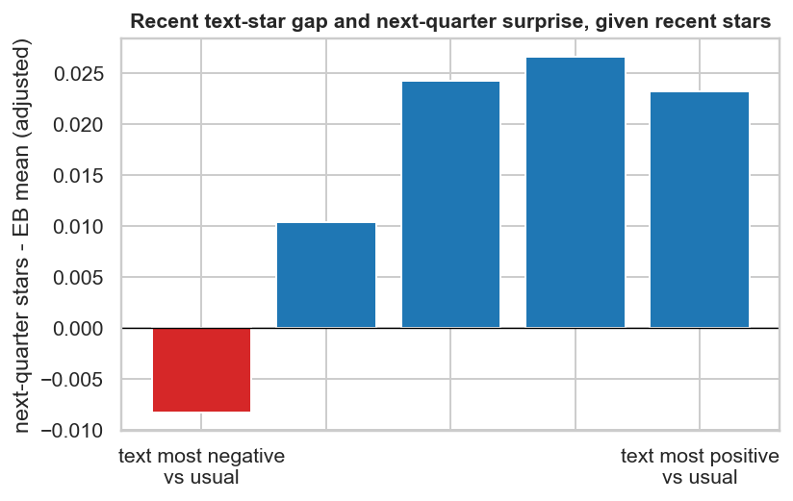
Text as an early warning: real, but small
+0.028 stars
per 1 SD of the sentiment-star gap, given recent stars (p < 0.001)
Gap = stars expected from the text minus actual stars
Recent stars matter more (+0.11 per SD)
The raw pattern reverses without the control, because a low gap often follows good recent stars
19
Notes:
The hypothesis is that if the text is more negative than the stars, later stars fall. With recent stars controlled, one standard deviation of the gap goes with 0.028 stars next quarter, p below 0.001, against 0.11 for recent stars. Without the control the raw pattern reverses, because a low gap often just follows good recent stars. This is a useful warning against reading raw charts.

Slide 20
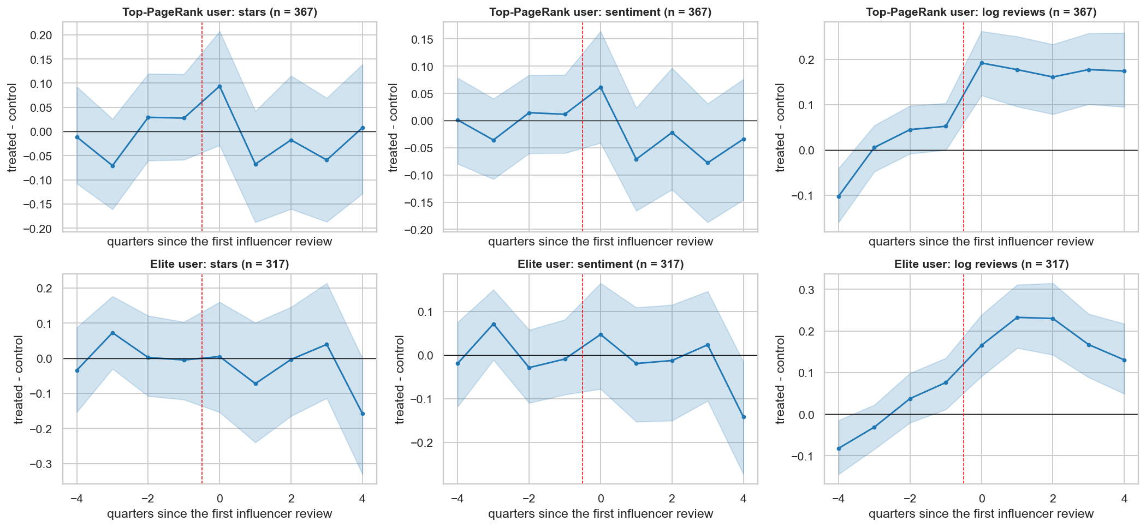
Influencers: no effect on stars, and volume was already rising
No effect
on later stars or sentiment (367 and 317 events)
−0.08
volume beyond the pre-event trend (CI includes 0)
Places with growing attention likely attract their first influencer, not the other way round.
20
Notes:
Each first influencer review is matched to up to three similar businesses, on the level and trend of stars and of volume. Outcomes come from other reviewers. Stars and sentiment show no detectable effect. Volume looks like it rises by 0.17 to 0.19 log points, but the gap was already growing before the event, and beyond that trend the estimate is about minus 0.08, CI including zero. The likely reading is reverse causation.

Slide 21
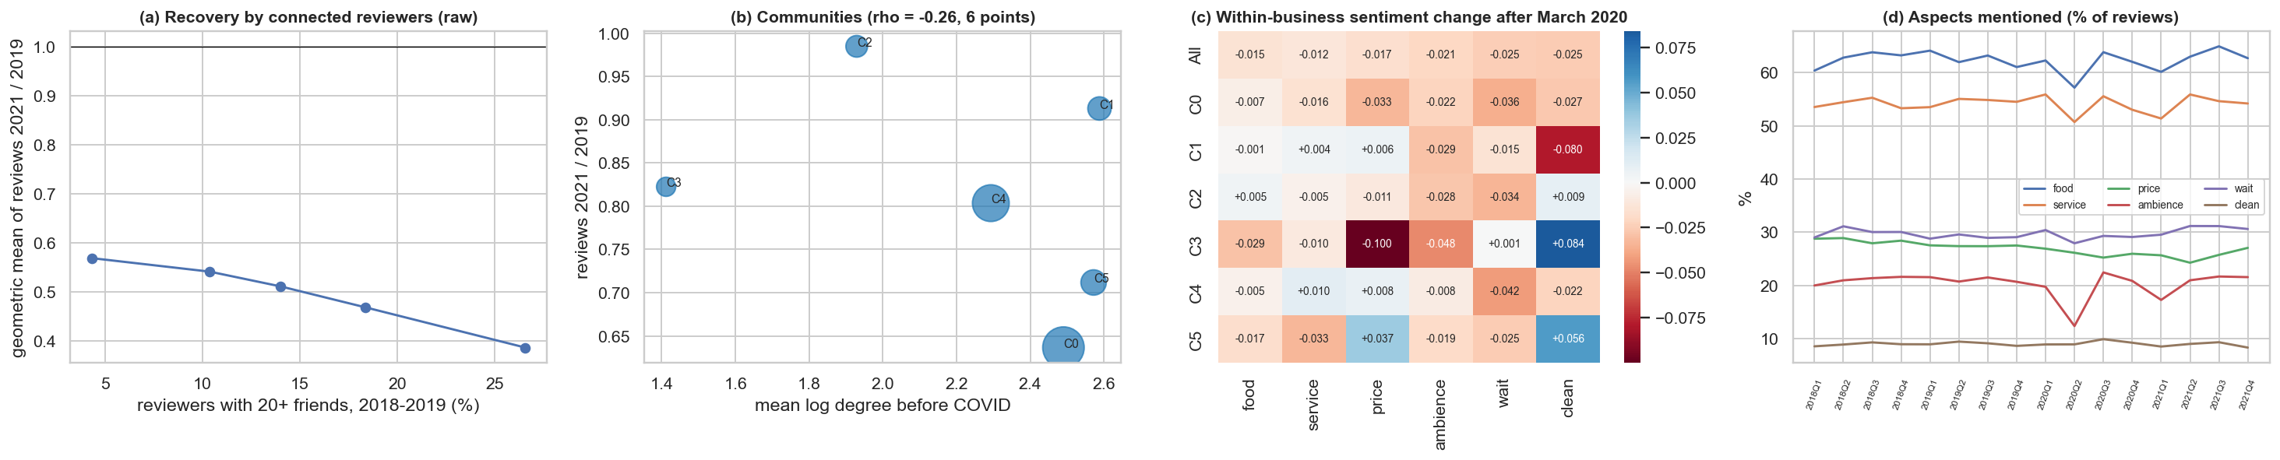
COVID: connected businesses did not recover faster
−12 %
−0.26
−0.01 to −0.03
2021 volume per 1 SD more connected reviewers (p = 0.007; Holm p = 0.067)
Spearman, connectivity and recovery, six communities: descriptive only
sentiment change within businesses; communities do not differ reliably
21
Notes:
Network position is measured with 2018-2019 data only, so it cannot be a result of the recovery. If anything, businesses with more connected reviewers recovered less: about 12 percent lower volume per SD, p = 0.007, but Holm p = 0.067. With six communities the analysis is only descriptive. Aspect sentiment fell slightly, and communities do not differ reliably. Ambience mentions fell in spring 2020 and returned, a sign the measure reacts to real events.

Slide 22
Sharp rating changes go together with service
121
0.69
of 397 businesses have a significant break
stars: median size (68 falls, 53 rises)
Permutation tests with false discovery rate control, because scanning for a break finds something even in noise
Descriptive: text and stars are written together, so this does not show the cause
22
Notes:
For 397 businesses with at least 200 reviews, we search for the single largest shift in stars, using permutation tests and false discovery rate control. 121 businesses show a significant break, with a median of 0.69 stars. Service explains changes best, consistent with the aspect analysis. The R-squared of 0.84 partly reflects text and stars being written together, so this describes the breaks and does not explain their cause.

Slide 23
Reviews echo longer after well-connected reviewers
Last week: 3.5 % against 1.7 % (difference p = 0.09)
2-4 weeks ago: 2.2 % against about 0 (p < 0.001)
Consistent with friends going where friends went
Alternative: connected users may choose rising places earlier
23
Notes:
A discrete self-exciting model of weekly review counts, for 499 businesses. Both real triggers and shared demand raise counts, so the level proves nothing. The contrast is informative: at 2 to 4 weeks, reviews by users with 20 or more friends go with 2.2 percent more reviews, against about zero for unconnected users, p below 0.001. Connected users may simply choose rising places earlier. The effect per review is small.

Slide 24
What limits these conclusions
Undated friendships
Influence not identified
One region of one platform
Some ties may have formed after the reviews, which can overstate the network's value.
Placebos, matching and timing narrow the options but cannot settle them.
Santa Barbara, with many visitors. Friends outside the area are missing.
Self-selected ratings
Text methods
Many tests
Ratings are voluntary and may be filtered, so stars do not directly measure quality.
No fine-tuning without a GPU. VADER is weak on wait and price.
Corrected within each family, not over the whole project.
24
Notes:
State these openly. The most important is the undated friendship list: some ties may have formed after the reviews, which may overstate the network's value. So the business-level null is conservative, while the individual gain may be optimistic. Influence is not identified with observational data.

Slide 25
Conclusions
1
Forecasting
Modest but real: 6-9 % lower MSE, with most remaining error due to noise
2
Text
A small gain, and service is what matters most
3
Network
Clear for individuals, invisible for businesses, because few reviews are exposed
4
Recommender
A hybrid of visits and content wins; friends add no value here
Next steps: fine-tune a transformer with a GPU, look for quasi-random exposure for a more causal test, and apply the design to other regions.
25
Notes:
To conclude: forecasting works modestly, text adds a little, and the network has a clear effect only for individuals. For a business, watch service sentiment. For researchers, check how many people are exposed before expecting an individual effect in aggregates. Next steps are fine-tuning with a GPU, seeking quasi-random exposure and testing other regions. Thank you.

