Slide 1
Cmpe481 Fınal Exam presentatıon
Muhammed Göktepe
2017400162

Slide 2
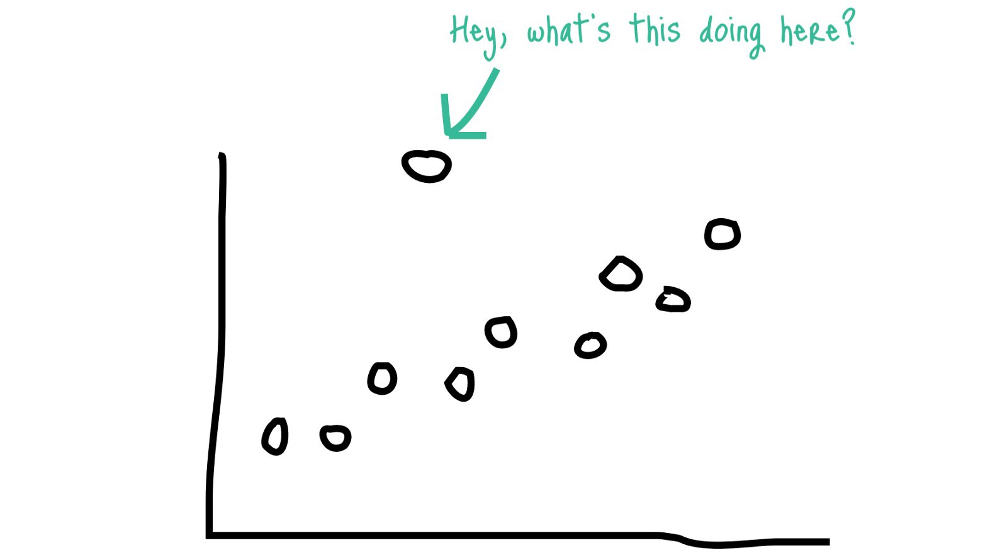
What ıs an outlıer
Outliers are generally defined as samples that are exceptionally far from the mainstream of data.

Slide 3
causes of outliers
Data entry errors (human errors)
Measurement errors (instrument errors)
Experimental errors (data extraction or experiment planning/executing errors)
Intentional (dummy outliers made to test detection methods)
Data processing errors (data manipulation or data set unintended mutations)
Sampling errors (extracting or mixing data from wrong or various sources)

Slide 4
outlier detection
Outlier Detection is the identification of rare items, events or observations which raise suspicions by differing significantly from the majority of the data.
There are several detection algorithms:
Isolation Forest
Elliptic Envelope
Local Outlier Factor
Z-score
IQR-score
DBSCAN

Slide 5
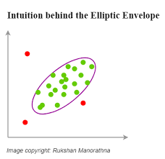
Ellıptıc Envelope
An object for detecting outliers in a Gaussian distributed dataset.
Elliptic Envelope is intuitively built on the premise that data comes from a known distribution. If we draw an ellipse around the gaussian distribution of data, anything that lies outside the ellipse will be considered an outlier.
The assumption in the Elliptic Envelope is that normal data points are Gaussian distributed.

Slide 6
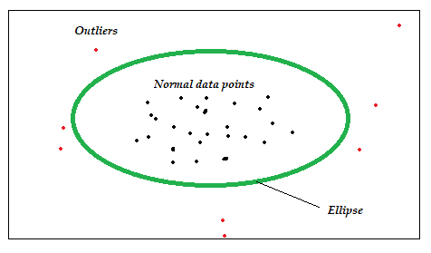
Ellıptıc Envelope
Creates an imaginary elliptical area around a given dataset.
Values that fall inside the envelope are considered normal data and anything outside the envelope is returned as outliers.
So, naturally, the red data points in the above diagram should be identified as outliers by this algorithm.
As evident from this figure, the algorithm works best if data has a Gaussian distribution.

Slide 7
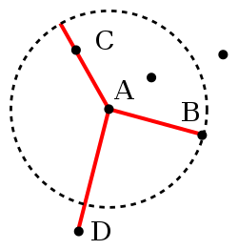
Local Outlier Factor
The anomaly score of each sample is called the Local Outlier Factor.
It measures the local deviation of the density of a given sample with respect to its neighbors.
It is local in that the anomaly score depends on how isolated the object is with respect to the surrounding neighborhood.
More precisely, locality is given by k-nearest neighbors, whose distance is used to estimate the local density.
By comparing the local density of a sample to the local densities of its neighbors, one can identify samples that have a substantially lower density than their neighbors. These are considered outliers.
Small k has local focus. Erroneous if there is much noise in data.
Large k can miss local outliers

Slide 8
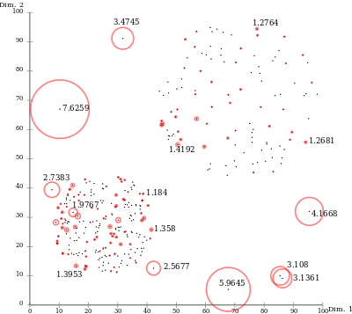
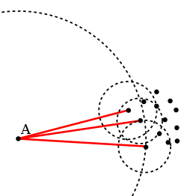

Slide 9
Local Outlier Factor
Dısadvantages:
The resulting values are hard to interpret. A value of 1 or even less indicates a clear inlier, but there is no clear rule for when a point is an outlier. In one data set, a value of 1.1 may already be an outlier, in another dataset and parameterization (with strong local fluctuations) a value of 2 could still be an inlier. These differences can also occur within a dataset due to the locality of the method.
Advantages:
Due to the local approach, LOF is able to identify outliers in a data set that would not be outliers in another area of the data set.

Slide 10
My ımplementatıon

Slide 11
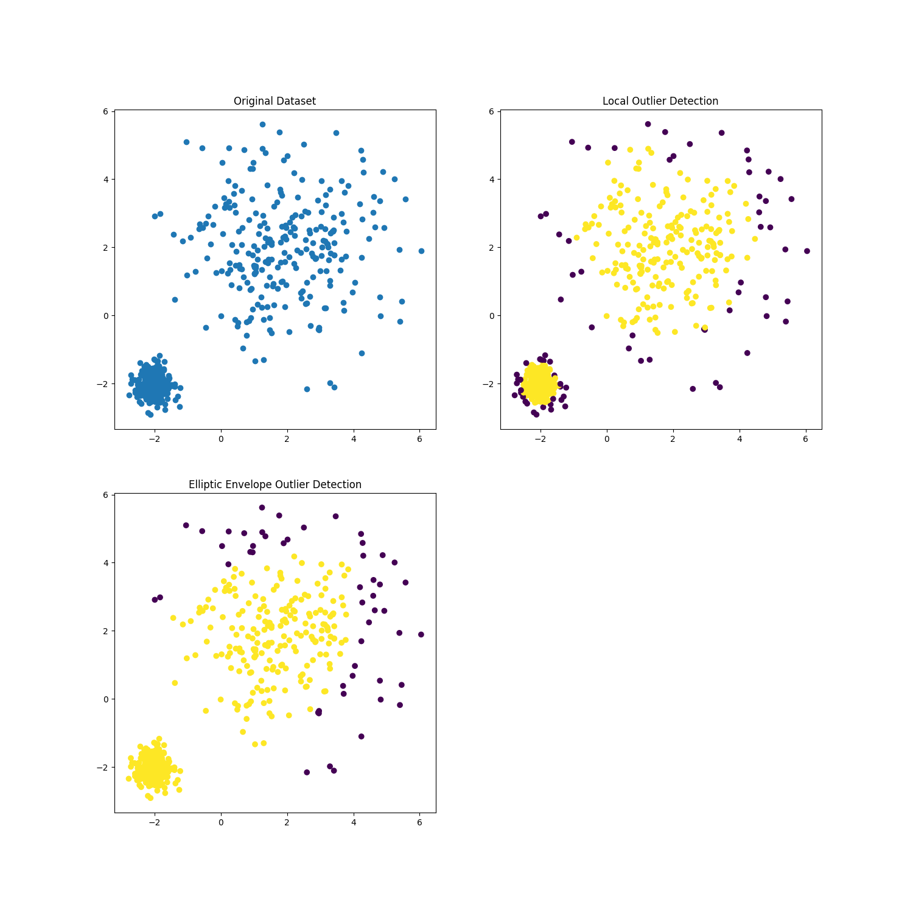
Centered data
Local Outlier Factor perform reasonably well for multi-modal data sets.
K=35

Slide 12
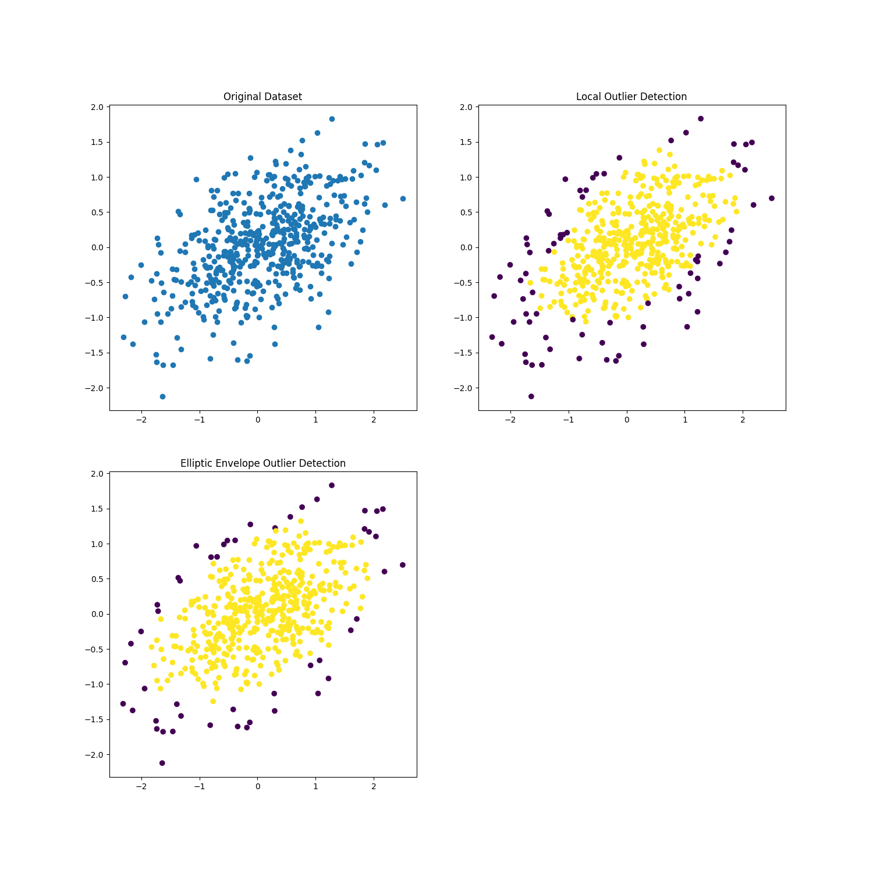
Gaussian distributed data.
Elliptic Envelope assumes the data is Gaussian and learns an ellipse. It thus degrades when the data is not unimodal.

Slide 13
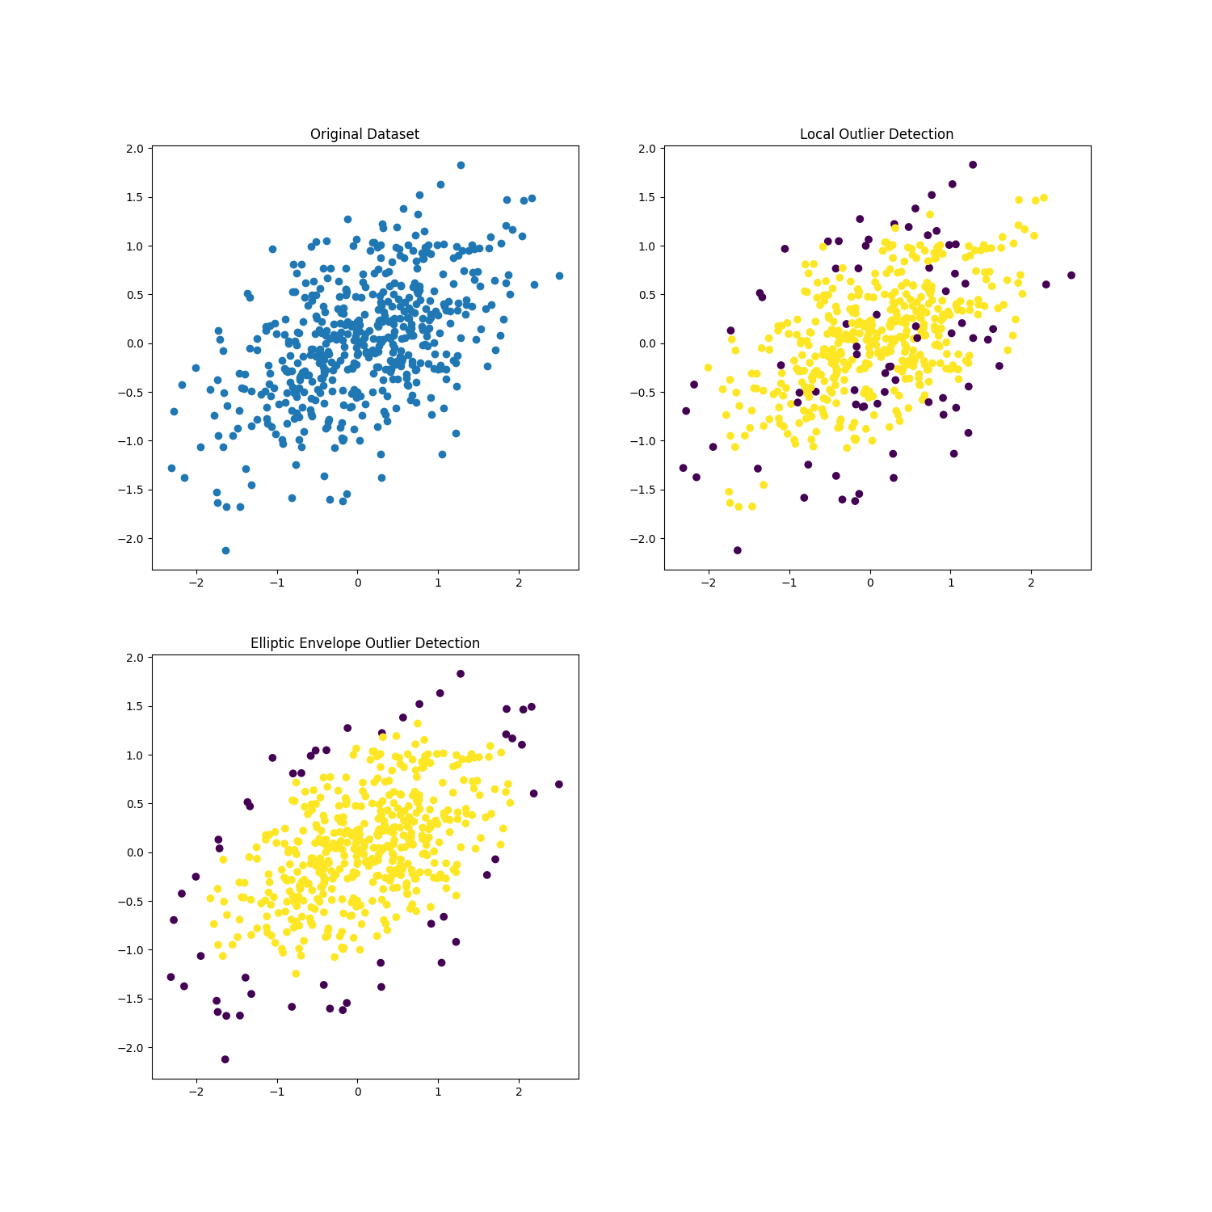
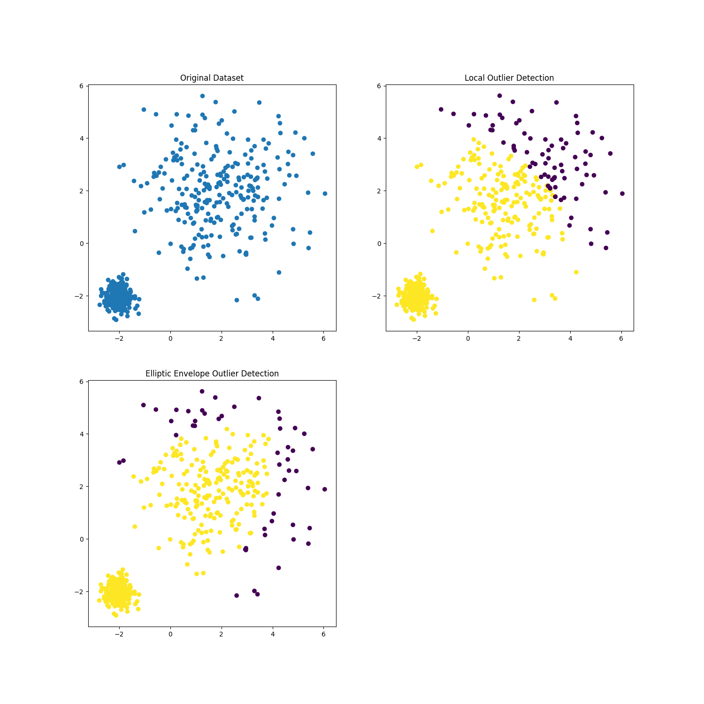
Local outlıer factor wıth dıfferent k’s
K=5
K=400

Slide 14
References
https://scikit-learn.org/stable/auto_examples/miscellaneous/plot_anomaly_comparison.html#sphx-glr-auto-examples-miscellaneous-plot-anomaly-comparison-py
https://scikit-learn.org/stable/modules/generated/sklearn.covariance.EllipticEnvelope.html#sklearn.covariance.EllipticEnvelope
https://scikit-learn.org/stable/modules/outlier_detection.html
https://scikit-learn.org/stable/modules/generated/sklearn.neighbors.LocalOutlierFactor.html#sklearn.neighbors.LocalOutlierFactor
https://towardsdatascience.com/anomaly-detection-with-local-outlier-factor-lof-d91e41df10f2
https://en.wikipedia.org/wiki/Local_outlier_factor

