Slide 1


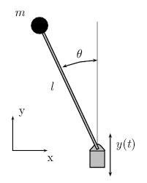
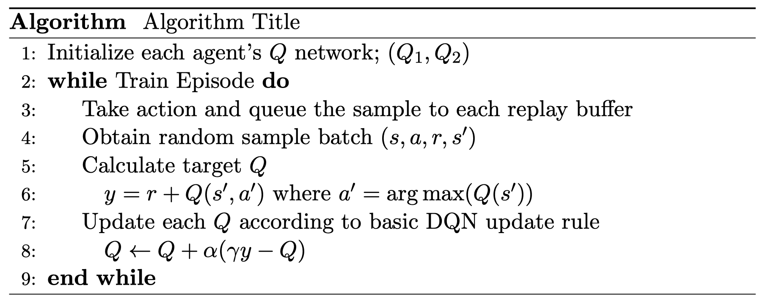
Bi-discounting Factor Reinforcement Learning
Myeungseok Ryu, Minji Kim, Junseo Ha
School of Mechanical Engineering, Gwangju Institute of Science and Technology, 123 Cheomdan-gwagiro (Oryong-dong), Buk-gu, Gwangju, 61005, Republic of Korea
Introduction
Experiment
Most of RL algorithms needs hyperparameter epsilon to ensure that the agent chooses action randomly to explore the environment. The factor epsilon can determine the performance and the range of the environment that agent explores. To omit the hyperparameter epsilon’s influence, we uses two agents that oversee long-term and short-term return respectively with their different discounting factors. Two agents advise each other to take action that it never choose and provide their experiences by sharing the replay buffer when update their Q-network. Therefore, the agents can update their Q-network including the actions they did not act indeed without the hyperparameter epsilon.
Pendulum Environment Hyperparameters
The objective of this environment is to swing the pendulum into an upright side.
State space is continuous and consists of cartesian coordinates and angular velocity.
Due to the characteristic of DQN, action space is discretized
Proposed Algorithm
Basic DQN Algorithm Basic DQN algorithm uses greedy action to update its Q-network. This update scheme removes dependencies between the agent policy and explored samples. Proposed algorithm Two agents whose discounting factors are small and large respectively are trained without the hyperparameter epsilon. Due to the feature of the off-policy, the replay can be shared to save. Replay buffer filled up faster therefore, the train starts earlier. Each agent utilize another agent’s greedy action according to its Q-network with a 0.1 probability. Without random action, the agent is only able to reach the certain trajectory by the greedy action. By sharing the replay buffer, the agents is available to experiences that they never explore. Because the agent with small discounting factor is only attracted to the short-term reward, it cannot train overall environment, although another agent experiences are provided.
Agent | Epsilon | Discounting Factor (Gamma)
DQN | 0.9 (decaying to 0.5) | 0.99
Small Gamma | 0 | 0.1
Large Gamma | 0 | 0.9
Basic DQN Train Update Rule
Results & Discussion
Train Results
DQN
Small Gamma DQN
Large Gamma DQN
Proposed DQN Train Update Rule
Reward Mean
Reward Table
Agent | Mean Reward (100 samples)
DQN | -207.835
Small Gamma | -1174.199
Large Gamma | -191.076
High and small gamma represents the size of each agent’s discounting factor.
High discounting factor agent and the DQN shows well trained performances.
Reference
Conclusion
[1] Mnih, V., Kavukcuoglu, K., Silver, D. et al. Human-level control through deep reinforcement learning. Nature 518, 529–533 (2015) [2] gymnasium pendulum envirnoment. https://gymnasium.farama.org/environments/classic_control/pendulum/ [3] reinforcement learning DQN . https://pytorch.org/tutorials/intermediate/reinforcement_q_learning.html
The result of experiment shows that the proposed algorithm has similar performance. Without random action from epsilon, the proposed algorithm was able to converged stably. Learning proceeds are more stable due to there is no random action. As expected, with high discounting factor the train result of agent is better than another agent.

