Slide 1
Programming Assignment2
Structure-from-Motion
Jun-Seo Ha

Slide 2
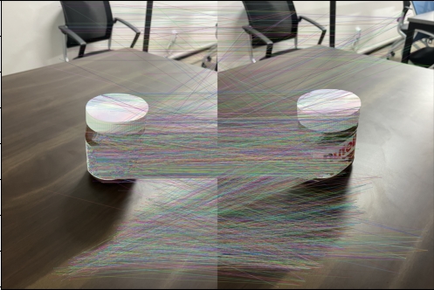
Step I. Feature extraction & matching in general
1. 이미지 불러오기 (‘sfm03.jpg’, ‘sfm04.jpg’)
Feature Extraction

Slide 3
Step II. Essential matrix estimation
[5] Nistér, David. "An efficient solution to the five-point relative pose problem.“ TPAMI 2004
Estimate Essential matrix ‘E’ given a set of match points {x, x’}
Normalized image coordinate에서 5개 쌍의 매칭된 점들을 랜덤샘플링한다.
calibrated_fivepoint .m 파일에서 이용해 Essential matrix의 후보값들을 계산한다.
RANSAC 알고리즘으로, 랜덤 샘플링된 매칭 쌍들에 대해 x’Ex < threshold를 만족하는 개수가 가장 많은 Essential matrix를 채택한다.

Slide 4
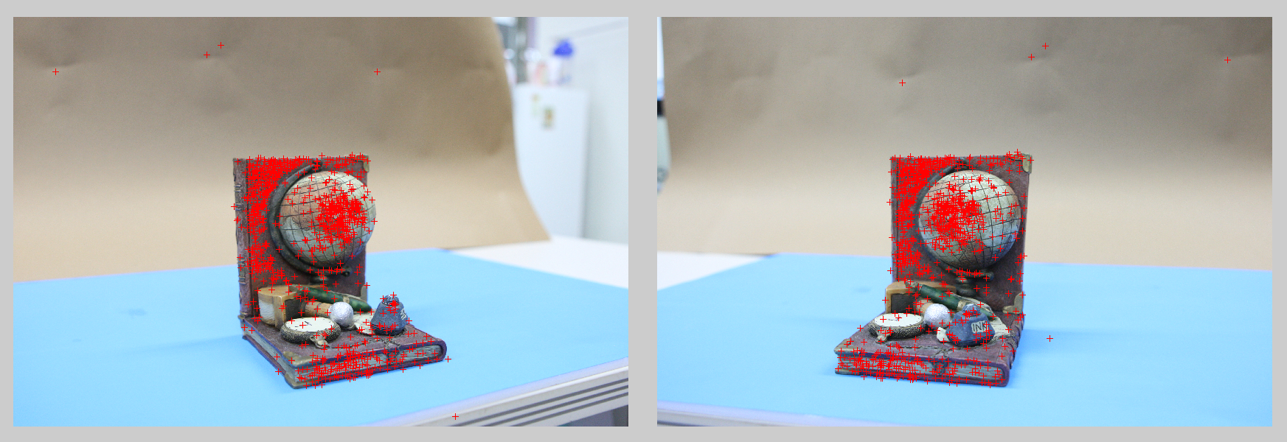
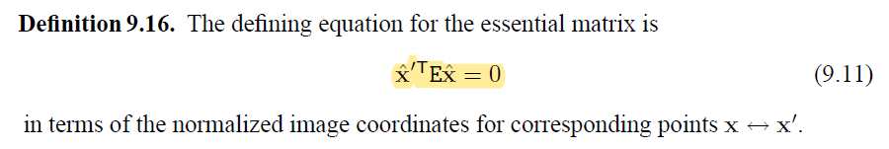

Step II. Essential matrix estimation
5-pts algorithms with RANSAC
2 points
threshold
1. Randomly select sets of 5 points
2. Generate E(hypothesis) and evaluate using other points with pre-defined threshold - epipolar distance
3. Do this for many times and choose the most supportive hypothesis having the most inliers
3 points
6 points
2 points
Randomly Selected correspondence
$$\{x_{c1}, …,x_{c5}\}$$
$$\{{x′}_{c1}, …,{x′}_{c5}\}$$
E using calibrated
5-pt algorithm

Slide 5
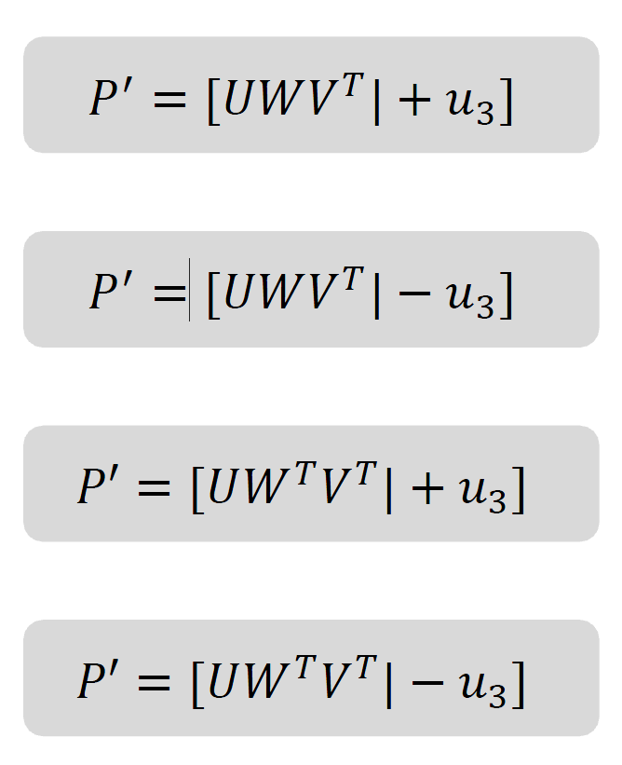
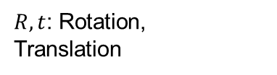

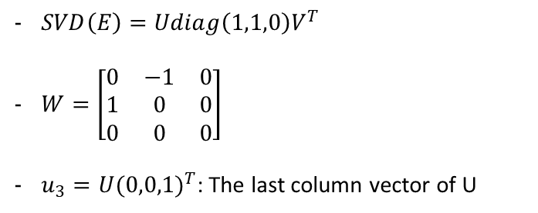
Step III. Essential matrix decomposition
Essential Matrix Decomposition to [R|T]
Camera matrix to essential matrix
Essential matrix to camera matrix
Make your own code
MVG 9.6 (p.257-p.260)
6.2.3 (p.162)
$$E=[t]_{×}R=R[R^{T}t]$$
$R,t$: Rotation, Translation
$SVD\left(E\right)=Udiag\left(1,1,0\right)V^{T}$
$W=\left[\begin{matrix}0 & −1 & 0 \\ 1 & 0 & 0 \\ 0 & 0 & 0\end{matrix}\right]$
$u_{3}=U{(0,0,1)}^{T}$: The last column vector of U
A set of images
Feature Extraction
& Matching
Initialization Step
Growing Step
8, 7-pt algorithm (F)
Essential matrix decomposition
Triangulation
Calibrated, 5-pt algorithm (E)

Slide 6
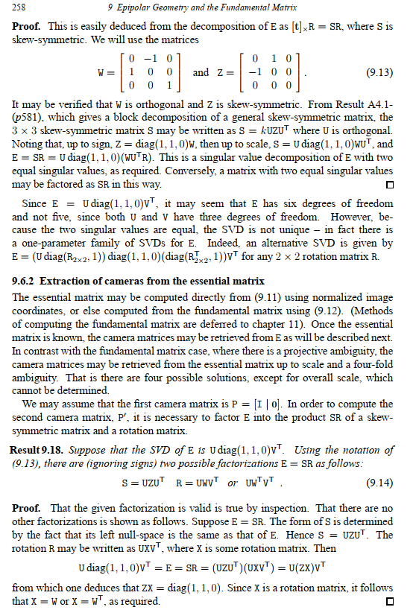
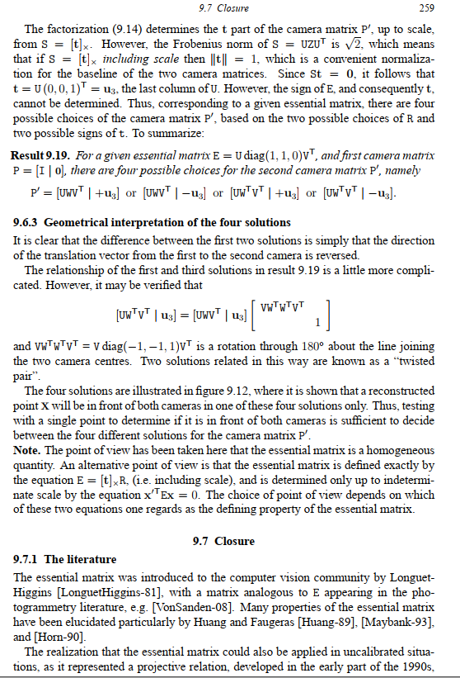
Step III. Essential matrix decomposition

Slide 7
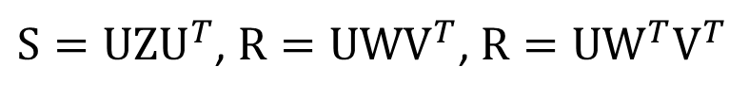
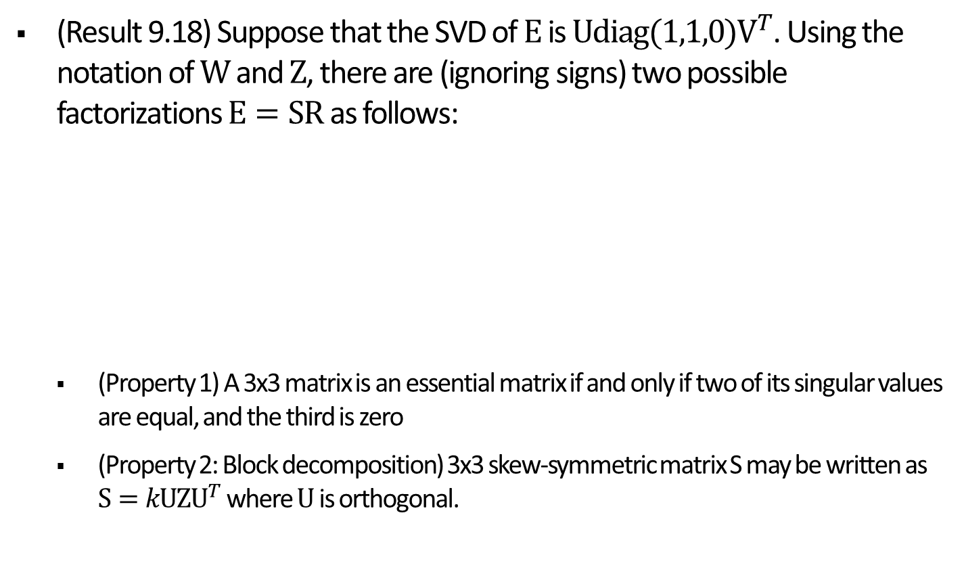
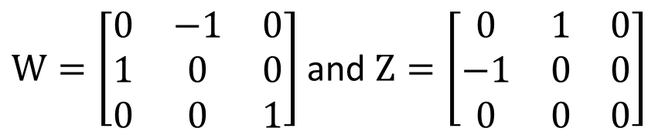
Step III. Essential matrix decomposition
(Result 9.18) Suppose that the SVD of $E$ is $Udiag(1,1,0)V^{T}$. Using the notation of $W$ and $Z$, there are (ignoring signs) two possible factorizations $E=SR$ as follows:
(Property 1) A 3x3 matrix is an essential matrix if and only if two of its singular values are equal, and the third is zero
(Property 2: Block decomposition) 3x3 skew-symmetric matrix S may be written as $S=kUZU^{T}$ where $U$ is orthogonal.
$S=UZU^{T}$, $R=UWV^{T}$, $R=UW^{T}V^{T}$
$W=\left[\begin{matrix}0 & −1 & 0 \\ 1 & 0 & 0 \\ 0 & 0 & 1\end{matrix}\right]$ and $Z=\left[\begin{matrix}0 & 1 & 0 \\ −1 & 0 & 0 \\ 0 & 0 & 0\end{matrix}\right]$

Slide 8
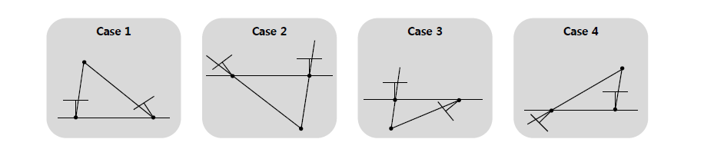
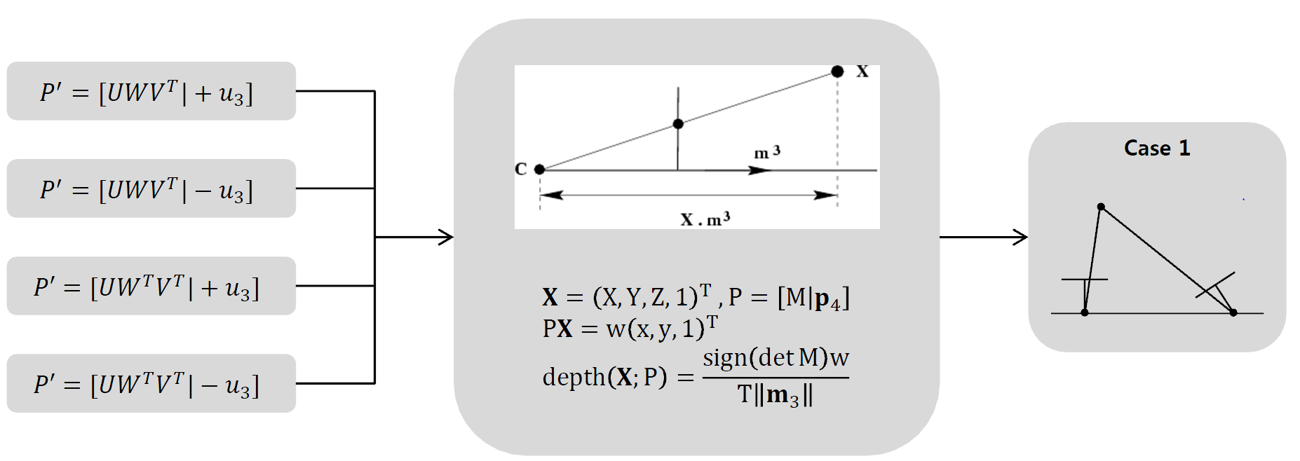
Step III. Essential matrix decomposition
Essential Matrix Decomposition to [R|T]
There are four possible reconstruction
Depth for both camera should be positive value (case 1)
Not negative value (case 2, 3, 4)
You should figure out the optimal camera pose

Slide 9
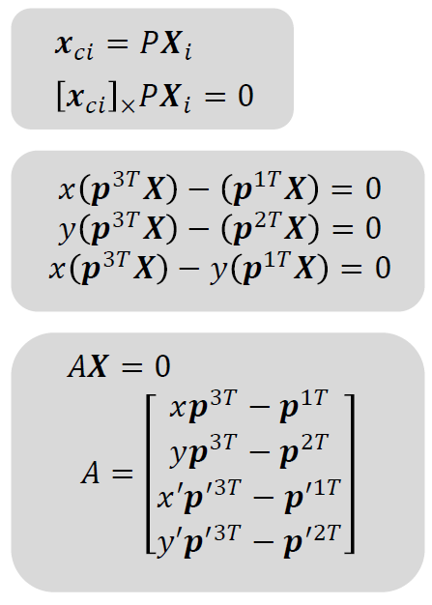
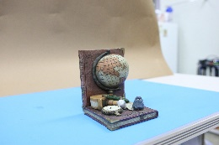
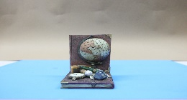


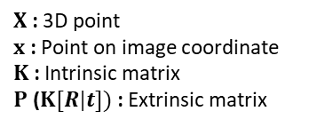







Step IV. Triangulation
$X$ : 3D point
$x$ : Point on image coordinate
$K$ : Intrinsic matrix
$P$ ($K[R|t])$: Extrinsic matrix
Triangulation
Get 3D points from Camera pose & correspondences
$$X_{2}$$
$$X_{1}$$
$$X_{3}$$
$${x′}_{2}$$
$$x_{1}$$
$$x_{2}$$
$${x′}_{1}$$
$${x′}_{3}$$
$$x_{3}$$
Cam2
Cam1
A set of images
Feature Extraction
& Matching
Initialization Step
Growing Step
8, 7-pt algorithm (F)
Essential matrix decomposition
Triangulation
Calibrated, 5-pt algorithm (E)
Notes:
삼각측량법
Step 3, 4가 동시에 이루어짐

Slide 10
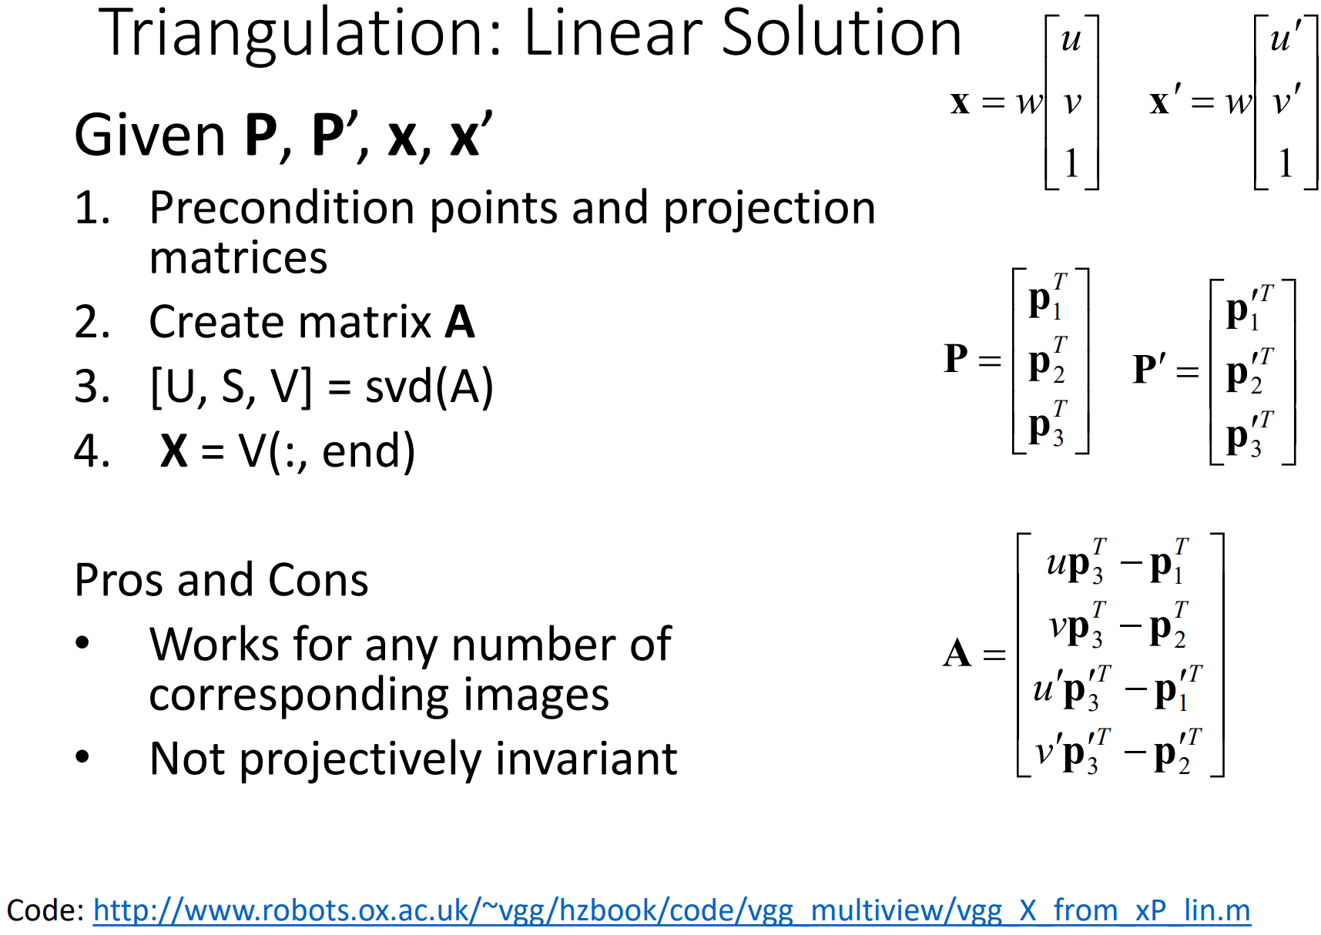
Step IV. Triangulation
$X$ : 3D point
$x$ : Point on image coordinate
$K$ : Intrinsic matrix
$P$ ($K[R|t])$: Extrinsic matrix
Triangulation
Get 3D points from Camera pose & correspondences
Notes:
삼각측량법
Step 3, 4가 동시에 이루어짐

