Slide 1

Audioset Analysis Sound Classification with Neural Networks
MSc Business Analytics
Big Data Content Analytics
Athens, September, 2019

Slide 2
Team Members & Roles
Data Engineer (Kotoulas Evangelos)
Data preparation, interpretation and Neural Network construction
Data Scientist (Kyritsis Georgios)
Research, implementation and review of the Neural Networks performance
Business Analyst (Voudris Athanasios)
Business case analysis and interpretation of the Neural Network analysis results

Slide 3
Contents
Problem Identification / Business Idea
Dataset Description
Exploratory Data Analysis (Technology, Process, Results)
Data Preparation
Model Development
Evaluation
Results
Conclusions

Slide 4
Problem Identification / Business Idea
Directly or indirectly, we are always in contact with audio. Our brain is continuously processing and understanding audio data and giving us information about the environment.
Audio analytics is the process of compressing data and packaging the data into single format called audio. Audio Analytics refers to the extraction of meaning and information from audio signals for Analysis.
The mission of the project is to try and build a model that can with a good accuracy predict, based on recorded audio data, the classification of audio data.

Slide 5
Dataset Description
In total, there are 2.1 million annotated videos, 5.8 thousand hours of audio and 527 classes (labels) of annotated sounds.
The dataset consists of csv files describing, for each segment, the YouTube video ID, start time, end time, and one or more labels.
The dataset is divided into three disjoint sets: a balanced evaluation set, a balanced training set, and an unbalanced training set.
Balanced train dataset: 22,176 segments from distinct videos chosen with the same criteria: providing at least 59 examples per class with the fewest number of total segments.
Evaluation dataset: 20,383 segments from distinct videos, providing at least 59 examples for each of the 527 sound classes that are used. Because of label co-occurrence, many classes have more examples.

Slide 6
Exploratory Data Analysis (Technology & Process)
EDA Technology:
Important Libraries/Packages: Keras, Tensorflow, OS, Librosa
EDA Process:
The balanced csv file is loaded and the dataframe includes the following columns: (url (i.e. –PJHxphWEs), start_time (i.e. 30.0), end_time (i.e. 40.0), labels (i.e. /m/09x0r,/t/dd00088), file_downloaded (i.e. 1), filename (i.e. __pjhxphwes.mp3))
A temporary dataframe is created including the labels of each file ('/g/122z_qxw': 'Firecracker‘)
All the indexes (i.e. /g/122z_qxw) are replaced in the temporary dataframe with their labels (i.e. Firecracker)
Finally, the dataframes balanced and temporary are concatenated
The same process is followed for the evaluation csv file

Slide 7
Exploratory Data Analysis (Results)
MFCC — Mel-Frequency Cepstral Coefficients
One of the most important methods to extract a feature of an audio signal
It is used majorly whenever working on audio signals
MFCC’s of a signal are a small set of features which concisely describe the overall shape of a spectral envelope
Librosa library in Python

Slide 8
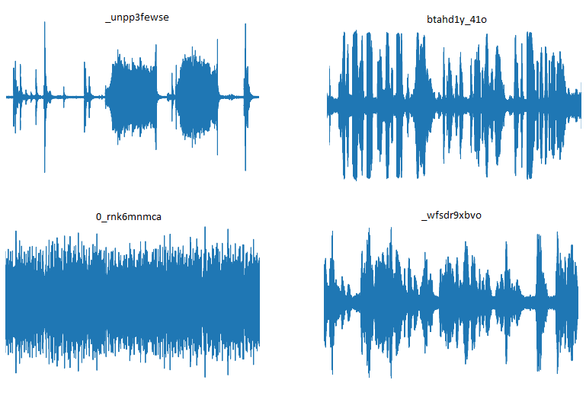
Exploratory Data Analysis (Results)
For the above presented images we have used the embedded function of the Librosa library waveplot, but as it can be observed the waveforms of the sounds do not depict a clear distinctive characteristic for classification purposes.

Slide 9
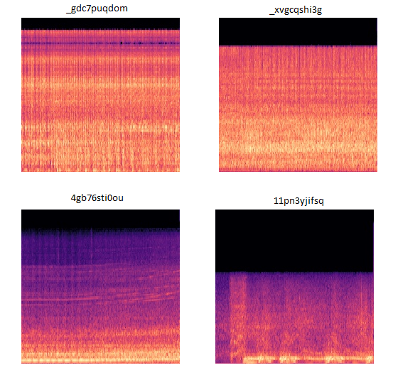
Exploratory Data Analysis (Results)

Slide 10
Data Preparation
Regarding the data cleaning and transformation, the corrupted mp3 files were removed from the dataset
20 mp3 files in the train dataset out of the 19938 mp3 files were found to be corrupted
8 mp3 files in the validation dataset out of the 18680 mp3 files were found to be corrupted

Slide 11
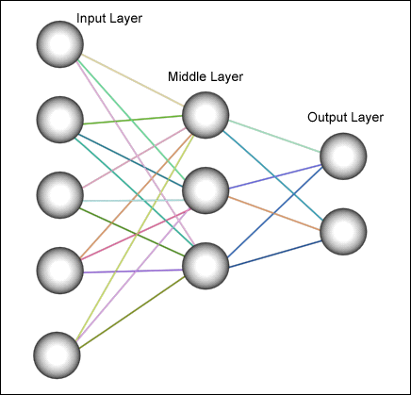
Model Development (Neural Network)
Model Architecture:
Sequential model
Fully connected layers
Dropout: 0.1
Input layer: shape: 40, output: 25
Hidden layer: shape: X, activation function: ReLu
Output layer: shape: 40, sigmoid function
MFCC | Image Recognition
Feed Forward model | CNN
Fully connected layers | Fully connected layers
Dropout: 0.1 | Dropout:0.5
Input layer: Input shape: (128,) | Input shape: (64,64,3)
Hidden layers: Dense layers, activation function: ReLu | Conv2D, MaxPooling, activation function: Relu
Output layer: output shape: 527 Final activation function: sigmoid | Output layer: output shape: 527 Final activation function: sigmoid

Slide 12
Model Development (Neural Network)
Model Compiling:
MFCC | Image Recognition
Loss Function: Binary Crossentropy | Loss Function: Binary Crossentropy
Optimizer: ADAM | Optimizer: RMSP
Metrics: Accuracy, Top_k_Category_Accuracy | Metrics: Accuracy, Top_k_Category_Accuracy
EarlyStopping: Min(Val_Loss), Patience=5 | EarlyStopping: Min(Val_Loss), Patience=3

Slide 13
Model Development (Neural Network)
Model Training:
MFCC | Image Recognition
Train data: 97% | Train data: 85%
Validation data: 1.5% | Validation data: 10%
Test data: 1.5% | Test data: 5%
Number of epochs: 500 | Number of epochs: 500

Slide 14
Results
Loss: 2%,
Accuracy: 99 %,
Top k categorical accuracy: 20%

Slide 15
Conclusions
Accuracy is misleading
Unbalanced dataset
Great performance in top representative labels (Music – Speech)
Poor performance in most label recognitions
Suggestions / Future Research
Under / Over Sampling
Weighted labels
More computational resources

Slide 16
References
[1]: https://www.analyticsvidhya.com/blog/2017/08/audio-voice-processing-deep-learning/
[2]: https://www.datasciencecentral.com/profiles/blogs/a-quick-start-to-automatic-audio-data-analysis
[3]: https://www.researchgate.net/publication/297683425_Big_Data_Analytics_Challenges_And_Applications_For_Text_Audio_Video_And_Social_Media_Data
[4]:
Radhakrishnan, Ajay Divakaran and Paris Smaragdis, ―AUDIO ANALYSIS FOR SURVEILLANCE APPLICATIONS‖, 2005 IEEE Workshop on Applications of Signal Processing to Audio and Acoustics, October 16-19, 2005, New Paltz, NY.
[5]: https://medium.com/@mikesmales/sound-classification-using-deep-learning-8bc2aa1990b7
[6]: https://www.quora.com/What-is-audio-data
[7]: https://pdfs.semanticscholar.org/3b05/d8762acf58a2a55e3520a7ccb84d673f8f7d.pdf
[8]: https://research.google.com/audioset/index.html
[9]: https://github.com/gkoniaris/youtube-downloader
[10]: https://towardsdatascience.com/journey-to-the-center-of-multi-label-classification-384c40229bff
[11]: https://keras.io/
[12]: https://www.pythonforbeginners.com/os/pythons-os-module
[13]: https://medium.com/@mikesmales/sound-classification-using-deep-learning-8bc2aa1990b7
[14]: https://medium.com/@mikesmales/sound-classification-using-deep-learning-8bc2aa1990b7
[15]: https://scikit-learn.org/stable/modules/generated/sklearn.metrics.classification_report.html

Slide 17
Thank You!
Kotoulas Evangelos: kotoulasvagelis@gmail.com
Kyritsis Georgios: gkyr92@gmail.com
Voudris Athanasios: voudristhanos@gmail.com

