Slide 1
Updates
Dec 23rd, 2021
Michael Ruan

Slide 2
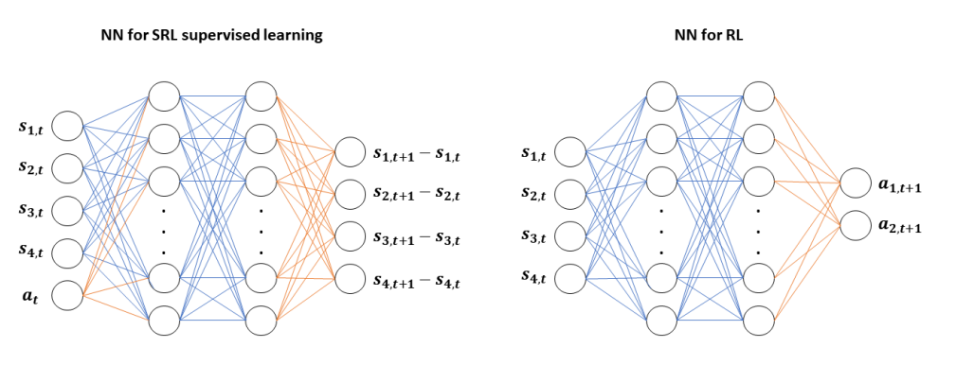

SRL Details
Dataset Generation
Only random actions (NN model independent)
Dataset Size = 50k
SRL training
$lr=5×{10}^{−3}$
Trained for 10k iters
CartPole-v0/v1 + A2C

Slide 3
Heatmaps

Slide 4
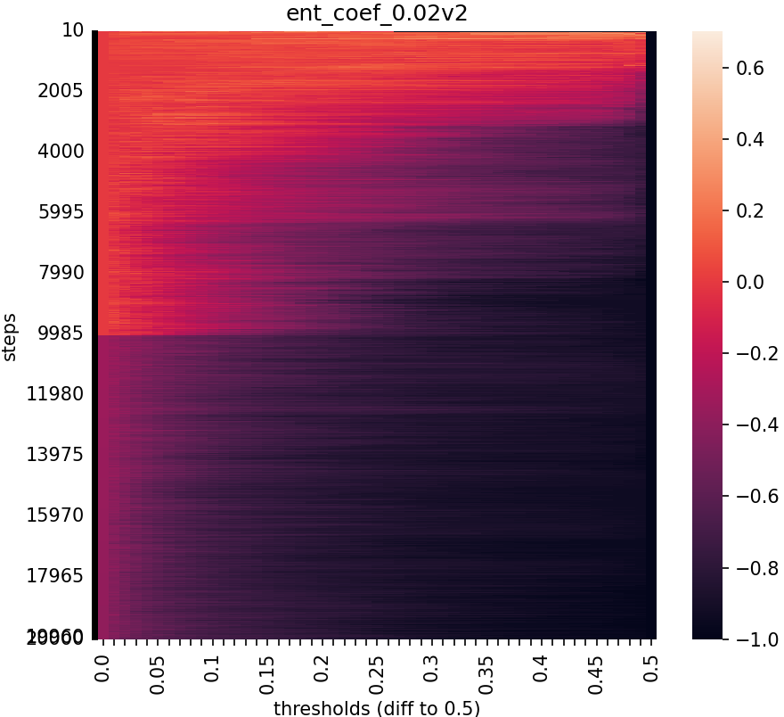
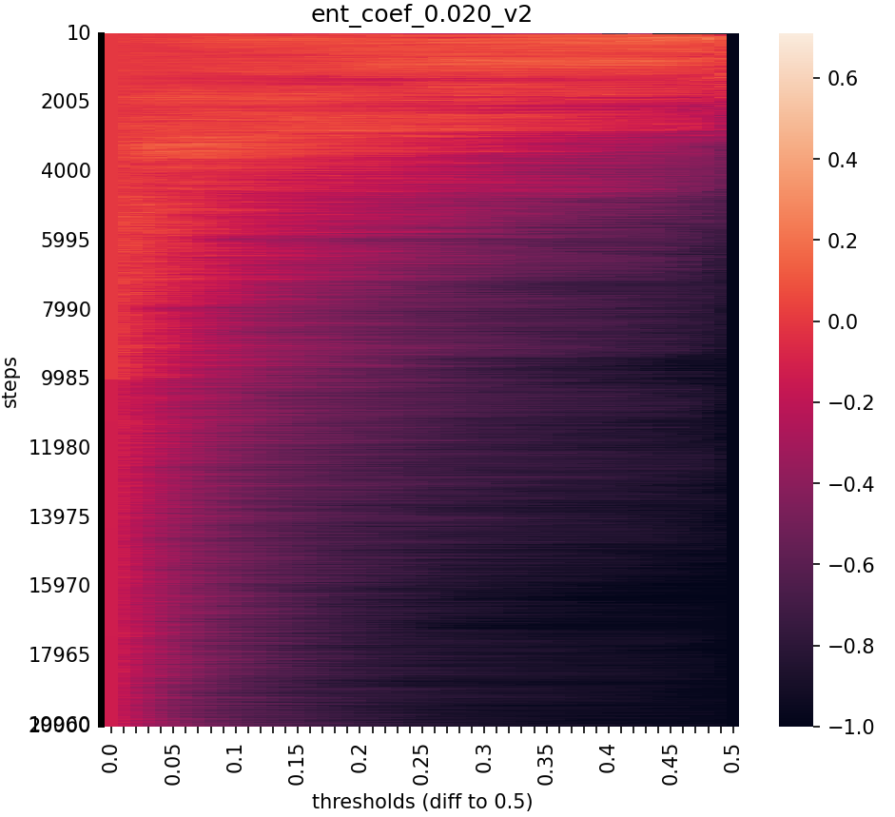
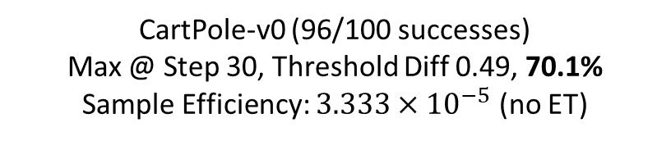

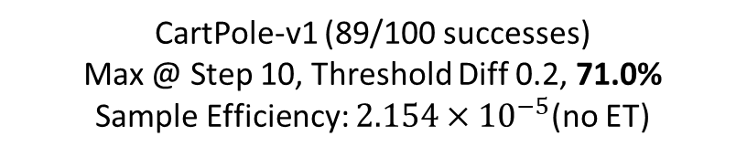
LARGE LR$\left(5×{10}^{−3}\right)$
CartPole-v0 (96/100 successes)
Max @ Step 30, Threshold Diff 0.49, 70.1%
Sample Efficiency: $3.333×{10}^{−5}$ (no ET)
CartPole-v1 (89/100 successes)
Max @ Step 10, Threshold Diff 0.2, 71.0%
Sample Efficiency: $2.154×{10}^{−5}$(no ET)

Slide 5
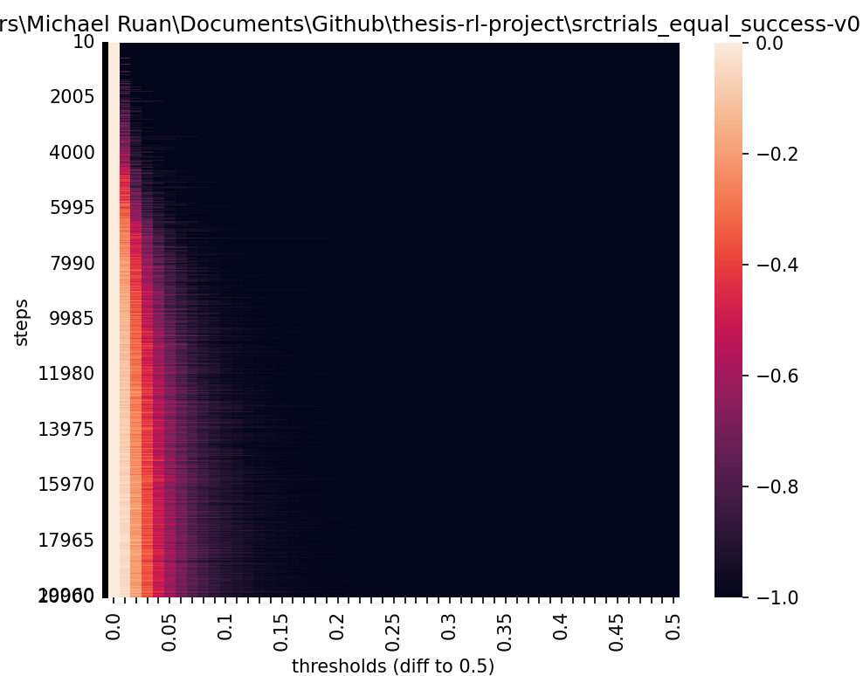
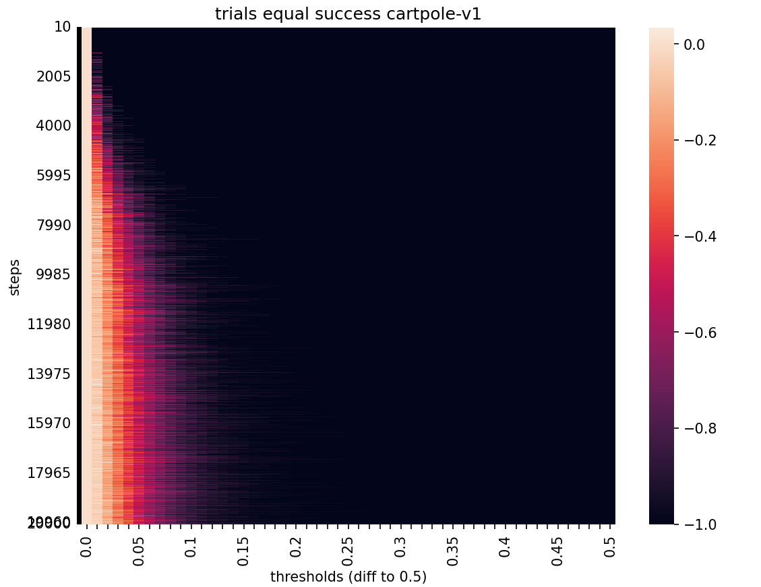
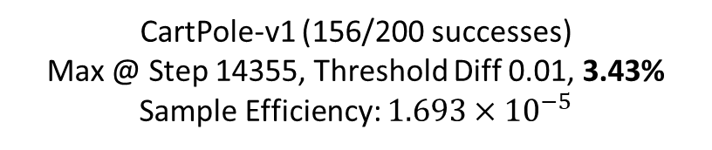
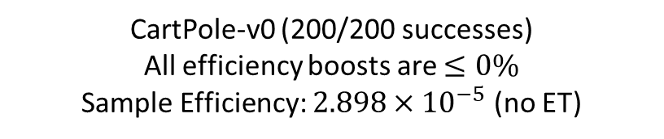

SMALL LR $\left(1×{10}^{−4}\right)$
CartPole-v0 (200/200 successes)
All efficiency boosts are $≤0\%$
Sample Efficiency: $2.898×{10}^{−5}$ (no ET)
CartPole-v1 (156/200 successes)
Max @ Step 14355, Threshold Diff 0.01, 3.43%
Sample Efficiency: $1.693×{10}^{−5}$

Slide 6
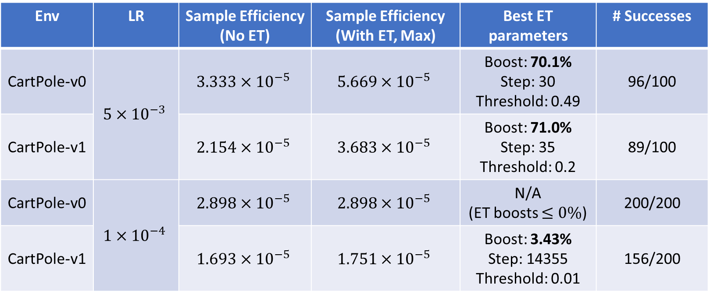
Combined Table
Env | LR | Sample Efficiency (No ET) | Sample Efficiency (With ET, Max) | Best ET parameters | # Successes
CartPole-v0 | $$5×{10}^{−3}$$ | $$3.333×{10}^{−5}$$ | $$5.669×{10}^{−5}$$ | Boost: 70.1% Step: 30 Threshold: 0.49 | 96/100
CartPole-v1 |  | $$2.154×{10}^{−5}$$ | $$3.683×{10}^{−5}$$ | Boost: 71.0% Step: 35 Threshold: 0.2 | 89/100
CartPole-v0 | $$1×{10}^{−4}$$ | $$2.898×{10}^{−5}$$ | $$2.898×{10}^{−5}$$ | N/A (ET boosts $≤0\%$) | 200/200
CartPole-v1 |  | $$1.693×{10}^{−5}$$ | $$1.751×{10}^{−5}$$ | Boost: 3.43% Step: 14355 Threshold: 0.01 | 156/200

Slide 7
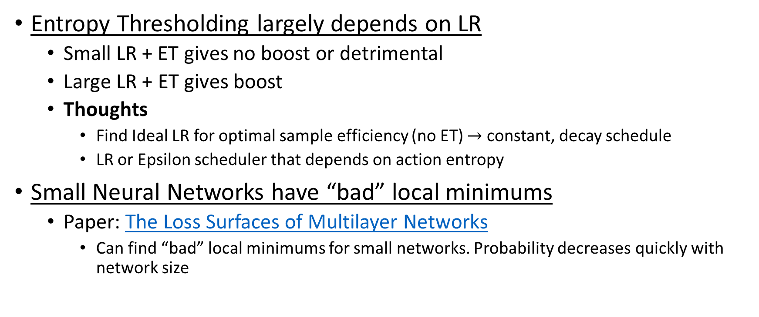
Discussion
Entropy Thresholding largely depends on LR
Small LR + ET gives no boost or detrimental
Large LR + ET gives boost
Thoughts
Find Ideal LR for optimal sample efficiency (no ET) $→$ constant, decay schedule
LR or Epsilon scheduler that depends on action entropy
Small Neural Networks have “bad” local minimums
Paper: The Loss Surfaces of Multilayer Networks
Can find “bad” local minimums for small networks. Probability decreases quickly with network size

Slide 8
Next Steps (In Order)
LR selection
SRL
Mountain Car

