Slide 1
Updates
Dec 30th, 2021
Michael Ruan

Slide 2
Updates to Logging
Previously
Log values every 5 steps
Now
Log values every 50 steps
Reason
For CartPole, 50 steps (5 per minibatch X 10 for vectorized envs)
Vectorized envs will give faster results, and a core part of A2C, PPO, etc…
End user would want faster training
All presented data ran in about 12hrs
Sample Efficiency at “peaks” comparable → next slide

Slide 3
LR/Arch Tuning

Slide 4
ARCH | 8x8 | 16x16 | 32x32
Best Boost | 2.05% | 4.07% | 21.6%
ARCH | 48x48 | 64x64 | Mean
Best Boost | 9.9% | 16.2% | 10.7%

Slide 5
Literature Review

Slide 6
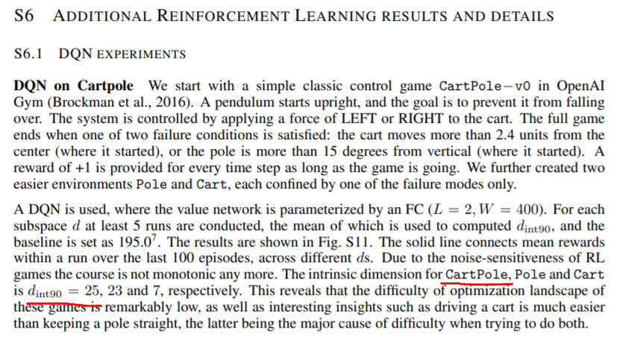
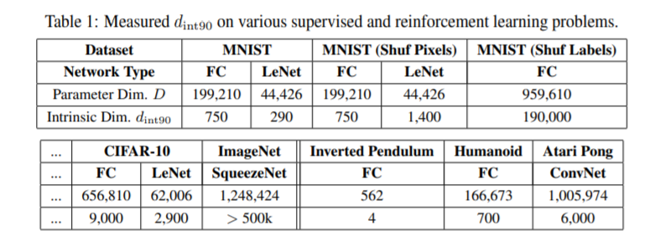
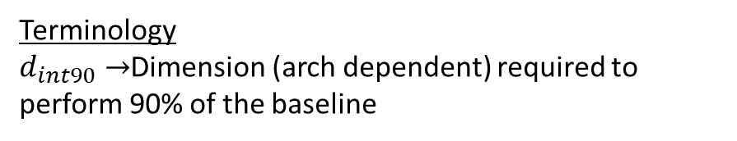
Measuring the Intrinsic Dimension of Objective Landscapes (https://arxiv.org/pdf/1804.08838.pdf)
Terminology
$d_{int90}→$Dimension (arch dependent) required to perform 90% of the baseline
Thoughts
From graphs (pending more results), might not be architecture size dependent.
If we treat ET as a way to find a good initialization, then it might make sense to think of the ratio of good to bad states. First thought is to use the intrinsic dimension of the problem as a measure of the ratio.
If this is true, inverted pendulum should have higher ET

Slide 7
Discussion
ET % boost very large for bad sample efficiencies (not our focus)
ET % boost marginal (~9%) for good sample efficiencies (our focus)
Still need to try larger NNs (>64, 3-layers)
ET as a way to find a good initialization
Perhaps SRL gives better boosts because we restrained the search space
Is ET model size independent?
Need to run some larger networks, and other problems
Might depend on the intrinsic dimension of the problem instead

Slide 8
Next Steps
Continue LR/Arch Tuning
Finish CartPole-v0
Start/Finish CartPole-v1
Start/Finish SRL CartPole-v0/v1
Start exploring how to find ET parameters (on the fly/defaults)

