Slide 1
Update
Jan 13th, 2022
Michael Ruan

Slide 2
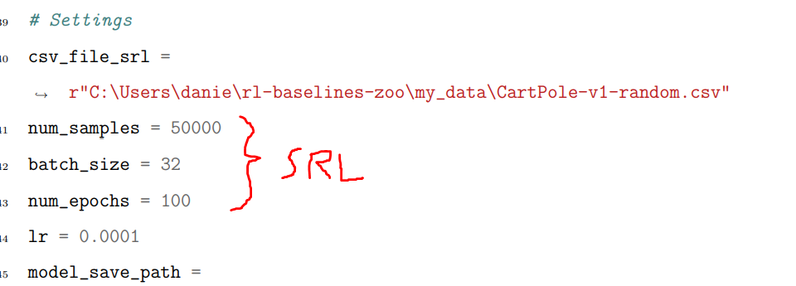
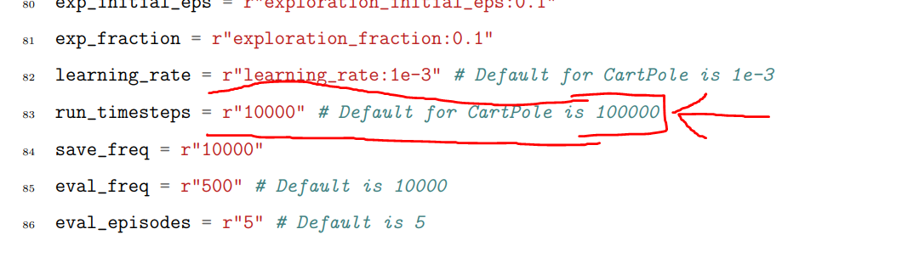
Notes on Daniel’s Work
SRL Iterations = 50k X 100 = 5million
DRL Iterations = 10k
My sample efficiency is >1e-4 typically, requiring <10k iterations
I don’t think Daniel’s implementation to yield 22.24% boost is right…
(my results later show that SRL just does not help)

Slide 3
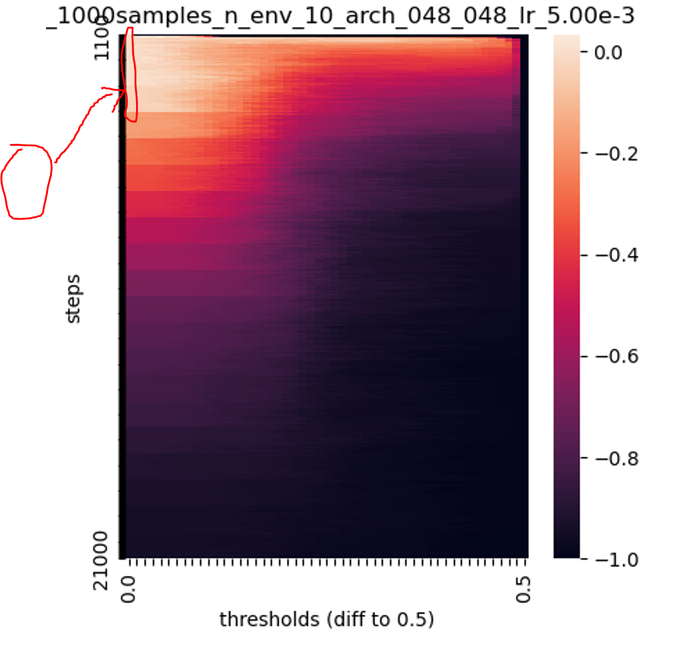
Notes from Last Meeting
“Fix” for max(boost in heatmap, 0) issue
Was never actually max(boost in heatmap, 0), but the heatmap covers the no thresholding case.
Again, will depend on our ET algorithm → Ideal if we can also identify when not to do ET

Slide 4
Results

Slide 5
CartPole-v0
Arch | 16x16 | 32x32 | 48x48 | 64x64 | 80x80 | 96x96 | 112x112 | 128x128 | MEAN
Total S.E. | 1.96e-4 | 1.78e-4 | 1.78e-4 | 1.74e-4 | 1.96e-4 | 1.96e-4 | 1.80e-4 | 1.85e-4 | 1.85e-4
Best S.E. Boost | 4.08% | 21.6% | 9.92% | 16.2% | 7.94% | 1.93% | 20.8% | 0% | 10.3%
Best S.E. | 2.04e-4 | 2.15e-4 | 1.94e-4 | 2.00e-4 | 2.12e-4 | 2.00e-4 | 2.11e-4 | 1.85e-4 | 2.03e-4
100 Trials
(No SRL)
Arch | 16x16 | 32x32 | 48x48 | 64x64 | 80x80 | 96x96 | 112x112 | 128x128 | MEAN
Total S.E. | 1.23E-4 | 9.85E-5 | 1.02E-4 | 8.02E-5 | 8.62E-5 | 8.57E-5 |  |  | 1.91e-4
Best S.E. Boost | 0 | 9.5% | 0 | 8.5% | 3.5% | 1.8% |  |  | 3.88%
Best S.E. |  |  |  |  |  |  |  |  | 1.98e-4
100 Trials (SRL 1k)
Arch | 16x16 | 32x32 | 48x48 | 64x64 | 80x80 | 96x96 | 112x112 | 128x128 | MEAN
Total S.E. | 6.05e-5 | 5.42e-5 | 5.60e-5 | 5.28e-5
Best S.E. Boost | 0 | 0 | 0 | 0 | … | … | … | … | 0
Best S.E. | 6.05e-5 | 5.42e-5 | 5.60e-5 | 5.28e-5
100 Trials
(SRL 10k)

Slide 6
CartPole-v1
Arch | 16x16 | 32x32 | 48x48 | 64x64 | 80x80 | 96x96 | 112x112 | 128x128 | MEAN
Total S.E. | 9.37e-5 | 8.55e-4 | 9.9e-5 | 8.5e-5 | 9.47e-5 | 10.5e-5 | 10.0e-5 | 10.2e-5 | 9.56e-5
Best S.E. Boost | 23.5% | 34.9% | 21.9% | 50.1% | 20.6% | 22.4% | 14.2% | 13.9% | 25.2%
Best S.E. | 1.15e-4 | 1.15e-4 | 1.22e-4 | 1.30e-4 | 1.15e-4 | 1.30e-4 | 1.15e-4 | 1.16e-4 | 1.19e-4
100 Trials
(No SRL)
Arch | 16x16 | 32x32 | 48x48 | 64x64 | 80x80 | 96x96 | 112x112 | 128x128 | MEAN
Total S.E. | 7.08E-5 | 6.65E-5 | 6.33E-5 | 5.87E-5 | 5.27E-5 | 5.74E-5 | 5.58E-5 | 5.55E-5 | 6e-5
Best S.E. Boost | 1.4% | 7.2% | 5.3% | 5.5% | 8.4% | 9.4% | 10.0% | 7.7% | 6.86%
Best S.E.
100 Trials
(1k SRL)

Slide 7
Discussion/Next Steps
Drop SRL?
Try finding ET scheduler

