Slide 1
Week 5 Updates
Michael Ruan

Slide 2
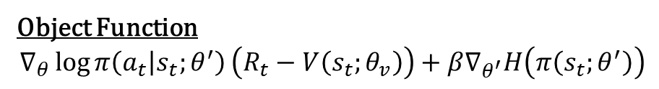
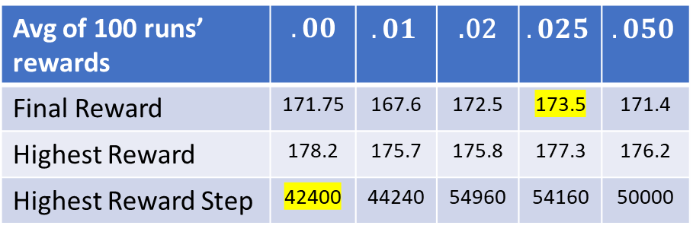


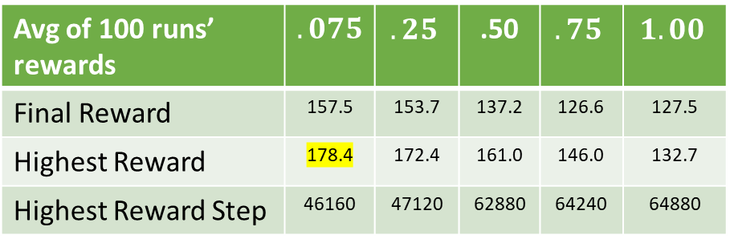
Results—Entropy Regularization
Avg of 100 runs’ rewards | $$.00$$ | $$.01$$ | .02 | $$.025$$ | $$.050$$
Final Reward | 171.75 | 167.6 | 172.5 | 173.5 | 171.4
Highest Reward | 178.2 | 175.7 | 175.8 | 177.3 | 176.2
Highest Reward Step | 42400 | 44240 | 54960 | 54160 | 50000
Low $β$
Run Details
Model: A2C (Stable Baseline, SB)
Policy: MlpPolicy (2 64 hidden neuron layers)
Env: CartPole-v1
Avg of 100 runs’ rewards | $$.075$$ | $$.25$$ | .50 | $$.75$$ | $$1.00$$
Final Reward | 157.5 | 153.7 | 137.2 | 126.6 | 127.5
Highest Reward | 178.4 | 172.4 | 161.0 | 146.0 | 132.7
Highest Reward Step | 46160 | 47120 | 62880 | 64240 | 64880
Object Function
$$∇_{θ}\log{π\left(a_{t} | s_{t};θ^{′}\right)}\left(R_{t}−V\left(s_{t};θ_{v}\right)\right)+β∇_{θ^{′}}H\left(π\left(s_{t};θ^{′}\right)\right)$$
High $β$

Slide 3


Low $β$
High $β$

Slide 4

“Entropy Thresholding” (solely for data gathering)
Run all experiments to finish, and see what would happen should we have used entropy threshold of value $x$ at step $n$

Slide 5
Research Qs
Q1
If we can’t get a good default / automatic entropy threshold (not regularization), is this still worth publishing?
Q2
Guided backpropagation to visualize neuron activation at entropy threshold analysis time?

Slide 6
Next Steps
Repeat tests on MountainCar, Fetch & Reach
Find best entropy threshold value, and apply to CartPole, MountainCar, F&R data

Slide 7
