Slide 1
TEXT AND DATA MINING
Basics for information professionals

Slide 2
TEXT AND DATA MINING
What is Text and Data Mining (TDM)?
Why use TDM? Who is using it as a research tool?
Overview of TDM Processes and Methods
Examples of TDM
Useful Tools and Resources

Slide 3
What is text and data mining?
TDM /DTM
The use of computational techniques and tools to discover new and unexpected information from an aggregated collection of machine readable text
Different from ‘Search’
Applied across multiple data sets
Data mining can reveal trends and patterns across structured data sets
Text mining is the same in principle but looks at unstructured data that ‘machines’ can’t place meaning and context on to without human input

Slide 4

Why use TDM in research?
80% of the worlds data is unstructured (Schneider, 2015)
Find trends and/or patterns in unstructured texts eg Humanitarian concerns and progress from Red Cross publications
Identify topics or test theories by comparing scholarly works
Enables analysis of large bodies of texts in literature review processes eg: the complete works of Shakespeare
“Mining” – the metadata that sits behind – the deeper level

Slide 5
Who is using TDM?
Scientists and Social Scientists - already well developed skills, tools and technology for structured data mining
Arts and Humanities research adopting similar technology and methods to apply to unstructured data – machine readable text
Growth in field of Digital Humanities – presenting research in digital formats and using digital research methods
Business, government agencies, NGO’s

Slide 6
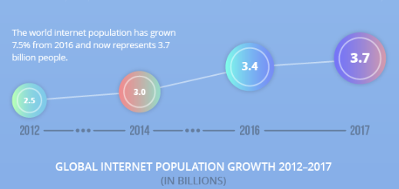
Data … just a little bit!
IBM estimates that we are generating 2.5 quintillion bytes of data each day, more than 90 percent of which was created in the last two years (Silver, 2012)

Slide 7
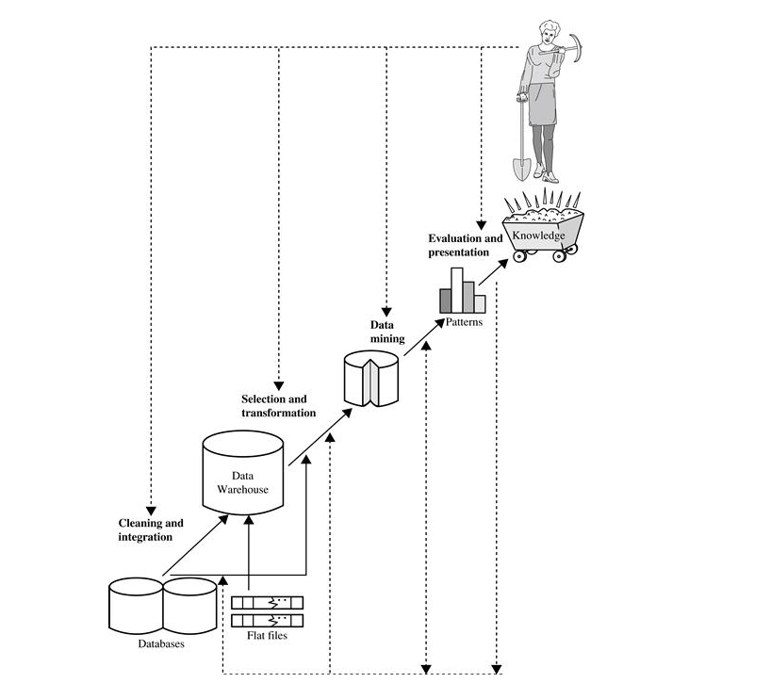
Data Mining processes
Han et al, 2011

Slide 8
ANU Student research projects
A Data-driven Self-aware Smart Building with Internet-of-Things
Discovering Inconsistent Data in a Dynamic World
Entity Resolution: From Similarity to Patterns
Finger tapping measures in Parkinson's disease - building a keyboard device and a smartphone app and comparing their accuracy
Flexible and realistic synthetic medical data generator
Innovative Machine Intelligence and Cybersecurity Solutions to Safeguard the Patient Information Associated with a New Generation of Medical Devices
Research in population informatics
Space/time efficient privacy-preserving medical data representation
Weather projection techniques and system with consideration of extremes

Slide 9
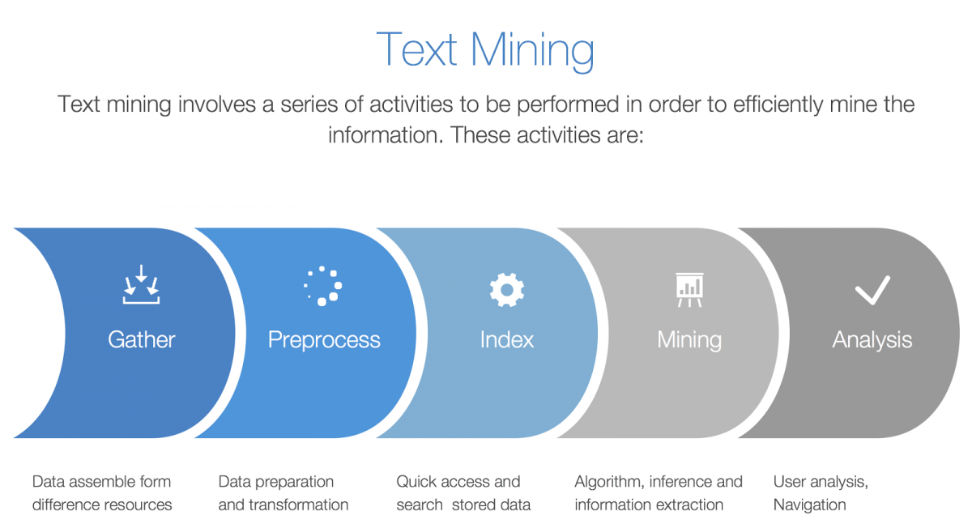
FOSTER, 2018

Slide 10
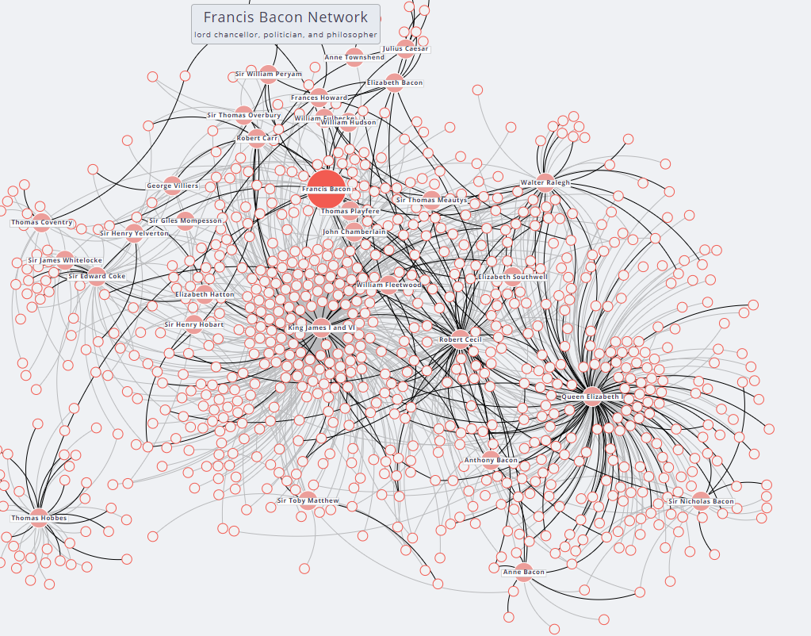

Slide 11
Data Text Mining and You!
Or, guiding ANU community members to resources.
Whilst this brief intro may not turn you into an expert; it might help with assisting Students or researchers to access materials
http://libguides.anu.edu.au/data-and-text-mining

Slide 12
Data Mining at ANU
https://cecs.anu.edu.au/research/intelligence/data-mining-matching
https://dmm.anu.edu.au/
http://cdhr.cass.anu.edu.au/

Slide 13
References
Australia, & Law Reform Commission. (2013). Copyright and the digital economy. ALRC.
Facilitate Open Science Training for European Research, 2018. Text mining 101, available from https://www.fosteropenscience.eu/content/text-mining-101
Han, J., Kamber, M. & Pei, J. 2011, Data mining: concepts and techniques, 3rd ed., Elsevier, Burlington.
Schneider, C. 2016, The biggest data challenges that you might not even know you have, IBM available from https://www.ibm.com/blogs/watson/2016/05/biggest-data-challenges-might-not-even-know/
Silver, N. 2012, The signal and the noise: why so many predictions fail--but some don't, Penguin Press, New York.

